Slide 1
BackpackerMatcher
EECE418 Demo
Group 13: International Love

Slide 2
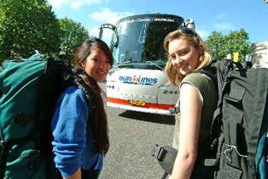

Introduction
Matches prospective travellers
Targets EU backpackers

Slide 3
The Hypotheses
H1: The more number of mutual friends a user has with another individual, the more trust the user has in that individual.
H0-1: The number of mutual friends a user has with another individual, does not affect the user’s trust in that individual.

Slide 4
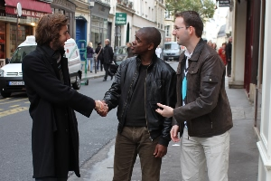
Variables Involved
Number of Mutual Friends
Level of trust

Slide 5
H2: The built-in messaging system makes it easier for users to contact each rather than no-built messaging system (e.g. email, facebook, public forum).
H0-2: The is no difference between between easiness of contacting people in a built-in (internal) messaging system and a non-built-in (external) messaging system.

Slide 6
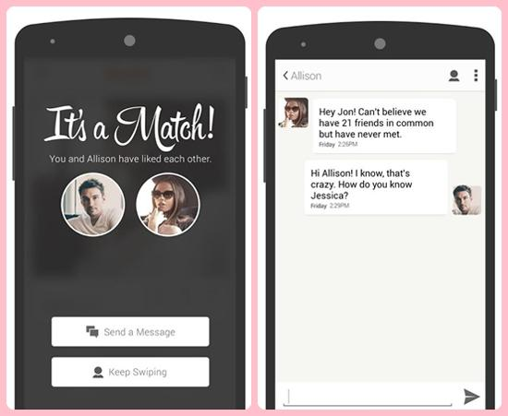
Variables Involved
Type of messaging system
Convenience, sense
of security and
preference of system

Slide 7
Interview Process
Found people that fit target users (prospective EU Backpackers)
Presented interfaces in different orders
Questionnaire (randomized order)

Slide 8
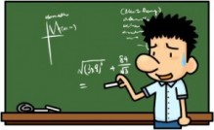

Conclusion
Statistical Analysis
User comments

