Slide 1
Usability evaluation of kadi4mat
Marco Joost & Imke Schwenke

Slide 2
Content

Slide 3
Task
Choosing methods
thinking our loud, survey SUS, testing with timetracking
Creating a test plan
Includes various tasks, that mimic normal workflow
Carrying it out with participants
Analyzing the results
Suggesting improvements for the software
Define Goals
Formative Usability Evaluation on Kadi4Mat

Slide 5
Background
Kadi4Mat
Electronic laboratory notebook
Managing research data
Working collaboratory
Used by research community
Usability
Various definitions exist
ISO 9241-11
Effectiveness
Efficiency
Satisfaction
Interaction Principles
ISO 9241-11
Guidance for design of UIs
Suitability, self-descriptiveness, conformity of the user’s expectation, controllability, error tolerance, learnability
System Usability Scale
Questionnaire
Assessing perceived usability
10 questions
Designed by John Brooke in 1986

Slide 7
Methodology
- Mimic features of analog notebook
- functions of ELN
Suitability

Slide 9

Methodology
- Mimic features of analog notebook
- functions of ELN
Suitability
Effectiveness:
$success rate=\frac{\# tasks completed}{\# tasks}$
The success rate should be above 80%
Efficiency:
Time to perform tasks should be < 30 minutes

Slide 10
Methodology
- Mimic features of analog notebook
- functions of ELN
Lack of experience by userbase
Suitability
Effectiveness:
$success rate=\frac{\# tasks completed}{\# tasks}$
The success rate should be above 80%
Efficiency:
Time to perform tasks should be < 30 minutes
Learnablility

Slide 12
Methodology
- Mimic features of analog notebook
- functions of ELN
Lack of experience by userbase
Suitability
Effectiveness:
$success rate=\frac{\# tasks completed}{\# tasks}$
The success rate should be above 80%
Efficiency:
Time to perform tasks should be < 30 minutes
Learnablility
Time per task decreases
Time per task of participants approximates to expert time

Slide 14
Methodology
- Mimic features of analog notebook
- functions of ELN
Lack of experience by userbase
Accurate experiments and data collection
Suitability
Effectiveness:
$success rate=\frac{\# tasks completed}{\# tasks}$
The success rate should be above 80%
Efficiency:
Time to perform tasks should be < 30 minutes
Learnablility
Time per task decreases
Time per task of participants approximates to expert time
Customizability

Slide 15
Methodology
- Mimic features of analog notebook
- functions of ELN
Lack of experience by userbase
Accurate experiments and data collection
Suitability
Effectiveness:
$success rate=\frac{\# tasks completed}{\# tasks}$
The success rate should be above 80%
Efficiency:
Time to perform tasks should be < 30 minutes
Learnablility
Time per task decreases
Time per task of participants approximates to expert time
Customizability
Success rate of customizability tasks
Time of customizability tasks compared to expert
Statements and notes of participants during testing

Slide 16
Methodology
- Mimic features of analog notebook
- functions of ELN
Lack of experience by userbase
Accurate experiments and data collection
Used by diffrent scientific disciplines
Suitability
Effectiveness:
$success rate=\frac{\# tasks completed}{\# tasks}$
The success rate should be above 80%
Efficiency:
Time to perform tasks should be < 30 minutes
Learnablility
Time per task decreases
Time per task of participants approximates to expert time
Customizability
Success rate of customizability tasks
Time of customizability tasks compared to expert
Statements and notes of participants during testing
Error tolerance

Slide 17
Methodology
- Mimic features of analog notebook
- functions of ELN
Lack of experience by userbase
Accurate experiments and data collection
Used by diffrent scientific disciplines
Suitability
Effectiveness:
$success rate=\frac{\# tasks completed}{\# tasks}$
The success rate should be above 80%
Efficiency:
Time to perform tasks should be < 30 minutes
Learnablility
Time per task decreases
Time per task of participants approximates to expert time
Customizability
Success rate of customizability tasks
Time of customizability tasks compared to expert
Statements and notes of participants during testing
Error tolerance
Success rate of changes task
Time of changes task compared to expert
Statements and notes of partcipants during testing

Slide 18
Methodology
Usability Test Plan
Goal: formative evaluation of Kadi4Mat
Test taks:
Covering a typical workflow
Login
creating a group, project and experiment
working with templates
Changing, finding and customizing entries
Thinking-aloud method, time-tracking
System Usability Survey
Participants
Wie wir partcipants gewählt haben

Slide 19
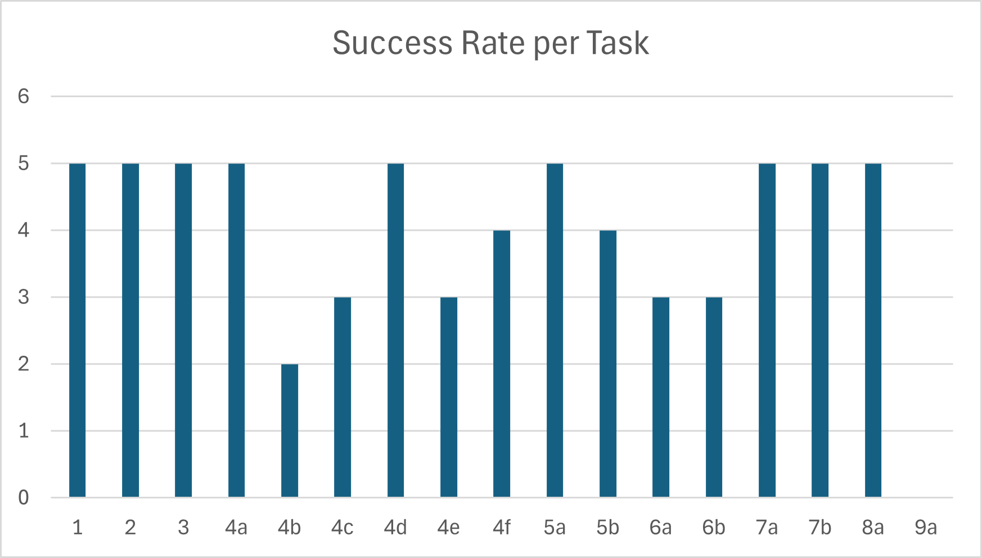
Results (Suitability)
Effectiveness
Accumulated success rate: 78,82%
Less than defined minimum

Slide 20
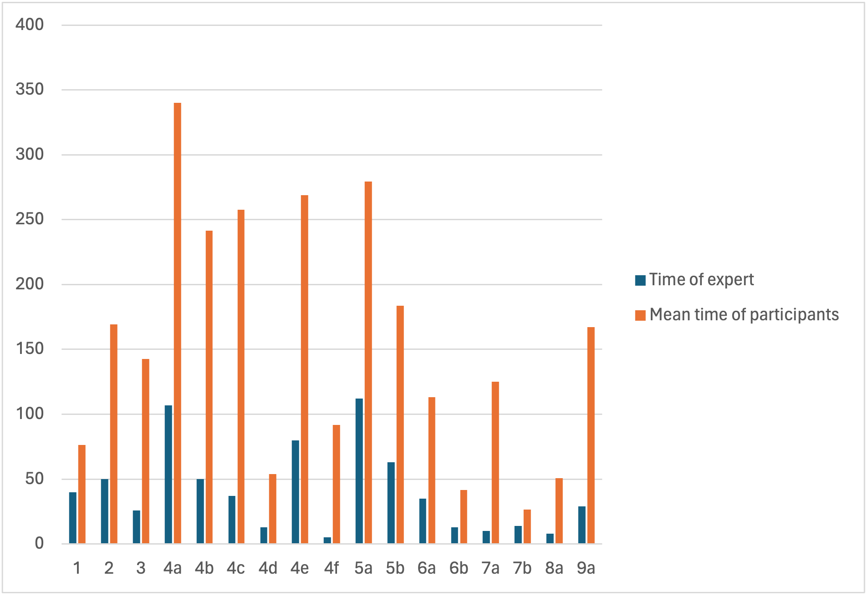
Results (Suitability)
Efficiency
Mean time to finish tasks: 43 min 23 sec
Expert needed: 11 min and 32 sec

Slide 21
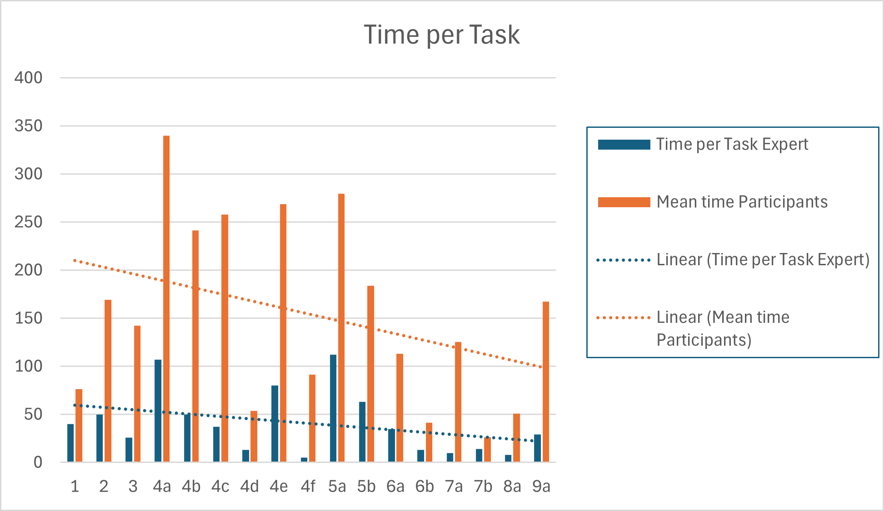
Results (Learnability)
The Time to finish a task decreases faster for test subjects

Slide 22
Results
Customizability
Language switching
Success rate: 100%
Mean time for task: 51 seconds
Customizing notes
Success rate: 0%
Mean time for task: 167 seconds
Error tolerance
Changing data
Success rate: 60%
Mean time for tasks: 155 seconds

Slide 23
Recommendations
Erklärboxen (Was is int/String…)
Colours, everything looks the same
Hirachie for the object in application
Collaboration, Project, Experiment

Slide 24
Personal Reflection
Complex planning the testing before the actual testing
Finding (suitable) participants
Impossible to accurately measure every goal with one method → Need to combine methods
Not enough participants for “good” dataset
Usability cannot always be expressed by data, sometimes it just “feels good/bad”

Slide 25
References
Gediga, H. K.-C. D. I., G. (1999). The isometrics usability inventory: An operationalization of iso 9241-10 supporting summative and formative evaluation of software systems. Behaviour Information Technology, 18 (3), 151-164. doi: https://doi.org/10.1080/014492999119057 [Titel anhand dieser DOI in Citavi-Projekt übernehmen]
Hamborg, K.-C. (1996). Zum einfluss der komplexit ̈at von software-systeme auf fehler bei computernovizen und experten. Zeitschrift f ̈ur Arbeits- und Organisationspsychologie, 40 (1), 30-11.
ISO 9241-11. (1997). Ergonomic requirements for office work with visual display terminals (vdt’s), part 12: Presentation of information.
ISO 9241-110. (2006). Ergonomics of human-system interaction, part 10: Dia- logue principles.
Nielsen, J. (1994). Usability engineering. Morgan Kaufmann.
Theis, S. (2023, November). Usability engineering and human factors. Institute for Software Technology.

