Slide 1
Smart cap for visually impaired

Slide 2

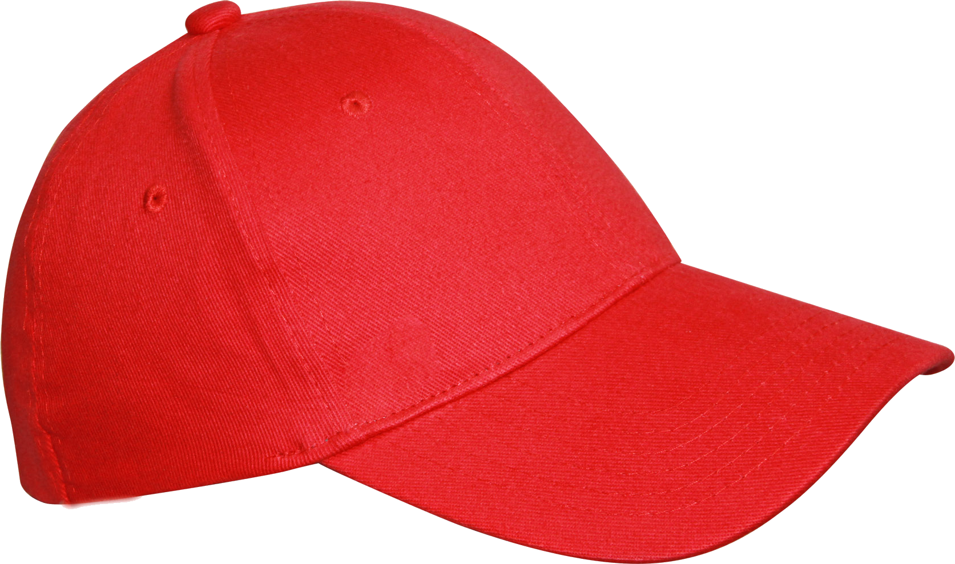


Slide 3
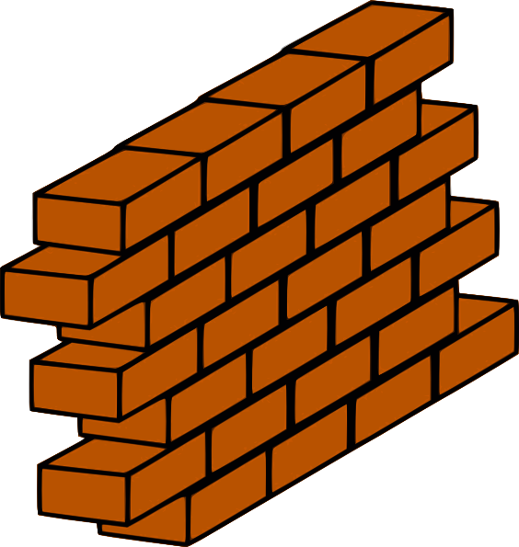

Slide 4
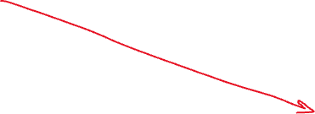

Slide 5
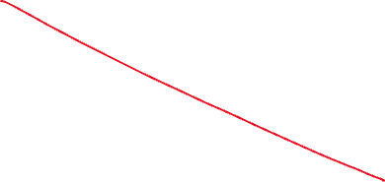

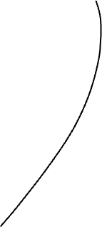
Error

Slide 6
In the above slides if a single sensor is used then the obstacle detected in the head level only.
If two sensors is used .
If the wearer tilt his head then the second sensor gives false positives due to pre-determined obstacle detection length .

Slide 7
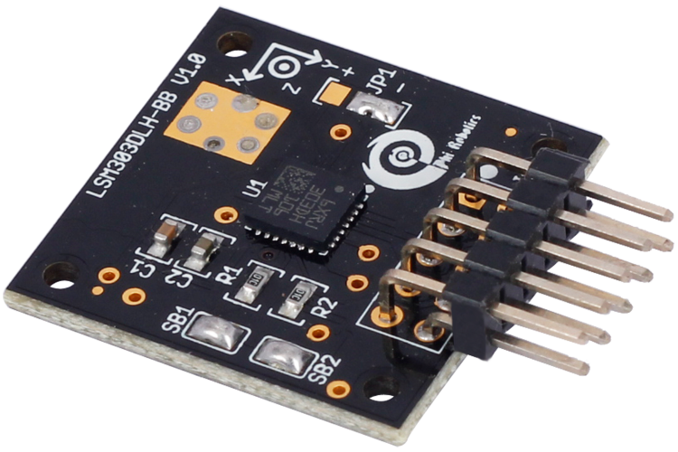
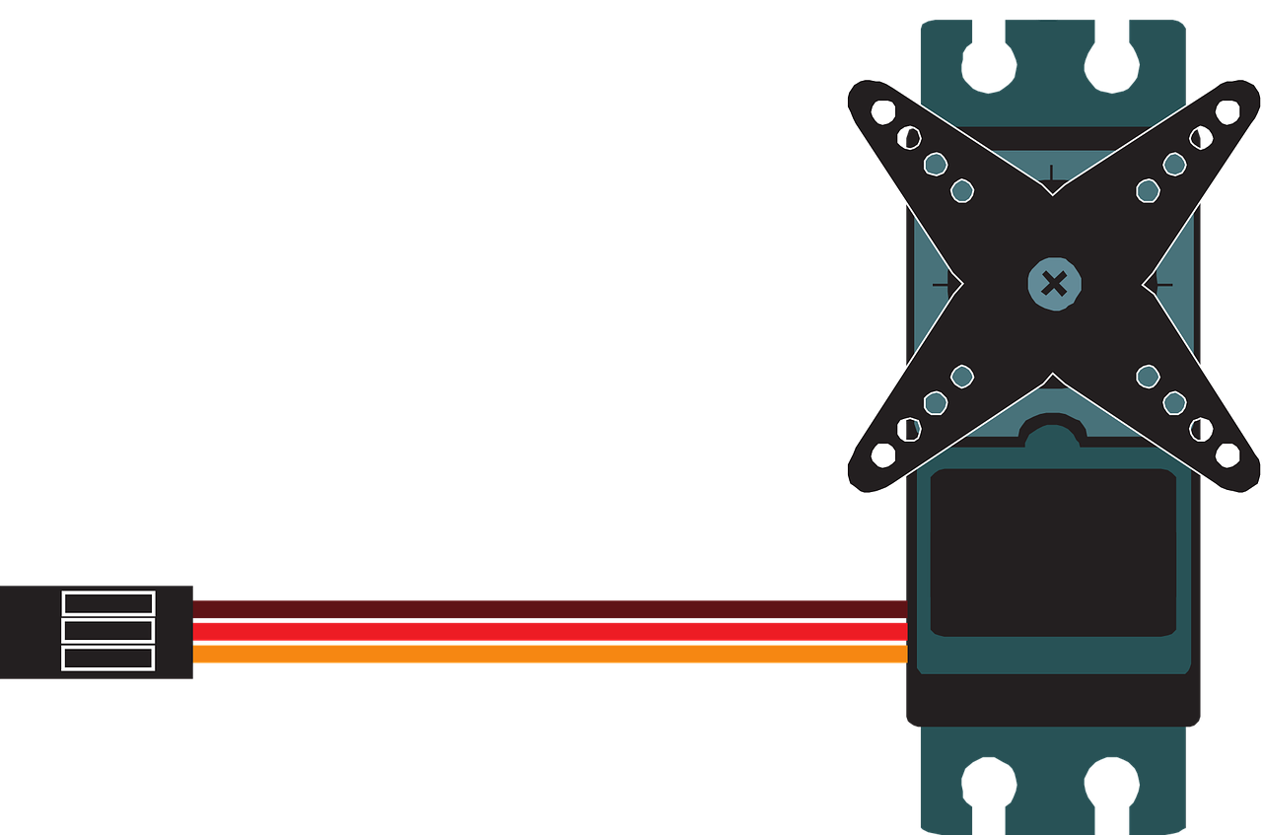

Slide 8
To solve the previous error due to fixed positioning of sensors
In the above slide a gyroscope sensor is used to detect the tilt of cap.
A mechanical link is connected to servo motor and holds two sensors 45 degree apart.
If any tilt is detected by gyroscope sensor, the servo motor rotates in opposite direction to compensate the tilt and minimize error.

Slide 9

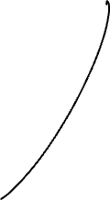
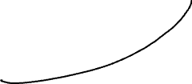
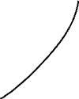
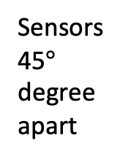
gyroscope
Mechanical link to servo motor
Sensors 45$°$ degree apart
Servo motor

Slide 11
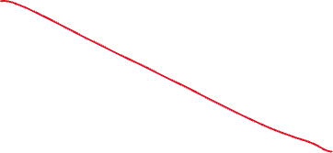

Slide 12
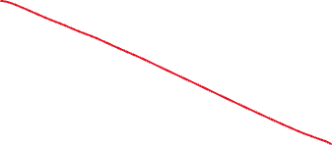
The head tilts towards ground, servo motor rotates mechanical link to upward and compensate the tilt

