Slide 1
OBSERVER PATTERN
Keerati Limkulphong

Slide 2
View
View
View
Relative Percentages
A B C D
A
X 15 35 35 15
D
Y 10 40 30 20
B
C
Z 10 40 30 20
A
B
C
D
A=10%
B=40%
C=30%
D=20%
Data(Model) Object

Slide 3

Intent
Define a one-to-many dependency between objects so that when one object changes state, all its dependents are notified and updated automatically.
Encapsulate the core (or common or engine) components in a Subject abstraction, and the variable (or optional or user interface) components in an Observer hierarchy.
The "View" part of Model-View-Controller.
Publish-Subscribe
Dependents
Also Known As

Slide 4
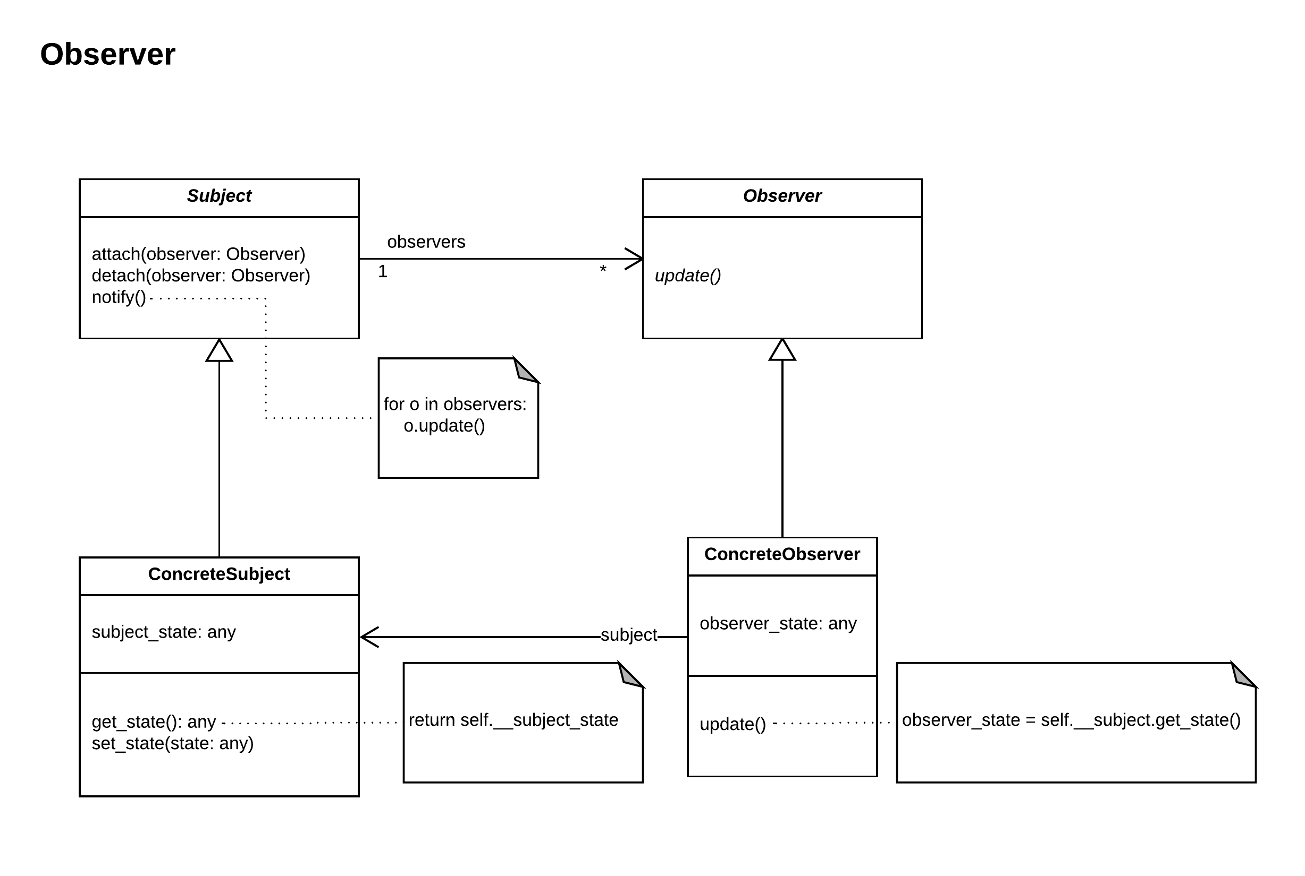

Slide 5
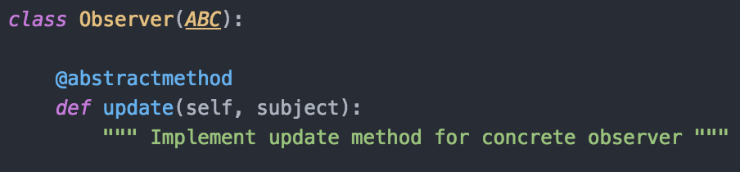
Observer
Defines an updating interface for objects that should be notified of changes in a subject.

Slide 6
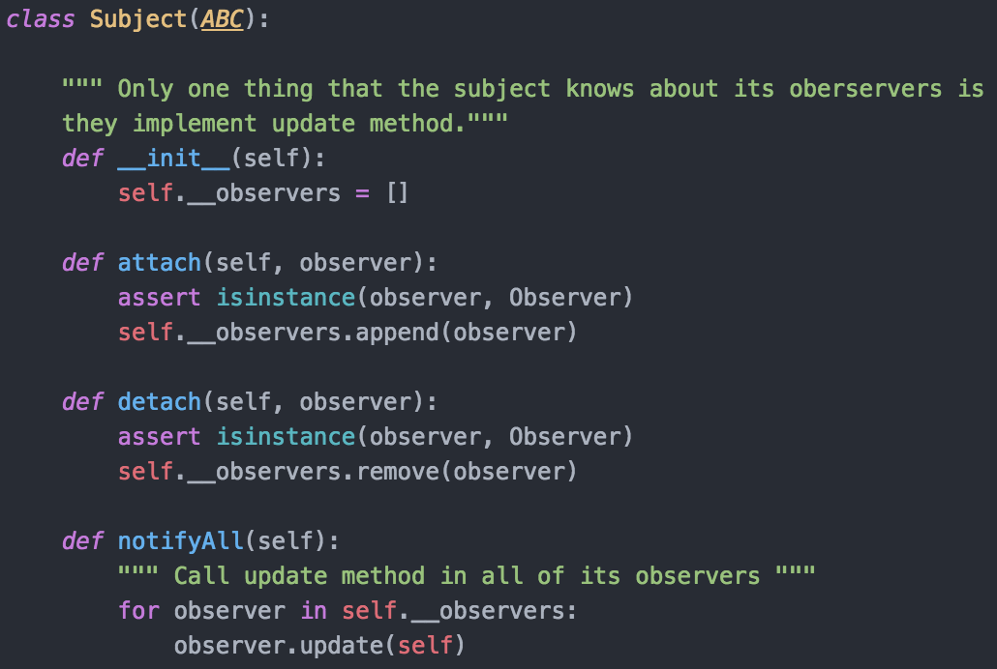
Subject
Knows its observers. Any number of Observer objects may observe a subject.
Provides an interface for attaching and detaching Observer objects.

Slide 7
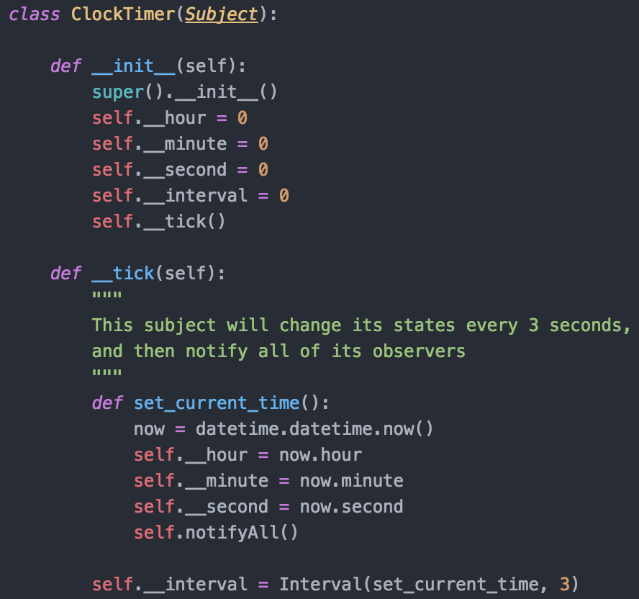

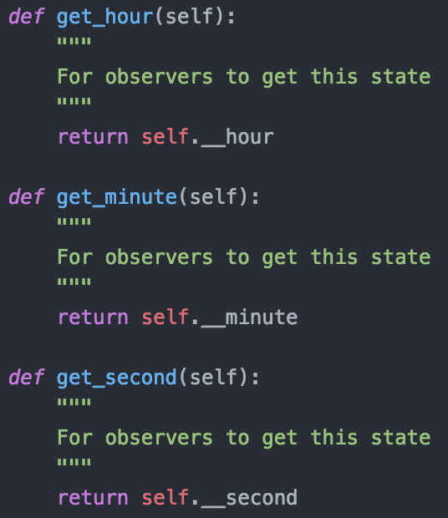
Concrete Subject (ClockTimer)
Stores state of interest to ConcreteObserver objects.
Sends a notification to its observers when its state changes.

Slide 8
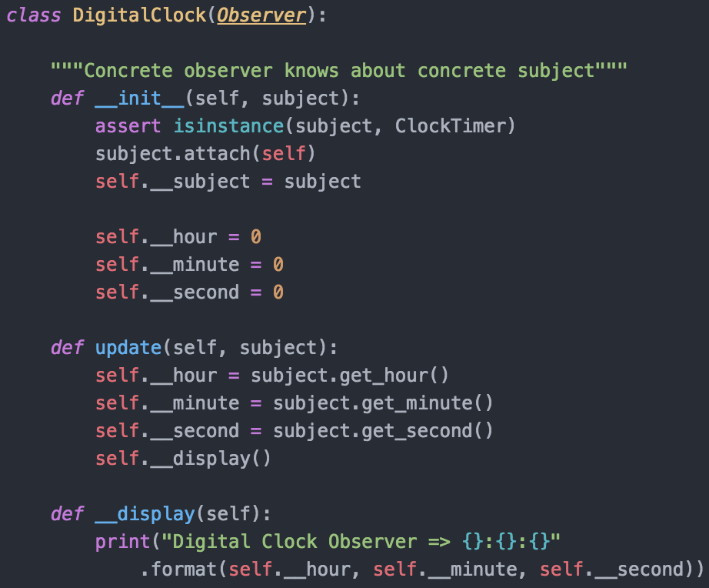
Concrete Observer (DigitalClock)
Maintains a reference to a ConcreteSubject object.
Stores state that should stay consistent with the subject’s.
Implements the Observer updating interface to keep its state consistent with the subject’s.

Slide 9
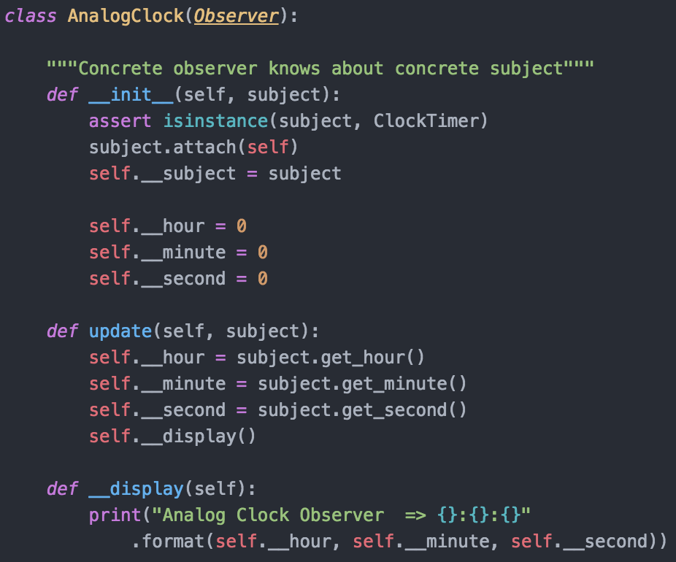
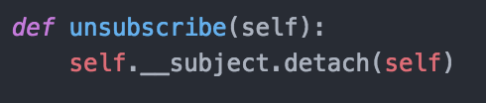
Concrete Observer (AnalogClock)

Slide 10
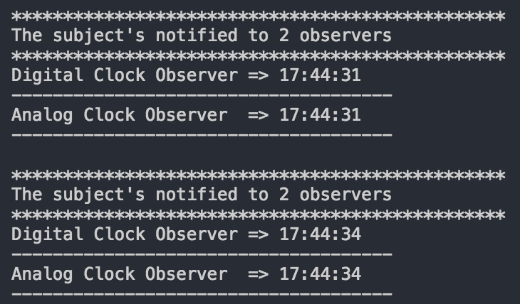
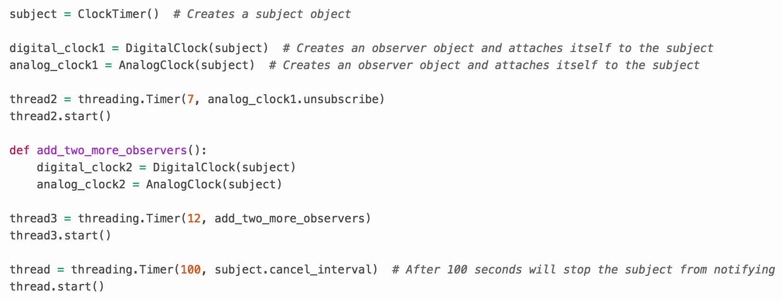
Run this program

Slide 11
Example Code
https://github.com/imkrish/python-design-patterns/ tree/master/behavioral_patterns/observer
Thank You !

