Slide 1
Match or mismatch?
The story of bud burst and timing of breeding
IrisKro

Slide 2
Index
Introduction
Approach
Pipeline step by step
  Method
  Results

Slide 3
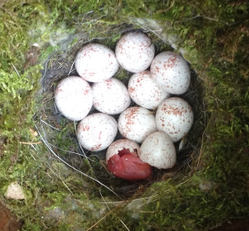
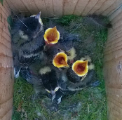
Birds in Dwingelderveld
Nest → eggs →incubation → hatch → young
Food needed
Synchronize breeding-food peak

Slide 4
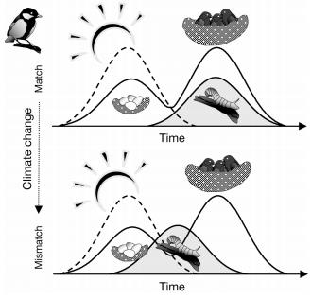
Problem
Global change
Shift of food peak
Mismatch

Slide 5
Question
What is the relation between bud burst and timing of breeding?

Slide 6
Goal
Answer
Visualize problem/data

Slide 7
Approach
Data (2007-2011)
Bud burst
First egg
→ Interval

Slide 8
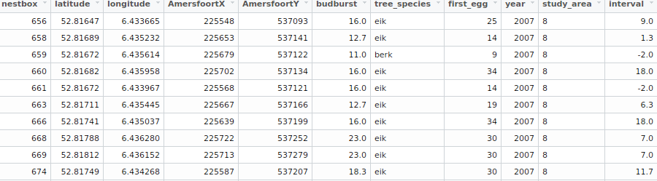

Slide 9
Approach (2)
Overall, within years
  First egg ~ bud burst
Between years
  Bud burst
  First egg
  Interval

Slide 10
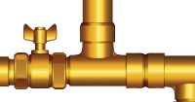
Pipeline
BASH script calls R scripts:
Step1 – Calculate interval,
delete missing data
Step2 – Subset
Step3a – Create maps
Step3b – Statistics
Step4 – Create GIFs
www.iexprofs.nl

Slide 11
Step1 – Calculate interval, delete missing data
Input: birddata.txt
Output: intervaldata.txt
birddata <- na.omit(birddata)
birddata$interval <- birddata$first_egg - birddata$budburst

Slide 13
Step2 – Subset
Input: intervaldata.txt
Output: area_birddata.txt
area_birddata <- subset(birddata, study_area == wanted_area)

Slide 14
Step3a – Statistics
Input: area_birddata.txt
Output: .txt/.doc with test-statistics
data2007 <- subset(birddata, year == 2007)
model2007 <- lm(first_egg~budburst, data = data2007)

Slide 15
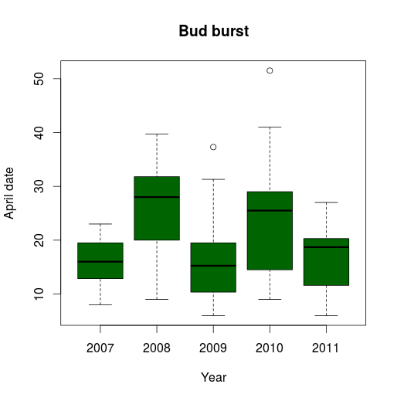
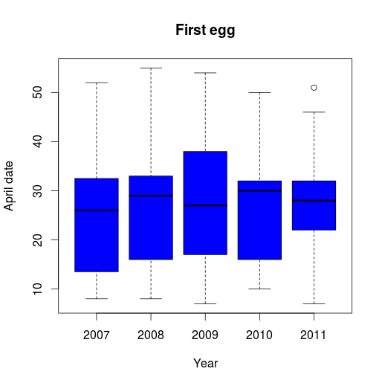
Step3a – Statistics
variable ~ year
(p < 0.02)
(p > 0.2)

Slide 16
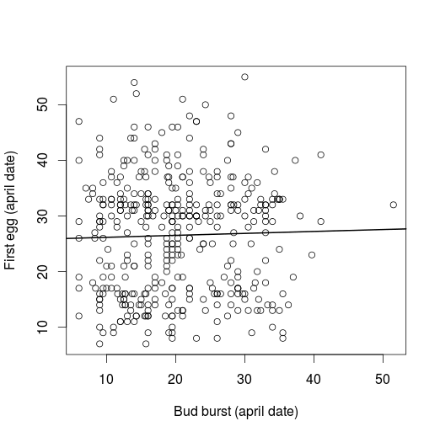
Step3a – Statistics
first egg ~ bud burst
(p > 0.5)

Slide 17
What does this mean?
Timing does not depend on bud burst
Bud burst changes over the years
Timing of breeding is stable
→ Interval changes over the years

Slide 18
What does this really mean?
Birds aren't able to adjust (fast enough)
Climate change → bud burst change

Slide 19
Future research
Bird species
Tree species
Weather conditions →estimation of future situation

Slide 20
Now the cool stuff..

Slide 21
Step3b – Create maps
Input: area_birddata.txt
Get map, add data, save image
Output: 15 images
focalArea <- get_googlemap(center = c(xcenter,ycenter),
zoom = 16, maptype="satellite")
AreaMap <- ggmap(focalArea, extent = "device", legend = "topleft")
Packages: ggplot2, ggmap

Slide 22
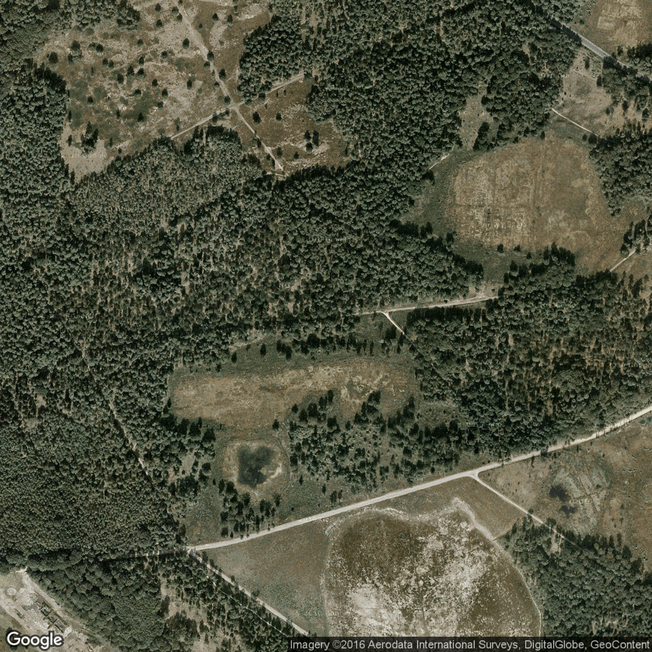

Slide 23
Step3b – Create maps
Input: area_birddata.txt
Get map, add data, save image
Output: 15 images
for (theyear in 2007:2011){
subsetName <- paste(theyear, "Data", sep="")
subsetName <- subset(birddata, year == theyear)
budburstmap <- AreaMap +
geom_point(aes(x = subsetName$longitude,
y = subsetName$latitude,colour = subsetName$budburst),
data = subsetName) + limitsBudburst +
labs(color= "Budburst (april date)", title = theyear) +
theme(legend.title = element_text(size=7, family = "Calibri"), plot.title = element_text(family="Calibri"), legend.position = "bottom")
Eggmap <- AreaMap + etc... }

Slide 24
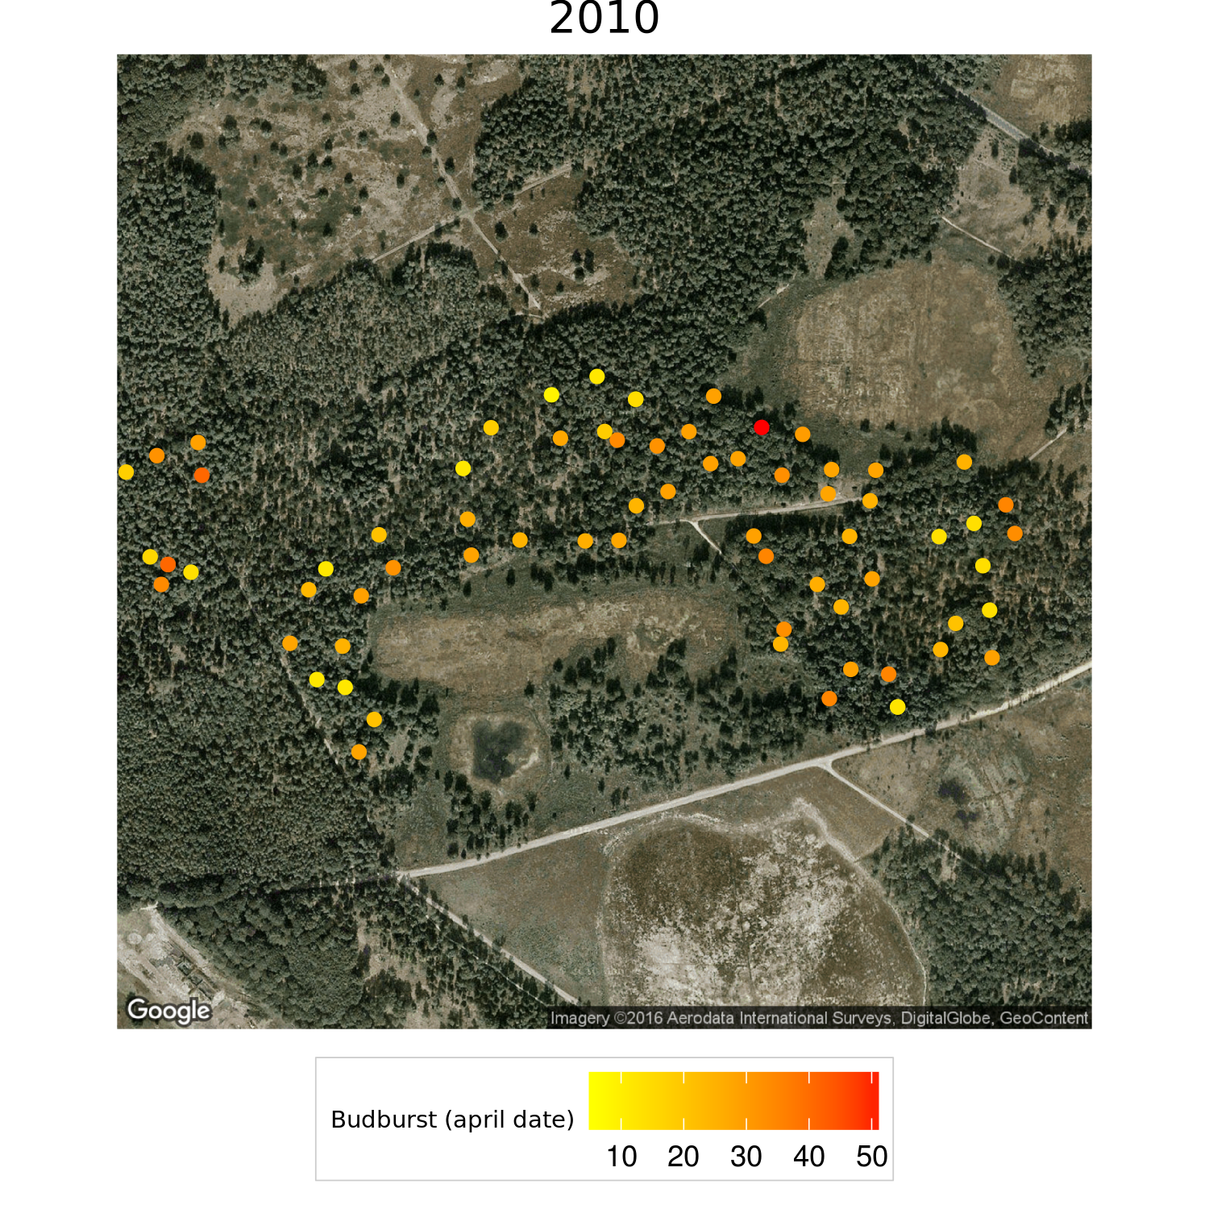

Slide 25
Step3b – Create maps
Input: area_birddata.txt
Get map, add data, save image
Output: 15 images
  Name: category_map_year.png
ImageNameBudburst <- paste("budburst_map_", theyear, ".png", sep="")
ggsave(budburstmap, file = ImageNameBudburst, width = 5,
height = 5, type = "cairo-png")

Slide 26
Step4 – Create GIFs
Input: 15 images
Output: 3 GIFs
for (category in categoryList){
if (category == 1){
ImportFiles <- "budburst_map_*.png"
OutputFile <- "budburst.gif"
} else if (category == 2) etc...
im.convert(files = ImportFiles, output = OutputFile, convert = c("convert", "gm convert"),
cmd.fun = if (.Platform$OS.type == "windows") shell else system, extra.opts = "", clean = FALSE)
Package: animation

Slide 27
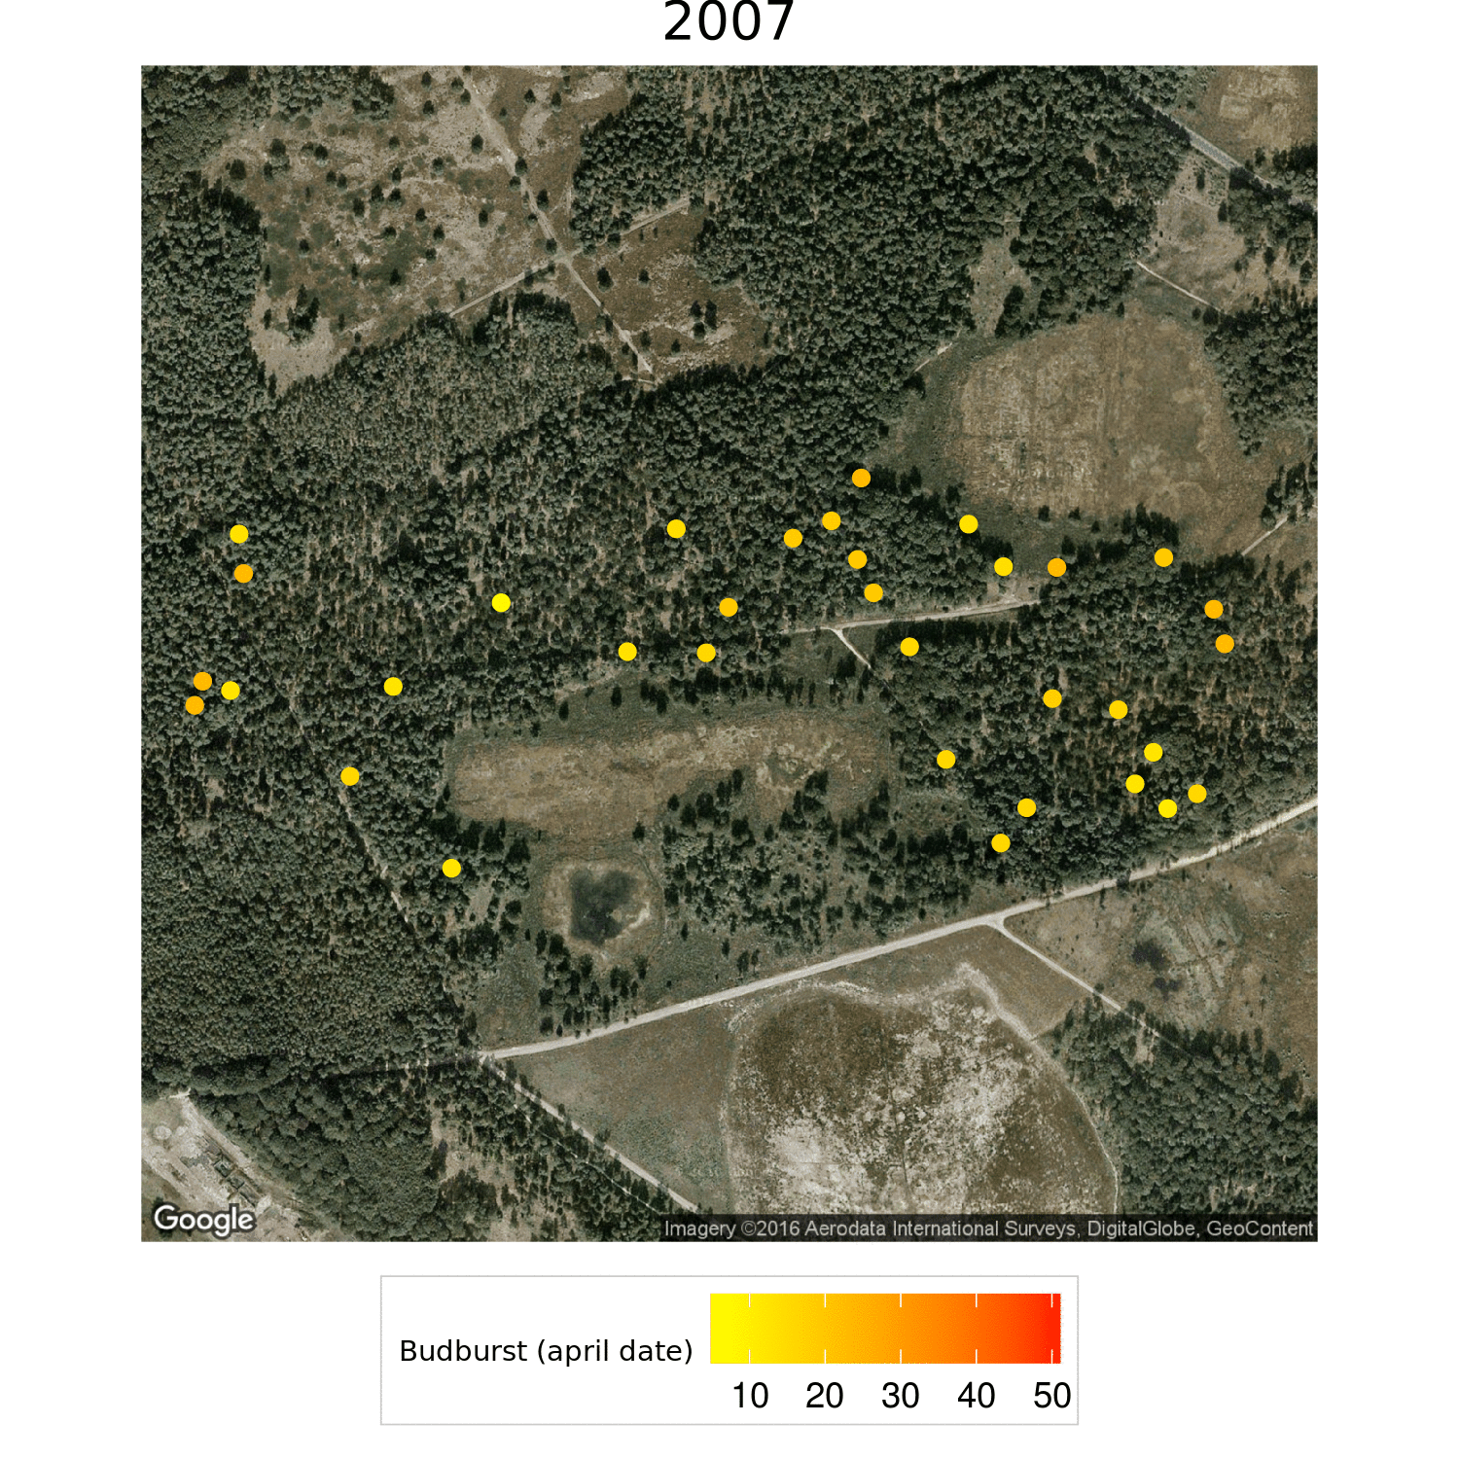
https://github.com/imkromhout/bioinfProject/blob/master/Results/budburst.gif

Slide 28
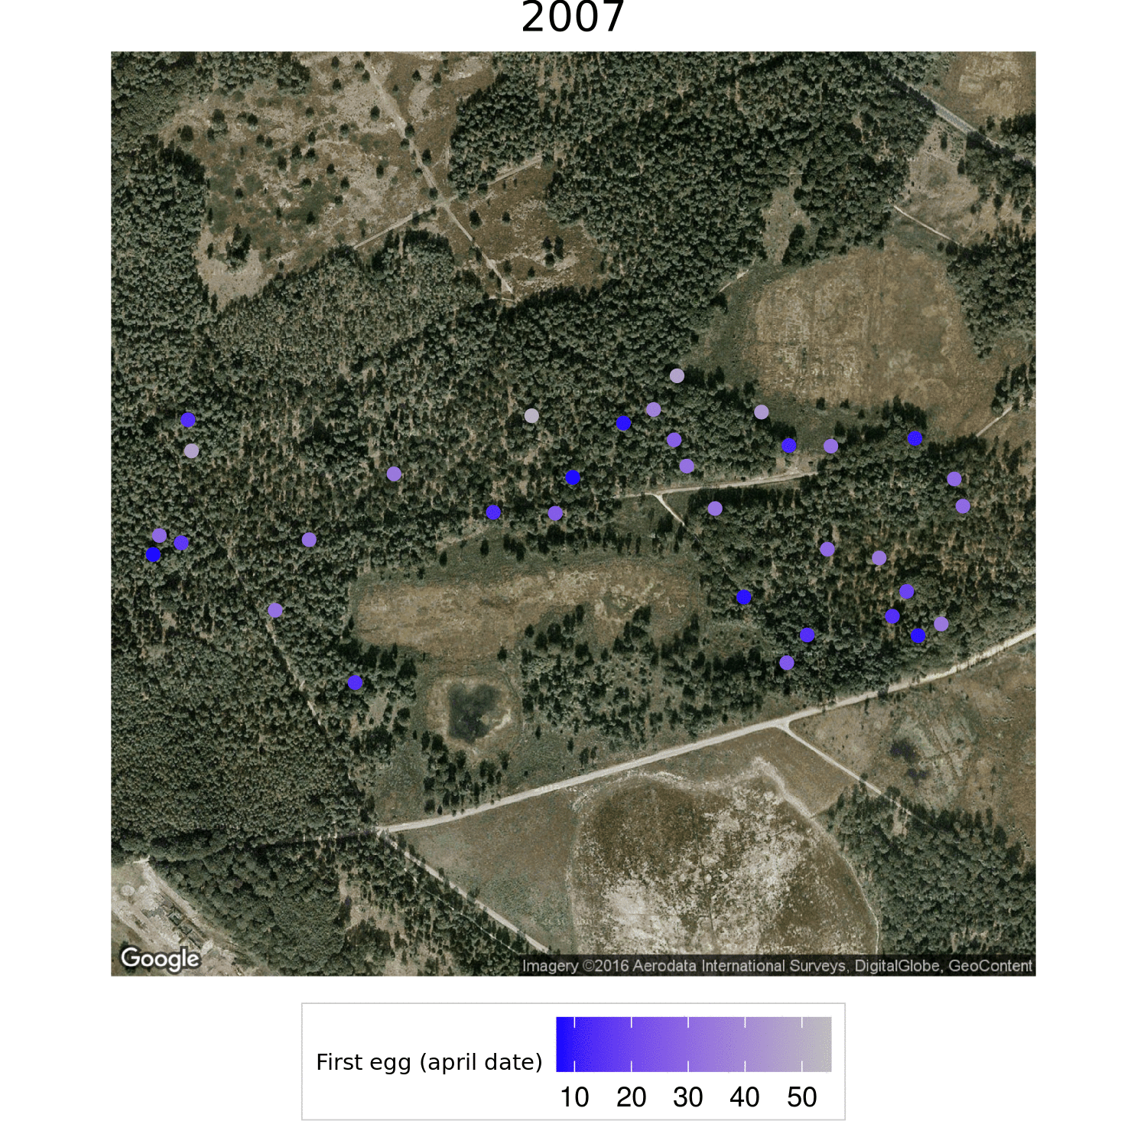
https://github.com/imkromhout/bioinfProject/blob/master/Results/egg.gif

Slide 29
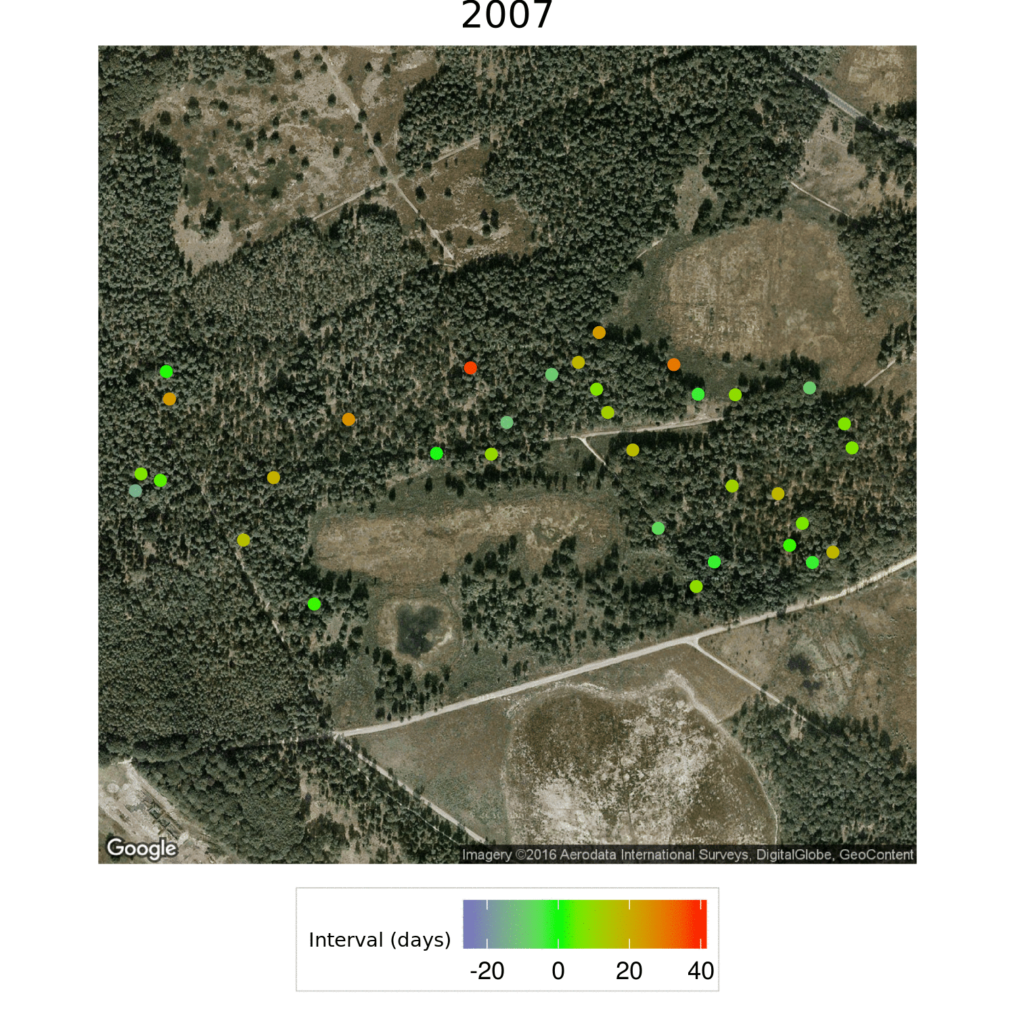
https://github.com/imkromhout/bioinfProject/blob/master/Results/interval.gif

Slide 30
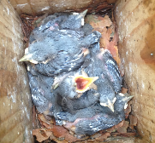
Thank You!
https://github.com/imkromhout/bioinfProject
https://github.com/imkromhout/bioinfProject/blob/master/Results/interval.gif

