Slide 1
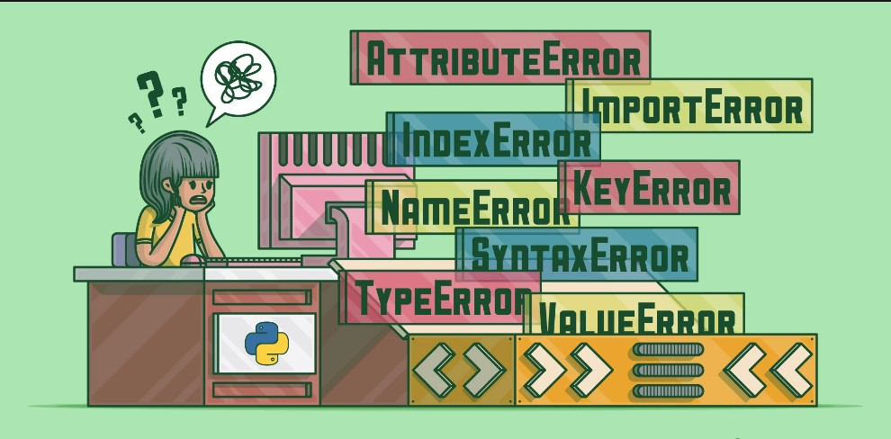
EXCEPTION HANDLING
IMPORTANT QUESTIONS ASKED
BY-KSHITIJ SHARMA

Slide 2
1.WHAT IS AN EXCEPTION ?
Exception is an error that occurs during the execution of a Python program.
When an exception occurs the program stops running and displays an error message That describes what went wrong.
We can handle exceptions by using try and except block
Syntax:
try:
error or exception code
except:
code that handle exception

Slide 3
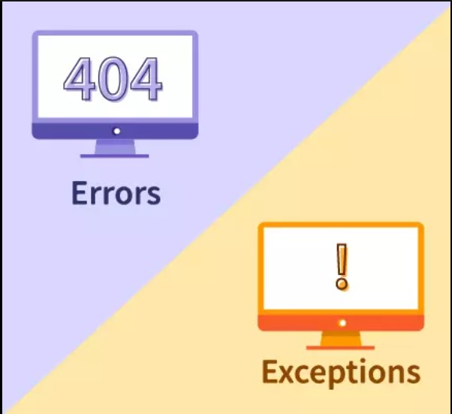
2.DIFFERENCE BETWEEN ERRORS AND EXCEPTION?
An error is when something goes wrong in a program, Like when we misspell a word or forget a semicolon. It includes all kinds of mistakes that can happen in a code. Such as syntax errors, logical errors or hardware malfunctions.
Where as an exception is a specific kind of error that happens when the program is running and something unexpected happens like when we divide a number by zero called exception because its intrupt the normal flow of the program

Slide 4
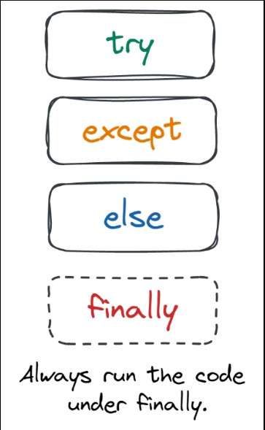
3. HOW CAN WE ENSURE THAT CERTAIN CODE BLOCK RUNS NO MATTER WHETHER THERE IS AN EXCEPTION OR NOT
We use finally block in python to ensure that a certain line of code block runs no matter whether there is an exception or not.
Finally block is also used for tasks such as cleaning up resources ( eg: closing files, and databases)

Slide 5
4. GIVE SOME EXAMPLES OF BUILT-IN EXCEPTIONS ?
1.Type error: Accur when function applied to object with inappropriate type Example:
X = 5 + ”five” –Type error
2.Value error: Accur when receive argument of correct type but inappropriate value
Example:
X =int(”five”) –value error
3.Index error: When you try to access an index of a list and tuple that doesn’t exist
Example:
my_list=[1,2,3]
print(my_list[3]) –index error(no value at 3 index)
4.FileNotFoundError: When we try to open a file that doesn’t exist
Example:
File=open(“Hello.txt”,’r’) –FileNotFoundError

Slide 6
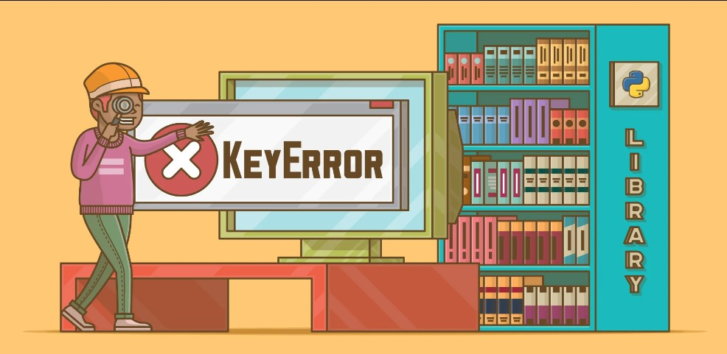
EXAMPLES OF BUILT-IN EXCEPTIONS:
5.ZeroDivisionError: Raised when you try to divide a number by zero
Example:
X=10/0 – ZeroDivisionError
There is so many examples of built-in exceptions in python

Slide 7
5.HOW WE HANDLE EXCEPTION WITH TRY/EXCEPT/FINALLY?
We can exception with try/except/finally by following proper blocks as shown below:
try:
In this block we contains the code that may raise an exception
except:
In this block we catches the exception and handles it by printing an error message or whatever message we want
finally:
This block runs no matter whether an exception was raised or not and can be used for tasks such as cleaning up resources(eg:closing files,or network connections)

Slide 8
6.”EVERY SYNTAX ERROR IS EXCEPTION BUT EVERY EXCEPTION CANNOT BE A SYNTAX ERROR”.JUSTIFY THIS
So every syntax error is an exception because it is an error that occurs at runtime by doing a specific type of mistake like misspelling a word, forgetting to put parenthesis, etc. We get a syntax error. And we can handle these types of errors by using exception blocks so that the program continues to run.
So we say that every syntax error is an exception because we handle it by exception blocks and let our program continue
Whereas,Every exception cannot be a syntax error:
Because there are many other types of errors that can occur at runtime besides syntax errors we can also say that there are many factors that caused exceptions and its not always easy to fix and track down them or refer to only one error

Slide 9
7.USE OF RAISE STATEMENT?
Raise statement is used to signal that an error occurred and specify the type of error
Example:
If x<0:
raise ValueError(“x must be positive”)

Slide 10
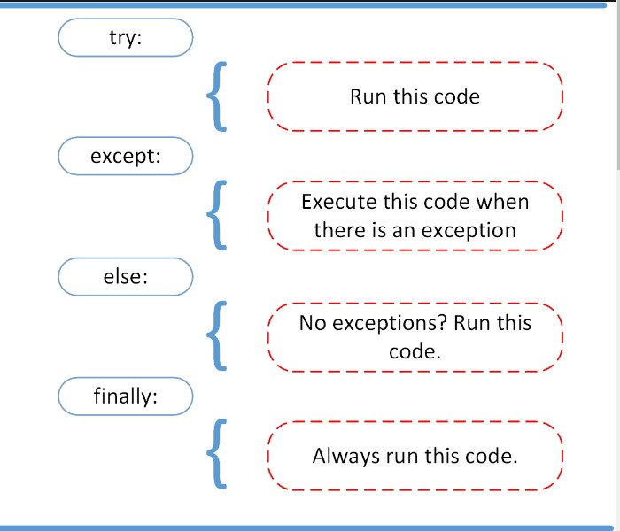
8.USE OF ELSE BLOCK IN EXCEPTION HANDLING.
Else block in exception handling gives us power to perform some extra coding to the program when no exception raised.
Else block actually beautify the code in exception handling

Slide 11
9.Finally block purpose.
‘Finally’ block is used with ‘try’ and ‘except’ blocks to make sure that some code is always executed, even if there is an error or exception.
It works like a safety net in exception handling like if something goes wrong. The ‘finally’ block ensures that any necessary cleanup or other actions are taken before the program exists.
Example:
If you catch the exception or error in except block or you don’t catch you still need to close the file properly , even there is an error or not Than you use finally block where you put close the file code.

Slide 12
10.DIFFERENCE BETWEEN TRY-EXCEPT AND TRY-FINALLY BLOCK
Try-except block is used to catch and handle errors that may occur in the ‘try’ block .
Like in ‘try’ block we try a code or exception if exception occur except block except and display or give certain type of message.
Whereas in try-finally block is used to ensure that some code is always executed, regardless of whether an error occurs in the ‘try’ block or not

Slide 13

THANK YOU
FOR LEARNING PYTHON WITH ME
KSHITIJ SHARMA
END

