Slide 1

ASSIGNMENT GUIDELINES
Make the changes in the PPT as you solve the parts
This file contains the template for all the parts of the project.
Check the instructions added in the note section of every slide for clarity.
Don’t move around any image or text box
If you require more/lesser elements, be careful when you copy/delete the existing ones.

Slide 2
ASSIGNMENT
Name: Rahul Kumar
Problem Statement
The sales pipeline conversion percentage at TechnoServe (a tech SaaS startup) has dropped from 35% at the end of last fiscal (FY 2017-18) to 25% at present.
Assignment Objective
Understand the problem, come up with a hypothesis for low conversions faced by TechnoServe, and analyse the dataset provided to arrive at possible solutions to increase it.
Notes:
Problem Statement

Slide 3
PART I : 1. Understanding the Problem
Sales Pipeline Conversion at a SaaS Startup
Who?
Type your answer here
Who is affected and which team are impacted ?
Sales Team
Marketing Team
Product Team
Top level management
What?
Type your answer here
What is the situation caused by the problem?
The sales pipeline conversion is low 25% only.
Leads quality is inconsistence.
Customers expectation is sifted.
Revenue growth is slow down
When?
Type your answer here
When did the issue first noticed?
In the last financial year when Q conversion started decline.
This trend become serious in the last two Q. after cost cutting in marketing and reduce fud in production
Where?
Type your answer here
Where exactly the issue is happening?
In the sales funnel
Lead generation – Qualification-conversion stage.
How?
Type your answer here
How is the company currently dealing with it, and what outcomes have seen?
Current Action:
Increasing tele sales activity to compensate for fewer marketing event.
Trying to optimize cost by using low – budget digital campaigns.
Outcomes: No major improvement in conversion rates.

Slide 4
PART I : 2. Understanding the Problem
Sales Pipeline Conversion at a SaaS Startup
Situation
Type your answer here
Our product has been become outdated and customers no longer interested in this product.
As of this result our sales target is not completing and our conversion is 25 % only.
As we have cut down the marketing expanse our main lead source are tele sales and social channels for lead generation.
Problem
Type your answer here
The sales conversion is dropped to 25%. As a sharp decline from last year.
Our most sales are conversion is coming from tele sales and social media marketing but these are not genuine for B2B segment
Due to lake of upgrade and old features in our product customers lost there trust and no longer interested in our product.
Implication
Type your answer here
Due to this company losing its existing customers and also, they are not able to onboard new clients.
If these continue like this TechnoServe will lose his market share and competitors who are offering updated product will capture the market.
Need-Payoff
Type your answer here
Why customers is not choosing our product even though our reach and visibility is good?
What are the issues with our product that making less appealing to the customers ?
Why steps has been not taken to rectify these issues?
Notes:
Provide at least three questions under each branch.

Slide 5
PART II : Formulating Hypotheses
Sales Pipeline Conversion at a SaaS Startup
Framework Used
5 C’s of Marketing
Reason for using the selected framework
I used the 5C framework because most of our challenges were related to marketing. We were not reaching the right customers, and our approach was still limited to basic social media. The company wasn’t using advanced marketing methods, which made it hard to expand our reach. By applying the 5C framework, I was able to understand the gaps in customers, competitors, channels, and company capabilities, and identify where we needed to improv.
How you have used the framework here
I used the 5C framework by breaking our main problem into five parts. I looked at the company to understand our internal gaps, the customers to see who we were not reaching, and the competitors to study how they were attracting the same audience. I reviewed our collaborations and partners to check if we were using them effectively. Finally, I studied the market context to understand trends and changes in marketing. This helped me see the exact areas where our strategy was weak and what needed to be improved.
Notes:
All the frameworks that are used should be mentioned.
A suitable reason is a must to provide here

Slide 6
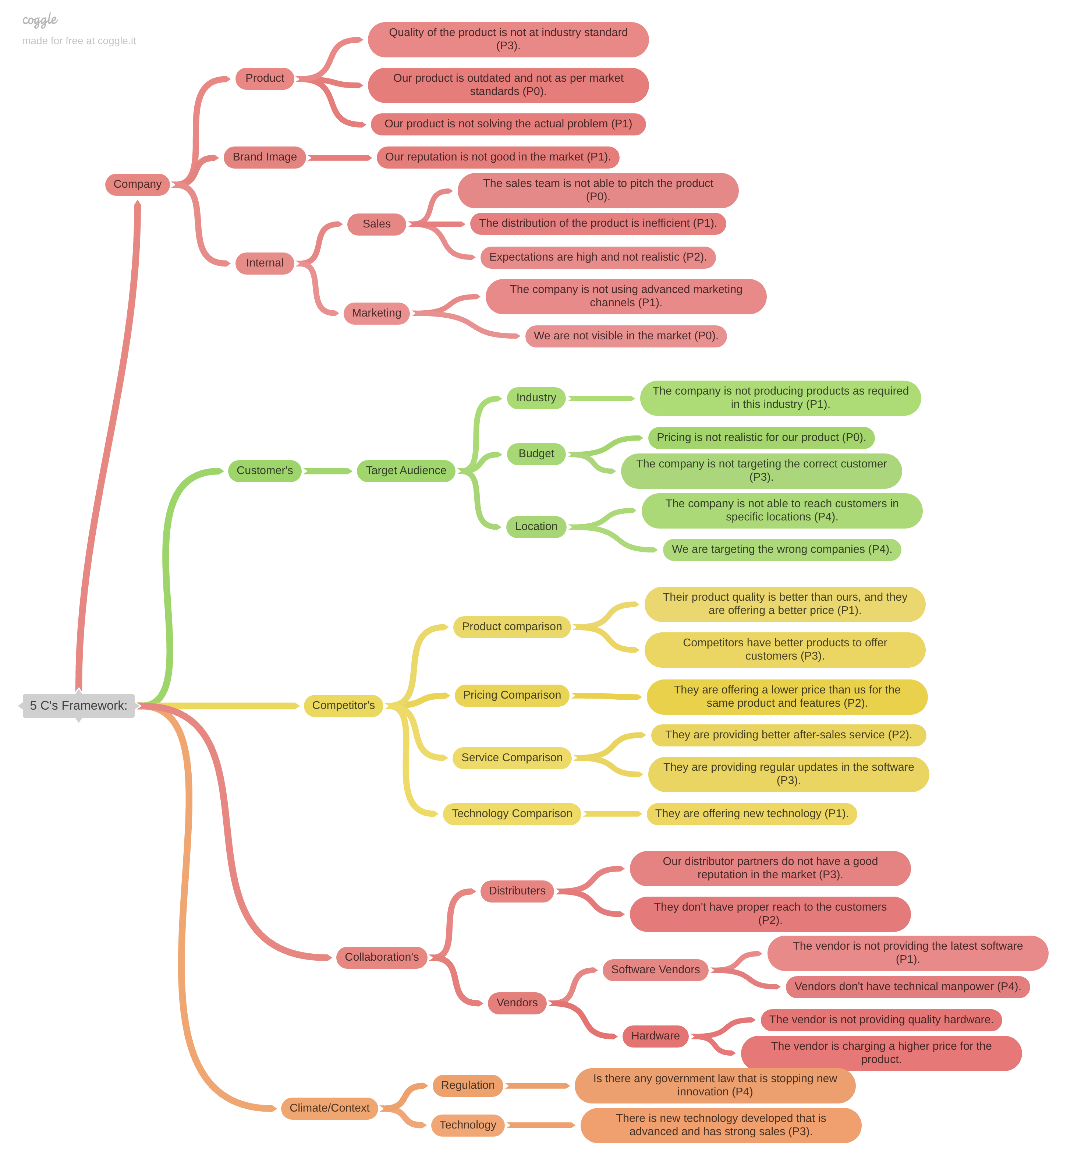
PART II : Formulating Hypotheses
Sales Pipeline Conversion at a SaaS Startup
Notes:
Use the “download as” feature of Coggle if you are using the tool.
Provide one image with complete tree along with separate elements where the text is readable.
Copy the slide if you require more space

Slide 7
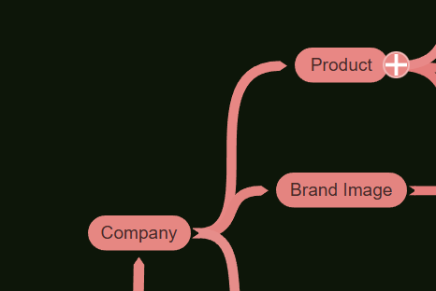
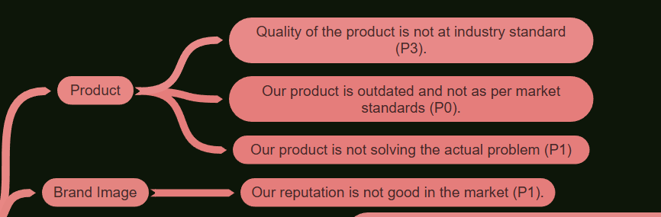
PART II : Formulating Hypotheses
Sales Pipeline Conversion at a SaaS Startup
Branch 1
Company
Branch 2
Company : Product
Brand Image
Notes:
Each branch must follow this naming pattern:
Problem – Branch 1 – Sub-branch 1 – Sub-branch 2 – …… – Hypotheses
There must be minimum 10 hypotheses in total and at least 1 in each branch.

Slide 8
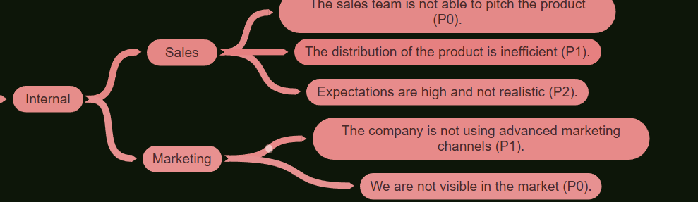
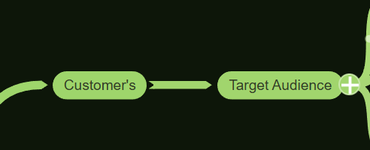
PART II : Formulating Hypotheses
Sales Pipeline Conversion at a SaaS Startup
Branch 3
Company branch 3 Internal – sales and marketing
Branch 4
Customers – Target Audience
Notes:
Each branch must follow this naming pattern:
Problem – Branch 1 – Sub-branch 1 – Sub-branch 2 – …… – Hypotheses
There must be minimum 10 hypotheses in total and at least 1 in each branch.

Slide 9
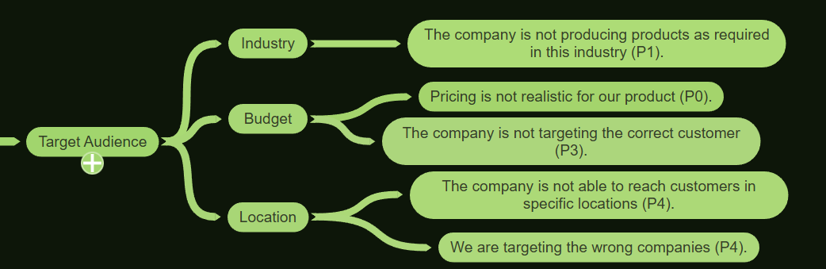
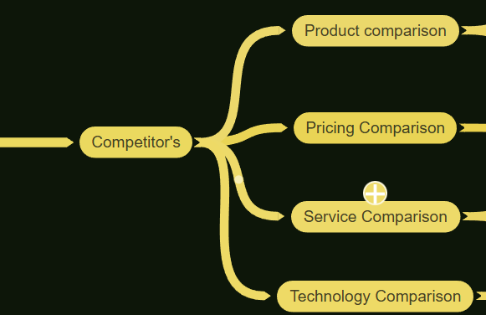
PART II : Formulating Hypotheses
Sales Pipeline Conversion at a SaaS Startup
Branch 5
Customers – Target Audience
Industry
Budget
Location
Branch 6
Competitor’s
Notes:
Each branch must follow this naming pattern:
Problem – Branch 1 – Sub-branch 1 – Sub-branch 2 – …… – Hypotheses
There must be minimum 10 hypotheses in total and at least 1 in each branch.

Slide 10
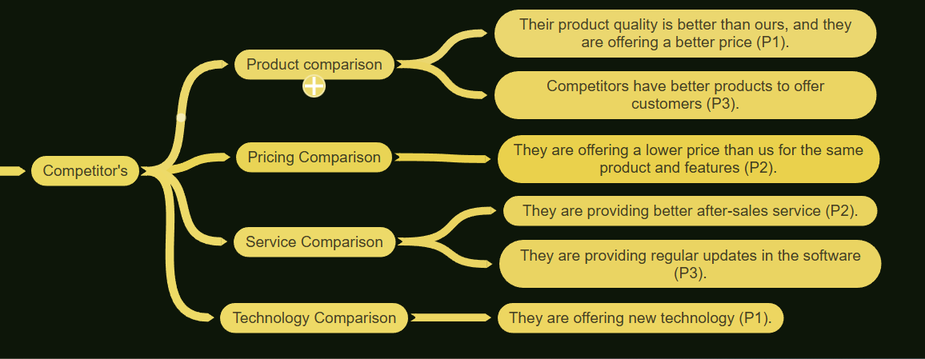
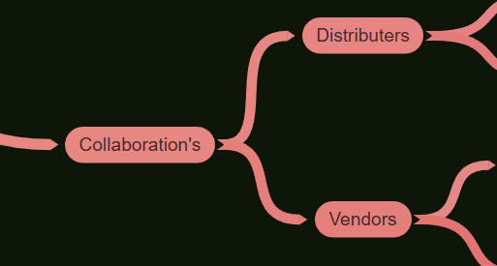
PART II : Formulating Hypotheses
Sales Pipeline Conversion at a SaaS Startup
Branch 7
Competitor’s –
Product Comparison
Pricing
Service
Technology
Branch 8
Collaboration
Notes:
Each branch must follow this naming pattern:
Problem – Branch 1 – Sub-branch 1 – Sub-branch 2 – …… – Hypotheses
There must be minimum 10 hypotheses in total and at least 1 in each branch.

Slide 11
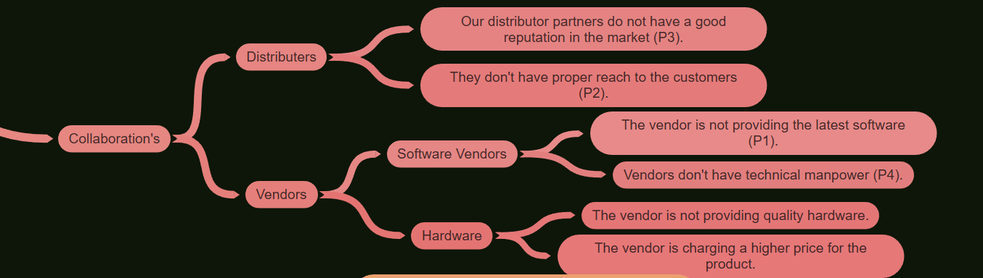
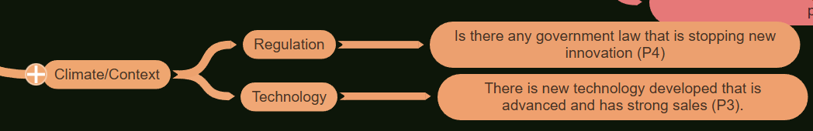
PART II : Formulating Hypotheses
Sales Pipeline Conversion at a SaaS Startup
Branch 9
Collaboration
Distributers
Vendors
Branch 10
Context
Notes:
Each branch must follow this naming pattern:
Problem – Branch 1 – Sub-branch 1 – Sub-branch 2 – …… – Hypotheses
There must be minimum 10 hypotheses in total and at least 1 in each branch.

Slide 12
PART III A : Generating Insights
Sales Pipeline Conversion at a SaaS Startup
Variable
These are the factors affecting the sales pipeline.
Example variables you can use:
Lead Source
Product Features
Pricing
Sales Team Performance
Delivery Channels
Competitor Strength
Marketing Quality
Customer Fit
Insights if any
Most leads are coming from telesales and social channels.
These channels are giving low intent leads.
Conversion dropped from last year’s 40% to 25%.
High-quality channels like referrals and partnerships are not giving enough leads.
Pattern of Insight
Lead quality is the major driver behind the drop in conversions.
Low-intent channels dominate the pipeline, so the funnel is weak from the top.
Earlier high-intent channels are shrinking, causing revenue leakage.
Notes:
Analyse the variables in the dataset, find the insights and mention the pattern of insights in the data. Make more copies of this slide if needed.

Slide 13
PART III A : Generating Insights
Sales Pipeline Conversion at a SaaS Startup
Variable under consideration:
Used variables
Opportunity Status
We converted only 23% Leads rest of 77% lost
Notes:
For each variable that produced an interesting insight, explain you analysis bit here – the results you got from excel and the necessary visualisations. Note: it is compulsory for you to mention the results of the analysis on these variables - 'Technology Primary', 'B2B Sales Medium', 'Client Revenue Sizing', 'Opportunity Sizing' and 'Business from Client last year’.

Slide 14
PART III A : Generating Insights
Sales Pipeline Conversion at a SaaS Startup
Variable under consideration:
Used Variables
B2B sales Medium
Opportunity Status (Won)
Notes:
For each variable that produced an interesting insight, explain you analysis bit here – the results you got from excel and the necessary visualisations. Note: it is compulsory for you to mention the results of the analysis on these variables - 'Technology Primary', 'B2B Sales Medium', 'Client Revenue Sizing', 'Opportunity Sizing' and 'Business from Client last year’.

Slide 15
PART III A : Generating Insights
Sales Pipeline Conversion at a SaaS Startup
Variable under consideration:
Used Variables
Opportunity size
Technology Primary
We have the highest opportunity in ERP Implementation at
61.8 percent, followed by Technical Business Solutions
at 37 percent.
The lowest opportunity area is at 0.3 percent.
Notes:
For each variable that produced an interesting insight, explain you analysis bit here – the results you got from excel and the necessary visualisations. Note: it is compulsory for you to mention the results of the analysis on these variables - 'Technology Primary', 'B2B Sales Medium', 'Client Revenue Sizing', 'Opportunity Sizing' and 'Business from Client last year’.

Slide 16
PART III A : Generating Insights
Sales Pipeline Conversion at a SaaS Startup
Variable under consideration:
City
Opportunity Status (WON)
Mumbai and Delhi have the highest conversion rates at
25 percent and 23 percent.
Kolkata and Pune have the lowest conversion rates at
21 percent and 19 percent.
Notes:
For each variable that produced an interesting insight, explain you analysis bit here – the results you got from excel and the necessary visualisations. Note: it is compulsory for you to mention the results of the analysis on these variables - 'Technology Primary', 'B2B Sales Medium', 'Client Revenue Sizing', 'Opportunity Sizing' and 'Business from Client last year’.

Slide 17
PART III A : Generating Insights
Sales Pipeline Conversion at a SaaS Startup
Variable under consideration:
B2B Sales Medium
Opportunity Status
As you can see, most of the leads are coming through marketing,
but the conversion rate is only 8.87 percent.
This shows a clear gap that needs attention.
Notes:
For each variable that produced an interesting insight, explain you analysis bit here – the results you got from excel and the necessary visualisations. Note: it is compulsory for you to mention the results of the analysis on these variables - 'Technology Primary', 'B2B Sales Medium', 'Client Revenue Sizing', 'Opportunity Sizing' and 'Business from Client last year’. Make more copies of this slide if needed.

Slide 18
PART III A : Generating Insights
Sales Pipeline Conversion at a SaaS Startup
Recommendations
Management should increase investment in marketing and enterprise sales.
It is also important to hire more tech-savvy professionals with experience in ERP systems.
The sales team requires structured training. They should be provided with a clear template and a well-prepared sales pitch.
The system needs timely upgrades.
Additionally, greater focus on the Mumbai and Delhi markets is recommended, as these locations generate the highest number of conversions.
Corresponding Insights
We are losing 78 percent of our leads, and only 22 percent are converting. This is a significant gap, and it highlights the need to train the sales team.
We also have a higher number of customers interested in ERP implementation.
Mumbai and Delhi are the markets from which we receive the highest number of leads. This indicates that these two cities have the strongest potential to generate revenue for the company.
Marketing and enterprise sellers are contributing 93 percent of the total leads, making them the strongest lead sources for the business.
The main cause of the drop from 35 percent to 25 percent is that management is not ready to invest in innovation or after-sales service. They are also not investing in strengthening the brand image.
Notes:
For each recommendation explain the insights that form the reasoning for giving that recommendation. Make more copies of this slide if necessary.

Slide 19
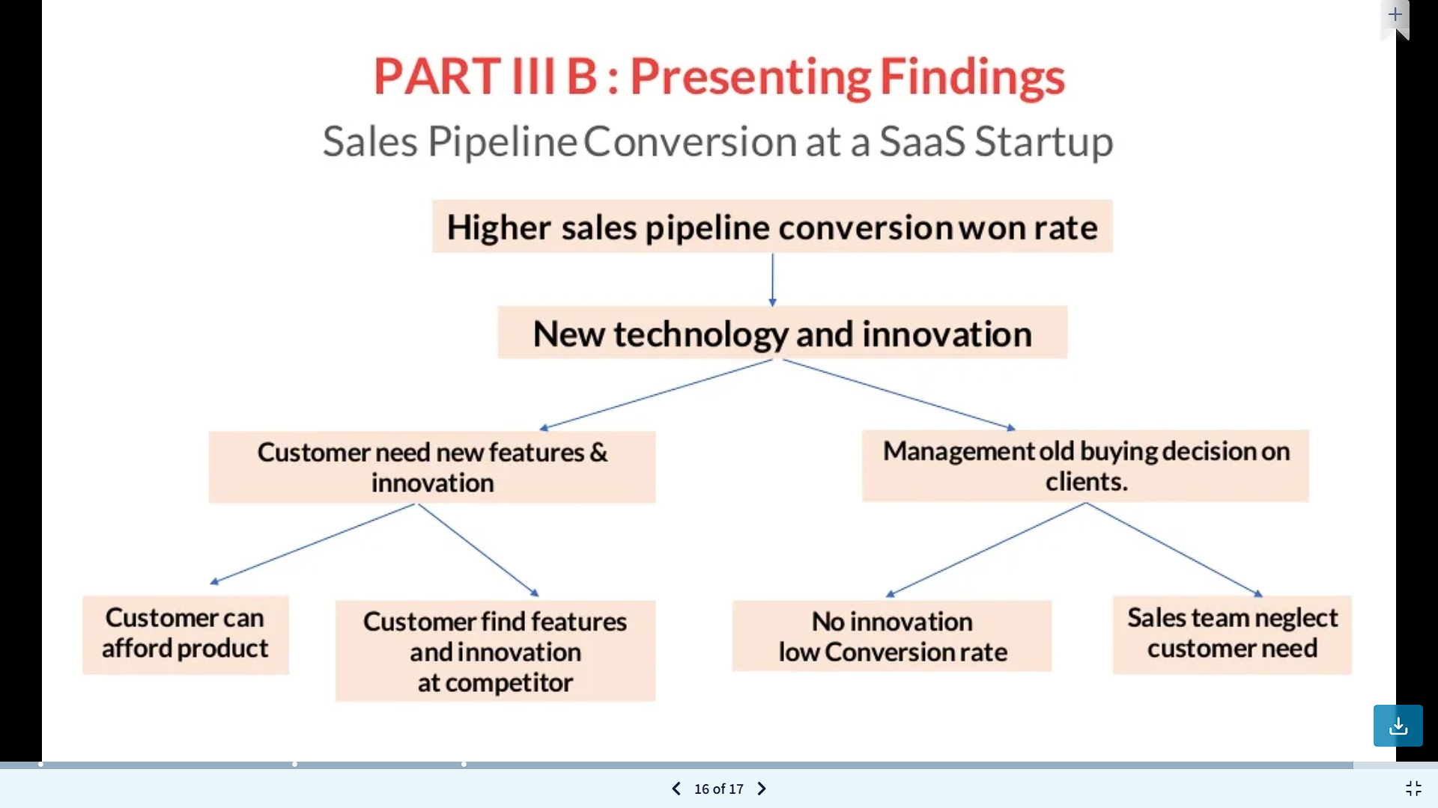
PART III B : Presenting Findings
Sales Pipeline Conversion at a SaaS Startup
Notes:
You are free to use the elements and boxes mentioned previously. Make sure you’re using the pyramid principle, data visualization, visual design principle and storyboarding concepts to design these slides.

