Slide 1
High Level Design (HLD)
High Level Design (HLD)
High Level Design (HLD)
Thyroid Disease Detection

Slide 2
High Level Design (HLD)
Document Version Control
Date Issued | Version | Description | Author
 | 1 | Initial HLD-V1.0 | Upendra Kumar

Slide 3
High Level Design (HLD)
Contents

Slide 4
High Level Design (HLD)
Abstract
At least a person out of ten is suffered from thyroid disease in India. The disorder of thyroid disease primarily happens in the women having the age of 17–54. The extreme stage of thyroid results in cardiovascular complications, increase in blood pressure, maximizes the cholesterol level, depression and decreased fertility.
The hormones, total serum thyroxin (T4) and total serum triiodothyronine (T3) are the two active thyroid
hormones produced by the thyroid gland to control the metabolism of body. For the functioning of each cell and each tissue and organ in a right way, in overall energy yield and regulation and to generate proteins in the ordnance of body temperature, these hormones are necessary .
The basis of classification of thyroid disease is euthyroidism, hyperthyroidism and hypothyroidism which are denoting normal, excessive or defective levels of thyroid hormones. The state euthyroidism depicts the normal production of thyroid hormones and normal levels at the cellular level by the thyroid gland. The state hyperthyroidism is clinical symptom due to excessive circulation and intracellular thyroid hormones. The state hypothyroidism is most of due to the lack of thyroid hormone generation and poor alternate therapy.
Cure of disease is a regular concern for the health care practitioners, and the errorless diagnostic at the right time for a patient is very important. Recently, by some advanced diagnosis methods, the common medical report can be generated with an additional report based on symptoms. The different questions like ‘‘what are the causes for affecting the thyroid?’’, ‘‘Which age group of people are affected due to thyroid?’’, ‘‘what is the relevant treatment for a disease?’’. All these answers we can find on implementing machine learning methods on Health care data. Health care data can be processed and after implementing with certain methodologies; it can provide information that can be used in diagnosis and treatment of diseases more efficiently and accurately with better decision making and minimizing the death risk.

Slide 5
High Level Design (HLD)
1 Introduction
1.1 Why this High-Level Design Document?
The purpose of this High Level Design (HLD) Document is to add the necessary details to the current project description to represent a suitable model for coding. This document is also intended to help detect contradictions prior to coding, and can be used as reference manual for how the modules interact at a high level.
The HLD will
Present all of the design aspects and define them in detail
Describe the user interface being implemented
Describe the hardware and software interfaces
Describe the performance requirements
Include design feature and the architecture of the project
List and describe the non-functional attribute like:
Security
Reliability
Maintainability
Portability
Reusability
Application compatibility
Resource utilization
Serviceability
1.2 Scope
The HLD document presents the structure of the system, such as the database architecture, application architecture (layers), application flow (Navigation), and technology architecture. The HLD uses non-technical to mildly-technical terms which should be understandable to the administrators of the system.
1.3 Definitions

Slide 6
High Level Design (HLD)
2 General Description
2.1 Product Perspective
The Thyroid Disease Detection solution system is a data science-based machine learning model which help us to detect the thyroid disease in the male and female and take necessary action.
2.2 Problem Statement
To create an AI solution for detecting thyroid disease and to implement the following use cases.
To detect thyroid disease in healthy person.
To detect thyroid disease in unhealthy person.
Here unhealthy person means person already affected by thyroid disease.
2.3 Proposed Solution
The solution proposed here is a data science model based on machine learning can be implemented to perform above mention use cases. In first use case , we will take input from a healthy person who is not suffering from thyroid disease and see whether proposed solution is going to detect it or not. And in second use case, we will take input from an unhealthy person, already suffering from thyroid disease and check our solution whether it is performing or not in right way.
2.4 Further Improvements
The Thyroid disease detection solution can be added with more use cases in health care domain. TDD solution can also be synchronized with other health care domain solution to give one step extra confirmation of health to those people who has little symptoms of thyroid disease also.
2.5 Technical Requirements

Slide 7
High Level Design (HLD)
2.6 Data Requirements

Slide 8





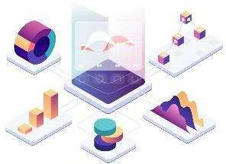



High Level Design (HLD)
2.7 Tools used
Python programming language and frameworks such as NumPy, Pandas, Scikit-learn, Matplotlib, Plotly, Flask etc are used to build the whole model.
PyCharm is used as IDE
Virtual Studio Code is also used as IDE
For visualization of the plots, Matplotlib, Seaborn and Plotly are used.
AWS is used for deployment of the model.
Tableau/Power BI is used for dashboard creation.
Cassandra database is used DB operations
Python, Flask and Django is used for backend development
Github is used as Version Contol System.

Slide 9
High Level Design (HLD)

Slide 10

High Level Design (HLD)
2.8 Constraints
The Thyroid Disease Detection solution system must be correct enough that it not mislead any report and as automated as possible and users should not be required to know any of the workings.
2.9 Assumptions
The main objective of the project is to implement the use cases as previously mentioned for new dataset that comes through Hospitals which has this solution install in their campus to capture people reports.

Slide 11
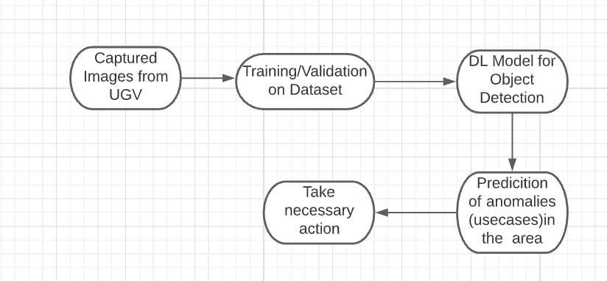
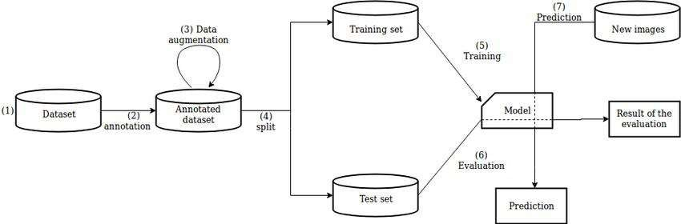
High Level Design (HLD)
3 Design Details
3.1 Process Flow
For identifying the different types of anomalies, we will use machine learning base model. Below is the process flow diagram is as shown below
Proposed methodology
3.1.1 Model Training and Evaluation

Slide 12
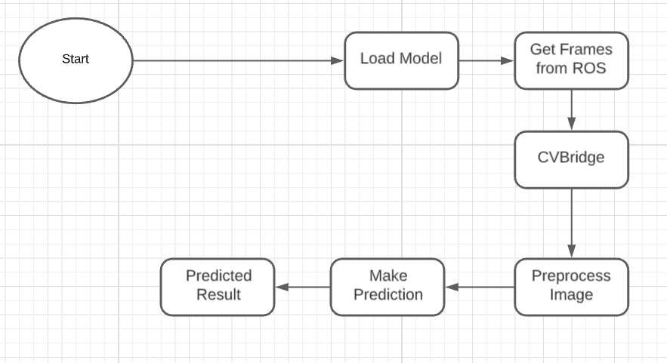
High Level Design (HLD)
3.1.2 Deployment Process
3.2 Event log
The system should log every event so that the user will know what process is running internally.
Initial Step-By-Step Description:
The System identifies at what step logging required.
The System should be able to log each and every system flow.
Developer can choose logging method. You can choose database logging/ File logging s well.
System should not hang even after using so many loggings. Logging just because we can easily debug issues so logging is mandatory to do.
3.3 Error Handling
Should errors be encountered, an explanation will be displayed as to what went wrong? An error will be defined as anything that falls outside the normal and intended usage.

Slide 13


High Level Design (HLD)
4 Performance
4.1 Reusability
The code written and the components used should have the ability to be reused with no problems.
4.2 Application Compatibility
The different components for this project will be using python as an interface between them. Each component will have its own task to perform, and it is the job of the Python to ensure proper transfer of information.
4.3 Resource utilization
When any task is performed, it will likely use all the processing power available until that function is finished.
4.4 Deployment

Slide 14


High Level Design (HLD)
5 Dashboards
Dashboards will be implemented to display and indicate certain KPIs and relevant indicators for the unveiled problems that if not addressed in time could cause catastrophes of unimaginable impact.
As and when, the system starts to capture the historical/periodic data for a user, the dashboards will be included to display charts over time with progress on various indicators or factors.
5.1 KPIs (Key Performance Indicators)
Key indicators displaying a summary of the anomaly detection in the society/area.
Time and workload reduction using the UGV based surveillance.
To detect mob (illegal) activities and inform police.
On time alert to nearest hospital on medical emergency (accident).
Taking adequate evidence of mob.
Send disaster details to concerned authorities.
Display of battery life and percentage of UGV.
Distance travelled by UGV.
Get the exact location of UGV.

Slide 15
High Level Design (HLD)
6 Conclusion

Slide 16
High Level Design (HLD)
7 References

