Slide 1

Win Prediction Analytics
Data Science Prodegree Project
Capstone Group 5
-Aafreen
-Abhijeet
-Dipti
-Gaurav Gangrade
-Upendra

Slide 2

Table of Contents
1
Introduction
2
Problem Statement
3
Exploratory Data Analysis
4
Missing Data Handling
5
Methodology
6
Models Used
7
Predictive Analysis
8
Prescriptive Analysis
9
Conclusion

Slide 3
Introduction
Win Prediction: IT Firms compete for winning large deals by designing and proposing solutions to their clients.These deals often differ from each other in terms of sector, client and solution. The deal value can reach up to millions of dollars, which leads to highly competitive bidding processes.
Application: By predicting the probability of winning a deal, the engagement teams can prioritize the pipeline of opportunities to staff the most attractive option first. Deal engagement manager can ensure that for the most profitable deals there are resources available.
Data: We have been provided with a single file which contains data related to the deals won or lost. This data contains the client, Solution, date, sector, location, VP, manager, deal cost, status of deal from 2011 to 2019(Mid.).

Slide 4
Problem Statement
Organization puts in a lot of effort in bidding preparation with no indications whether it will be worth it. With multiple bid manager and VP willing to work on every opportunity, it becomes difficult for the management to decide which bid should be given to which bid manager and VP.
Our task is to identify the best bid manager-VP combination who can convert an opportunity to win with the provided data points.
Objective 1: Predictive Analytics – Build a ML model to predict the probability of win/loss for bidding activities for a potential client.
Objective 2: Prescriptive Analytics – Identify variables that are most likely to help in converting an opportunity into a win.

Slide 5
Dataset
Provided with a single file which contains data related to the projects/deals won or lost. This data contains the project category, price and sector from 2011 to 2019.
Column Name | Description
Client Category | Industry in which the client works
Solution Type | The solution group the client requires
Deal Date | The date the opportunity was created
Sector | The sector for which the solution is to be provided
Location | Client location
VP Name | Sr. Manager or VP which is dealing with the client
Manager Name | Manager of the team working on the project
Deal Cost | The initial cost of the deal
Deal Status Code | Final status of the deal(won/lost)
The table on the left shows the information of the different columns on the dataset.
There are 8 input columns with 1 output column.
7 variables are Categorical, “Deal Cost” being numerical and “Deal Status Code” is boolean
Out of the 8 input columns, only 3 columns can be controlled by the organization, which are
VP Name
Manager Name
Deal Cost
VP Name and Manager name can be changed easily, whereas, Deal Cost can be manipulated only to a certain extent.

Slide 6
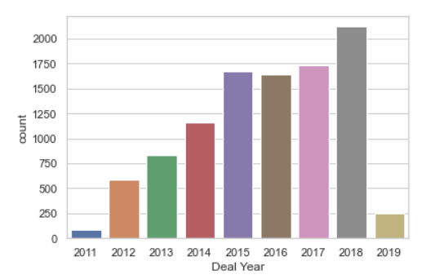
Exploratory Data Analysis
Deal Year
Comparing Company’s growth over the years
Variable | 2011 | 2019
Client Category | 21 | 41
Sector Type | 11 | 25
Solution Type | 12 | 67
VP | 7 | 43
Manager | 30 | 278
Location | 6 | 13
.
From above bar chart, Shows company’s number of bidding increasing year on year which shows company growth.
Notes:
- Win-Loss Analysis (No. of Loss higher)
- Internal Data Win% (Anomaly) (Shown in Graph )
- Lost Higher value deals Won Smaller value deals
- Deal Cost – Right Skewed
- Organization deal number is increasing every year.

Slide 7
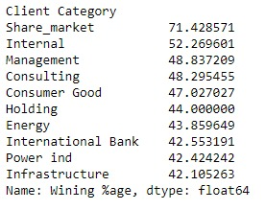
Client Category
Solution Type
Client Category has 41 distinct values. In which Others, internal & service based Category witnesses 50% frequency.
Solution Type Variable consists of 67 distinct values. In which Solution Type 9, 10 & 32 having high frequency.
These Solution Type involved in 38 client category
Sector
Sector Variable consists of 25
distinct values. In which Solution Type 2, 23 having high frequency approx 44% of the dataset.
Location
As above figure shows,
Internal client category creates Anomaly.
Location variable consist of 13 values, in which L10, L5, L1 witnesses 70% frequency.

Slide 8
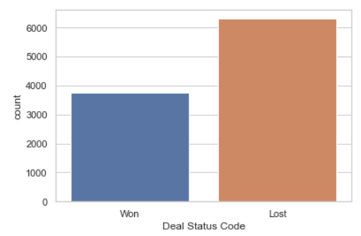
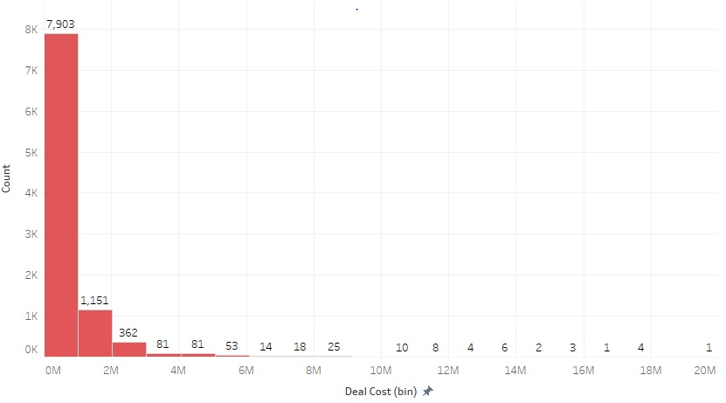
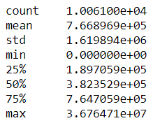
Deal Status Code
Deal Cost
From above chart, Won deal status is lesser than Lost deals status. Indicating data set is imbalance.
Deal Cost is right skewed , which indicates that company has taken part more in less value deal( up to 1 mn ). Minimum deal cost value is 0, which would need to be handled as missing values.

Slide 9
Handling of Missing Values
Missing values were present only in client category.
Total missing values: 79
All those missing values were of location: L10
We replaced those missing values with the modular value of client category at L10 that is “Others”.
Deal Cost had some zero values.
Total observation with zero deal cost: 245
Won deals: 4
Lost deals: 241
We replaced those deal cost with the median value of deal cost of lost deals
Duplicates Data :
Total duplicate data rows :- 14

Slide 10
Methodology
 | Approach 1 | Approach 2 | Approach 3 (Final)
Data Cleansing | Client Category Blanks replaced with "Others" Deal Cost 0 , replaced with median of deal cost | Client Category Blanks replaced with "Others" Deal Cost 0 , replaced with median of deal cost Internal Client Category Data Rows Removed | Client Category Blanks replaced with "Others" Deal Cost 0 , replaced with median of Lost deal cost Internal Client Category Data Rows Removed
Feature Engineering | All Categorical Variables replaced by Dummy Variables (One Hot Encoding) Data set split by 70:30 for Train and Test | Count Encoding (for VP Name and Manager) Applied target guided ordinal encoding to rest categorical feature Split - Data in year 2011 -17 (Train) , and rest 2018-19(Test) | Combined VP and Manager to create a ‘VP+Manager’ Variable Applied target guided ordinal encoding for each categorical feature Data set split by 80:20 for Train and test
Hyper parameter Tuning | Randomised search cross validation | Randomised search cross validation | Randomised search cross validation

Slide 11
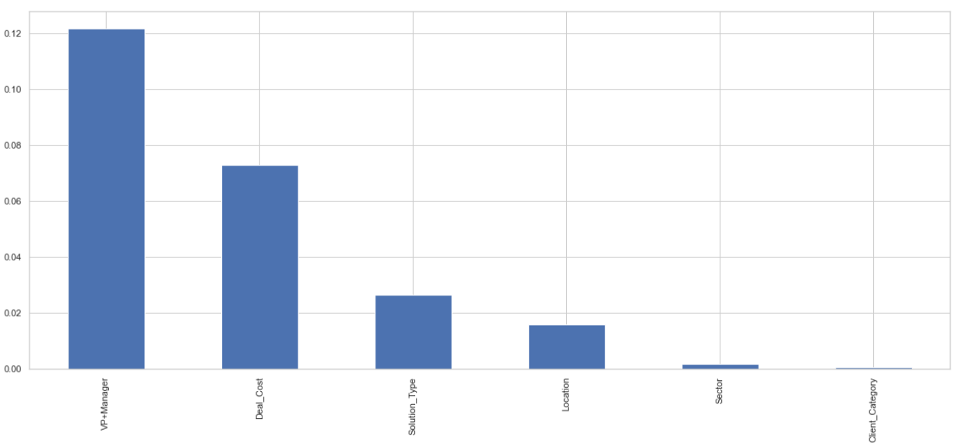
Methodology – Approach 3 in detail
Data Cleansing –
Client Category Blanks replaced with "Others"
Deal Cost 0 , replaced with median of Lost deal cost
Internal Client Category Data Rows Removed
Deal Date Column was removed
Feature Engineering –
Used Mutual Information Gain for feature Selection
We observed, combining VP and Manager in 1 variable (VP+Manager) gives us higher info gain
Applied target guided ordinal encoding for each categorical feature
Data set split by 80:20 for Train and test

Slide 12
Models Used - Dipti
Marked for deletion
After Analysing the Problem Statement, it is clear that this is a Classification Problem. We have used the following Classification Algorithms to build the best model
Model Name | Reason | Assumptions | Comments ??
Logistic Regression | Logistic regression is used to examine the association of (categorical or continuous) independent variable(s) with one dichotomous dependent variable. it is used to describe data and to explain the relationship between one dependent binary variable and one or more nominal, ordinal, interval or ratio-level independent variables. | Logistic regression does not require a linear relationship between the dependent and independent variables .
Decision Tree | Decision Tree is used to create a training model that can be used to predict the class or value of the target variable by learning simple decision rules inferred from prior data(training data) | The whole training set is considered as the root. Feature values are preferred to be categorical. If the values are continuous then they are discretized prior to building the model. Records are distributed recursively on the basis of attribute values.
Random Forest | Random forest algorithm can be used for both classifications and regression task. It provides higher accuracy through cross validation. Random forest classifier will handle the missing values and maintain the accuracy of a large proportion of data. | Random forests are non-parametric and can thus handle skewed and multi-modal data as well as categorical data that are ordinal or non-ordinal.
Xgboost

Slide 13
Predictive Analysis
Model Name | Accuracy | Precision | True Loss
Logistic Regression | 0.65 | 0.42 | 4.660965e+08
Decision Tree | 0.84 | 0.85 | 1.399324e+08
XGBoost | 0.85 | 0.85 | 1.354529e+08
Random Forest | 0.85 | 0.86 | 1.388944e+08
(Graphs if any)
ROC Curve

Slide 14
Prescriptive Analysis - Upendra

Slide 15
Conclusion - Upendra

Slide 16
Thank You

