Slide 1


Win Prediction Analytics
Data Science Prodegree Project
Capstone Group 5
-Aafreen Khan
-Abhijeet Chourey
-Dipti
-Gaurav Gangrade
-Upendra Kumar

Slide 2

Table of Contents
1
Introduction
Gaurav
2
Problem Statement
3
Exploratory Data Analysis
Abhjijit
4
Missing Data Handling
5
Methodology
Aafreen
6
Predictive Analysis
Dipti
7
Prescriptive Analysis
Upendra
8
Conclusion

Slide 3
Introduction
Win Prediction: IT Firms compete for winning large deals by designing and proposing solutions to their clients.These deals often differ from each other in terms of sector, client and solution. The deal value can reach up to millions of dollars, which leads to highly competitive bidding processes.
Application: By predicting the probability of winning a deal, the engagement teams can prioritize the pipeline of opportunities to staff the most attractive option first. Deal engagement manager can ensure that for the most profitable deals there are resources available.
Data: We have been provided with a single file which contains data related to the deals won or lost. This data contains the client, Solution, date, sector, location, VP, manager, deal cost, status of deal from 2011 to 2019(Mid.).

Slide 4
Problem Statement
Organization puts in a lot of effort in bidding preparation with no indications whether it will be worth it. With multiple bid manager and VP willing to work on every opportunity, it becomes difficult for the management to decide which bid should be given to which bid manager and VP.
Our task is to identify the best bid manager-VP combination who can convert an opportunity to win with the provided data points.
Objective 1: Predictive Analytics – Build a ML model to predict the probability of win/loss for bidding activities for a potential client.
Objective 2: Prescriptive Analytics – Identify variables that are most likely to help in converting an opportunity into a win.

Slide 5
Dataset
Provided with a single file which contains data related to the projects/deals won or lost. This data contains the project category, price and sector from 2011 to 2019.
The table on the left shows the information of the different columns on the dataset:-
There are 8 input columns with 1 output column.
7 variables are Categorical, “Deal Cost” being numerical and “Deal Status Code” is boolean
Out of the 8 input columns, only 3 columns can be controlled by the organization, which are
i) VP Name
ii) Manager Name
iii) Deal Cost
VP Name and Manager name can be changed easily, whereas, Deal Cost can be manipulated only to a certain extent.
Column Name | Description
Client Category | Industry in which the client works
Solution Type | The solution group the client requires
Deal Date | The date the opportunity was created
Sector | The sector for which the solution is to be provided
Location | Client Location
VP Name | Sr. Manager or VP which is dealing with the client
Manager Name | Manager of the team working on the project
Deal Cost | The initial cost of the deal
Deal Status Code | Final status of the deal(won/lost)

Slide 6
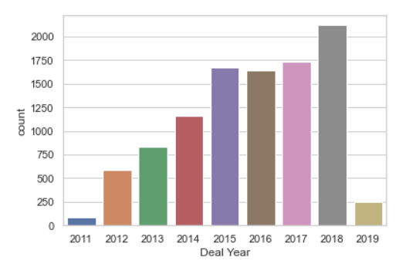
Exploratory Data Analysis
Comparing Company’s growth over the years
Deal Year
Variable | 2011 | 2019
Client Category | 21 | 41
Sector Type | 11 | 25
Solution Type | 12 | 67
VP | 7 | 43
Manager | 30 | 278
Location | 6 | 13
.
Above chart represents, Number of bids submitted per year, indicating that the organization is growing. This can also be inferred by the table, indicating rise in various Client Categories, Sectors etc. when comparing 2011 to 2019.
Notes:
- Win-Loss Analysis (No. of Loss higher)
- Internal Data Win% (Anomaly) (Shown in Graph )
- Lost Higher value deals Won Smaller value deals
- Deal Cost – Right Skewed
- Organization deal number is increasing every year.

Slide 7
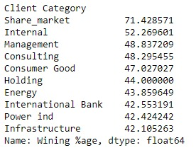
Exploratory Data Analysis
Client Category
Solution Type
Solution Type Variable consists of 67 distinct values. In which Solution Type 9, 10 & 32 having high frequency.
These Solution Type involved in 38 client category
Client Category has 41 distinct values. In which Others, internal & service based Category witnesses 50% frequency.
Sector
Sector Variable consists of 25 distinct values. In which Solution Type 2, 23 are having high frequency approx. 44% of the dataset.
Location
As above figure shows,
Internal client category creates Anomaly.
Location variable consist of 13 values, in which L10, L5, L1 witnesses 70% frequency.

Slide 8
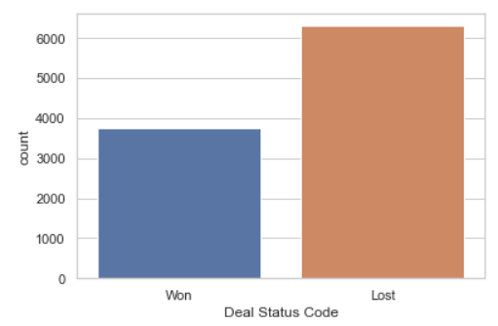
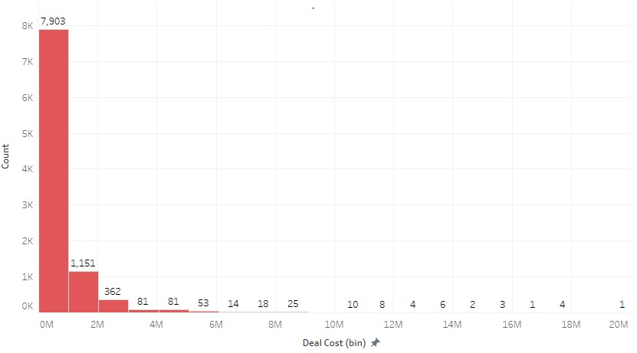
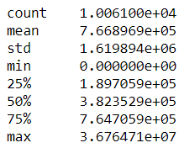
Deal Status Code
Deal Cost
From above chart, Won deal status is lesser than Lost deals status. Indicating data set is imbalance.
Deal Cost is right skewed , which indicates that company has taken part more in less value deal( up to 1 MUSD ). Minimum deal cost value is 0, which would need to be handled as missing values.

Slide 9
Handling of Missing Values
Missing values were present only in client category.
Total missing values: 79
All those missing values were of location: L10
We replaced those missing values with the modular value of client category at L10 that is “Others”.
Deal Cost had some zero values.
Total observation with zero deal cost: 245
Won deals: 4
Lost deals: 241
We replaced those deal cost with the median value of deal cost of lost deals
Duplicates Data :
Total duplicate data rows :- 14

Slide 10
Methodology
 | Approach 1 | Approach 2 | Approach 3 (Final)
Data Cleansing | Client Category Blanks replaced with "Others" Deal Cost 0 , replaced with median of deal cost | Client Category Blanks replaced with "Others" Deal Cost 0 , replaced with median of deal cost Internal Client Category Data Rows Removed | Client Category Blanks replaced with "Others" Deal Cost 0 , replaced with median of Lost deal cost Internal Client Category Data Rows Removed
Feature Engineering | All Categorical Variables replaced by Dummy Variables (One Hot Encoding) Data set split by 70:30 for Train and Test | Count Encoding (for VP Name and Manager) Applied target guided ordinal encoding to rest categorical feature Split - Data in year 2011 -17 (Train) , and rest 2018-19(Test) | Combined VP and Manager to create a ‘VP+Manager’ Variable Applied target guided ordinal encoding for each categorical feature Data set split by 80:20 for Train and test
Hyper parameter Tuning | Randomised search cross validation | Randomised search cross validation | Randomised search cross validation

Slide 11
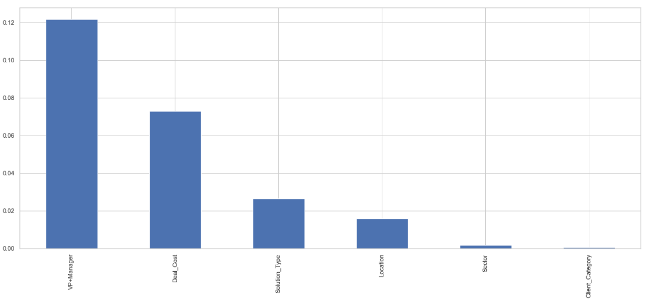
Methodology – Approach 3 in detail
Data Cleansing –
Client Category Blanks replaced with "Others"
Deal Cost 0 , replaced with median of Lost deal cost
Internal Client Category Data Rows Removed
Deal Date Column was removed
Feature Engineering –
Used Mutual Information Gain for feature Selection
We observed, combining VP and Manager in 1 variable (VP+Manager) gives us higher info gain
Applied target guided ordinal encoding for each categorical feature
Data set split by 80:20 for Train and test

Slide 12
Predictive Analysis
Comparing the Accuracy and Precision of the Models.
True Loss has been calculated as the Revenue Lost when a deal is predicted as a False Negative.
Model Name | Accuracy | Precision | True Loss (MUSD)
Logistic Regression | 0.75 | 0.74 | 2.213
Decision Tree | 0.84 | 0.84 | 1.359
XGBoost | 0.85 | 0.85 | 1.358
Random Forest | 0.84 | 0.86 | 1.431
From the above Model we can see, that accuracy, Precision lies around 85% for all models, except Logistic Regression.
We get the least true loss using XGBoost, and thus recommend the same.

Slide 13
Prescriptive Analysis
From the Dataset, we can observe that out of all the variables, only two can be controlled by the Organization, i.e. VP and Manager
Generally for Bids, VP and Manager combination will give us a better result, also seen from the predictive analytics.
Our Top 5 Recommendation of VP and Manager is based on the following :-
i) Win % (Calculated as Total Deals Won by Pair/ Total Number of Deal Done by Pair)
ii) Support (Calculated as Total Deals Won by Pair/ Total Number of Won Deals )
iii) Efficiency (win% * Support)
Our parameter for selecting the best combination is bases on Efficiency, to remove bias for Pairs who have done number of deals and poor win%, and Pairs who have done small number of deals and high win%
VP Name | Manager Name | Total Deals | Won Deals | %Win | Support | Efficiency
Long Bergstrom | Russell Dahlen | 92 | 64 | 69.565217 | 0.021369 | 1.486536
neeraj kumar | Vinay Kumar | 68 | 46 | 67.647059 | 0.015359 | 1.038987
Ekta Zutshi | neeraj kumar | 40 | 34 | 85 | 0.011352 | 0.964942
Rahul Bajpai | Rudraksh Sharma | 197 | 71 | 36.040609 | 0.023706 | 0.854385
Ekta Zutshi | Jean Sappington | 57 | 35 | 61.403509 | 0.011686 | 0.71757

Slide 14
Conclusion
Organization puts in a lot of effort in bidding preparation with no indications whether it will be worth it.
Using Data Analytics, we can Build a ML model to predict the probability of win/loss for bidding activities for a potential client. Which would help Identify variables that are most likely to help in converting an opportunity into a win.
From Our Analysis, we can say that VP and Manager combo has a significant influence on the probability of the deal win/loss, with slight significance from the Deal Cost and rest of the variables pose minimal significance.
Thus it is imperative for Organizations to staff VP and Managers with higher Efficiency to Deals which pose higher significance for the organization.
Using this model, the probability of win/loss for future deals can be predicted and best combination of VP and Manager can be assigned to increase the chances of converting the deal.

Slide 15
Further
The Organization can capture the Feedback behind a win or loss, this will enable to analyse the exact reason which the organization faces while dealing and enhance the major weak areas.
Specialized Managers can be assigned to work on particular Solution, enabling improved knowledge base of the

Slide 16
Thank You!

