Slide 1
PROJECT OVERVIEW
Global COVID-19
Historical reporting analysis | January 2020 to April 2021
Purpose
Examine how reported COVID-19 cases changed over time, how mortality differed across locations, and whether the source data support reliable comparisons.
THREE ANALYTICAL QUESTIONS
01
WHEN
02
WHERE
03
HOW RELIABLE
Monthly reported case changes
Deaths by continent and per 100K
Missing values, adjustments and coverage
SQL Server • Tableau • Historical OWID data • Snapshot: April 30, 2021

Slide 2
EXECUTIVE SNAPSHOT
COVID-19 reported burden at the cutoff
April 30, 2021 • 182 eligible locations
REPORTED CASES
REPORTED DEATHS
CASE FATALITY RATIO
151.40M
3.18M
2.10%
Source: Historical OWID data • January 2020 to April 2021

Slide 3
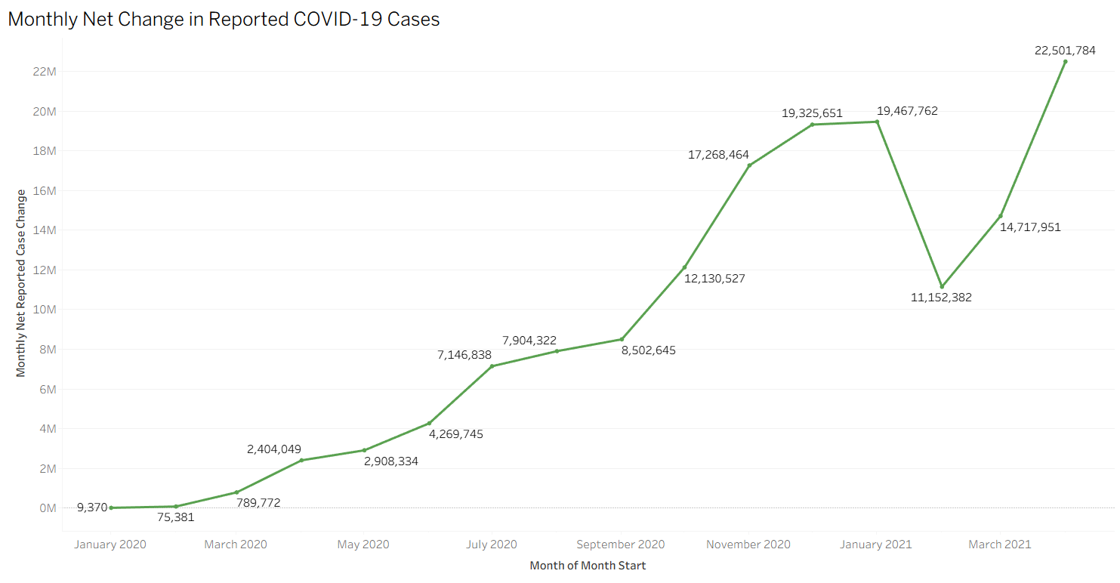
01 | TEMPORAL PERSPECTIVE
Reported cases over time
Monthly net change in reported COVID-19 cases • January 2020 to April 2021
What changed?
April 2021 recorded the highest monthly net change in the dataset: 22.50 million.
The series includes historical negative reporting adjustments. It describes changes in reported figures, not the actual dates of infection.
SOURCE | Historical OWID dataset via Alex The Analyst portfolio files
03 / 07

Slide 4
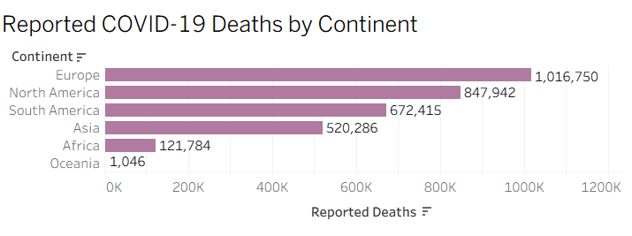
02 | GEOGRAPHIC BURDEN
Where were deaths concentrated?
Reported cumulative deaths by continent • April 30, 2021
What stands out?
Europe accounted for 1.02 million reported deaths, followed by North America (847,942) and South America (672,415).
These are absolute reported totals. They do not measure population-adjusted mortality.
SOURCE | Historical OWID dataset via Alex The Analyst portfolio files
04 / 07

Slide 5
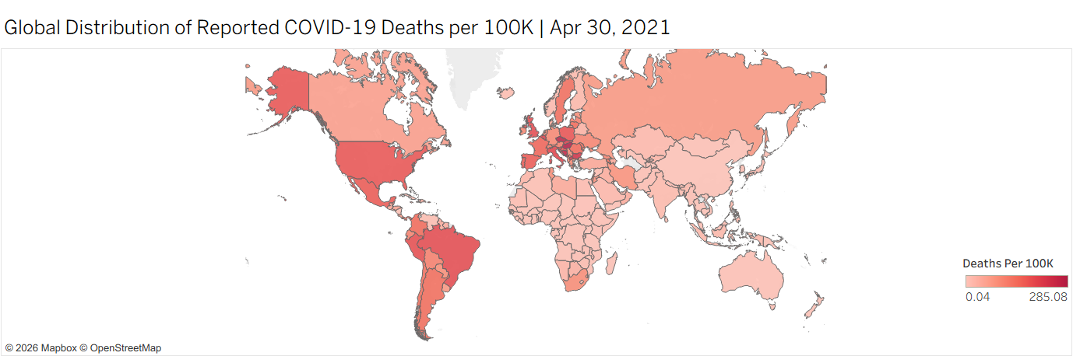
03 | POPULATION ADJUSTMENT
Geographic variation in reported mortality
Cumulative COVID-19 deaths per 100,000 residents • April 30, 2021
Why normalize?
A population-based rate helps compare locations of different sizes.
White or uncolored areas should not be interpreted as zero mortality. Reporting completeness and coverage vary.
SOURCE | Historical OWID dataset via Alex The Analyst portfolio files
05 / 07

Slide 6
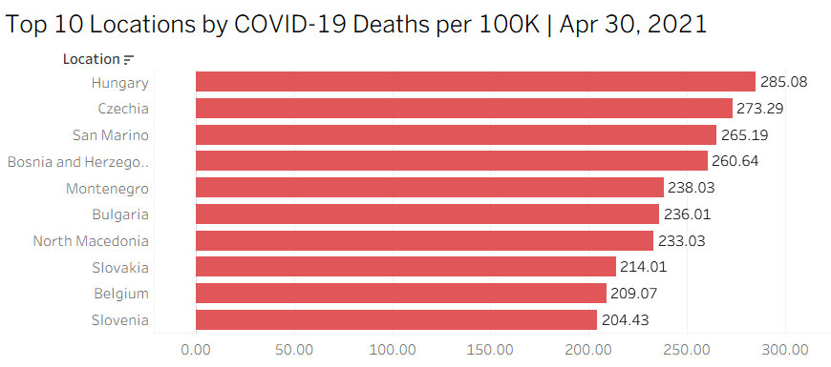
04 | LOCATION COMPARISON
Highest reported deaths per 100K
Top 10 eligible locations • April 30, 2021
What stands out?
Hungary (285.08), Czechia (273.29) and San Marino (265.19) led the eligible-location ranking.
The analysis used 182 locations with valid snapshot inputs out of 210 scoped locations.
SOURCE | Historical OWID dataset via Alex The Analyst portfolio files
06 / 07

Slide 7
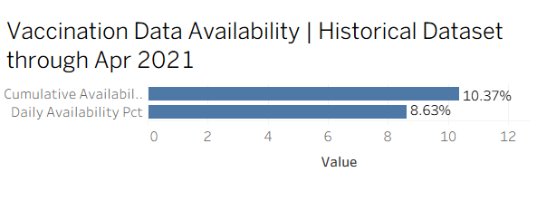
05 | REPORTING INTEGRITY
What can the data reliably support?
Vaccination field availability and implications for executive reporting
Data quality matters
Daily vaccination availability: 8.63%.
Cumulative vaccination availability: 10.37%.
Both are based on 81,060 location-date records. A rolling sum of sparse daily reports is not equivalent to a complete cumulative series.
Reporting recommendations
Publish cutoff dates and coverage. Keep absolute totals separate from population rates. Reconcile sparse vaccination data before reconstructing cumulative totals.
SOURCE | Historical OWID dataset via Alex The Analyst portfolio files
07 / 07

