Slide 1
Type 4 SST full-order differential-algebraic equations

Slide 2

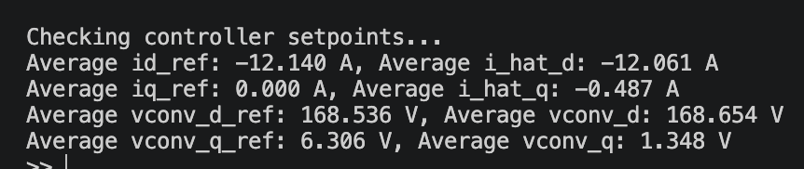
State | Value
id*
id_hat
vconv,d
vconv,q

Slide 3
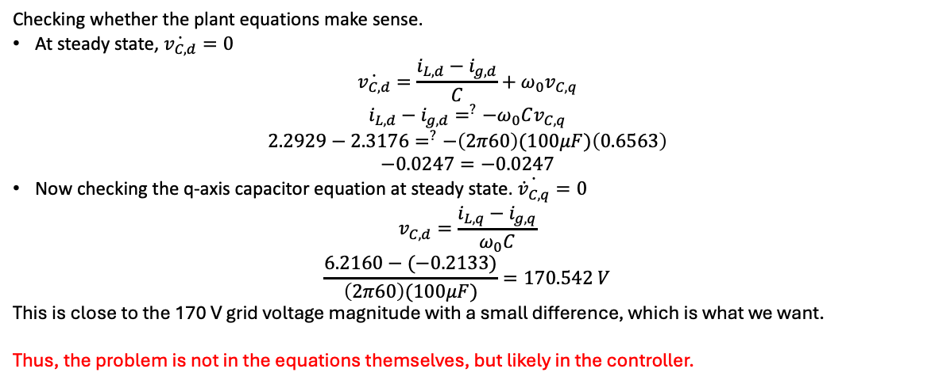
Rectifier – troubleshooting the grid-side state phase differences
Expectations
vg, ig must be about 180 degrees out of phase and igd<0, igq=~0
  I chose for the current going from the converter and the capacitor as positive. Meanwhile, the current direction for rectification is opposite of this to service the DC load.
  Since vg
iL must lead ig since iL = ig + iC
vg and vC must be almost equal. The small difference between the two is needed to drive current across the grid-side conductor
Observations
vg and ig are almost 180 degrees out of phase, with ig leading vg
ig > 0
iL lags ig
vg and vC are equal
From the check below, the plant equations hold when I use the script-generated average values.
State | Value
iLd | 2.2929
iLq | 6.2160
delta_iL | 69.7525
igd | 2.3176
igq | -0.2133
delta_ig | -5.2576
vCq | 0.6563
vCd
Checking whether the plant equations make sense.
At steady state, $\dot{v_{C,d}}=0$
$$\dot{v_{C,d}}=\frac{i_{L,d}−i_{g,d}}{C}+ω_{0}v_{C,q}$$
$$i_{L,d}−i_{g,d}=^{?}{−ω}_{0}Cv_{C,q}$$
$$2.2929−2.3176=^{?}−\left(2π60\right)(100μF)\left(0.6563\right)$$
$$−0.0247=−0.0247$$
Now checking the q-axis capacitor equation at steady state. $\dot{{\dot{v}}_{C,q}}=0$
$$v_{C,d}=\frac{i_{L,q}−i_{g,q}}{ω_{0}C}$$
$$\frac{6.2160−(−0.2133)}{\left(2π60\right)(100μF)}=170.542 V$$
This is close to the 170 V grid voltage magnitude with a small difference, which is what we want.
Thus, the problem is not in the equations themselves, but likely in the controller.

Slide 4
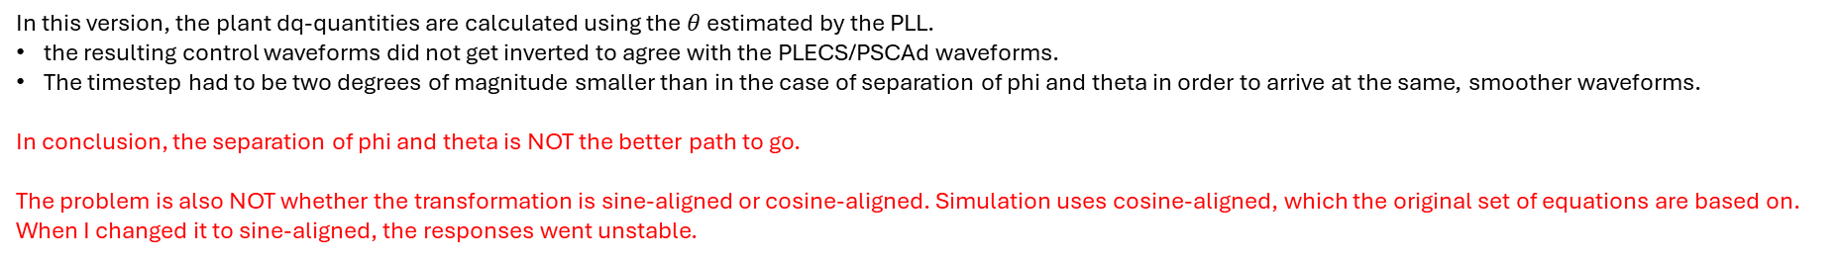
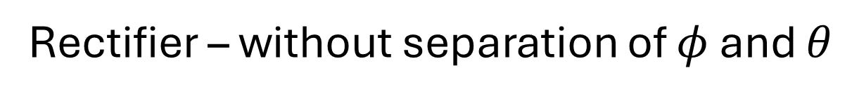
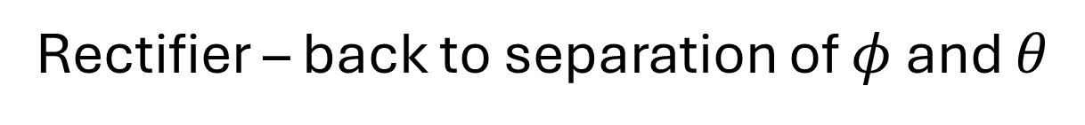
Rectifier – without separation of $φ$ and $θ$
In this version, the plant dq-quantities are calculated using the $θ$ estimated by the PLL.
the resulting control waveforms did not get inverted to agree with the PLECS/PSCAd waveforms.
The timestep had to be two degrees of magnitude smaller than in the case of separation of phi and theta in order to arrive at the same, smoother waveforms.
In conclusion, the separation of phi and theta is NOT the better path to go.
The problem is also NOT whether the transformation is sine-aligned or cosine-aligned. Simulation uses cosine-aligned, which the original set of equations are based on. When I changed it to sine-aligned, the responses went unstable.
Rectifier – back to separation of $φ$ and $θ$
In troubleshooting though, I observed that the the phase shifts between the grid-side states do not agree between simulations and the script.
Supposedly, the grid-side current and voltage are about 180 degrees out of phase, and while the convert-side current is leading the capacitor voltage.
In the script, the grid-side current is lagging the grid-side voltage, while the converter-side current is about 180 degrees out of phase with the capacitor voltage.

Slide 5
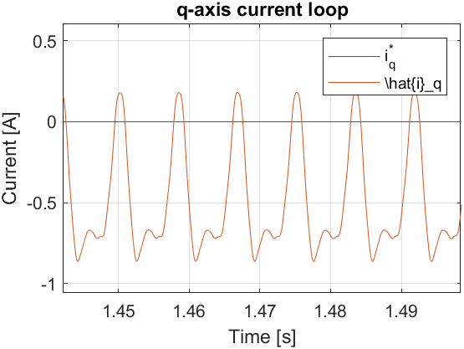
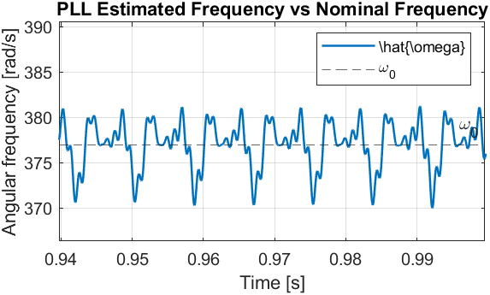
Rectifier - controller
While the DC output settled around the setpoint and the grid-side current and voltage look fine @ MATLAB script, there must be something wrong in the controller, likely in the transformations. This is marked by the reflection of MATLAB script waveforms along the horizontal axis around their respective setpoints, and of the jittery PLL frequency even when dt=1us in the script.
PSCAD (dt = 30us)

Slide 6
Rectifier – grid side
There are discrepancies between the MATLAB script (dt=1e-6s, max 1e-4s) and PLECS waveforms. PLECS and PSCAD (dt = 30us) waveforms are more similar to each other, but not exactly.

Slide 7
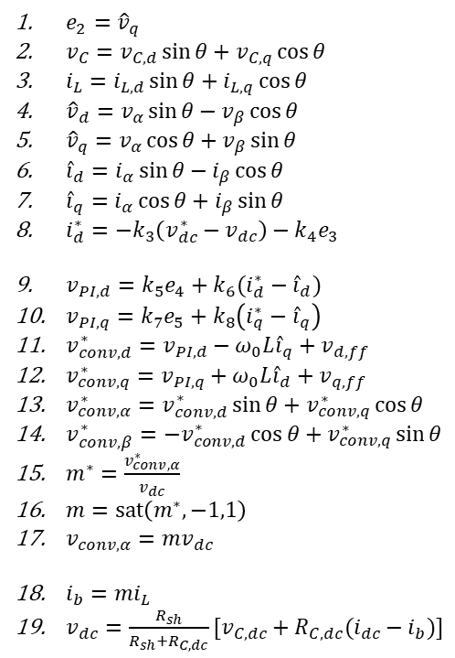
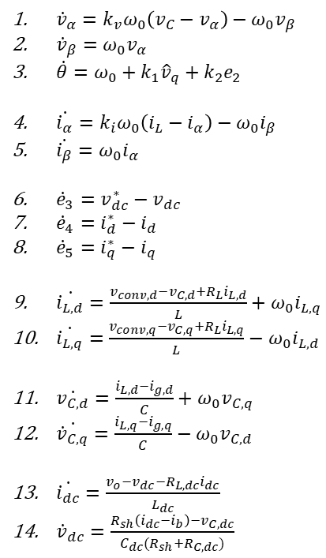
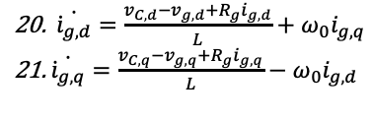
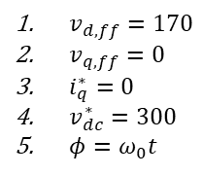
Rectifier
${\dot{v}}_{α}=k_{v}ω_{0}\left(v_{C}−v_{α}\right)−ω_{0}v_{β}$
${\dot{v}}_{β}=ω_{0}v_{α}$
$\dot{θ}=ω_{0}+k_{1}{\hat{v}}_{q}+k_{2}e_{2}$
$\dot{{\dot{i}}_{α}}=k_{i}ω_{0}\left(i_{L}−i_{α}\right)−ω_{0}i_{β}$
$\dot{{\dot{i}}_{β}}=ω_{0}i_{α}$
${\dot{e}}_{3}=v_{dc}^{∗}−v_{dc}$
${\dot{e}}_{4}=i_{d}^{∗}−i_{d}$
${\dot{e}}_{5}=i_{q}^{∗}−i_{q}$
$\dot{{\dot{i}}_{L,d}}=\frac{v_{conv,d}−v_{C,d}+R_{L}i_{L,d}}{L}+ω_{0}i_{L,q}$
$\dot{{\dot{i}}_{L,q}}=\frac{v_{conv,q}−v_{C,q}+R_{L}i_{L,q}}{L}−ω_{0}i_{L,d}$
$\dot{v_{C,d}}=\frac{i_{L,d}−i_{g,d}}{C}+ω_{0}v_{C,q}$
$\dot{{\dot{v}}_{C,q}}=\frac{i_{L,q}−i_{g,q}}{C}−ω_{0}v_{C,d}$
$\dot{{\dot{i}}_{dc}}=\frac{v_{o}−v_{dc}−R_{L,dc}i_{dc}}{L_{dc}}$
${\dot{v}}_{dc}=\frac{R_{sh}\left(i_{dc}−i_{b}\right)−v_{C,dc}}{C_{dc}(R_{sh}+R_{C,dc})}$
$e_{2}={\hat{v}}_{q}$
$v_{C}=v_{C,d}\sin{θ}+v_{C,q}\cos{θ}$
$i_{L}=i_{L,d}\sin{θ}+i_{L,q}\cos{θ}$
${\hat{v}}_{d}=v_{α}\sin{θ}−v_{β}\cos{θ}$
${\hat{v}}_{q}=v_{α}\cos{θ}+v_{β}\sin{θ}$
${\hat{i}}_{d}=i_{α}\sin{θ}−i_{β}\cos{θ}$
${\hat{i}}_{q}=i_{α}\cos{θ}+i_{β}\sin{θ}$
$i_{d}^{∗}=−k_{3}\left(v_{dc}^{∗}−v_{dc}\right)−k_{4}e_{3}$
$v_{PI,d}=k_{5}e_{4}+k_{6}(i_{d}^{∗}−{\hat{i}}_{d})$
$v_{PI,q}=k_{7}e_{5}+k_{8}\left(i_{q}^{∗}−{\hat{i}}_{q}\right)$
$v_{conv,d}^{∗}=v_{PI,d}−ω_{0}L{\hat{i}}_{q}+v_{d,ff}$
$v_{conv,q}^{∗}=v_{PI,q}+ω_{0}L{\hat{i}}_{d}+v_{q,ff}$
$v_{conv,α}^{∗}=v_{conv,d}^{∗}\sin{θ}+v_{conv,q}^{∗}\cos{θ}$
$v_{conv,β}^{∗}=−v_{conv,d}^{∗}\cos{θ}+v_{conv,q}^{∗}\sin{θ}$
$m^{∗}=\frac{v_{conv,α}^{∗}}{v_{dc}}$
$m=sat\left(m^{∗},−1,1\right)$
$v_{conv,α}=mv_{dc}$
$i_{b}=mi_{L}$
$v_{dc}=\frac{R_{sh}}{R_{sh}+R_{C,dc}}[v_{C,dc}+R_{C,dc}(i_{dc}−i_{b})]$
$v_{d,ff}=170$
$v_{q,ff}=0$
$i_{q}^{∗}=0$
$v_{dc}^{∗}=300$
$φ=ω_{0}t$
$\dot{{\dot{i}}_{g,d}}=\frac{v_{C,d}−v_{g,d}+R_{g}i_{g,d}}{L}+ω_{0}i_{g,q}$
$\dot{{\dot{i}}_{g,q}}=\frac{v_{C,q}−v_{g,q}+R_{g}i_{g,q}}{L}−ω_{0}i_{g,d}$
In this version1, the plant and the controller have different frame angles. $φ$ is the grid angle independent of the PLL; the PLL must track this angle. The PLL estimates $φ$ with $θ$. The plant and controller quantities, then, have different dq transformations. The controller uses the hatted dq values; any plant ab-quantity is rotated by $θ$ first before it is used further in the control.
This version also use virtual damping through the gain $K_{ad}$. When set to 0, there is no virtual damping, as in the simulations.

Slide 8
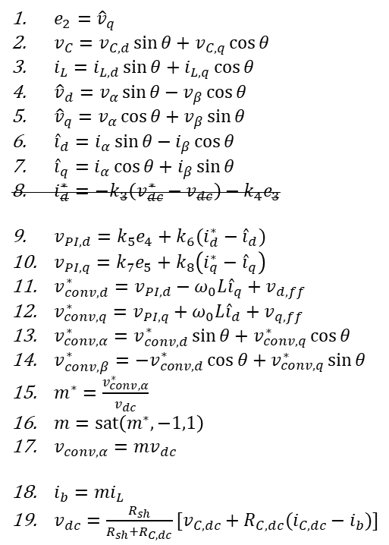
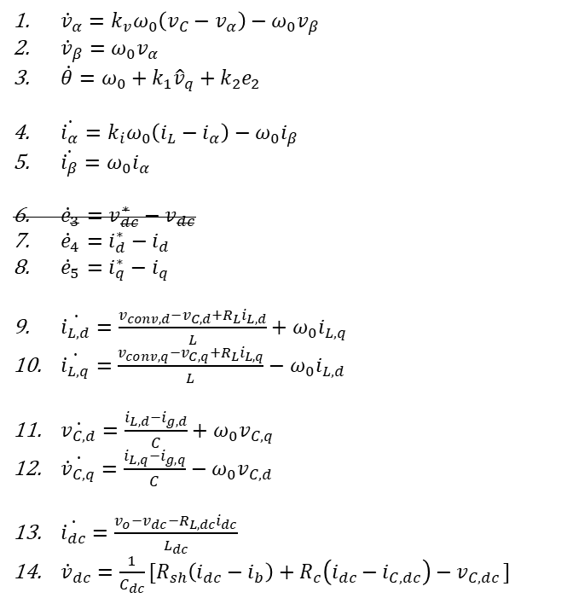
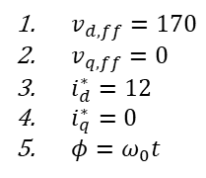
Inverter
${\dot{v}}_{α}=k_{v}ω_{0}\left(v_{C}−v_{α}\right)−ω_{0}v_{β}$
${\dot{v}}_{β}=ω_{0}v_{α}$
$\dot{θ}=ω_{0}+k_{1}{\hat{v}}_{q}+k_{2}e_{2}$
$\dot{{\dot{i}}_{α}}=k_{i}ω_{0}\left(i_{L}−i_{α}\right)−ω_{0}i_{β}$
$\dot{{\dot{i}}_{β}}=ω_{0}i_{α}$
${\dot{e}}_{3}=v_{dc}^{∗}−v_{dc}$
${\dot{e}}_{4}=i_{d}^{∗}−i_{d}$
${\dot{e}}_{5}=i_{q}^{∗}−i_{q}$
$\dot{{\dot{i}}_{L,d}}=\frac{v_{conv,d}−v_{C,d}+R_{L}i_{L,d}}{L}+ω_{0}i_{L,q}$
$\dot{{\dot{i}}_{L,q}}=\frac{v_{conv,q}−v_{C,q}+R_{L}i_{L,q}}{L}−ω_{0}i_{L,d}$
$\dot{v_{C,d}}=\frac{i_{L,d}−i_{g,d}}{C}+ω_{0}v_{C,q}$
$\dot{{\dot{v}}_{C,q}}=\frac{i_{L,q}−i_{g,q}}{C}−ω_{0}v_{C,d}$
$\dot{{\dot{i}}_{dc}}=\frac{v_{o}−v_{dc}−R_{L,dc}i_{dc}}{L_{dc}}$
${\dot{v}}_{dc}=\frac{1}{C_{dc}}[R_{sh}\left(i_{dc}−i_{b}\right)+R_{c}\left(i_{dc}−i_{C,dc}\right)−v_{C,dc }]$
$e_{2}={\hat{v}}_{q}$
$v_{C}=v_{C,d}\sin{θ}+v_{C,q}\cos{θ}$
$i_{L}=i_{L,d}\sin{θ}+i_{L,q}\cos{θ}$
${\hat{v}}_{d}=v_{α}\sin{θ}−v_{β}\cos{θ}$
${\hat{v}}_{q}=v_{α}\cos{θ}+v_{β}\sin{θ}$
${\hat{i}}_{d}=i_{α}\sin{θ}−i_{β}\cos{θ}$
${\hat{i}}_{q}=i_{α}\cos{θ}+i_{β}\sin{θ}$
$i_{d}^{∗}=−k_{3}\left(v_{dc}^{∗}−v_{dc}\right)−k_{4}e_{3}$
$v_{PI,d}=k_{5}e_{4}+k_{6}(i_{d}^{∗}−{\hat{i}}_{d})$
$v_{PI,q}=k_{7}e_{5}+k_{8}\left(i_{q}^{∗}−{\hat{i}}_{q}\right)$
$v_{conv,d}^{∗}=v_{PI,d}−ω_{0}L{\hat{i}}_{q}+v_{d,ff}$
$v_{conv,q}^{∗}=v_{PI,q}+ω_{0}L{\hat{i}}_{d}+v_{q,ff}$
$v_{conv,α}^{∗}=v_{conv,d}^{∗}\sin{θ}+v_{conv,q}^{∗}\cos{θ}$
$v_{conv,β}^{∗}=−v_{conv,d}^{∗}\cos{θ}+v_{conv,q}^{∗}\sin{θ}$
$m^{∗}=\frac{v_{conv,α}^{∗}}{v_{dc}}$
$m=sat\left(m^{∗},−1,1\right)$
$v_{conv,α}=mv_{dc}$
$i_{b}=mi_{L}$
$v_{dc}=\frac{R_{sh}}{R_{sh}+R_{C,dc}}[v_{C,dc}+R_{C,dc}(i_{C,dc}−i_{b})]$
$v_{d,ff}=170$
$v_{q,ff}=0$
$i_{d}^{∗}=12$
$i_{q}^{∗}=0$
$φ=ω_{0}t$

