Slide 1
Introduction to Object Oriented Programming (OOP)

Slide 2
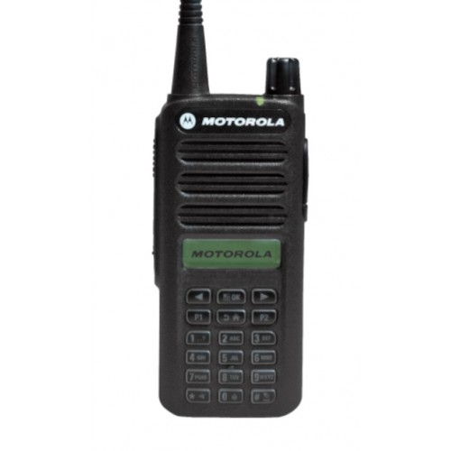
Motivating example
Imagine if you are a secret agent...
And you and your friend must talk over a radio phone
But your radio phone has no sound, only numpad:

Slide 3
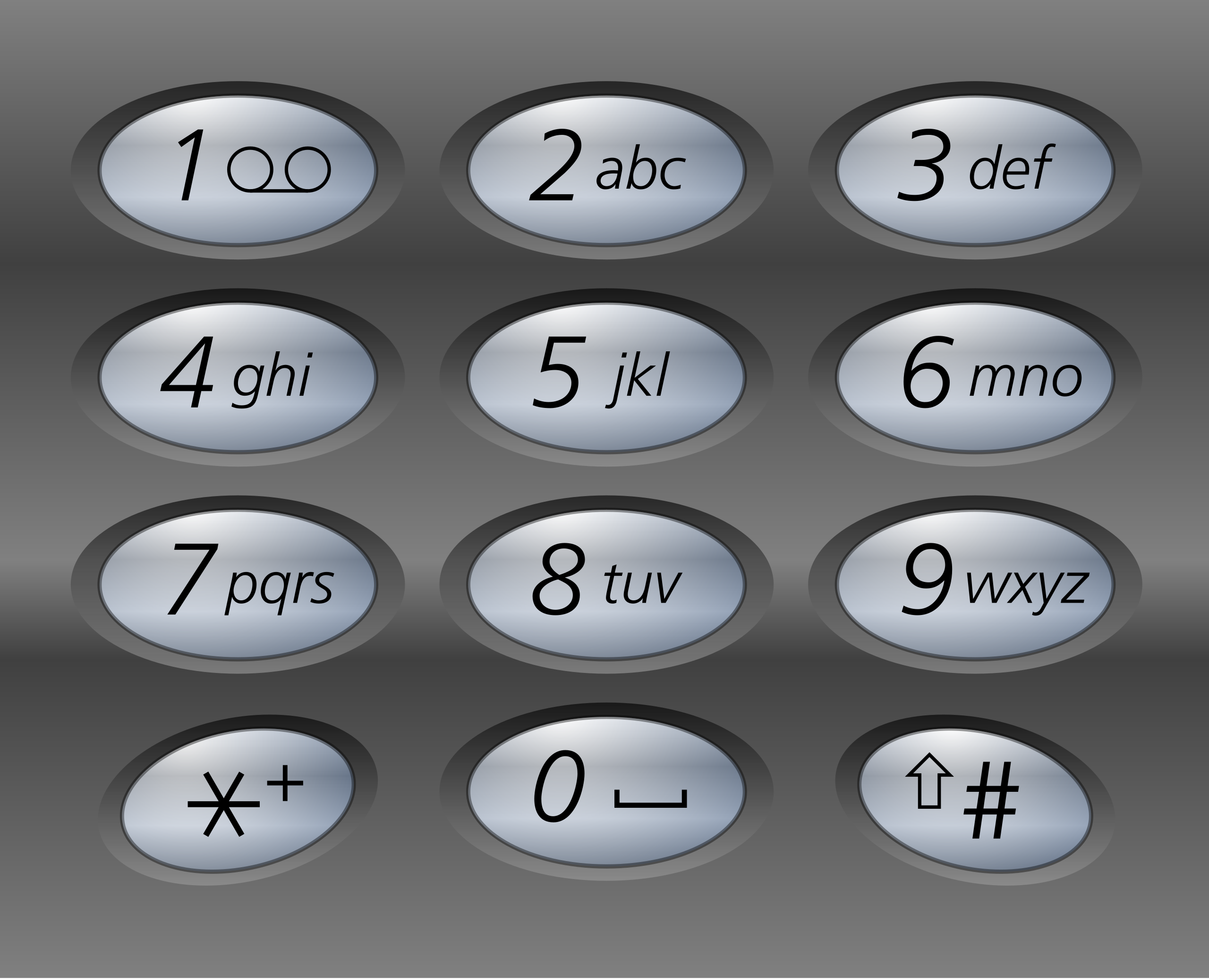
Motivating example
Imagine if you are a secret agent...

Slide 4
Motivating example
Imagine if you are a secret agent...

Slide 5
Motivating example
Imagine if you are a secret agent...

Slide 6
Motivating example
Imagine if you are a secret agent...
12543
12543

Slide 7
How do we communicate with each other?

Slide 8
Unique
Have a unique code for each letter
A | 01
B | 02
C | 03
... | ...
Z | 26

Slide 9
So we can now communicate text...
Using just numbers!

Slide 10
More complex messages
Have a unique code for each symbol
A | 01
B | 02
C | 03
... | ...
Z | 26
08 05 12 12 15
0805121215
H E L L O

Slide 11
More complex messages
Have a unique code for each symbol
A | 01
B | 02
C | 03
... | ...
Z | 26
...
space | 27
, | 28
. | 29
\n | 30
08 05 12 12 15 28 27 23 15 18 12 04 29
08051212152
82723151812
0429
H E L L O , W O R L D .

Slide 12
So we can now communicate text...
Using just numbers!

Slide 13

Data structures
Name: Bob
Age: 25

Slide 14
Data structures
Name: Bob
Age: 25
Format:
PERSON\n
BOB\n
25\n

Slide 15
More complex messages
Have a unique code for each symbol
A | 01
B | 02
C | 03
... | ...
Z | 26
...
space | 27
, | 28
. | 29
\n | 30
PERSON
BOB
25
PERSON
BOB
25
Name: BOB
Age: 25

Slide 16
More complex messages
Digits
034621...
Text
“HELLO, WORLD!”
People
Name: BOB
Age: 25

Slide 17
How memory works
... | 0 | 1 | 0 | 0 | 1 | 0 | 0 | 0 | 0 | 1 | 1 | 1 | ...

Slide 18
How memory works
... | 0 | 1 | 0 | 0 | 1 | 0 | 0 | 0 | 0 | 1 | 1 | 1 | ...

Slide 19
How memory works
... | 0 | 1 | 0 | 0 | 1 | 0 | 0 | 0 | 0 | 1 | 1 | 1 | ...
... | 72 | ...
...

Slide 20
How memory works
... | 0 | 1 | 0 | 0 | 1 | 0 | 0 | 0 | 0 | 1 | 1 | 1 | ...
... | 72 | ...
...
... | ‘H’ | ...

Slide 21
How memory works
... | 0 | 1 | 0 | 0 | 1 | 0 | 0 | 0 | 0 | 1 | 1 | 1 | ...
... | 72 | ...
...
... | ‘H’ | ...
... | ‘H’ | ‘e’ | ‘l’ | ‘l’ | ‘o’ | ‘,’ | ‘w’ | ‘o’ | ‘r’ | ‘l’ | ‘d’ | \0 | ...

Slide 22
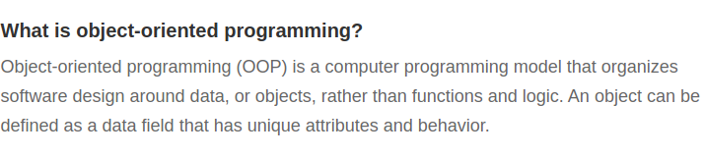
What is OOP?

Slide 23
What is OOP?
So far:
  A program is a sequence of operations
  We can group sequences of operations into functions
  A function is an operation
Now also:
  Operations are performed on data
  Data is typed (and structured)
  Just like functions, simple data organized -> complex data
    String and int -> Person

Slide 24
What is an object?
An object is a piece of structured data
Which can perform actions (interact)
  Person has
    Name
    age
  Person can:
    Say hello
    Introduce themselves
    Change their name
    Etc..

Slide 25
What is a class?
A class is a prototype for an object
Basically, a custom data type
Contains:
  Data representation
  List of actions, an object can perform

Slide 26

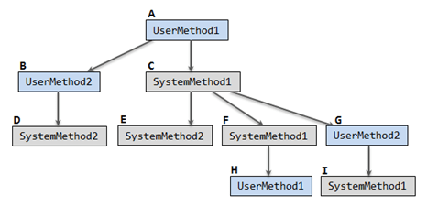


Functional vs Object Oriented
Object oriented programming
Functional programming

Slide 27
Example

Slide 28
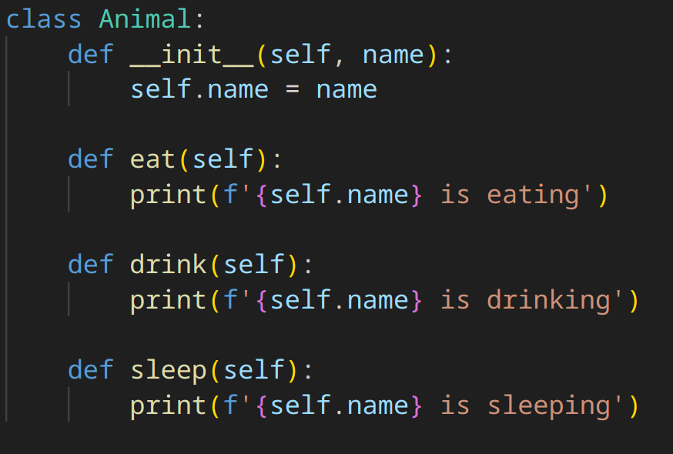
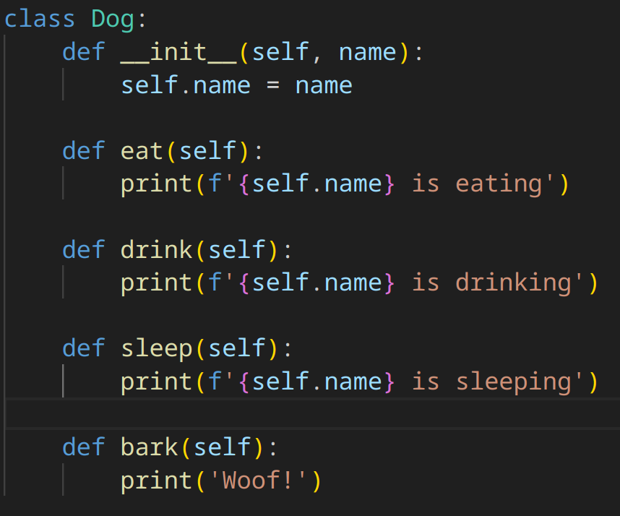
Inheritance
What is a datatype IS also another datatype:
  Ex: Cat IS an Animal
  Square IS a Shape

Slide 29
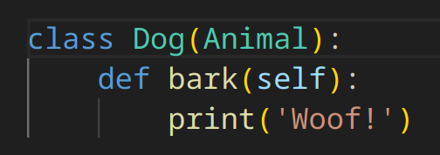
Inheritance
What is a datatype IS also another datatype:
  Ex: Cat IS an Animal
  Square IS a Shape

Slide 30
Inheritance
Technically: copy everything from Animal to Dog
Logically: Dog IS an Animal, and can do anything an Animal can

