Slide 1
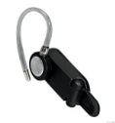
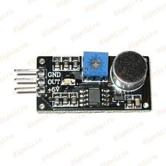

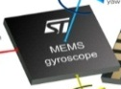

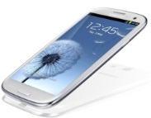
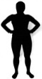
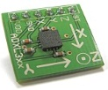
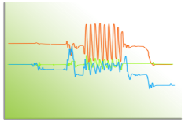



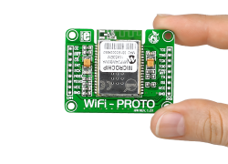
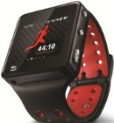
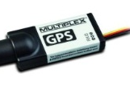

Human Activity Recognition using Mobile Devices - A Mini Survey
Lin Hao
HAR
Engine

Slide 2
Outline
HAR Classification
HAR Architecture
  Activity Model
  Feature Selection/Extraction
  Classification Algorithm
Miscellaneous
  HAR Implementation
  HAR Dataset (Design)
Ideas & Preparations

Slide 3
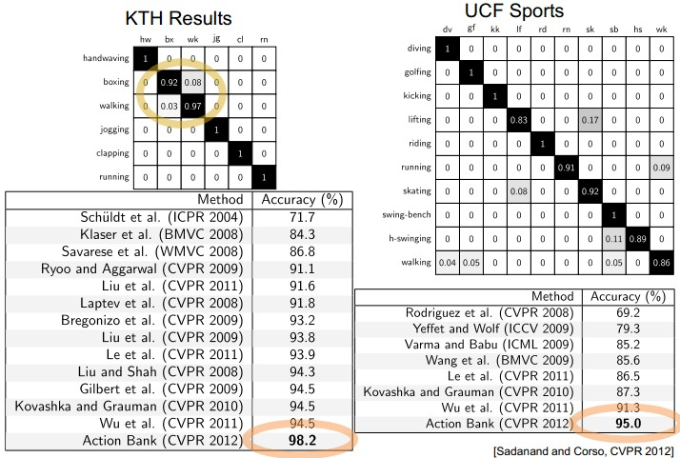
Computer Vision vs. Mobile Devices
A tutorial on CVPR 2011 and some works on HAR using CV (http://cvrc.ece.utexas.edu/mryoo/cvpr2011tutorial/)
Notes:
http://en.wikipedia.org/wiki/Activity_recognition is a good material
图片摘自：http://www.myexception.cn/software/743665.html
更多信息可参看：http://www.cse.buffalo.edu/~jcorso/r/actionbank/

Slide 4
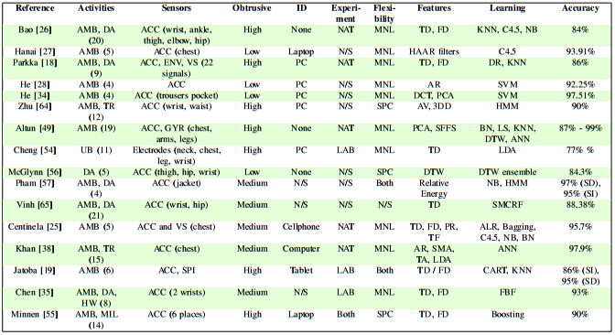
Computer Vision vs. Mobile Devices
A survey on human activity recognition using wearable sensors [Lara and Labrador, 2013]
Notes:
3DD 3D Deviation of the acceleration signals
ACC Accelerometers
AMB Ambulation activities (see Table I)
ANN Artificial Neural Network
ALR Additive Logistic Regression classifier
AR Autoregressive Model Coefficients
AV Angular velocity
BN Bayesian Network Classifier
CART Classification And Regression Tree
DA Daily activities (see Table I)
DCT Discrete Cosine Transform
DT Decision Tree-Based Classifier
DTW Dynamic Time Warping
ENV Environmental sensors
FBF Fuzzy Basis Function
FD Frequency-domain features
GYR Gyroscope
HMM Hidden Markov Models
HRB Heart Rate Beats above the resting heart rate
HRM Heart Rate Monitor
HW Housework activities (see Table I)
KNN k-Nearest Neighbors classifier
LAB Laboratory controlled experiment
LDA Linear Discriminant Analysis
LS Least Squares algorithm
MIL Military activities
MNL Monolithic classifier (subject independent)
NAT Naturalistic experiment
NB The Na¨ ?ve Bayes classifier
NDDF Normal Density Discriminant Function
N/S Not Specified
PCA Principal Component Analysis
PHO Activities related to phone usage (see Table I)
PR Polynomial Regression
RFIS Recurrent Fuzzy Inference System
SD Subject Dependent evaluation
SFFS Sequential Forward Feature Selection
SI Subject Independent evaluation
SMA Signal Magnitude Area
SMCRF Semi-Markovian Conditional Random Field
SPC User-specific classifier (subject dependent)
SPI Spiroergometry
TA Tilt Angle
TD Time-domain features
TF Transient Features [25]
TR Transitions between activities
UB Upper body activities (see Table I)
VS Vital sign sensors

Slide 5
Outline
HAR Classification
HAR Architecture
  Activity Model
  Feature Selection/Extraction
  Classification Algorithm
Miscellaneous
  HAR Implementation
  HAR Dataset (Design)
Ideas & Preparations

Slide 6


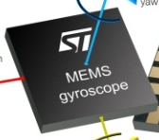

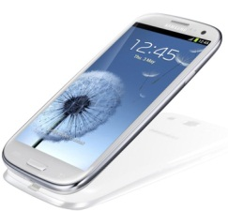
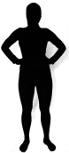
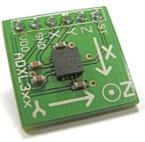
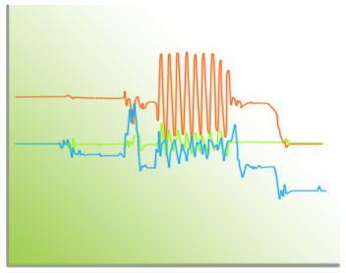
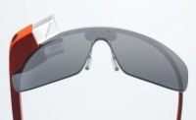



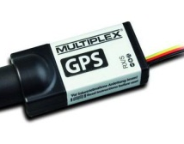

HAR Architecture
  Activity
  Model
  Feature
  Selection
  &
  Feature
  Extraction
Raw
Signals
  Classification
  Algorithm
HAR
Engine
Mobile
Devices
Sensors
Activities

Slide 7
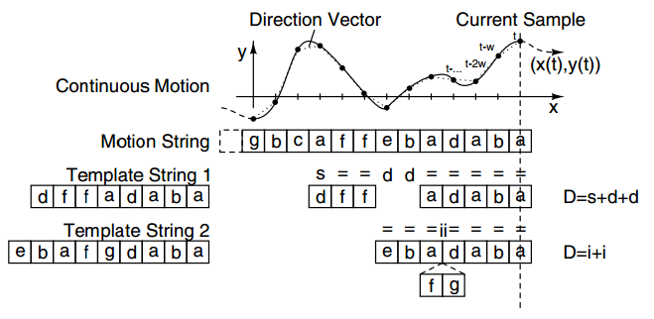
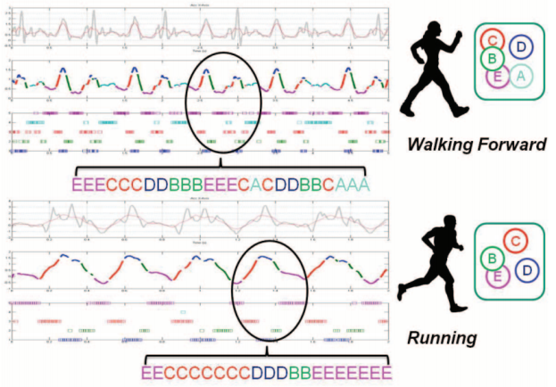
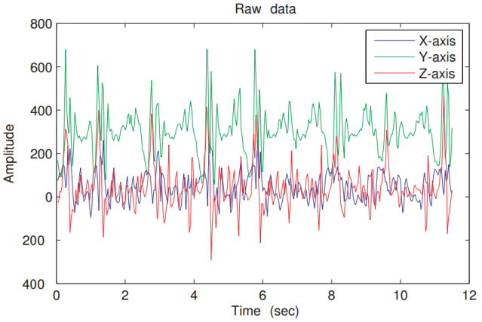
Activity Model
Using Motion String to represent continuous signal, and using string matching to do recognization [Stiefmeier et al., 2007]
Bag-of-Features (BoF), which builds activity models using histograms of primitive symbols [Zhang and Sawchuk, 2012a]
Sliding Window, A lot of papers are based on Sliding Window [Dernbach et al., 2012; Kose et al., 2012; Maguire and Frisby,2009; Gyorbiro et al., 2009; Sun et al., 2010; Ward et al., 2006]
Duration Model, build accurate activity models in the home and detecting abnormality [Duong et al., 2005, 2009]
HMM & CRF, handle temporal dependence of HAR [Pober et al., 2006; Han et al., 2010; Van Kasteren et al.,2008; Hao Hu et al., 2008]
Motion String
Bag-of-Features
Sliding Window
Notes:
The following topic is based on sliding window

Slide 8

Feature Selection/Extraction
Feature selection : Selecting the most relevant attributes
Feature extraction : Combining attributes into a new reduced set of features
1 tBodyAcc-mean()-X
2 tBodyAcc-mean()-Y
3 tBodyAcc-mean()-Z
…
559 angle(X,gravityMean)
560 angle(Y,gravityMean)
561 angle(Z,gravityMean)
Feature Vector generated in one sliding window, used by UCI HAR dataset [Anguita et al., 2012]
Using PCA in Weka to do feature extraction : I get 102 features
Notes:
Why 102 is because the class label is also a attribute

Slide 9
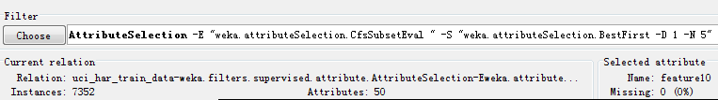
Feature Selection/Extraction
Following are some papers who use or research feature selection/ extraction in HAR
  [Maurer et al., 2006] : CFS (Correlation based Feature Selection)
  [Lester et al., 2005] : AdaBoost
  [Plötz et al., 2011, IJCAI] : PCA and auto-encoder based deep learning
I also have a test of CFS in Weka, and get 49 features
The problem is : how to select and improve the feature selection/extraction algorithm ?

Slide 10
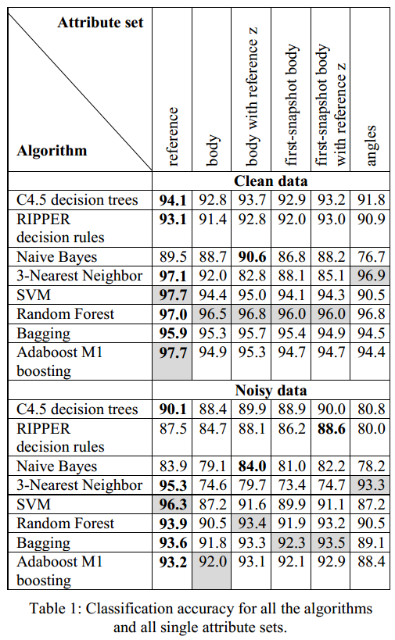
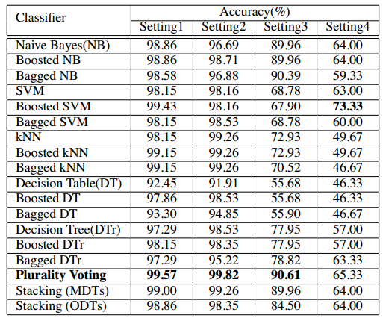
Classification Algorithm
Many people do many works on the classification algorithms.
[Lustrek and Kaluza, 2009]
[Ravi et al., 2005]

Slide 11
Outline
HAR Classification
HAR Architecture
  Activity Model
  Feature Selection/Extraction
  Classification Algorithm
Miscellaneous
  HAR Implementation
  HAR Dataset (Design)
Ideas & Preparations

Slide 12
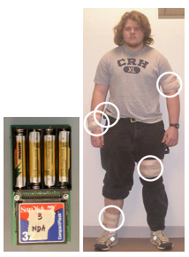
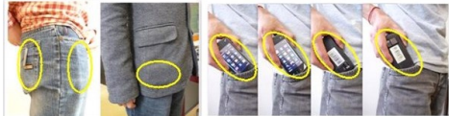
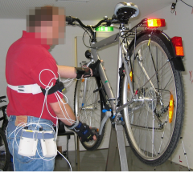
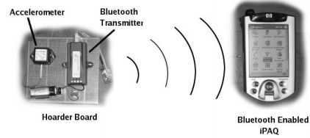
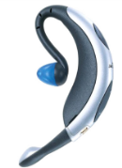
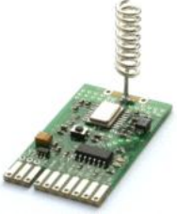
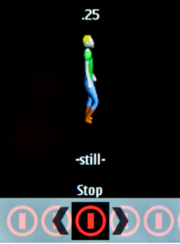
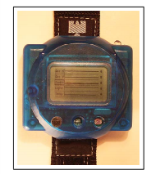
Misc. - HAR Implementation
[Sun et al., 2010]
[Bao and Intille, 2004]
[Stiefmeier et al., 2007]
[Ravi et al., 2005]
[Van Kasteren et al., 2008]
[Brezmes et al., 2009]
[Maurer et al., 2006]

Slide 13
Misc. - HAR Dataset (Design)
1. UCI-HAR-Dataset
https://github.com/tdomhan/smartphone-activity-recognition/tree/master/UCI%20HAR%20Dataset
[Anguita et al., 2012]
2.USC-HAD Dataset :
http://sipi.usc.edu/HAD/
3.MIT PlaceLab Dataset :
http://architecture.mit.edu/house_n/data/PlaceLab/PlaceLab.htm
4.UC Berkeley WARD Dataset :
http://www.eecs.berkeley.edu/~yang/software/WAR/
5.CMU Multi-Modal Activity Database (CMU-MMAC) :
http://kitchen.cs.cmu.edu/
6.OPPORTUNITY Dataset :
http://archive.ics.uci.edu/ml/datasets/OPPORTUNITY+Activity+Recognition
[Zhang and Sawchuk, 2012b]

Slide 14
Outline
HAR Classification
HAR Architecture
  Activity Model
  Feature Selection/Extraction
  Classification Algorithm
Miscellaneous
  HAR Implementation
  HAR Dataset (Design)
Ideas & Preparations

Slide 15
Ideas
Cross field knowledge migration
  HMM/CRF : speech recognition, natural language process, compute vision -> activity recognition
Online feature selection algorithm
  Different activity may use different features to approve recognition accuracy
C4.5 fixed point implementation
  An idea from wockets project , maybe we can do
Step counting using smart watch
  Although there are some step counter watchs selling on alibaba, but maybe we can improve the algorithm

Slide 16
Preparations
Having Weka arff file transformed from UCI-HAR-Dataset
Having an android program which can collect sensor data
Having an android program which can recognize 3 activities (walking, running, standing)
Natural Language Toolkit (written in python) which has implemented HMM and CRF
And CRF++ (written in c++) which has implemented CRF
Found lots of pedometer(step counting) program at github

Slide 17
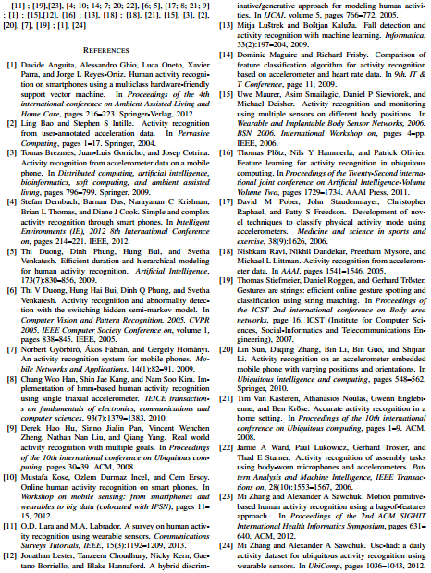

References

