Slide 1
Compiler programming hw2
411121307 葉宸君

Slide 2
Problem 1 description
Giving the following facts, find the relationship between any two person.
Using language: Java, ML, Prolog.

Slide 3
Java
Initialize:
Initialize two sets to separate male and female.
Using map to save the spouses. Should be initialize in pair.
Initialize the children that every parents have.
Use ‘scanner’ to read the user input.
Relation check:
If a and b have the same parents, they are siblings.
If a and b are siblings, and a and b are both male, they are brothers.
If a and b are siblings, and a and b are both female, they are sisters.
If a and b’s parents are siblings, they are cousins.

Slide 4
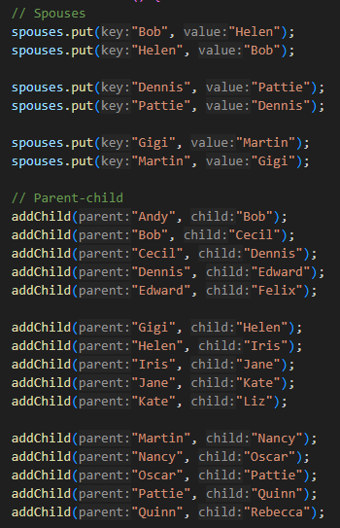
Java program listing
Initialize
Building relations in map

Slide 5
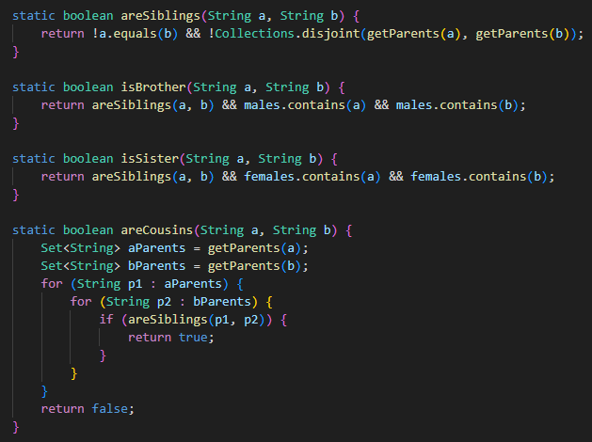
Java program listing cont.
Check relation whether exist

Slide 6
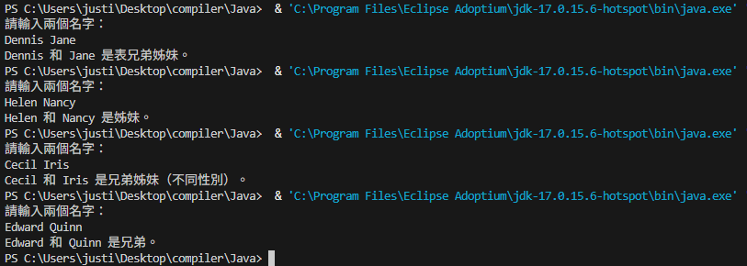
Java test run results

Slide 7
ML
Initialize relationship.
Define a function that returns the children’s parents.
Siblings check:
Find the children’s parents first.
List all the child the parents have.
Check every children whether have the same name as the input.
If yes, return true for siblings.
Cousin check:
Find input child’s parents first.
Find the parents’ siblings.
Find the siblings’ children.
These are the input child’s cousins.

Slide 8
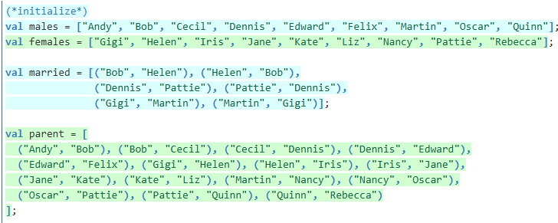
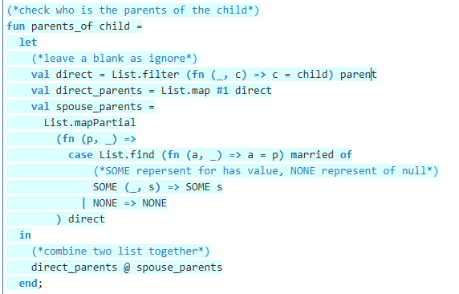
ML program listing
Initialize relationship
Find parents

Slide 9
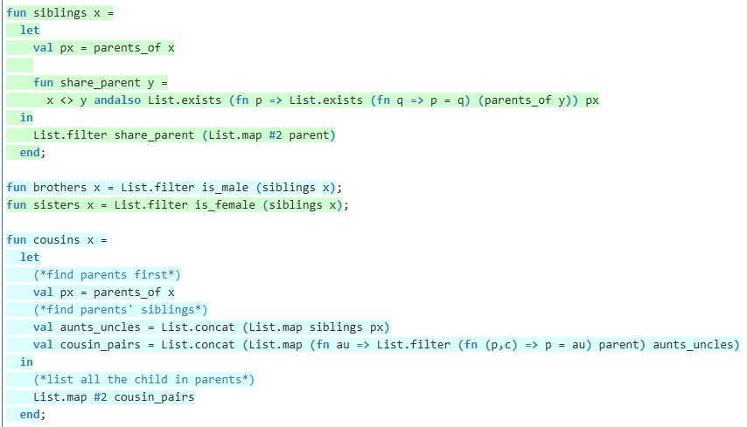
ML program listing cont.
Check relationship

Slide 10
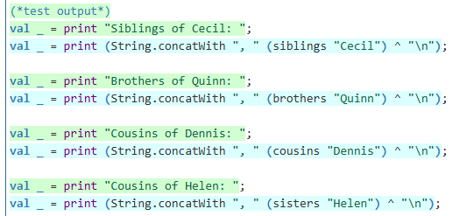
ML program listing cont.
Output test cases

Slide 11
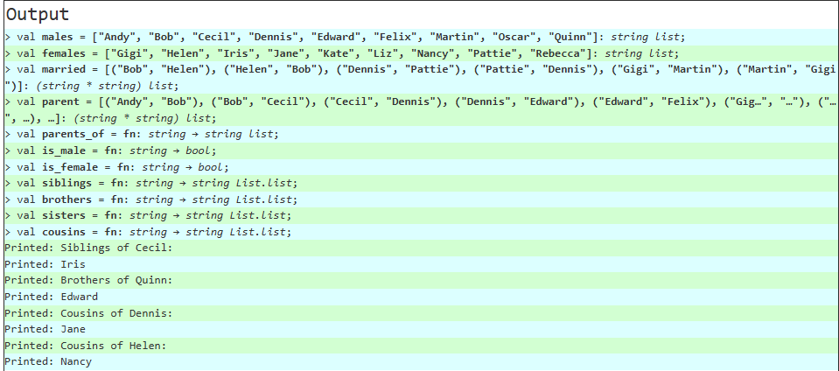
ML test run results

Slide 12
Prolog
Initialize relationship:
Gender using fact (Set).
Marriage and direct_parent using relation (HashMap).
Parent using rule.
Relation check:
if x and y have same parents, and x != y, they are siblings.
if x and y are siblings, and both x and y are male, they are brothers.
if x and y are siblings, and both x and y are female, they are sisters.
if y's parent w and z' parent x are siblings, then z and y are cousins.

Slide 13
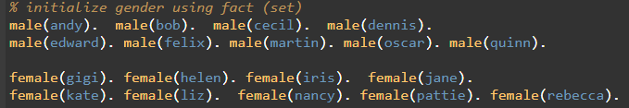

Prolog program listing
Initialize gender
Initialize marriage

Slide 14
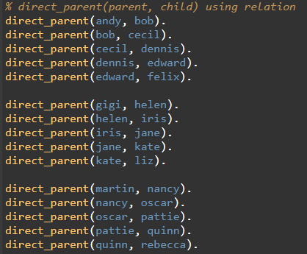

Prolog program listing cont.
Initialize direct parents
Building complete parents relation

Slide 15
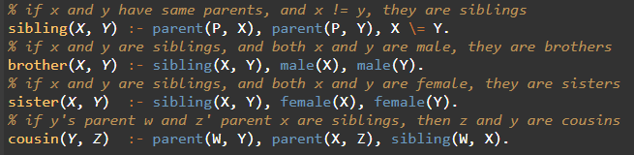
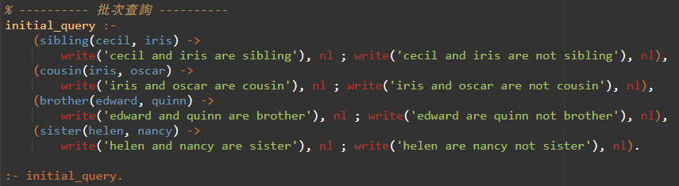
Prolog program listing cont.
Check relationship
Input test cases

Slide 16
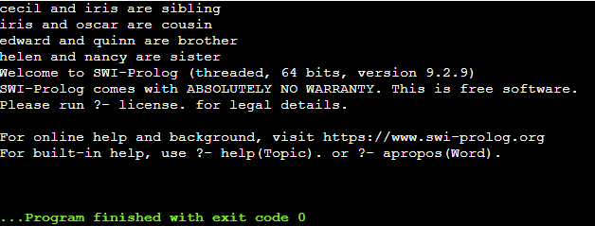
Prolog test run results

Slide 17
Problem 2 description
Given three files, giving the information about student id, how much they paid already, how much should they pay.
Output the total amount received from students before due and list all the students that did not pay the required fees with the amount short.
Using language: Cobol, R.

Slide 18
Cobol
Open three files, and process the data with “LINE SEQUENTIAL“.
Save student id, name, payment type and other data.
Check students’ payment:
Process all the column, match the payment type, search for how much that student had already paid.
Add total students payment.
If paid isn’t enough, display.
Display:
Students that didn’t pay enough.
Total students paid amount.

Slide 19
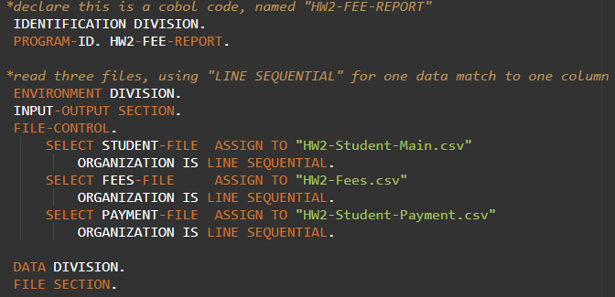
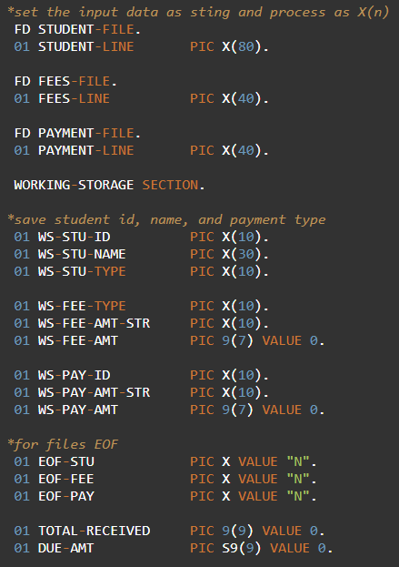
Cobol program listing
Read files
Process files’ data

Slide 20
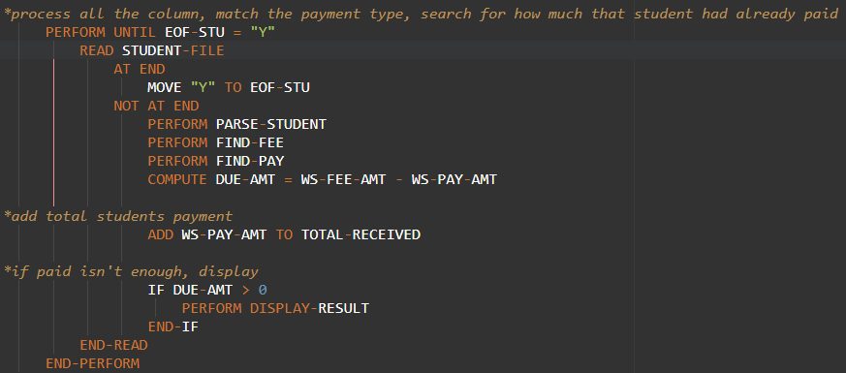
Cobol program listing cont.
Search payment type, add total payment, display students that didn’t pay enough.

Slide 21
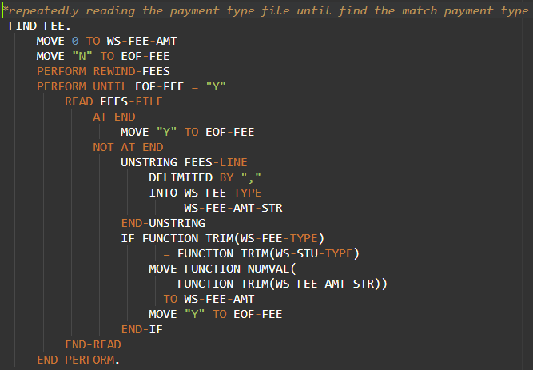
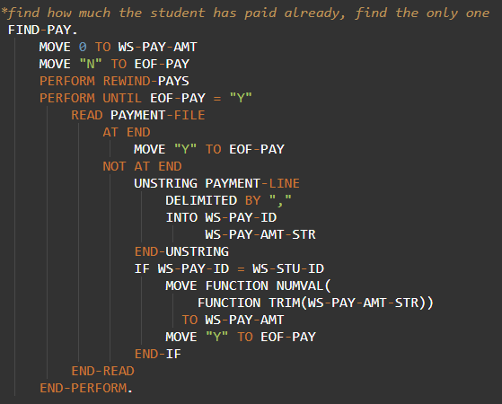
Cobol program listing cont.
Subprocess: find how much students should pay and how much they already paid.

Slide 22
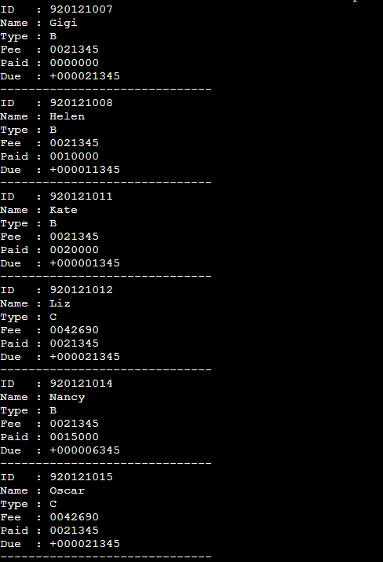
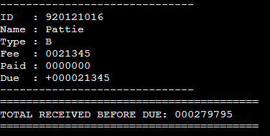
Cobol test run results

Slide 23
R
Read files.
Make sure data types are right.
Process data:
if a student have more than one payment data, add them.
based on the payment type, combine the student data and how much should they pay.
combine student data and how much they already paid.
Calculate arrears.
Display list and total pay amount.

Slide 24
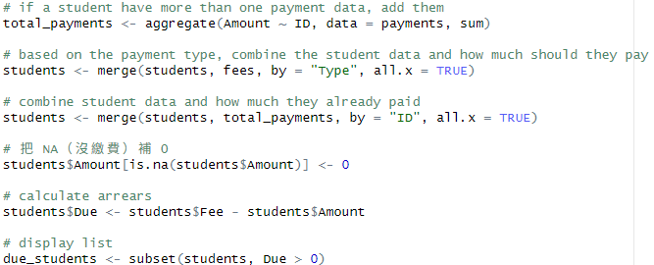
R program listing
Read files
Process data

Slide 25
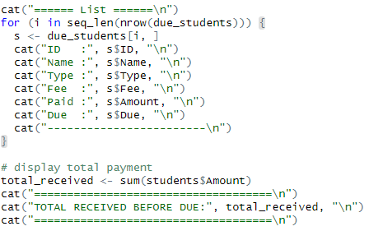
R program listing cont.
Display

Slide 26
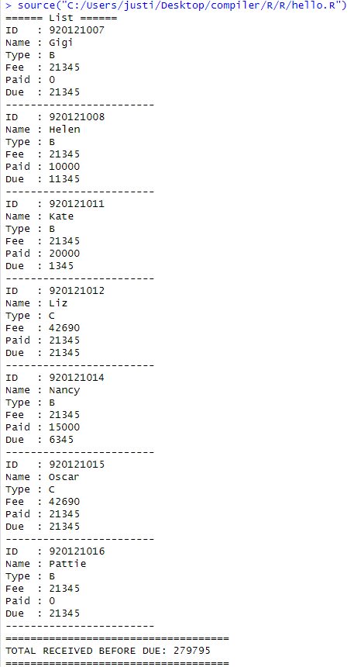
R test run results

Slide 27
Discussion
In question 1, we use Java, ML and Prolog to find the relationship between two people.
Java is imperative language, most of the code are based on OOT.
Advantage: Clear structure and high maintainability.
Disadvantage: The reasoning logic is lengthy and is not suitable for knowledge expression.
ML is functional programming language, suitable in logic processing.
Advantage: Suitable for writing clear logical rules.
Disadvantage: Compared to Prolog, lacks built-in automatic reasoning capabilities

Slide 28
Discussion cont.
Prolog is logical language, reasoning through rules and facts.
Advantage: Can directly express relationships and rules, the writing method is concise and intuitive.
Disadvantage: Hard to learn for the beginner.
In question 2, we use Cobol and R to read multiple files and calculate the students’ payment.
Cobol is imperative language, often used in business.
Cobol in question 2:
Suitable for processing structured text files (such as CSV).
Use FILE SECTION to read files and WORKING-STORAGE to temporarily store data.
All logic is clearly listed, such as "read line by line → analyze by segment → accumulate → display results“.
Suitable for processing the fixed process of traditional accounting systems.

Slide 29
Discussion cont.
R is a functional + declarative language, often used in statistical computing and data analysis.
R in question 2:
Use “read.csv()” to load data in one line, which is fast.
Provides “merge()”, “aggregate()” and other functions to associate and aggregate data.
Suitable for exploratory data analysis and report writing.

