Slide 1
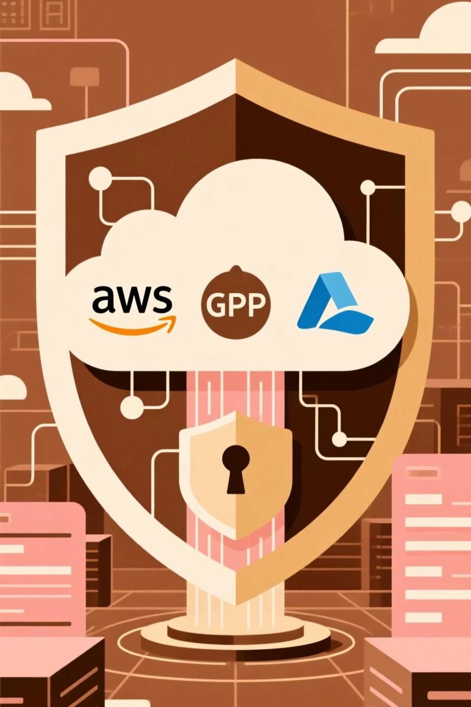
CloudGuard360
Multi-Cloud Monitoring, Analytics & Cost Optimization
A 360° view of your cloud environment.
—Presented By Cosmic Coder

Slide 2
Problem Statement: Common Pain Points
1
2
Fragmented Visibility
Soaring Cloud Costs
Companies often use AWS, GCP (and sometimes Azure), but monitoring resources across all platforms is manual and fragmented.
Over-provisioned or idle resources cause unnecessary spending. Teams struggle to forecast and optimize costs.
3
4
Security Gaps
Data Overload
Misconfigurations, exposed buckets, and insecure IAM roles are hard to track, leaving vulnerabilities open across platforms.
Teams waste hours manually analyzing logs and metrics, delaying critical decisions and insights.
5
6
Inaccurate Forecasting
Slow Anomaly Response
Predicting future cloud usage and costs is complex without proper analytics, leading to over/under-provisioning.
Delayed alerts for overspending, idle resources, or security risks mean missed opportunities for intervention and increased exposure.

Slide 3








CloudGuard360: Our Solution
Unified Dashboard
Cost Optimization
Automated Security
A single pane of glass for all AWS & GCP resources, usage, and costs.
Analyzes usage, forecasts trends, identifies idle resources, and recommends savings.
Scans for misconfigurations (e.g., public S3 buckets, IAM issues) and alerts instantly.
Real-time Analytics
ML-Powered Forecasting
Automated Alerts
Automates data collection (serverless Lambdas) and processes insights for instant display.
Predicts usage trends, future costs, and resource needs using Python & Scikit-learn.
Instant notifications (CloudWatch + Lambda) for anomalies, overspending, or security risks.
IaC Deployment
Compliance & Governance Challenges
Easy, consistent, and scalable deployment with Terraform.
Ensures cloud resources meet regulatory and internal policies by automatically monitoring compliance standards, generating reports, and flagging violations

Slide 4
Innovation & Impact
Multi-Cloud Coverage
Security & Compliance
Unified monitoring and analytics across both AWS and GCP, providing a truly holistic view.
Detects misconfigurations, public buckets, and IAM issues, triggering immediate alerts to bolster your cloud security posture.
Serverless & Scalable
Infrastructure-as-Code (IaC)
Leverages AWS Lambda for a fully serverless backend, ensuring auto-scaling and reduced infra costs.
Fully deployed via Terraform, enabling fast, repeatable, and reliable setup in any environment.
Automated Forecasting
Cost & Resource Optimization
Utilizes Python + ML (Scikit-learn) for proactive usage, cost, and trend forecasting, moving beyond reactive management.
Identifies idle/underused resources and provides predictive insights crucial for accurate budget planning.
Real-Time Insights
Tangible Impact
Visual dashboards with dynamic charts, tables, and summary cards deliver actionable data instantly.
Saves time and money, minimizes human error, facilitates data-driven decisions, and significantly enhances overall cloud security.

Slide 5
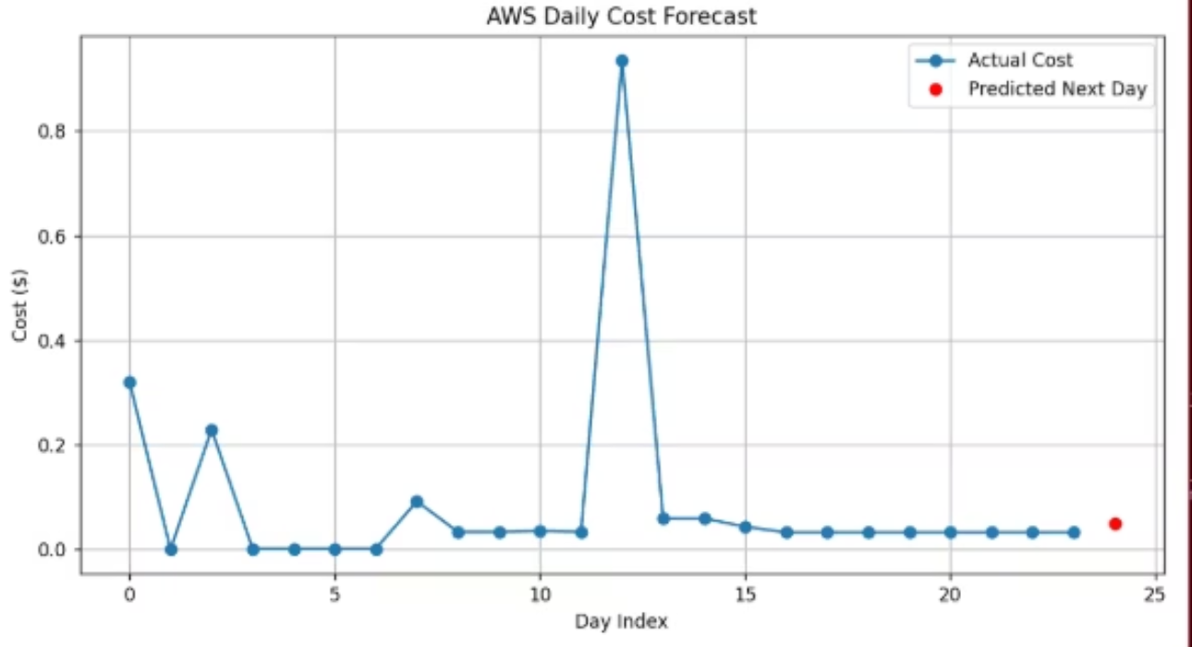
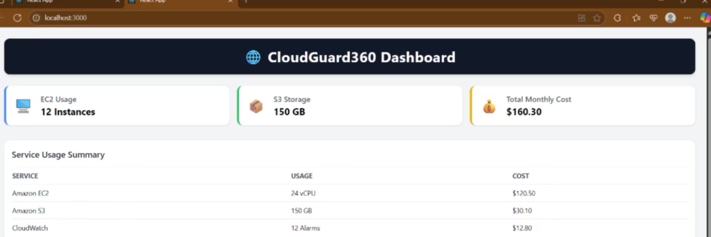
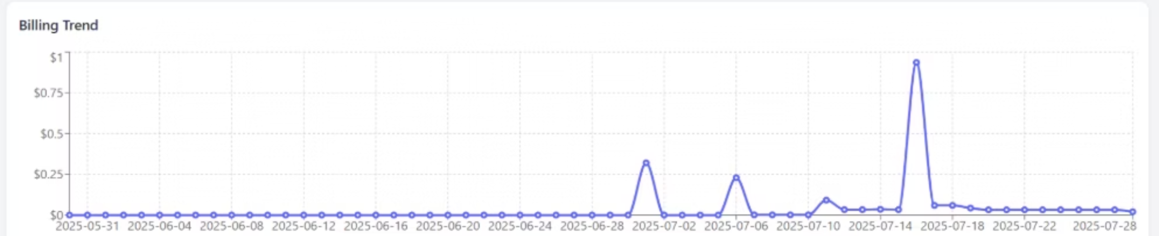
Robust Compliance & Governance

Slide 6
Thank You!

