Slide 1



Drip Ease - Seamless IV Placement
By CyberPunks

Slide 2

Introduction
Problem Statement :
In the modern medical world, precise IV drip placement is crucial for ensuring patient well-being. However, existing manual techniques frequently result in accuracy challenges, leading to patient discomfort, complications, and inefficiencies. Incorrect placement of IV drips can cause unnecessary pain, delays in treatment, and increased risks of infection.
Moreover, there are special cases where vein visibility is significantly impaired, such as in infants or obese patients, making vein detection extremely difficult with the naked eye. This lack of visibility exacerbates the challenges of IV drip placement, often requiring multiple attempts and leading to further patient distress and potential harm.

Slide 3
Solution :
D
R
I
P
E
A
S
E
The Drip Ease project aims to develop a seamless IV placement solution to address the challenges associated with manual IV drip placement, such as inaccuracies and patient discomfort. The solution integrates machine learning (ML), 3D modelling, and augmented reality (AR) to improve precision, enhance training, and streamline clinical workflows.
By leveraging advanced technologies, Drip Ease seeks to revolutionize IV drip placement, improving patient outcomes and clinical efficiency. The project is currently in progress, with significant milestones achieved in design and initial testing phases.

Slide 4

Objectives :
Enhance precision and accuracy in IV drip placement.
Minimize patient discomfort and complications.
Provide real-time guidance for healthcare practitioners.
Improve training effectiveness through VR simulation.
Develop a user-friendly interface for seamless integration.
Ensure interoperability with existing healthcare systems.
Elevate the quality of patient care and clinical workflows.
Hardware: VR/AR equipment, servers
Software: Machine learning algorithms, 3D modelling tools
Resources :

Slide 5
Methodology :
ML & IMAGE ANALYSIS: Analyze medical images to identify veins and critical injection sites, ensuring precision using HOG function and UNET.
AR for REAL - TIME GUIDANCE: Integrated AR offers real-time visualization of veins in the hand, providing precise guidance for needle placement & reducing attempts.
VR TRAINING & SIMULATION: Healthcare practitioners benefit from immersive VR training scenarios for skill enhancement in vein identification & IV drip placement.
USER - FRIENDLY INTERFACE : An intuitive interface for healthcare professionals, simplifying vein map viewing & automated assistance during procedures.
INTEROPERABILITY & INTEGRATION : Seamless integration with existing healthcare systems & electronic health records (EHR) ensures efficient workflow integration in clinical settings.

Slide 6
Proposed System Design / Use Cases :
SIMULATION ( TRAINING ):
Venipuncture Training: Healthcare professionals can use the solution for hands-on training in
inserting IV needles and locating veins accurately in a realistic virtual environment through
Simulation.
SCALING DOWN MEDICAL COMPLICATIONS :
For children and patients with difficult-to-access veins due to obesity, dehydration, or previous
IV complications, the solution aids in locating suitable sites for IV placement.
VR HARDWARE SALES AND DISTRIBUTION :
Developing and selling VR hardware/software applications specifically designed for medical
training, including IV placement and vein location simulations.
Medical Device Integration :
Integrating the IV drip placement solution with existing medical devices, such as IV pumps and
patient monitors, offers a complete IV management system.

Slide 7
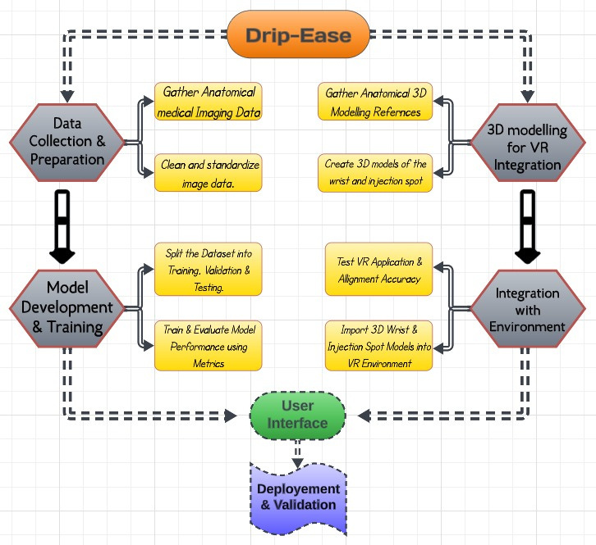
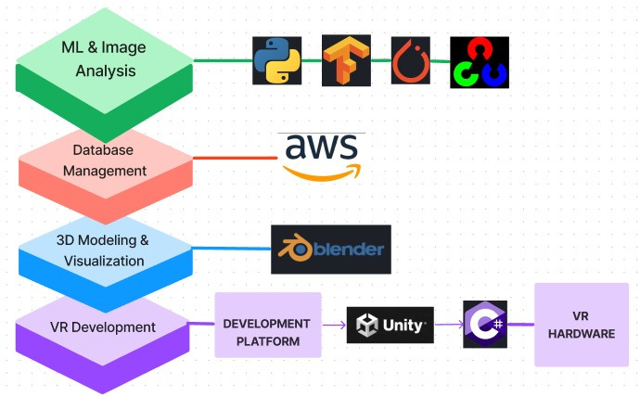
Technology Stack :
Process Flowchart :
Technology Stack :
Rufus Stewart

Slide 8
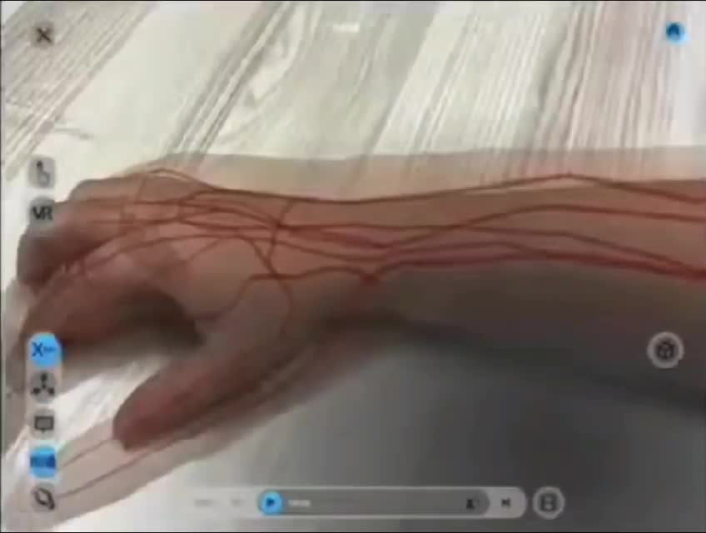
Explaination Video of the Project :
https://youtu.be/0BVESdFsSX0
Expected Prototype :

Slide 9


Dependencies / Challenges :
Data Availability
Anatomical Accuracy
Regulatory Compliance
Hardware Procurement
Testing Environment
Hardware Failures & Technical Glitches
08

Slide 10
Thank
You.

