Slide 1
PHASE 1 PROJECT
NAME: IMMANUEL CHERUIYOT
SDF-FT08BPORM
CLASS: SOFTWARE ENGINEERING
SCHOOL: MORINGA SCHOOL

Slide 2

This is Mr Beast
He is searching for a project on the internet to sponsor

Slide 3


Internet Scam Websites
Mr Beast is stressed searching for a legitimate website that has links to legitimate charitable organizations

Slide 4
I INTRODUCE TO YOU…..

Slide 5



TO THE SOLUTION

Slide 6
ABOUT
A web page that serves as a bridge between donors and charitable organizations

Slide 7
PROBLEM STATEMENT:
Many potential donors are willing to contribute to charitable causes, but they often find it challenging to discover trustworthy and impactful charitable organizations. On the other hand, charities struggle to reach a wider audience and communicate the urgency and impact of their projects effectively.
There is a need for a platform that seamlessly connects donors with verified charitable organizations, fostering transparency, engagement, and trust.

Slide 8
SOLUTION STATEMENT
I introduce a web-based platform called Donor_Charity_Connect that serves as a bridge between donors and charitable organizations.
-Donor_Charity_Connect aims to simplify the donation process by offering a user-friendly interface, detailed project information, and real-time updates.
-Donor_Charity_Connect empowers donors to make informed contributions and strengthens the impact of charitable initiatives.

Slide 9
PROJECT FEATURES

Slide 10



TECHNOLOGIES USED

Slide 11
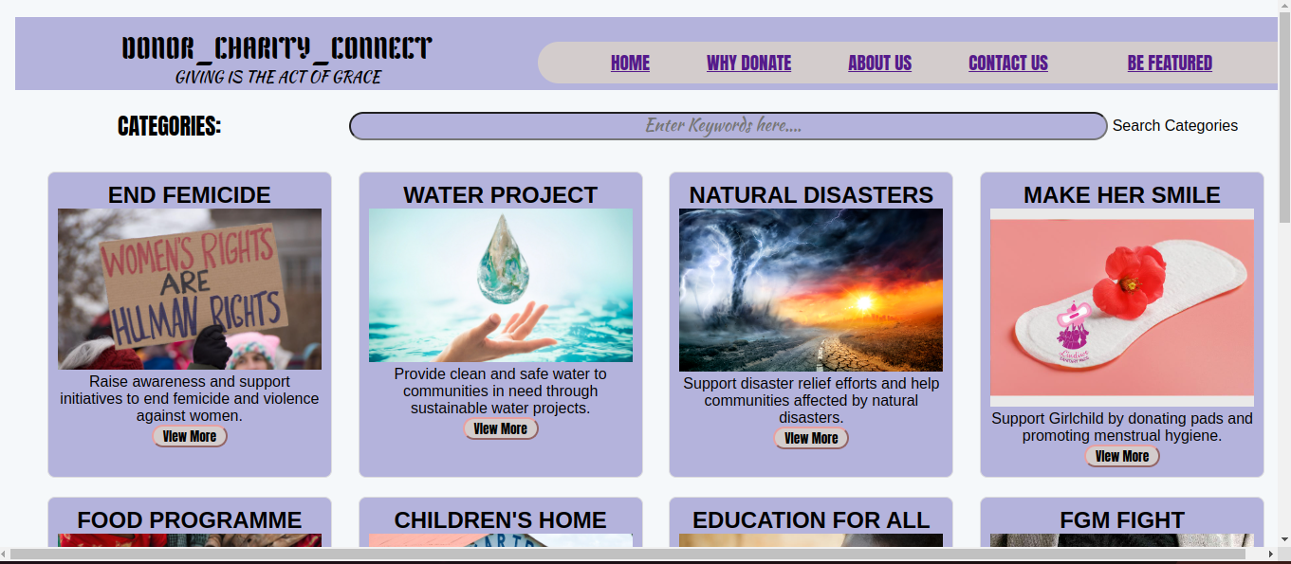
INTERACTIVE USER INTERFACE
HOME PAGE

Slide 12
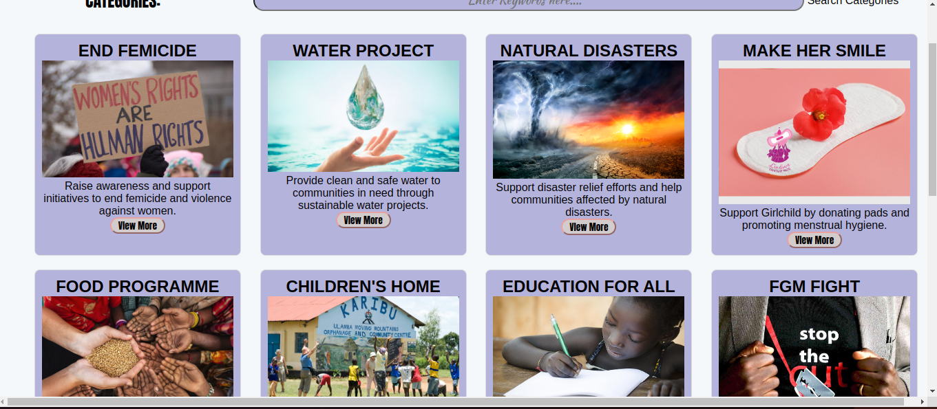
CHARITY CAUSES CATEGORIZED

Slide 13
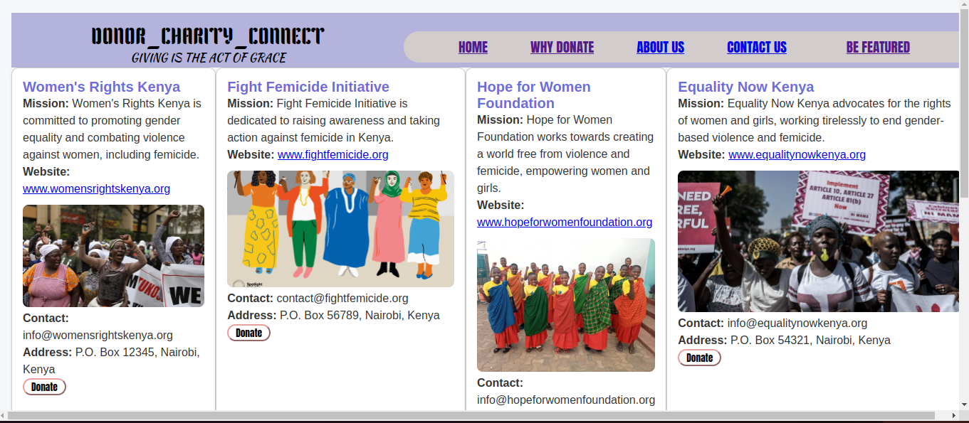
VIEW MORE ON CATEGORIES
With Donate Button

Slide 14
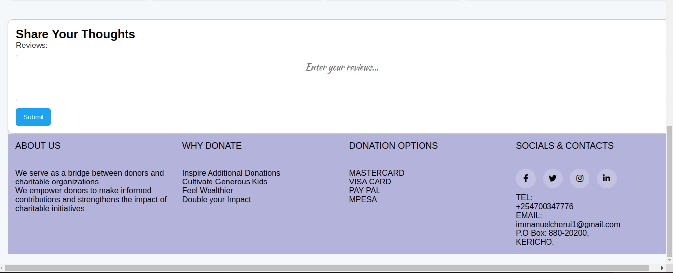
COMMENTS AND REVIEWS

Slide 15
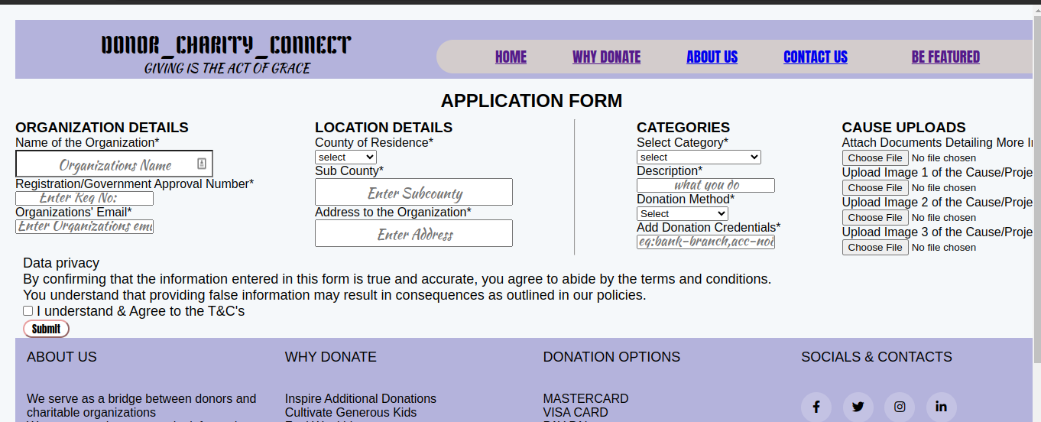
APPLICATION FORM FOR AN ORGANIZATION TO BE FEATURED

Slide 16
THANKYOU:
ANY QUESTIONS?

