Slide 1
Who still lacks safe drinking water, and is it improving?
DATA ANALYSIS PORTFOLIO | UN SDG 6: CLEAN WATER AND SANITATION
An end-to-end analysis of WHO/UNICEF JMP estimates: 213 countries in 2020, and 231 countries tracked from 2015 to 2020.
Joshua | Google Sheets + Python
Notes:
Portfolio walk-through of a two-part water-access analysis. Part 1 profiles the 2020 snapshot; Part 2 measures change between 2015 and 2020 using the Annual Rate of Change (ARC).

Slide 2
A two-part study of access to drinking water
PROJECT OVERVIEW
Why it matters
UN SDG 6 calls for safe, affordable drinking water for everyone. The WHO/UNICEF Joint Monitoring Programme ranks service on a ladder: at least basic, limited, unimproved, surface water.
Questions I set out to answer
Who lacks access: by area, population size, income?
Is access improving, and how fast?
Which regions are furthest behind?
213
231
countries in the 2020 snapshot (Part 1)
countries tracked 2015 to 2020 (Part 2)
12
+19
access measures: 4 service levels x national, rural, urban
engineered features on top of the 16 original columns
Notes:
SDG 6 asks for safe and affordable drinking water for all. The JMP ladder used here has four levels: at least basic, limited, unimproved and surface water.

Slide 3
Four findings: a rural gap, an income gap, uneven progress, one region behind
EXECUTIVE SUMMARY
~768M
13.4 pts
people in the 2020 data lack at least basic drinking water (about 1 in 10)
rural-urban gap in basic access: 81.3% rural vs 94.7% urban (country means)
63% vs 99.6%
135 of 231
basic access in low-income vs high-income countries: income is the sharpest divider
countries improved national access 2015-2020; 62 were already at full access, 16 stalled, 16 declined
Sub-Saharan Africa has the fastest national gains (0.56 pp a year) yet the furthest to go: 37 of the 44 countries below 80% basic access are there.
Notes:
The ~770 million figure is derived from the 2020 dataset as the sum over countries of (100 - basic access %) x population, so it is approximate and slightly understated because two countries have no national value. The time-to-full-access figure is an illustrative linear extrapolation of unweighted regional averages.

Slide 4
From messy imports to measured insight in four stages
APPROACH
1
2
3
4
Import and clean
Engineer features
Summarise
Visualise
Fix semicolon-split rows
Handle NAN and null markers
Cap impossible values >100%
Urban and rural counts
Year gap, ARC columns
Full-access flags, region
Mean, median, mode, IQR, SD
Pivot by income group
ARC averages and counts
Box plots, stacked columns
Histograms, bubble chart
Plain-language takeaways
Spreadsheet toolkit COUNTA, IF / IFERROR, LOOKUP, QUARTILE, ROUNDUP, COUNTIFS, pivot tables, native charts
Python reproduction pandas and matplotlib re-derive every metric; 84 of 84 checks match the workbooks
Notes:
Both parts follow the same loop. Spreadsheet formulas were used to build every feature, and a Python script reproduces them and checks the results against the workbooks.

Slide 5
Cleaning came first: three import problems fixed
PART 1 | DATA PREPARATION
Semicolon-split rows
5 rows imported into a single cell. Added value_cnt = COUNTA(row), filtered out the expected 16, then used Split text to columns on only the affected cells.
The check that caught them
value_cnt
= COUNTA(A2:P2)
Every clean row returns 16. In the final data all 213 country rows do.
Shares above 100%
9 basic-access values exceeded 100% (max 100.0000037). Created wat_bas_n (rounded), so no share exceeds 100%.
Missing values
Missing estimates arrive as text (NAN). Replaced #VALUE! rounding errors with NAN so MAX, AVERAGE and QUARTILE ignore them.
Notes:
Five rows were delimited by semicolons, so their values sat in one cell. COUNTA over each row should return 16 (one per feature); filtering out 16 isolates the broken rows. Nine national basic-access values were slightly above 100% (maximum 100.0000037), which is impossible for a share.

Slide 6
The dataset covers 99.6% of the world's people
PART 1 | POPULATION SIZE
0.44%
difference in total population (dataset vs 7.821 bn world)
56.2%
urban share in the dataset vs 55% for the world
1.70%
difference in urban head count vs the world estimate
Notes:
Percentage difference = |V2 - V1| / ((V1 + V2) / 2) x 100. The urban percentage and the urban head count differ because the head count is built country by country from pop_n x pop_u / 100, while the world figure applies one 55% share.

Slide 7
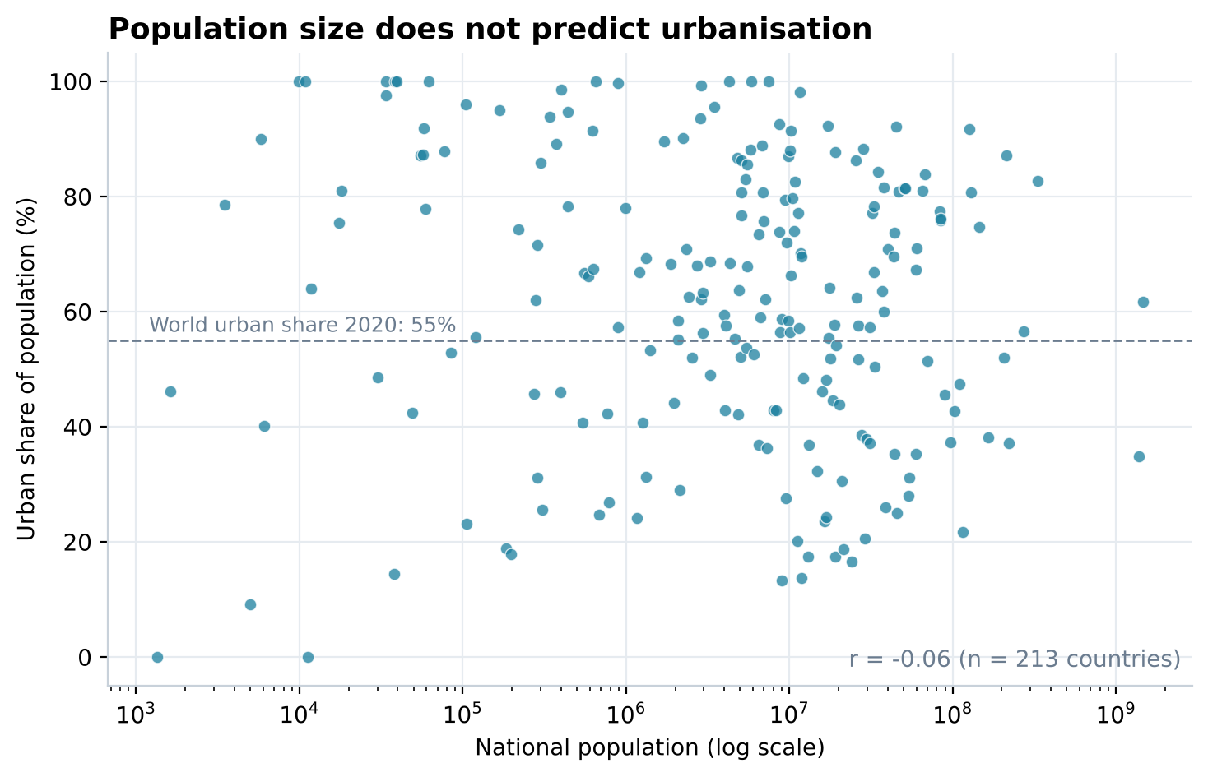
Population size says nothing about how urban a country is
PART 1 | POPULATION SIZE
r = -0.06
Large and small countries are equally likely to be mostly urban or mostly rural.
Chart decision log
Outliers (China, India) crushed the first line chart
Chose a unit change over deleting data
A log axis keeps all 213 countries visible
Notes:
The first line chart was unreadable: China and India (over 1.3 billion each) stretch the x-axis so 200+ countries are squashed together. I weighed three fixes: delete outliers (loses countries), cap the axis (hides the largest) or change the unit. The log-scale scatter keeps every country visible.

Slide 8
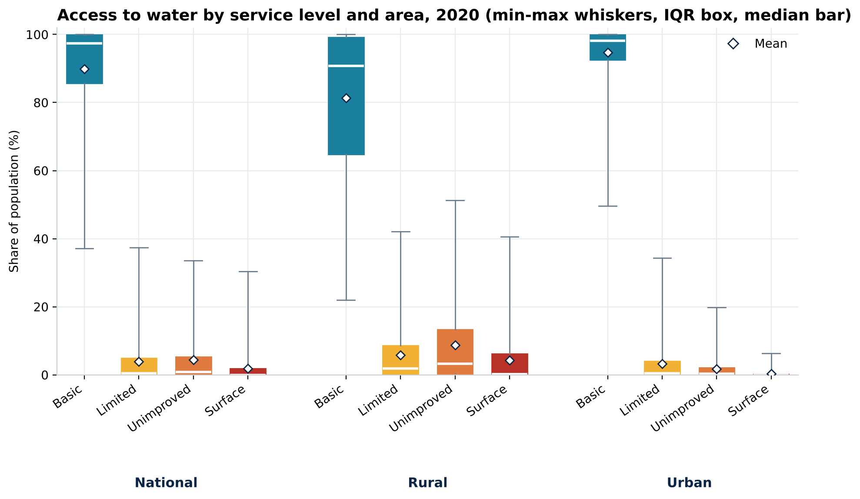
Rural access is both lower and far less even than urban
PART 1 | ACCESS BY AREA
Basic % | Natl | Rural | Urban
Mean | 89.9 | 81.3 | 94.7
Median | 97.3 | 90.7 | 98.1
IQR | 14.2 | 34.3 | 7.4
Lowest | 37.2 | 22.0 | 49.7
Rural spread (IQR) is 4.6x the urban spread.
Most countries sit at or near 100% (mode = 100), pulling the median above the mean.
Notes:
Mean, median, mode, quartiles, IQR and standard deviation were computed for all 12 service-level features. Means exclude countries with no value for that feature. Mean below median means a left-skewed distribution: most countries sit near 100% with a long tail of low-access countries.

Slide 9
Where basic water is missing, rural people fall to the lowest rungs
PART 1 | ACCESS BY AREA
13.5x
rural vs urban reliance on surface water
5.1x
rural vs urban reliance on unimproved sources
94.7%
urban basic access vs 81.3% rural
Notes:
Basic access dominates every column, so this chart shows the three lower rungs of the ladder where the differences are visible. Rural surface-water use is about 13 times the urban rate.

Slide 10
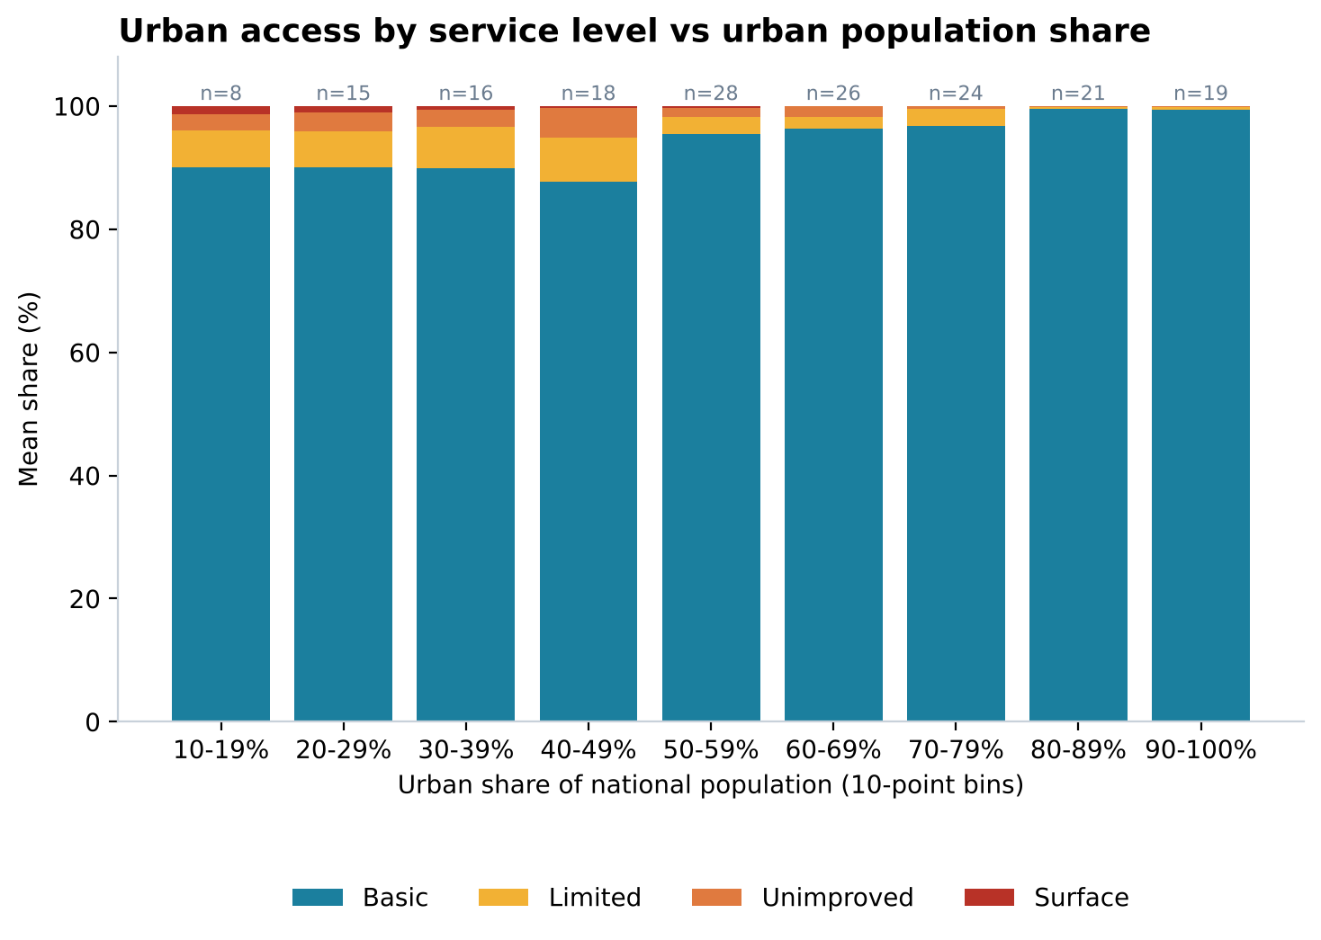
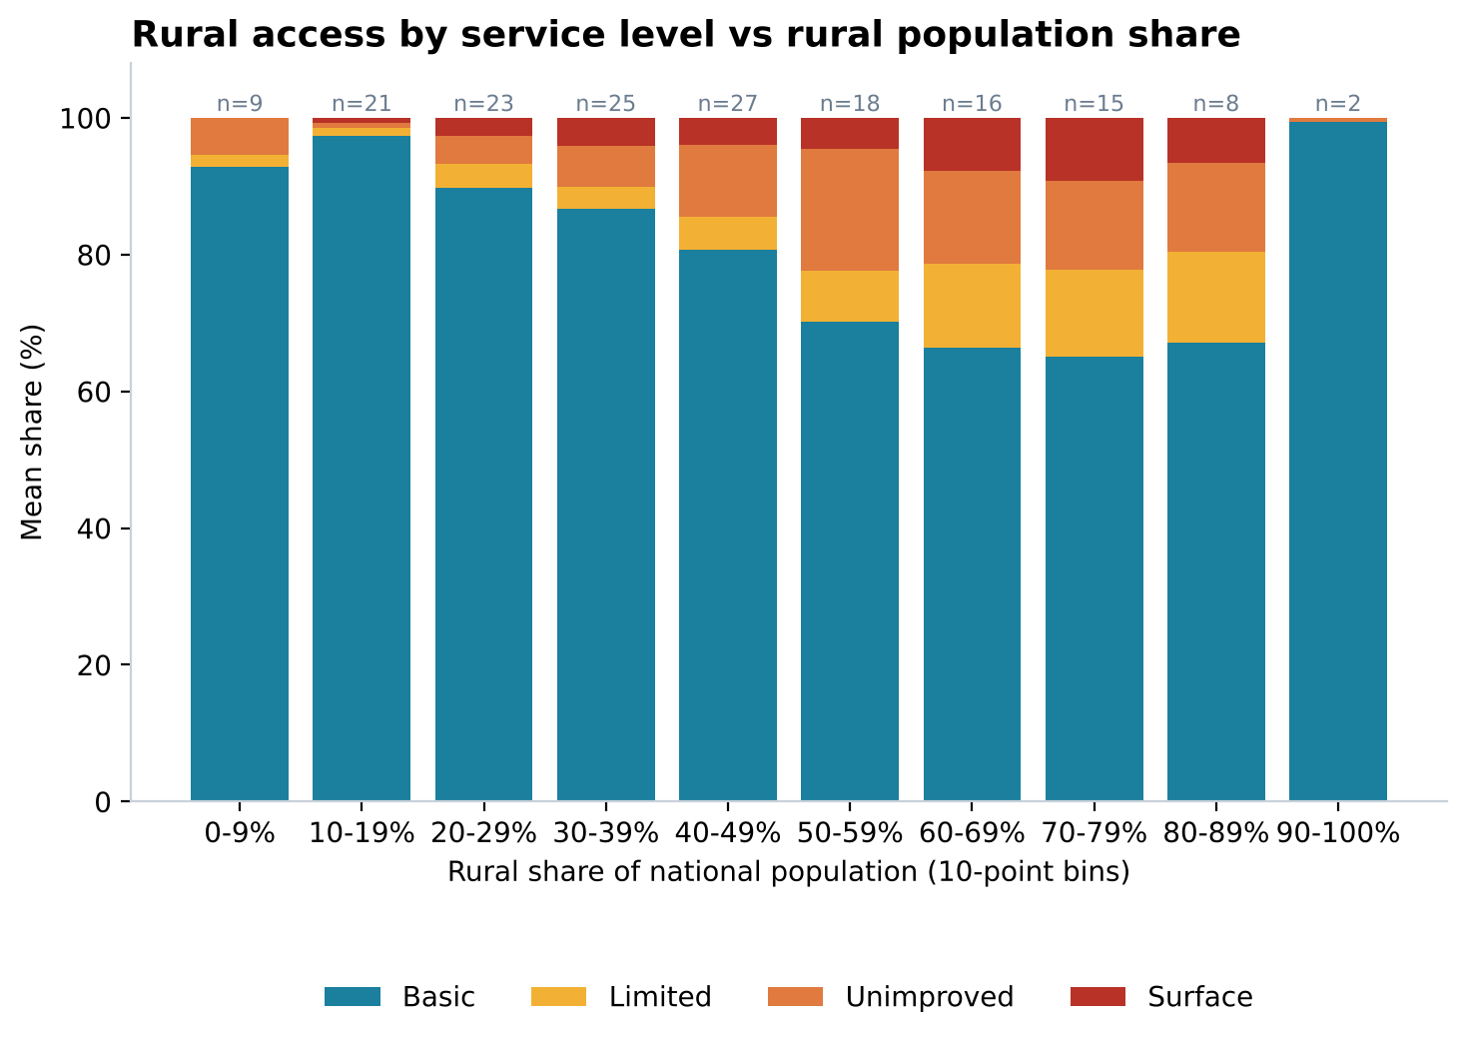
Access tracks how rural a country is, not how many people live there
PART 1 | ACCESS BY POPULATION SIZE
Population size vs basic access: r = 0.00. Urban share vs basic access: r = 0.55.
Rural basic access is weakest (about 65-70%) in countries where 50-89% of people live in rural areas.
Notes:
Bars show average service-level shares for countries grouped into 10-point bins of urban (left) or rural (right) population share. Correlation between population size and basic access is essentially zero; between urban share and basic access it is 0.55.

Slide 11
Income is the sharpest divider: low-income countries lag by 37 points
PART 1 | ACCESS BY INCOME GROUP
62.8%
basic access, low income (high income: 99.6%)
5.4%
rely on surface water (high income: 0.0%)
36% vs 79%
average urban share, low vs high income
Notes:
Pivot table grouped by income_group with the average of each national service level. Sixteen countries have no income classification and are left out of this chart.

Slide 12
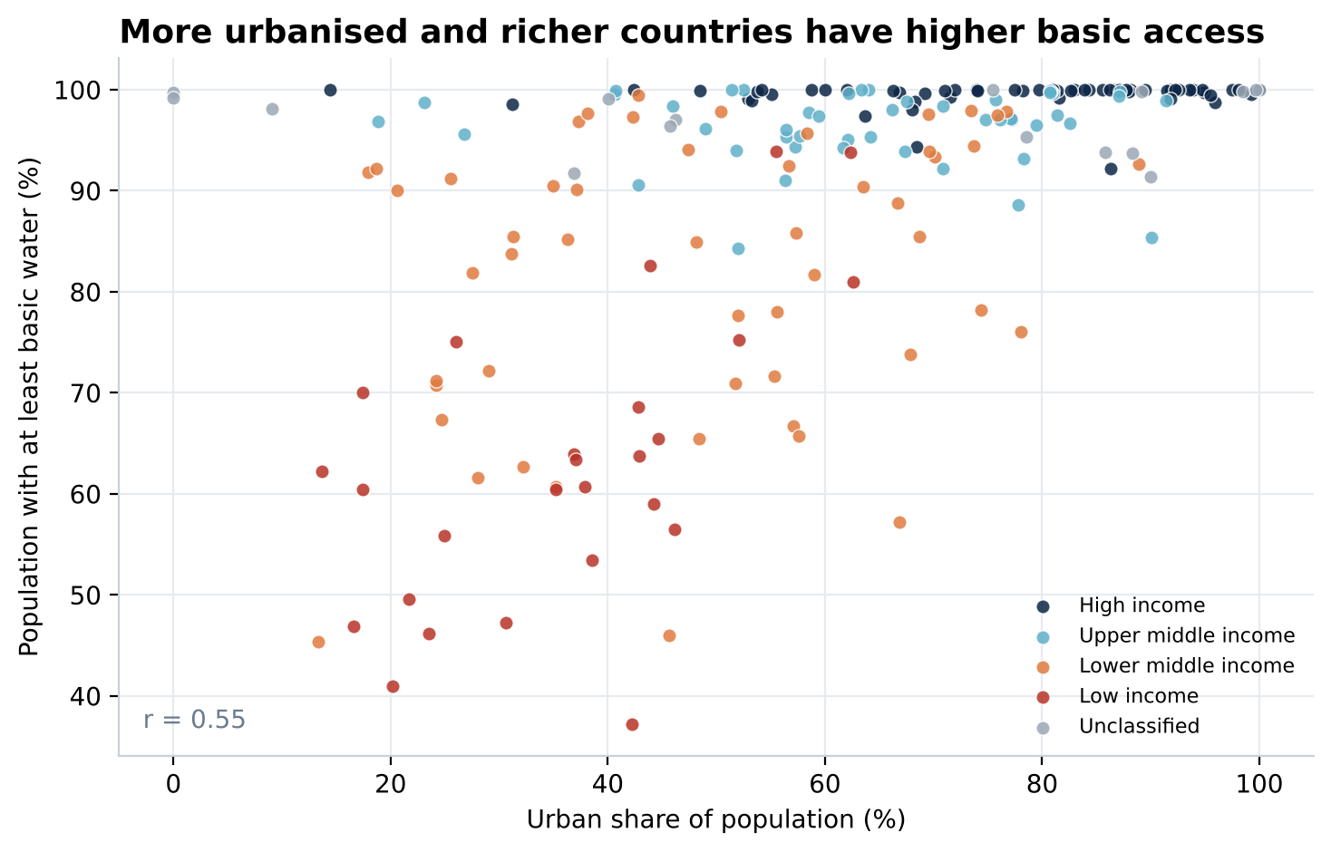
Urbanisation and income together separate the countries
PART 1 | ACCESS BY INCOME GROUP
r = 0.55
Moderate positive link between urban share and basic access.
56 countries are below 90% basic access and 8 below 50%.
Notes:
Each point is a country. Almost every high-income country sits at the top right; the low-income countries cluster lower left with basic access between roughly 40% and 90%.

Slide 13
The Part two workbook file is really two snapshots: 2015 and 2020
PART 2 | YEAR REPRESENTATION
4.8
average years between a country's two observations (range 1 to 5)
213 of 231
countries have the full 2015 to 2020 span
So change is measured per year, which keeps the 18 shorter spans comparable.
Notes:
Sorting by name then year showed that each country has exactly two rows. y_diff = year(n+1) - year(n) only when the country names match. y_diff = 0 would flag duplicates (none remain after cleaning). The year histogram has two peaks, so the distribution is neither normal nor skewed.

Slide 14
ARC turns two snapshots into a yearly rate of progress
PART 2 | ANNUAL RATE OF CHANGE
ARC_n =
IFERROR( IF( $A3=$A2,
(E3-E2) / ($B3-$B2), ), "null" )
ARC (pp/yr) | Avg | Min | Max
National | 0.28 | -1.02 | 2.75
Rural | 0.48 | -1.23 | 2.67
Urban | 0.15 | -1.62 | 2.67
Same-country test stops ARC crossing from one country to the next
Mixed references ($A, relative row) copy one formula across n, r, u
IFERROR labels missing estimates as null instead of #VALUE!
Full access = rounded basic access of 100 in both years
0.48 vs 0.15
rural vs urban average ARC: rural access gained faster, from a lower start
Notes:
ARC_x = (access in later year - access in earlier year) / (later year - earlier year), computed only when the next row is the same country. IFERROR returns null where either year has no estimate. Rural ARC is missing for 64 countries and urban ARC for 50.

Slide 15
Access improved in 135 of 231 countries, but rural gaps in the data limit the story
PART 2 | DIRECTION OF CHANGE
135 / 16 / 16
countries improving, stalled, declining nationally (not full access)
64 and 50
countries with no rural or urban ARC because an estimate is missing
Rural average ARC (0.48) beats urban (0.15) partly because urban areas start closer to 100%.
Notes:
Each country falls into exactly one bucket: missing ARC, full access in both years, ARC = 0, ARC < 0 or ARC > 0 (the last three excluding full-access countries). The counts add to 231 for national, rural and urban. Rural ARC is missing for 64 countries.

Slide 16
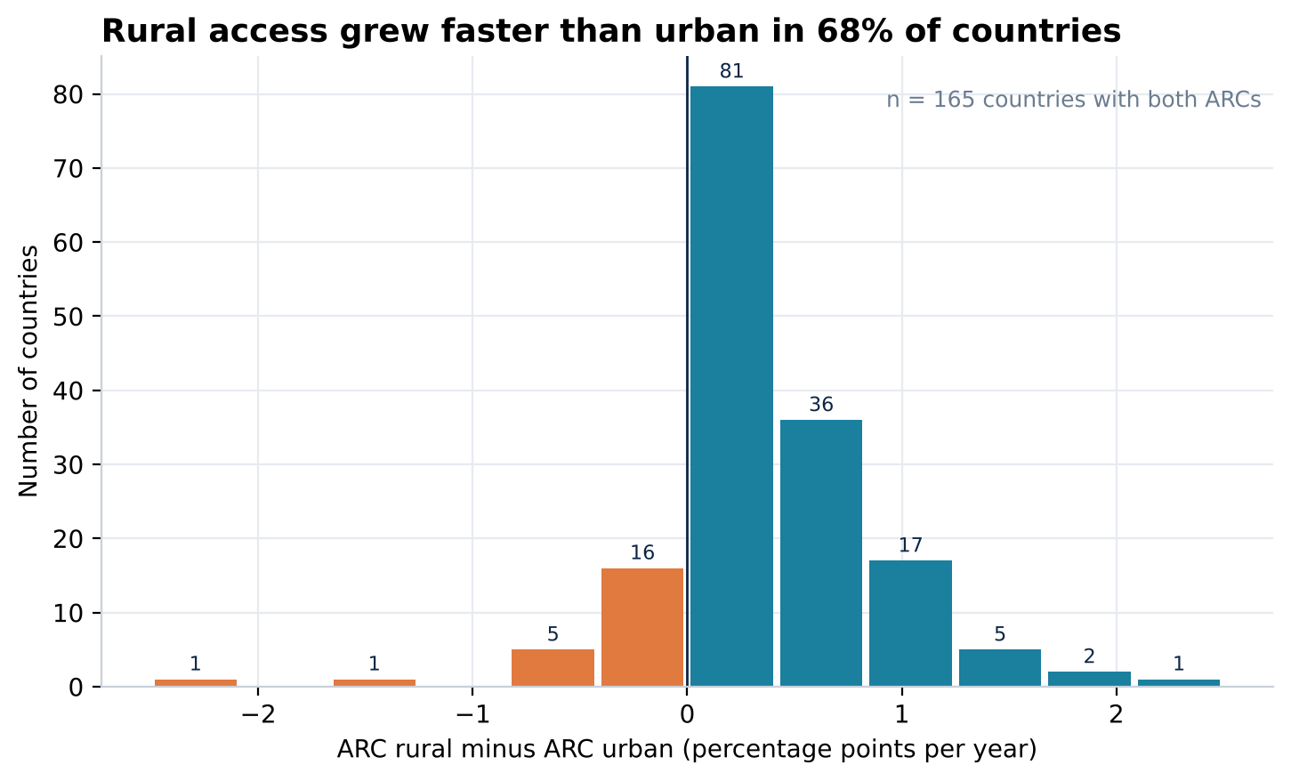
Rural access grew faster than urban in two out of three countries
PART 2 | RURAL VS URBAN
68%
of 165 countries: rural ARC above urban (median gap 0.21 pp/yr)
Largest gaps
Morocco: rural +2.63 vs urban +0.31
South Sudan: rural -0.63 vs urban +1.86
(pp per year)
Notes:
ARC_diff = ARC_r - ARC_u in percentage points per year, available for 165 countries with both values. A positive value means rural access improved faster.

Slide 17
Sub-Saharan Africa is improving fastest, from the lowest base
PART 2 | ACCESS BY REGION
0.56
pp a year: highest national ARC, in Sub-Saharan Africa
37 of 44
countries below 80% basic access are in Sub-Saharan Africa
Europe and North America move slowly because most countries are already near 100%.
Notes:
Region comes from the supplied country-to-region mapping (LOOKUP on country name). Averages are unweighted across countries. Some labels look unconventional (Tunisia is Sub-Saharan Africa; Philippines, Malaysia and Iran are South Asia), so the small regions (South Asia n=11, MENA n=10) are sensitive to the mapping.

Slide 18
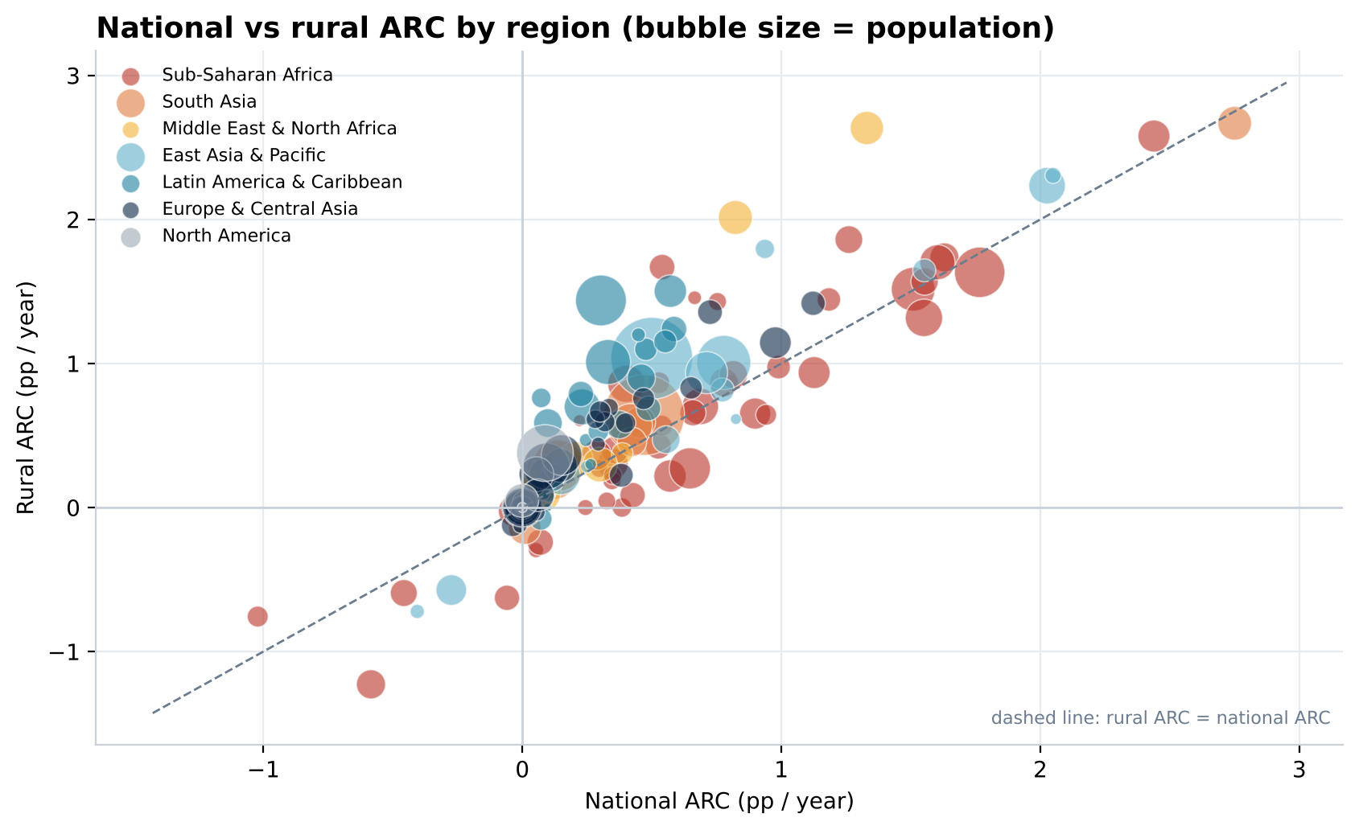
Sub-Saharan Africa has the widest range of national ARC
PART 2 | ACCESS BY REGION
Reading the chart
109 of 167 countries sit above the line: rural ARC beat the national ARC
Sub-Saharan Africa spans -1.0 to +2.4 pp a year nationally
11 of the 13 countries with over 100 million people sit between 0 and 1 pp a year
Notes:
Each bubble is a country; size is population; colour is region. Points above the dashed line saw faster rural than national progress. Sub-Saharan Africa's national ARC runs from -1.02 (Central African Republic) to 2.44.

Slide 19
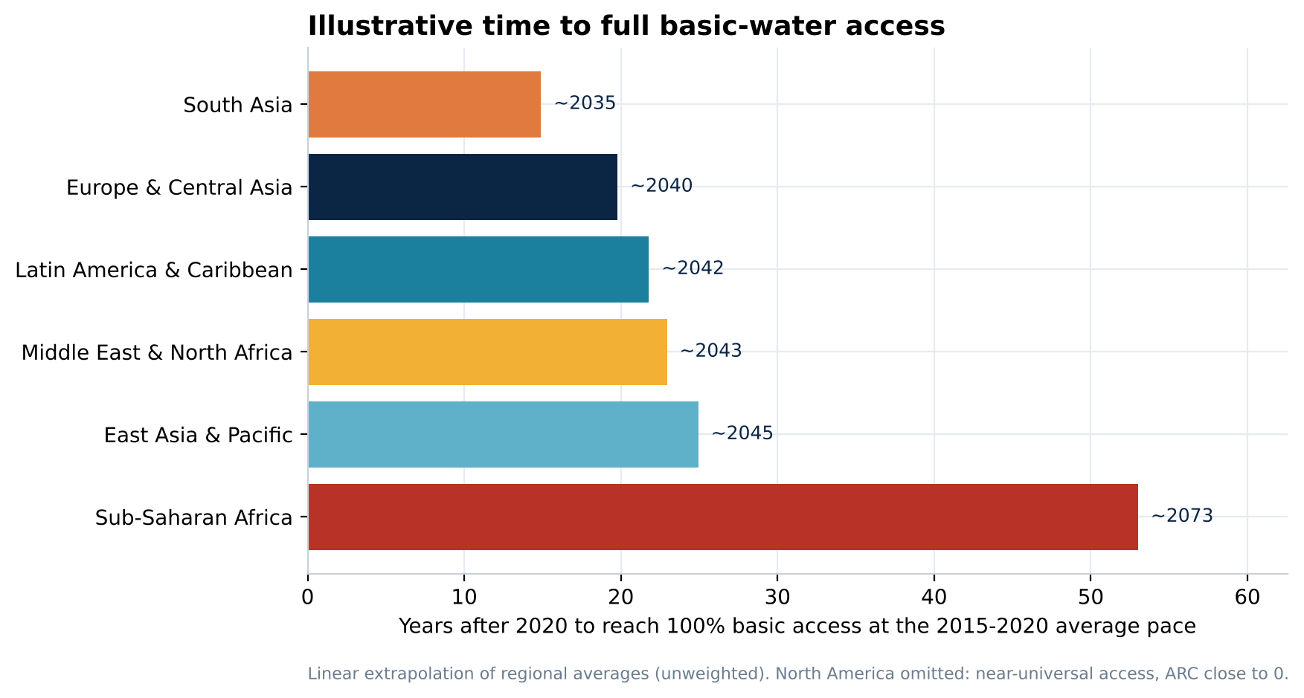
At the 2015-2020 pace, Sub-Saharan Africa needs roughly 50 more years
EXTENSION | ILLUSTRATIVE PROJECTION
How to read it
Years to 100% = (100 minus average basic access) divided by average national ARC.
Caveat
Linear and unweighted. A signal about relative urgency, not a prediction.
Notes:
This is an extension, not a forecast. It extrapolates each region's average national ARC linearly from its average end-year basic-access level. Averages are unweighted across countries; population-weighted ARC for Sub-Saharan Africa is higher (about 1.0 pp a year), so the gap in years would be smaller.

Slide 20
What the data says, and what I would do next
1
Rural and low-income populations carry the gap
A 13-point rural deficit and a 37-point income deficit in basic access.
2
Progress is real but uneven
135 countries improved; 32 stalled or declined; Sub-Saharan Africa gains fastest but starts lowest.
3
Targeting beats averaging
Aim investment at rural areas of low-income, low-urbanisation, mostly Sub-Saharan countries.
4
Next: weight, extend, deepen
Population-weight the averages, add the safely managed level, and use more than two years.
Notes:
The 32 'stalled or declined' figure is 16 countries with no change plus 16 with declining national access, excluding countries already at full access.

Slide 21
The 19 features I engineered
APPENDIX
Part | Feature | What it does
Part 1 | value_cnt | COUNTA of each row; should equal 16
Part 1 | pop_u_val, pop_r | Urban head count (pop_n x pop_u / 100); rural share (100 - pop_u)
Part 1 | pop_n (m), wat_bas_n (rounded) | Population rounded up to millions; basic access capped at 100%
Part 1 | pop_u (rounded), pop_r (rounded) | Shares rounded to whole numbers for charting
Part 2 | y_diff | Years between a country's two observations
Part 2 | ARC_n, ARC_r, ARC_u | Annual rate of change in basic access (pp per year)
Part 2 | wat_bas_x (rounded) x3, ARC_x_full x3 | Rounded basic access and full-access flags
Part 2 | ARC_diff, region | Rural minus urban ARC; region by lookup on country name
Notes:
Part 1 adds 7 features (16 to 23 columns). Part 2 adds 12 (16 to 28 columns).

