Slide 1
Predicting Contraceptive Use in Indonesia
Alexa Giftopoulos
Iliana Maifeld-Carucci
Shilpa Rajbhandari

Slide 2
Motivation
Predict contraceptive method of choice for Indonesian women based on her demographic and socio-economic characteristics.
Classification problem

Slide 3
Data Source
UCI Machine Learning Repository
Subset of 1987 National Indonesia Contraceptive Prevalence Survey
Sampled married women who were not pregnant or didn’t know they were pregnant.

Slide 4
Project Data
1473 observations, 10 variables
Target Variable:
Contraceptive Method Used (categorical)
Predictor Variables:
Wife’s Age (numerical)
Wife’s Education (categorical)
Husband’s Education (categorical)
Number of Children (numerical)
Wife’s Religion (binary)
Wife Working (binary)
Husband’s Occupation (categorical)
Standard of Living Index (categorical)
Media Exposure (binary)

Slide 5
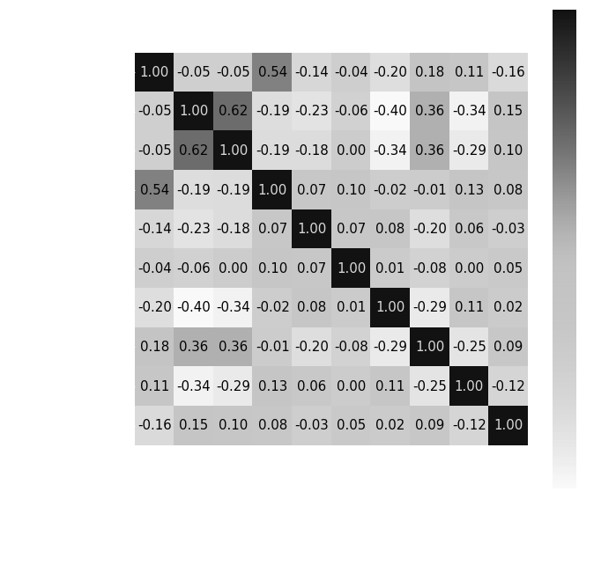
Correlation Analysis

Slide 6
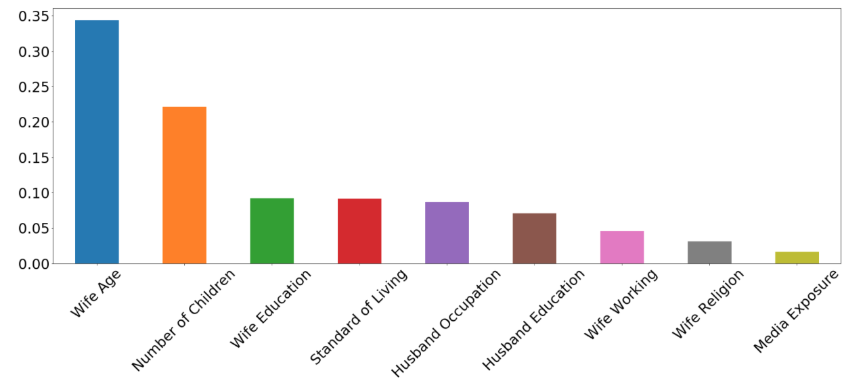
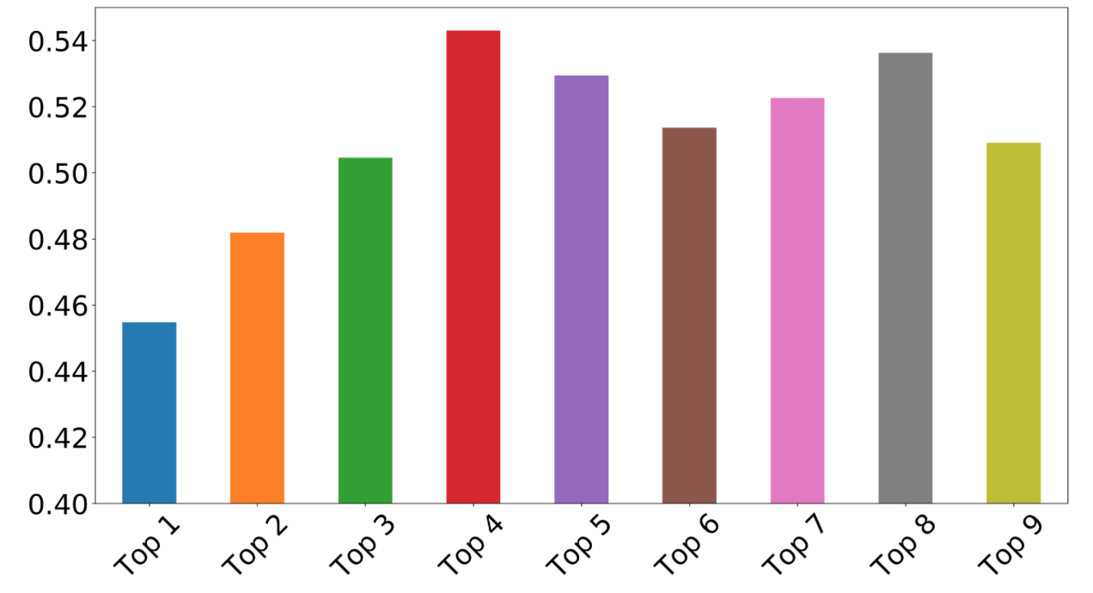
Feature Selection
Estimated feature importance using Random Forest Classifier
Sorted by feature importance, the top 4 features predicted our target variable the best

Slide 7
Random Forest
Standardization:
Not necessary
Robust to numerical instabilities due to partitioning rules that wouldn’t change with scaling
Model Specifications:
Number of trees
Ideally select largest amount of trees your computer can handle

Slide 8
Random Forest
Model with all 9 features
Model Accuracy Tests:
Train
.97
Test/Fscore
.52
Model with top 4 features
Model Accuracy Tests:
Train
.85
Test/Fscore
.54

Slide 9
Multinomial Logistic Regression
Standardization:
Not necessary, but because of gradient descent, speeds up convergence
Using L2 regularization assumes all features centered at 0 and same order variance
Model Specifications:
Multinomial because 3 target classes, not 2
L2 regularization
Prevents overfitting
Biases data towards smaller values and penalizes high valued coefficients by reducing weights.

Slide 10
Multinomial Logistic Regression
Model with all 9 features
Model Accuracy Tests:
Train
.54
Test/Fscore
.50
Cross-Validation (check overfitting):
Accuracy
.52
95% Confidence Interval:
+- .01
Model with top 4 features
Model Accuracy Tests:
Train
.53
Test/Fscore
.50

Slide 11
K- Nearest Neighbor
Standardization:
Calculates distance between data points so need standardizing
Guard against differences in variance impacting learning of algorithm
Model Specifications:
Rule of thumb to choose k=sqrt(n)
k=36 maximized testing accuracy while minimizing difference between testing and training accuracy

Slide 12
K- Nearest Neighbor
Model with all 9 features
Model Accuracy Tests:
Train
.55
Test/Fscore
.51
Cross-Validation (check overfitting):
Accuracy
.51
95% Confidence Interval:
+- .00
Model with top 4 features
Model Accuracy Tests:
Train
.59
Test/Fscore
.53

Slide 13
Support Vector Machines
Standardization:
Critical because use RBF kernel
Contribution of input will depend heavily on its variability relative to other inputs
Model Specifications:
RBF Kernel
Maps to infinite dimensional space
Non-linearly separable data
Gamma = .08, C= 1
Maximized accuracy

Slide 14
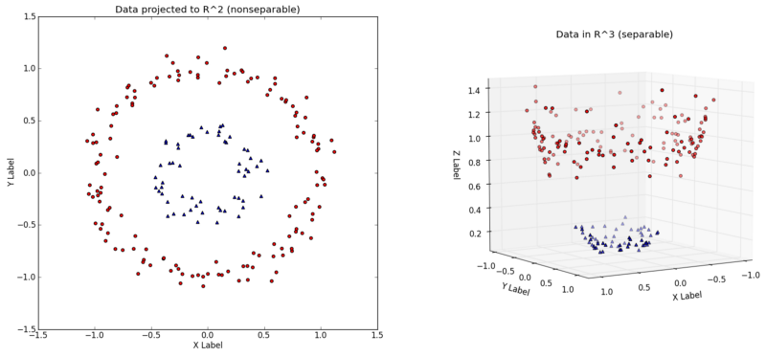
Support Vector Machines

Slide 15
Support Vector Machines
Model with all 9 features
Model Accuracy Tests:
Train
.63
Test/Fscore
.55
Cross-Validation (check overfitting):
Accuracy
.57
95% Confidence Interval:
+- .03
Model with top 4 features
Model Accuracy Tests:
Train
.59
Test/Fscore
.54

Slide 16
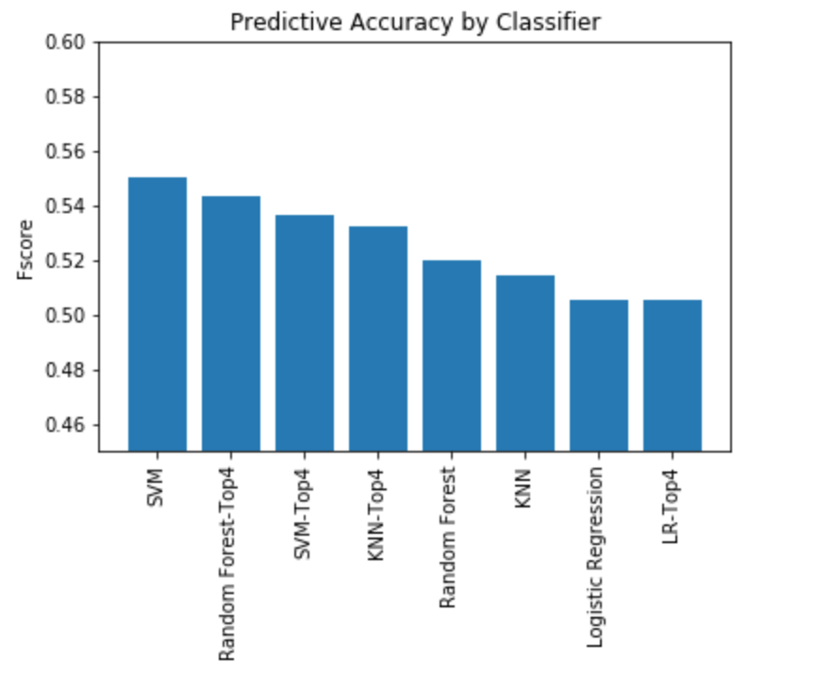
Best Classifier
Our original SVM (9 features) model predicts contraceptive method use the most accurately
Fscores:
SVM = 0.55
RF(top4) = 0.54
SVM(top4) = 0.54
KNN(top4) = 0.53

Slide 17
Conclusions
Need more features that would better explain contraceptive use.
SVM (9 features) had the best predictive power
Handles non-linear data and high dimensions well
RF (top4) performed second best
Handles non-linear data well
Logistic Regression (top4) performed the worst
Assumes linearly separable data, linear relationships
Doesn’t handle binary and categorical data well

