Slide 1
Wage Gap in the USA
Iliana Maifeld-Carucci

Slide 2
Data
Bureau of Labor Statistics Current Population Survey data on usual weekly earnings based on selected characteristics including sex
https://www.bls.gov/cps/cpswktabs.htm

Slide 3
Data Wrangling and Plot Tools
Did initial basic cleaning and separation of datasets in Excel
Finalized cleaning and manipulation of datasets in Python
Created plots in Python synced with Plotly

Slide 4
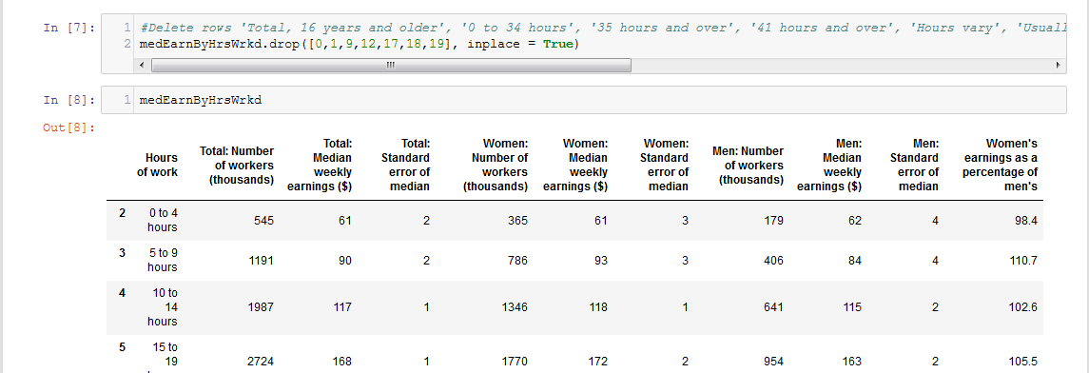
Python Data Wrangling

Slide 5
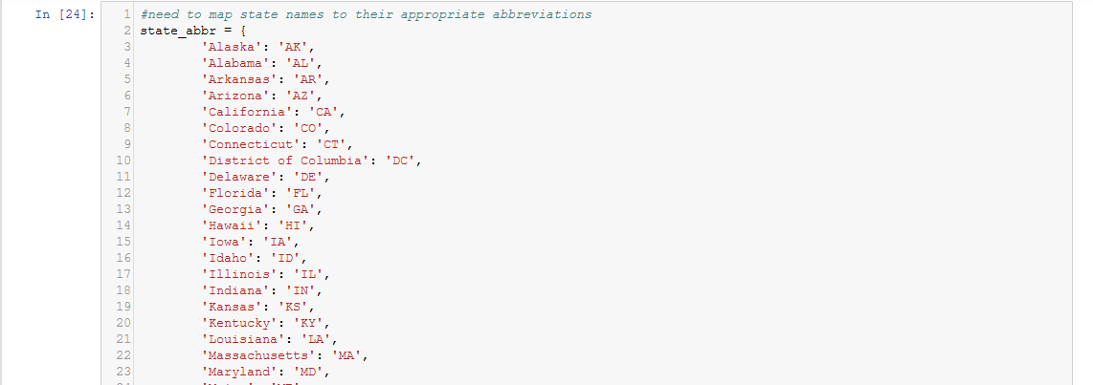
Python Data Wrangling

Slide 6
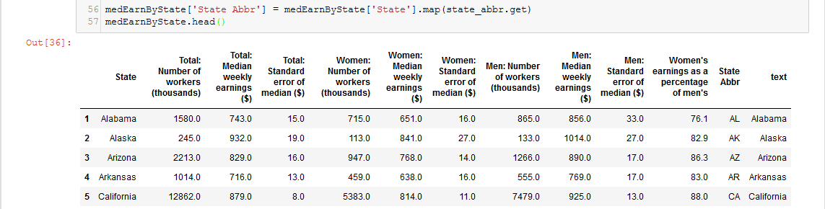
Python Data Wrangling

Slide 7
QuestioQuen 1:
Question 1:
How does the pay gap change based on how many hours someone works?

Slide 8
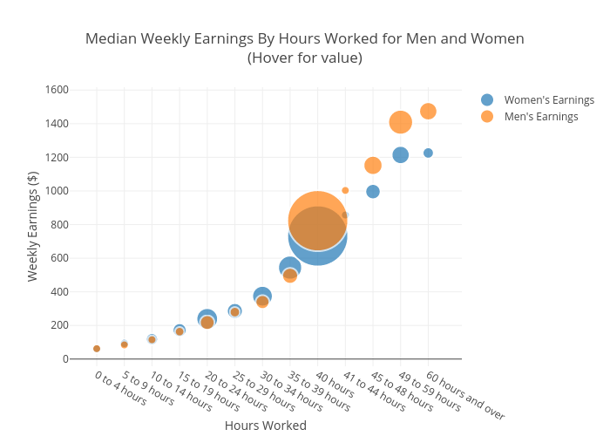

Slide 9
Question 2:
Question 2:
What are the top 10 jobs with the biggest and lowest pay gap?

Slide 10
Note:
Data was not available for occupations employing less than 50,000 people
Many occupations were eliminated

Slide 11
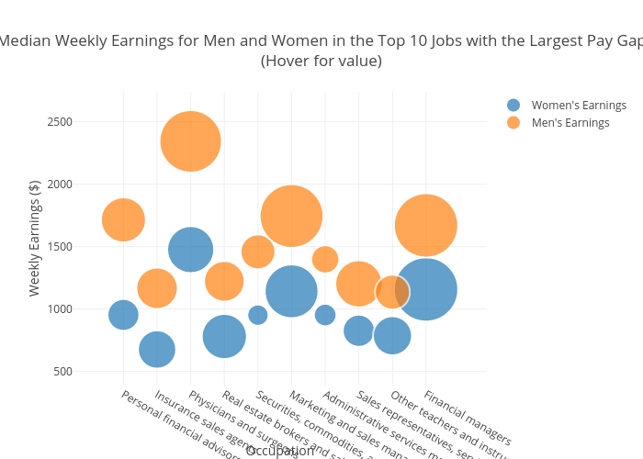

Slide 12
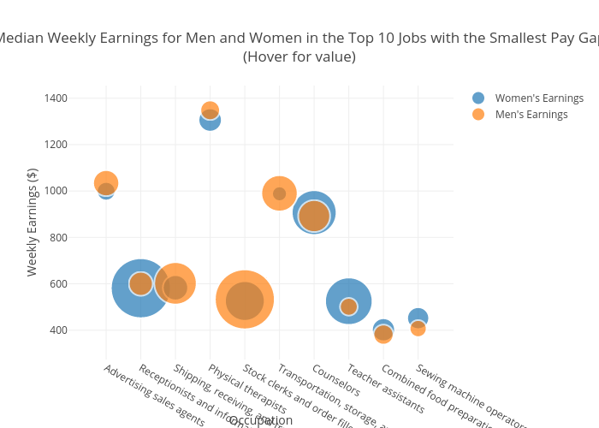

Slide 13
Question 3:
Question 3:
Which region of the country has the largest pay gap? How about the lowest?
*Note: larger sampling error

Slide 14
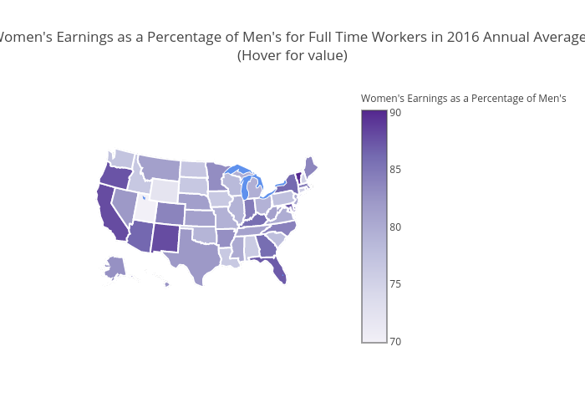

Slide 15
Question 4:
Question 4:
How does the wage gap change based on educational attainment from 1979-2016?
*Note: methodology has changed for the Current Population Survey over time

Slide 16
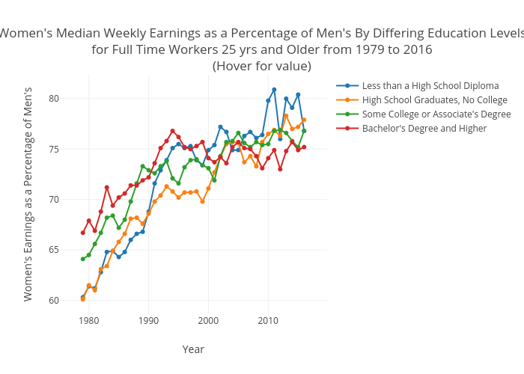

Slide 17
Question 5:
Question 5:
How does the difference in pay change depending on marital status and the presence of children?
Note: Married only includes opposite-sex couples. Other includes people who are never married; widowed; divorced; separated; and married, spouse absent.

Slide 18
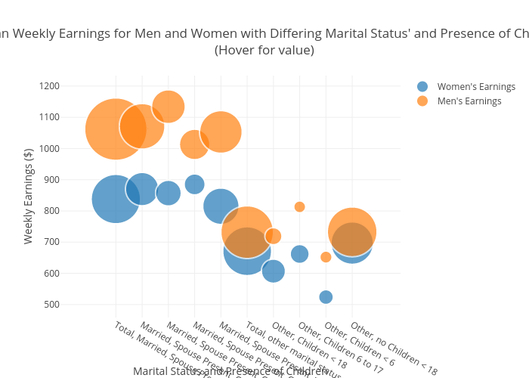

Slide 19
Learning Process, Lessons, and Future Research
Was able to learn a lot more about the nuances of programming in Python with Plotly
Figured out how to program several types of graphs
Was good practice in how to best visualize various datasets
More research could be done on how race, age, and class affect the pay gap
Could bring in more data from other sources

Slide 20
Questions?

