Slide 1
Poker Betting Strategies
DATS 6450_11 Project
By:
Iliana Maifeld-Carucci
Jonathan Hamburg

Slide 2
Motivation
Look at poker betting strategies independent of money or cards

Slide 3
Data Source
Michael Maurer’s IRC Poker Data, University of Alberta
Monthly data from 1995 - 2001
10 – 20 Texas Hold’em
4 rounds of betting
2 rounds, $20 bets
2 rounds, $40 bets

Slide 4
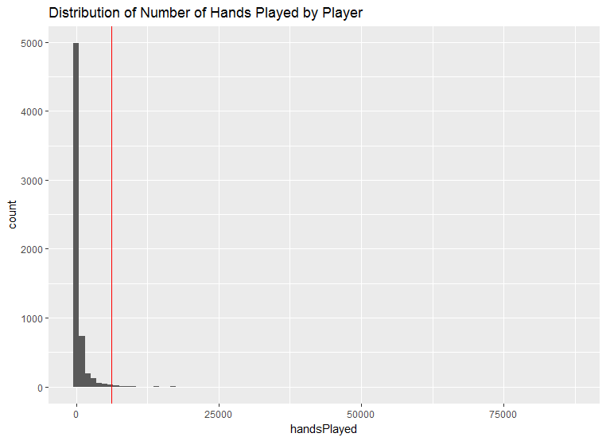
Project Data
Used games from year 2000
Limited to top 1% of players
~60 players
Removed Walks
800,000+ games

Slide 5
Variables
Predictor Variables
Initial bet flop
Initial bet turn
Initial bet river
Avg number of raises per game
Avg VPIP per game
Number of check raises
Position
Note: no money/cards
Dependent Variable
Winner

Slide 6
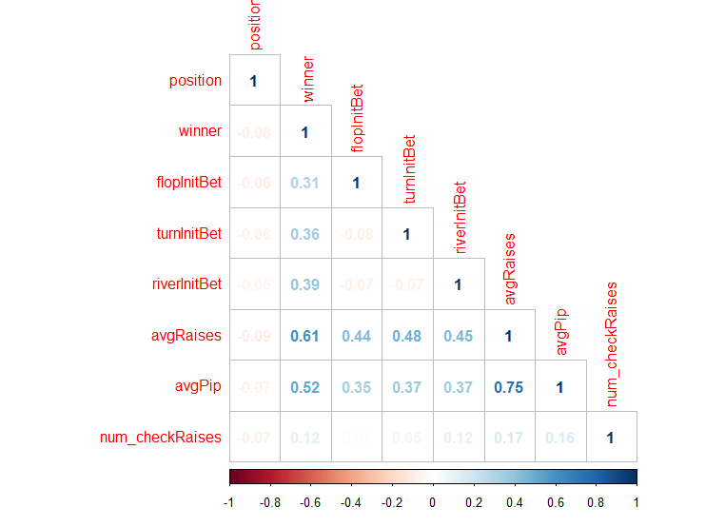
Feature Selection -- Correlation

Slide 7
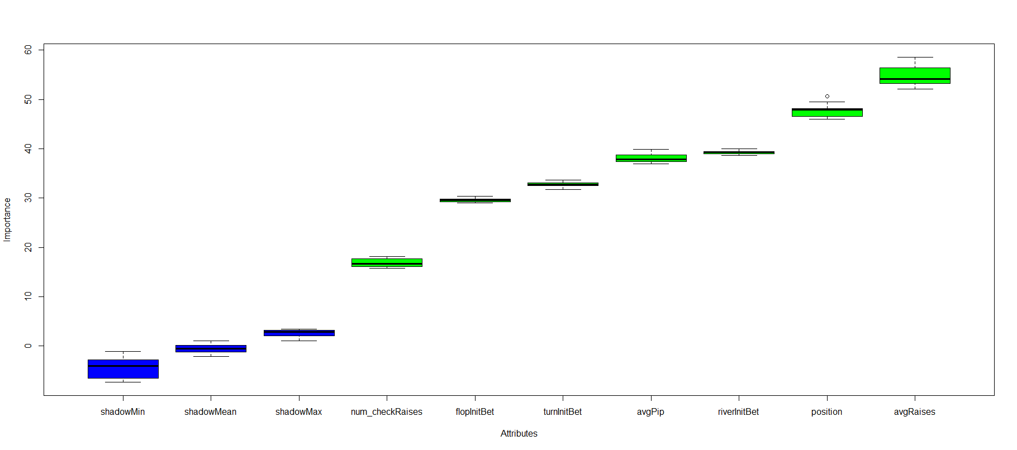
Feature Selection – by Calculation
Logistic Regression
Boruta
Coefficients:
Estimate Std. Error z value Pr(>|z|)
(Intercept) -3.319154 0.009759 -340.114 <2e-16 ***
position -0.002983 0.001489 -2.003 0.0452 *
flopInitBet 2.502891 0.013902 180.043 <2e-16 ***
turnInitBet 2.731119 0.014681 186.034 <2e-16 ***
riverInitBet 3.122253 0.015443 202.180 <2e-16 ***
avgRaises 0.526241 0.019350 27.195 <2e-16 ***
avgPip 0.903009 0.011063 81.623 <2e-16 ***
num_checkRaises 0.632304 0.028953 21.839 <2e-16 ***
---
Signif. codes: 0 ‘***’ 0.001 ‘**’ 0.01 ‘*’ 0.05 ‘.’ 0.1 ‘ ’ 1
(Dispersion parameter for binomial family taken to be 1)
Null deviance: 802800 on 882181 degrees of freedom
Residual deviance: 468622 on 882174 degrees of freedom
AIC: 468638
Number of Fisher Scoring iterations: 6

Slide 8
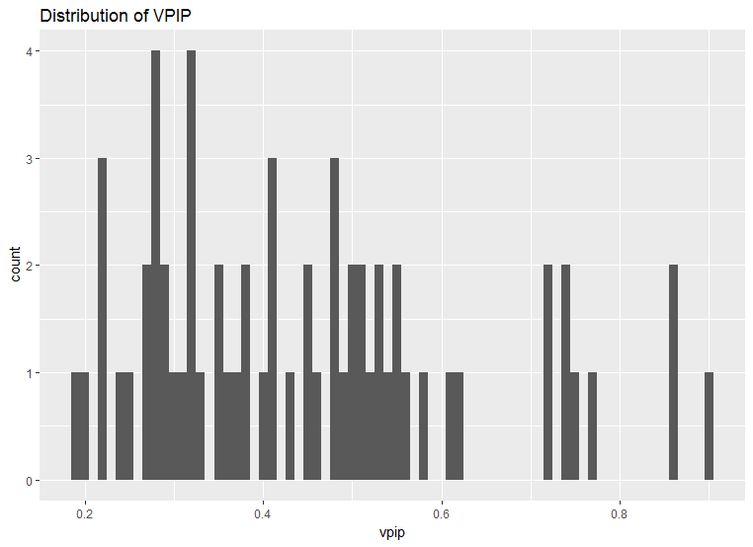
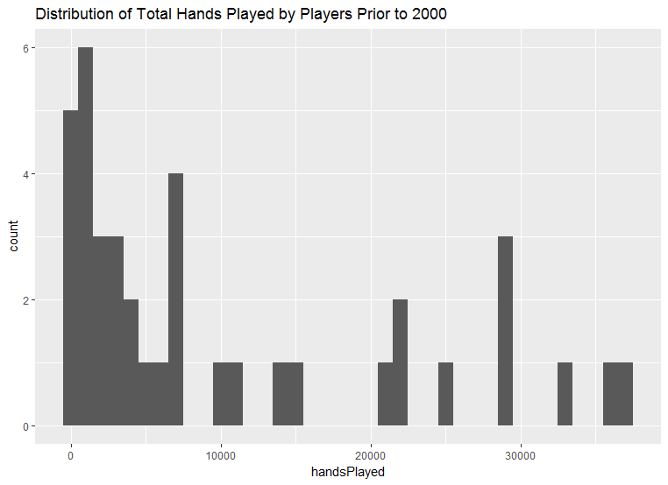
Hierarchies
Voluntarily Puts Into Pot (VPIP)
Equally distributed into 3 categories
Prior experience
Based on games 1995 - 1999

Slide 9





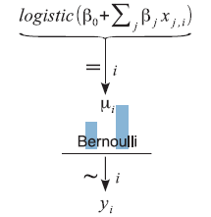
Model 1
Single Hierarchical Model
Grouped by VPIP type
Logistic Regression
Binomial
Figures taken from DBDA2E, Kruschke

Slide 10
Model 2
Single Hierarchical Model
Grouped by prior experience
Logistic Regression
Binomial
Figures taken from DBDA2E, Kruschke

Slide 11
Model 3
Double Hierarchical Model
Grouped by prior experience
Grouped by VPIP type
Logistic Regression
Binomial
Figures taken from DBDA2E, Kruschke

Slide 12
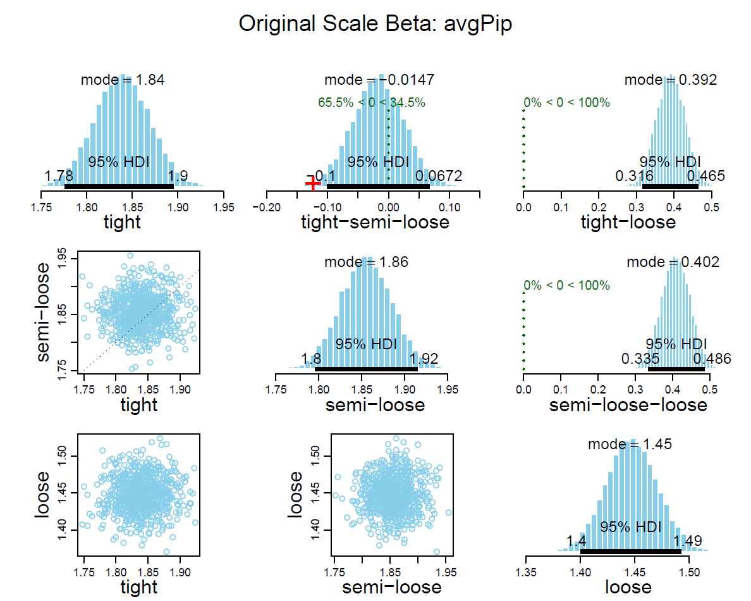
Analysis VPIP model
Loose players have lower number of average chips in the pot than other VPIP types

Slide 13
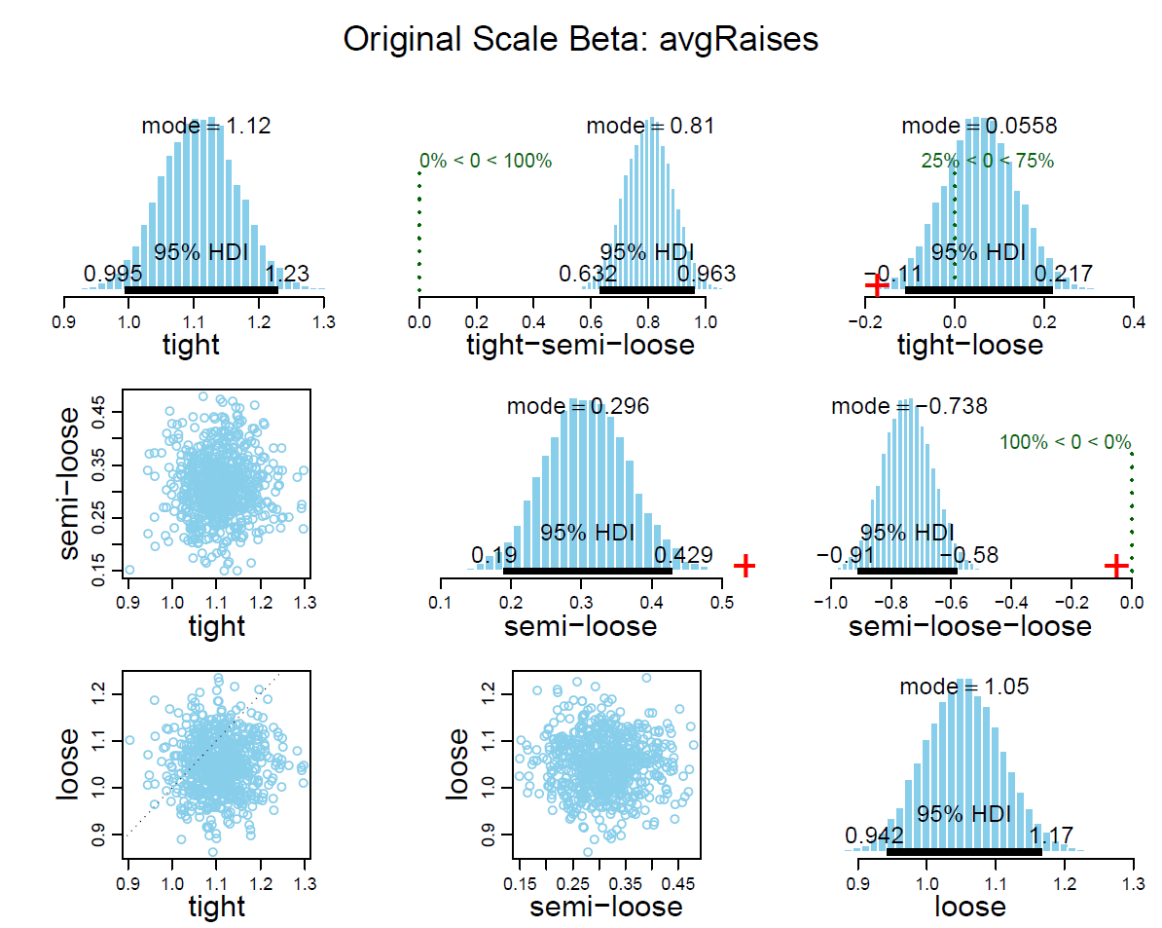
Analysis VPIP model
Semi-loose players raise less than other VPIP groups

Slide 14
Analysis VPIP model
Loose players less likely to make the first bet in each round.
Also have smaller average of chips put into the pot
However they’re more likely on average to raise

Slide 15
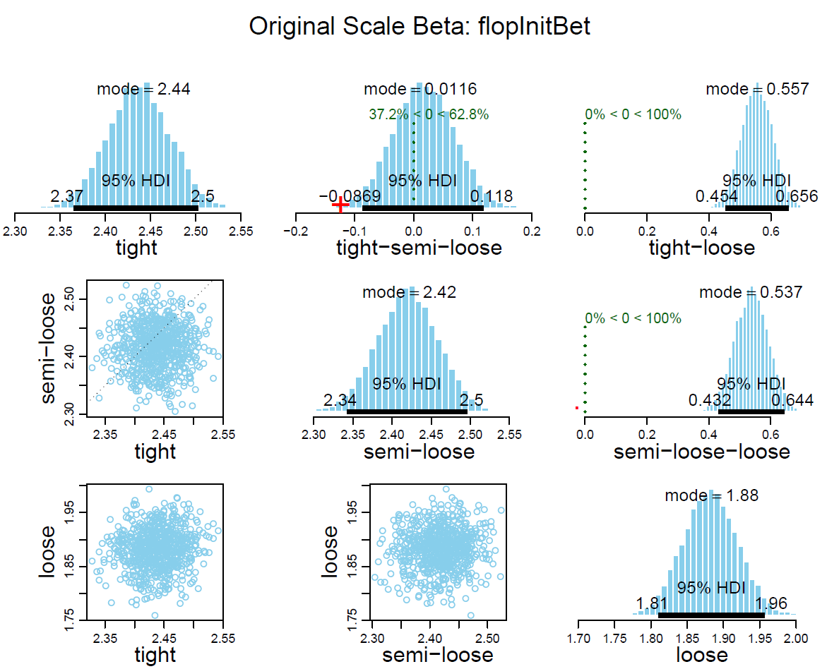
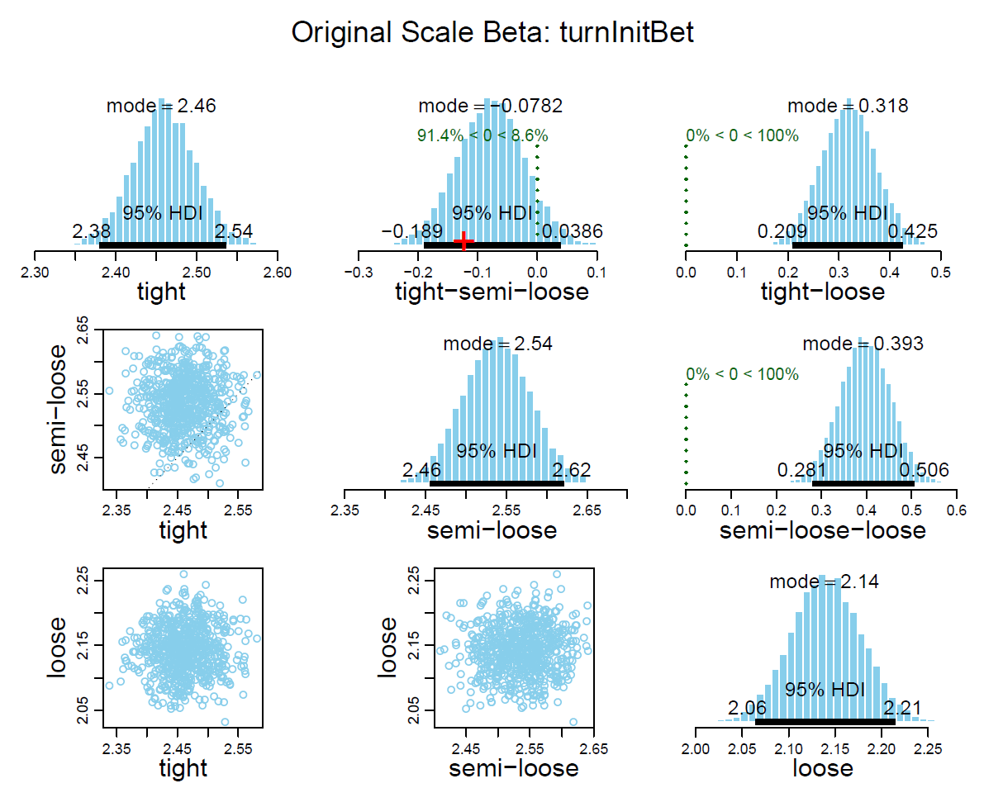
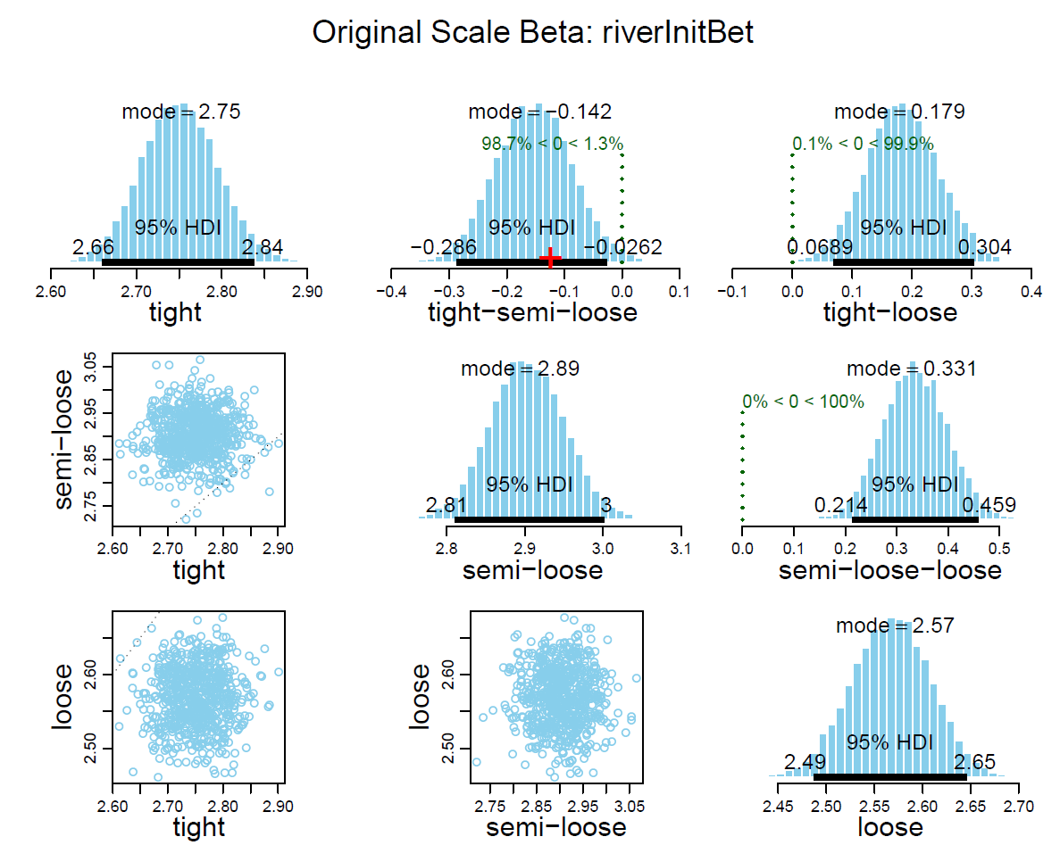
Analysis VPIP model

Slide 16
Analysis Prior Experience model
Experts have greater average of chips in pot per round
Mediocre players have greater average number of raises per round

Slide 17
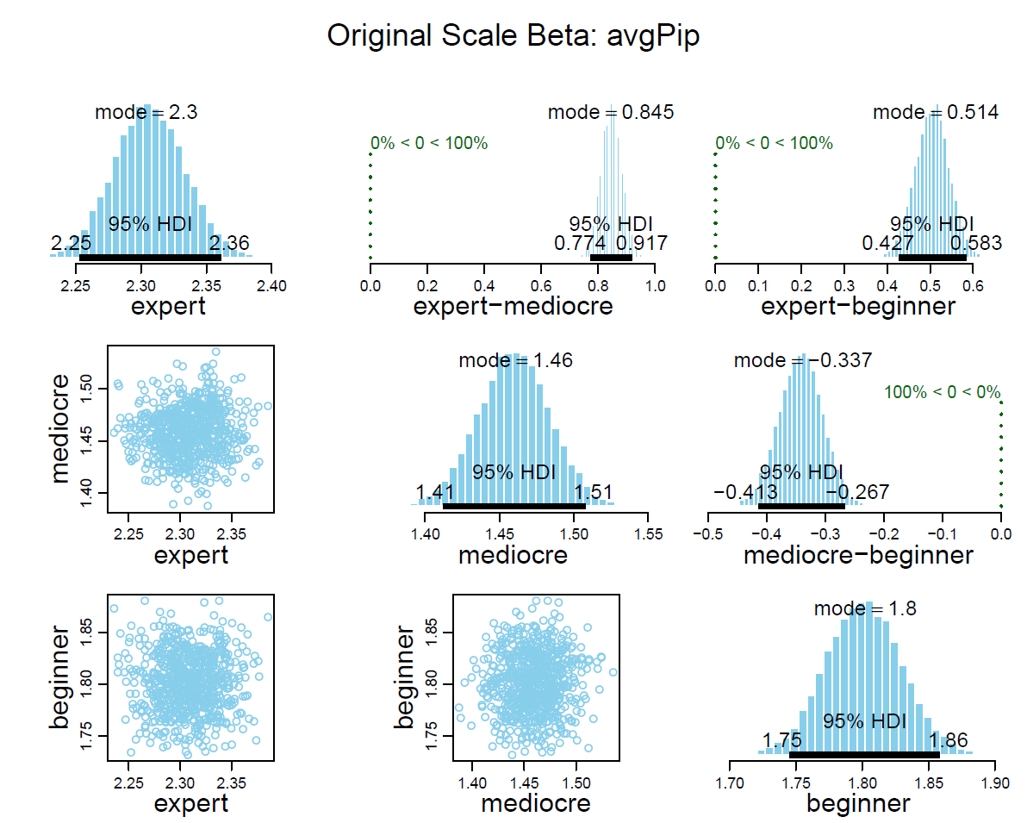
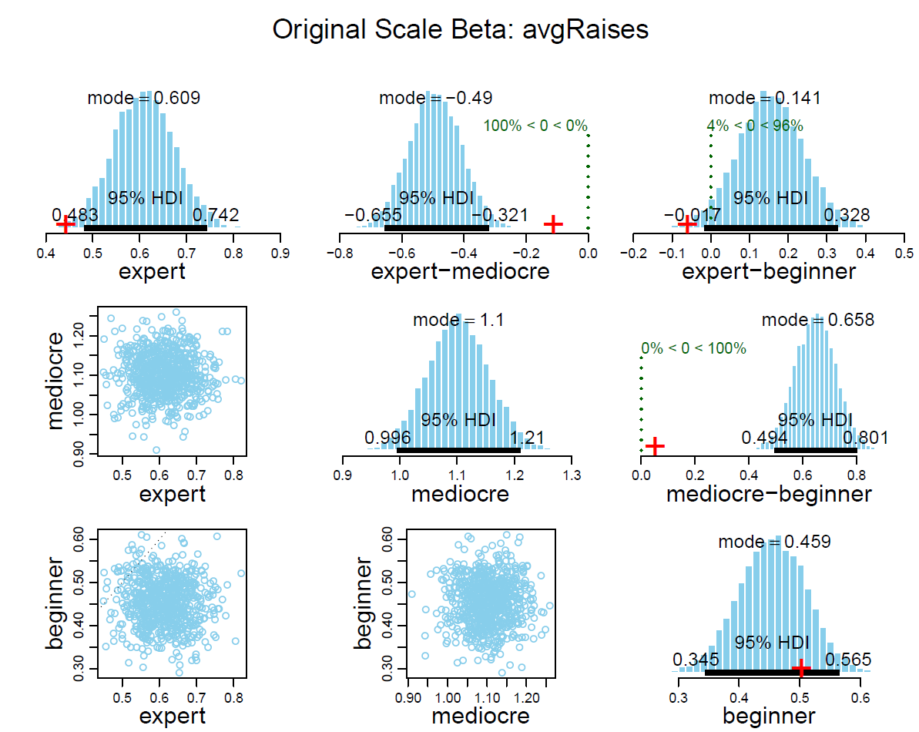
Analysis Prior Experience Model

Slide 18
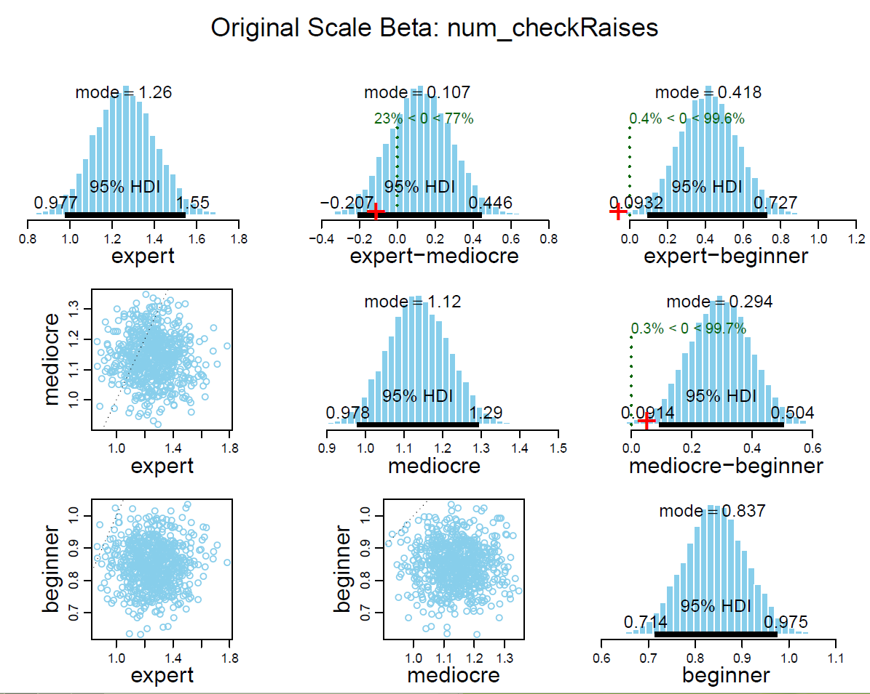
Analysis Prior Experience model
Beginners do fewer check raises

Slide 19
Analysis Prior Experience model
Mediocre players are less likely to have the initial bet
Beginners are more likely to have initial bet during the turn

Slide 20
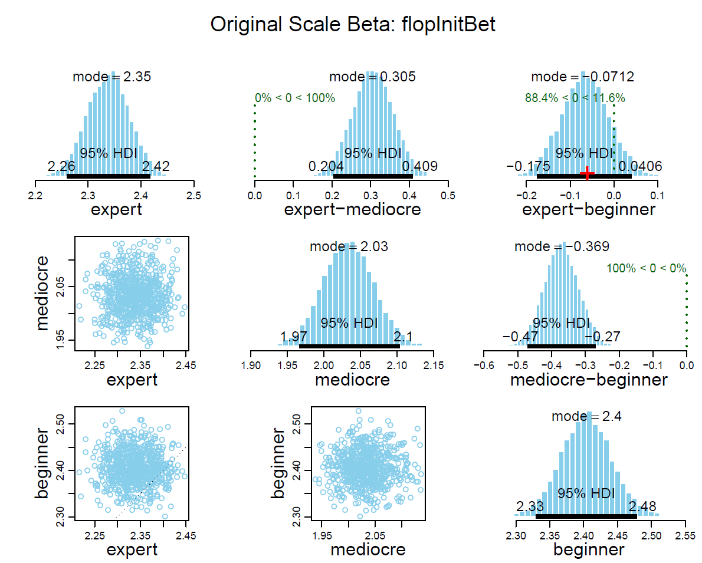
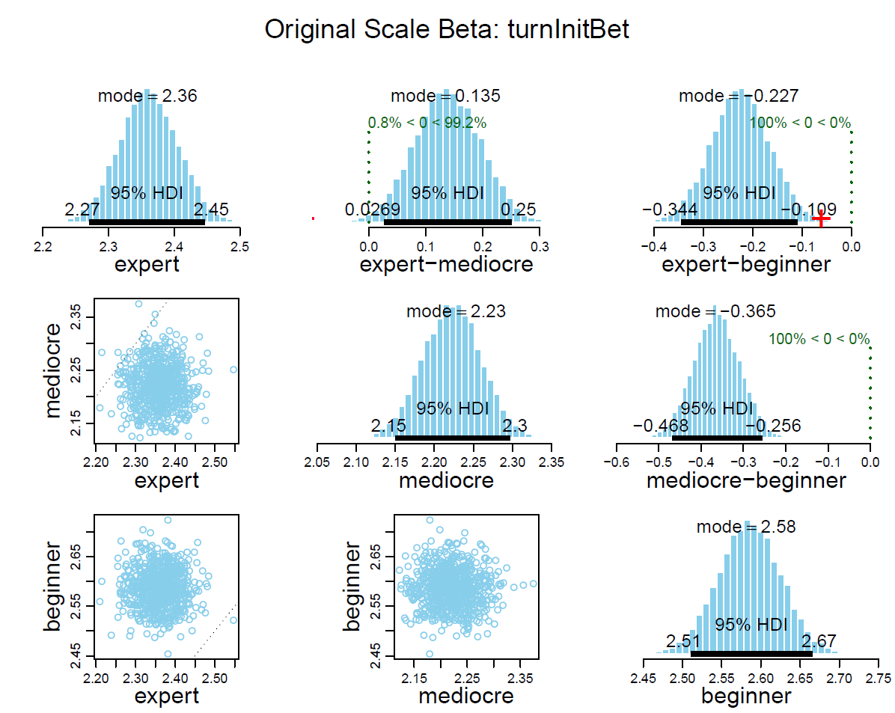
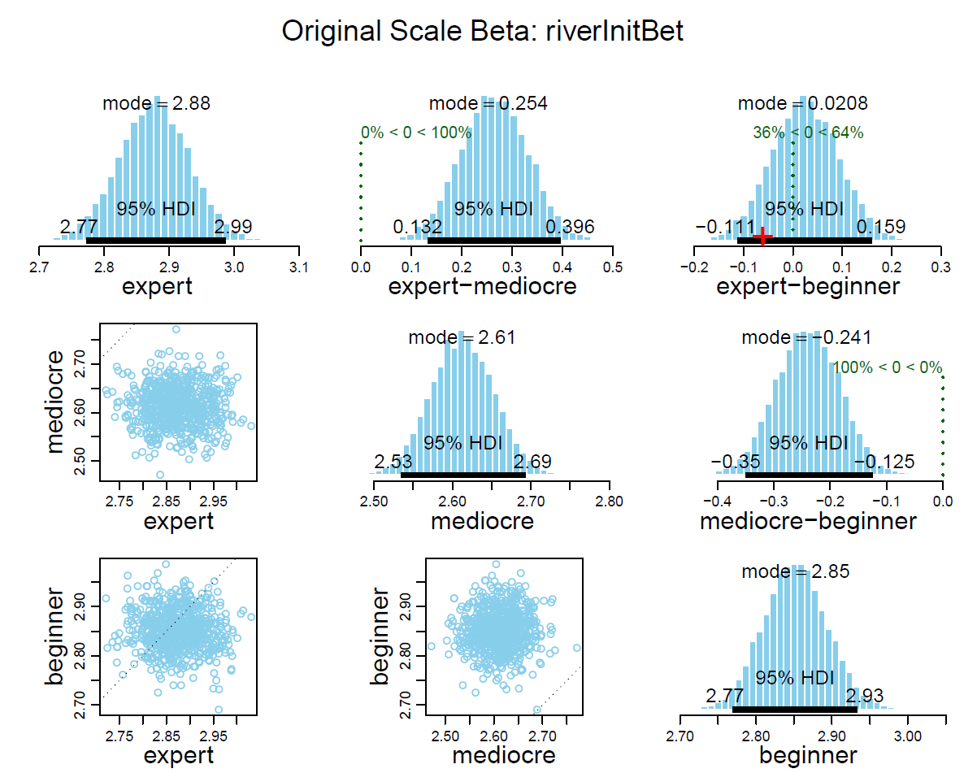
Analysis VPIP model

Slide 21
Analysis Double Hierarchy model
Distribution of prior experience for experts is much wider
No difference between central tendencies
Same conclusions as VPIP model, but strengthened

Slide 22
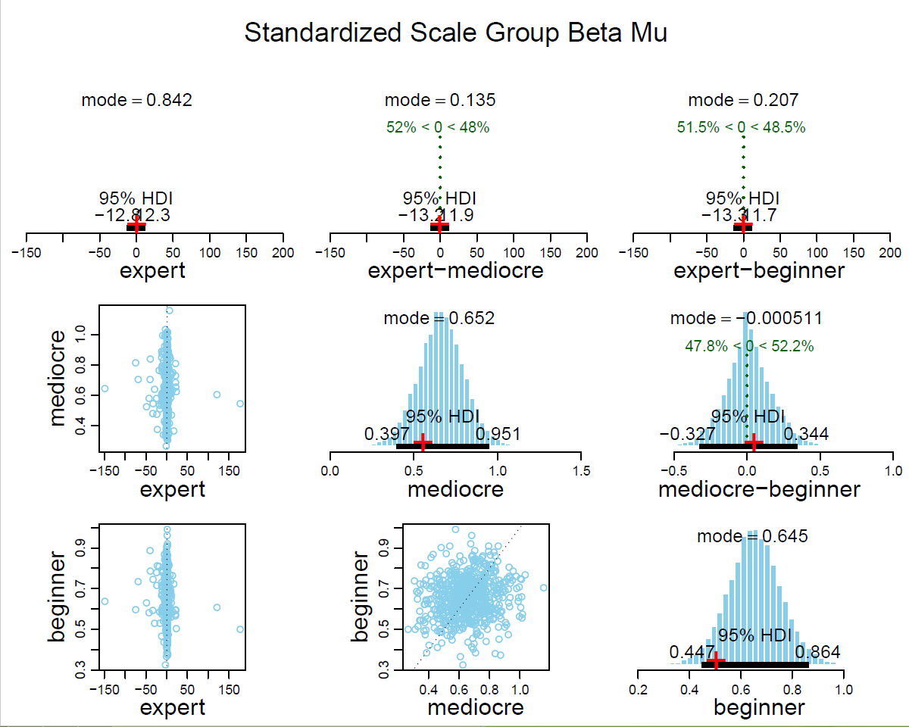
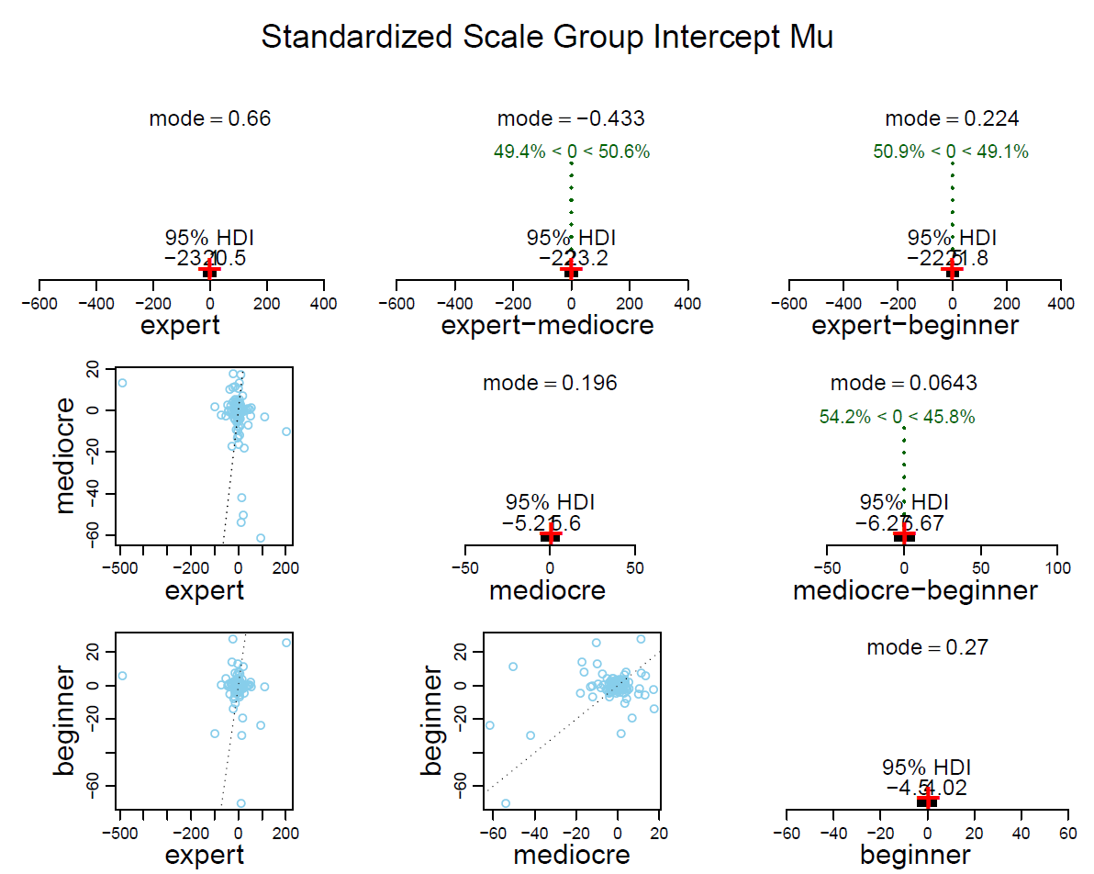
Analysis Double Hierarchy Model

Slide 23
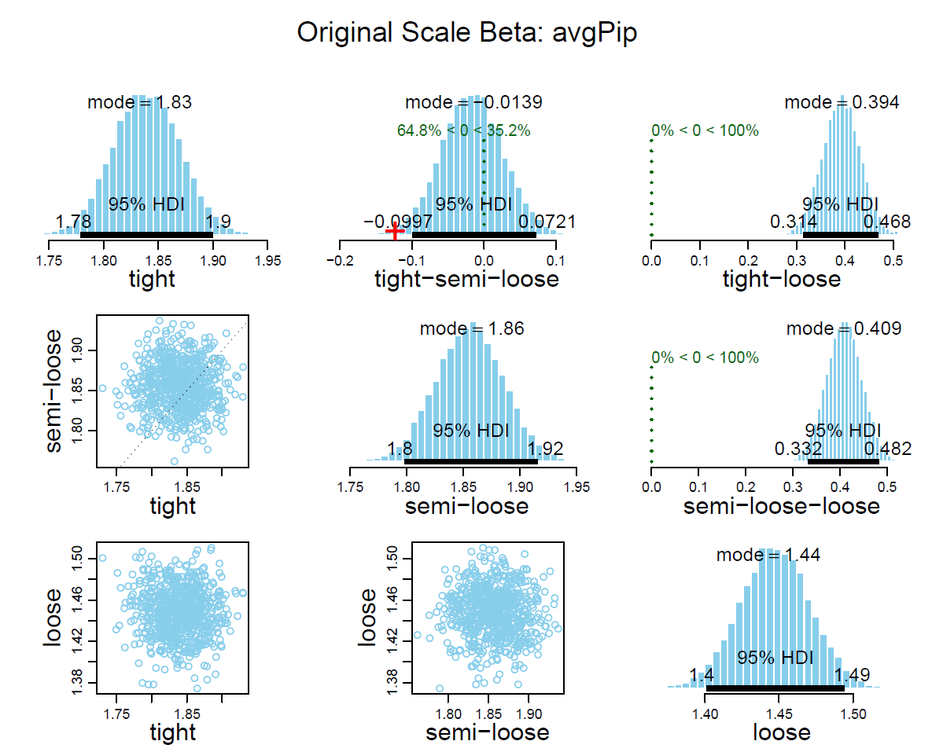
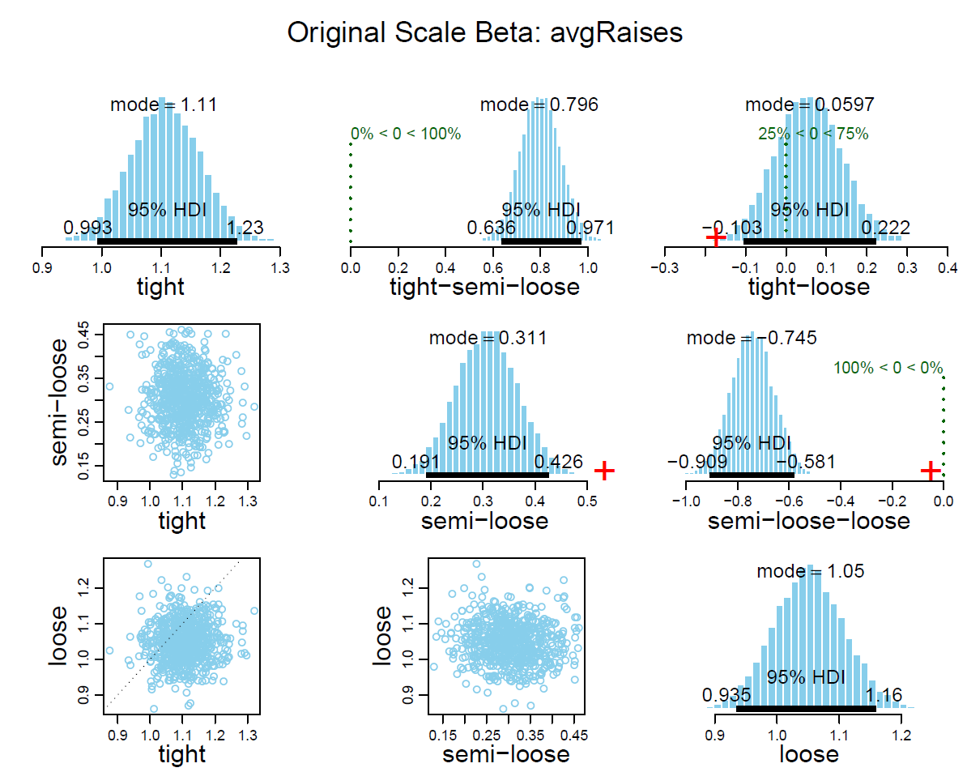
Analysis Double Hierarchy Model

Slide 24
Extensions
Increase the player pool
Add in additional grouping parameters
Number of players in game, number of players per round, Pre-flop Raise (PFR)
Best model based on predictions

