Slide 1

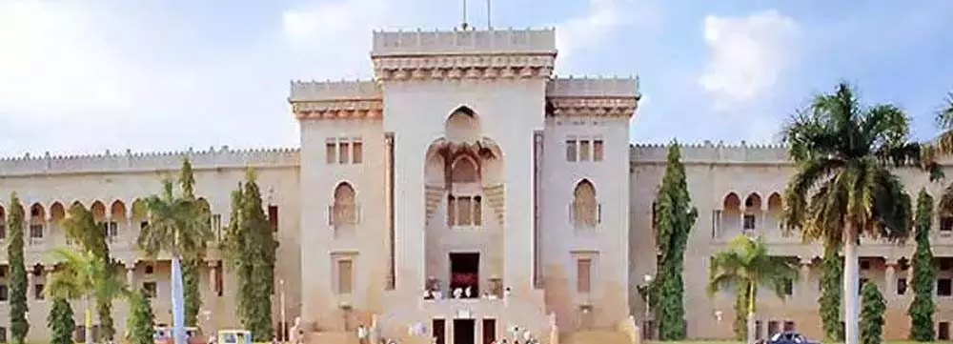


Slide 2











Upload

Slide 3



Founders

