Slide 1
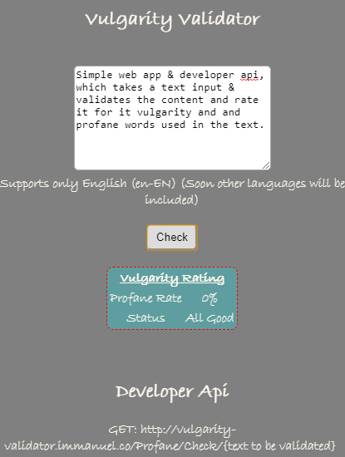
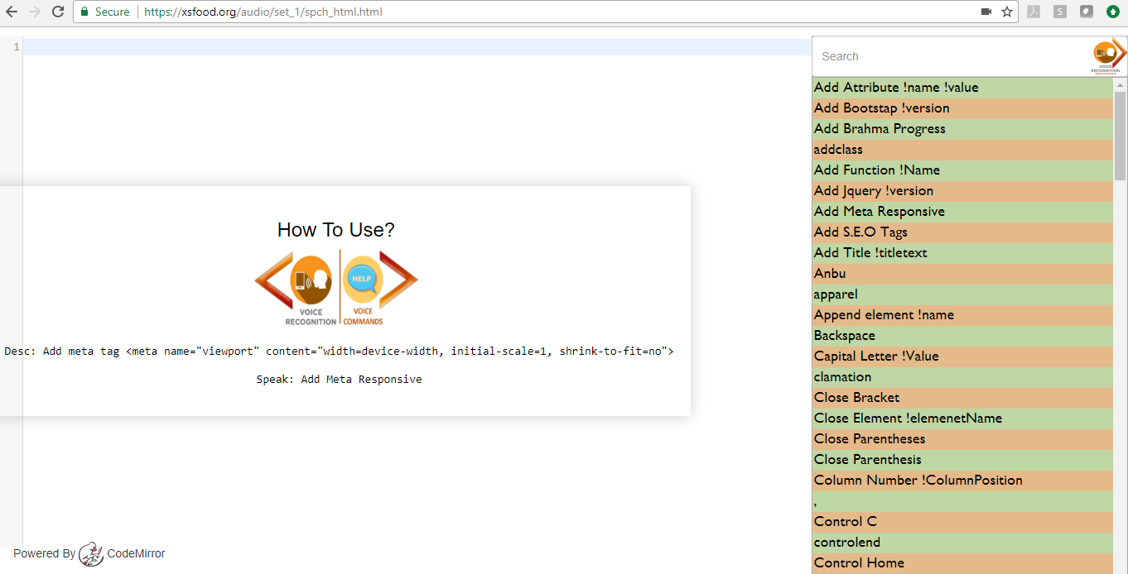

Slide 2
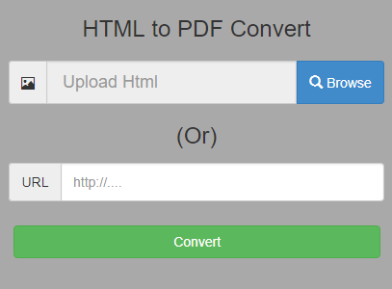
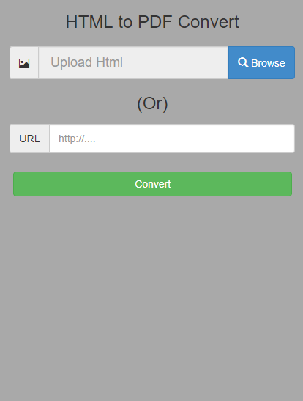
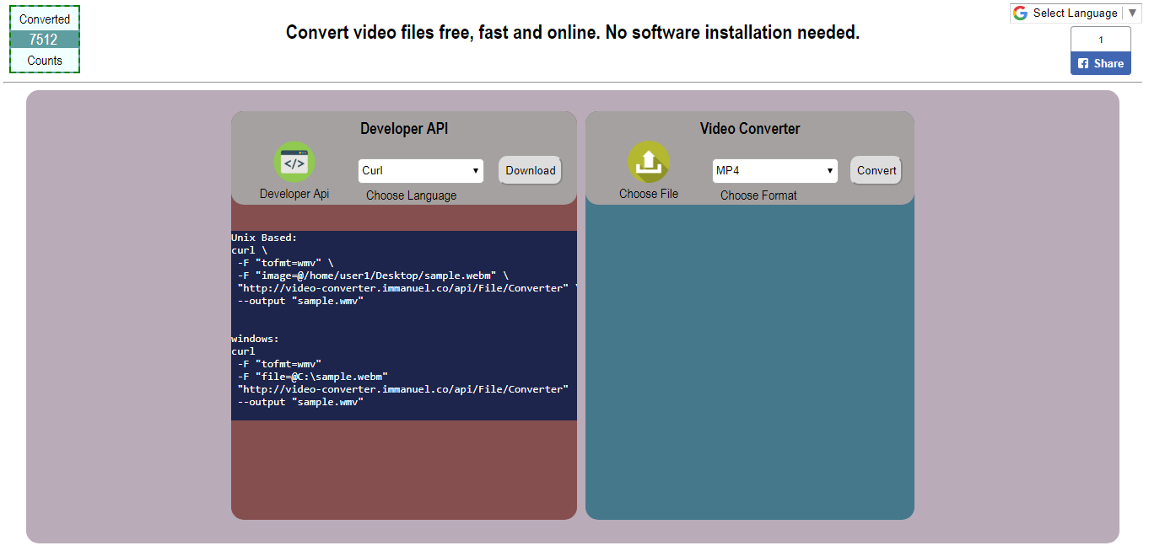


Slide 3



I m m a n u e l
Review & Comment

Slide 4


Immanuel Rate youtube video

Slide 5




Slide 6
My Blog

Slide 7

RAPID
R
A
K

