Slide 1

Basic Details of the Team and Problem Statement
Organization Name: MINISTRY OF ENVIRONMENT
PS Code: SIH1394
Problem Statement Title: VIRTUAL ZOO
Team Name: VICTUS
Team Leader Name: MITHUNKUMAR C
Institute Code: 4962
Institute Name: NATIONAL ENGINEERING COLLEGE
Theme Name: SMART EDUCATION

Slide 2
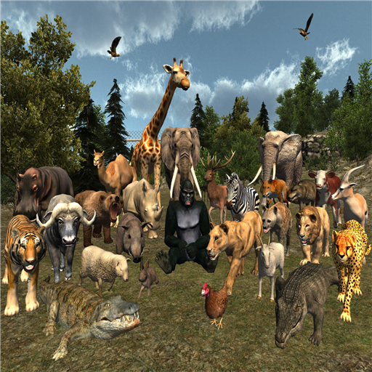
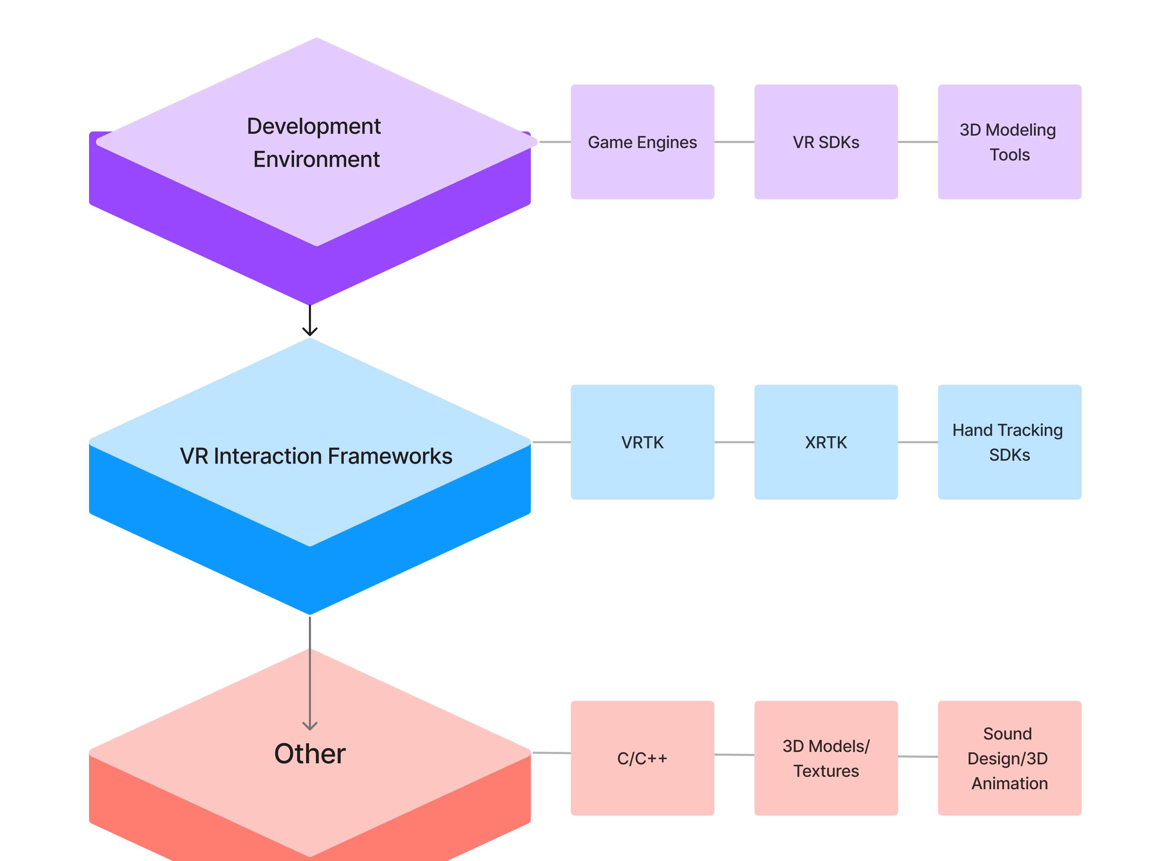
Idea/Approach Details
Simulation
Idea
Hardware and Software Setup: Acquire and set up VR hardware (headsets, controllers) and software (development tools, content creation software).
Content Creation: Create or source 3D models, textures, and audio assets for animals and environments, focusing on realism and quality.
Development: Use VR development software to build the virtual zoo, integrating assets, animations, and user-friendly navigation.
Testing and Iteration: Conduct user testing, address bugs, and optimize performance and user experience based on feedback.
Technology Stack

Slide 3
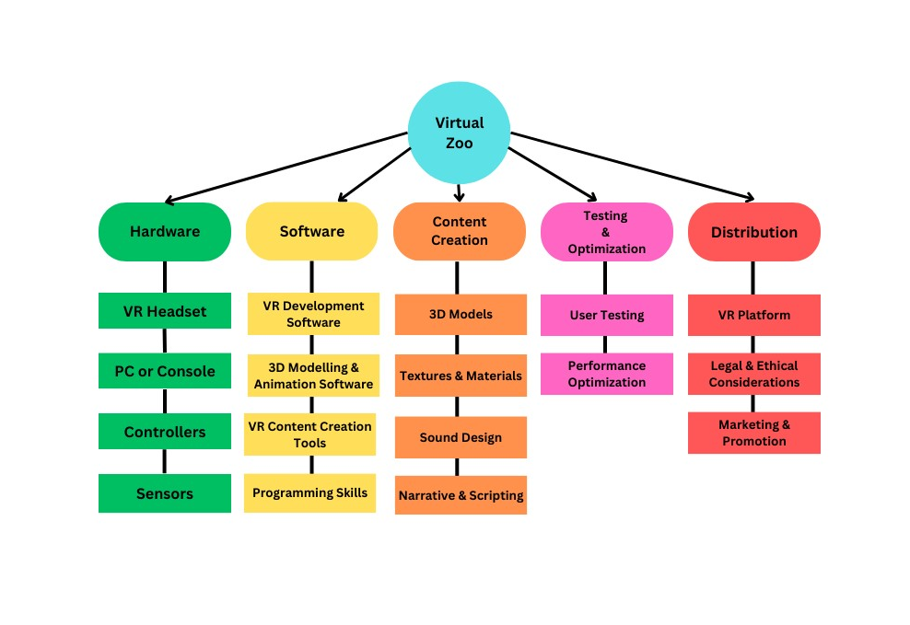
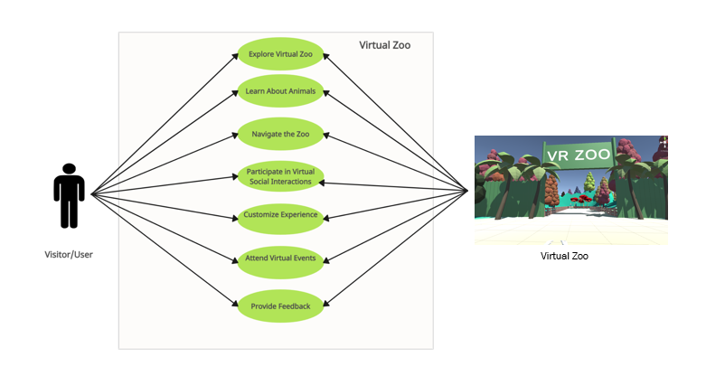
Idea/Approach Details
Use Cases
Dependencies

Slide 4
Team Member Details
Team Leader Name: MITHUNKUMAR C
Branch: BE Stream: CSE Year: III
Team Member 1 Name: KESAVAN S
Branch: BE Stream: CSE Year: III
Team Member 2 Name: SHRI KANNAN D
Branch: BE Stream: CSE Year: II
Team Member 3 Name: M.SANKAR
Branch: BE Stream: CSE Year: II
Team Member 4 Name: BHAVANI G
Branch: BE Stream: CSE Year: II
Team Member 5 Name: SARANYA M
Branch: BE Stream: CSE Year: II
Team Mentor 1 Name: J.KARTHIKEYAN Category: Academic Expertise: AR/VR Domain Experience:
Team Mentor 2 Name: R. VAZHAN ARUL SANTHIYA
Category: Academic Expertise: AR/VR Domain Experience:

