Slide 1

Defined-filter-aided NAS (DFA-NAS)
Truong Nguyen Huy, Vaibhav Jolly, Manmohan Dogra, Harsh Mishra

Slide 2
Introduction
Object recognition is the technique of identifying the object present in images and videos.
Convolution Neural Network (CNN) is one of the most popular ways of doing object recognition.
Recently, RL-NAS has been proven to be very effective in designing networks that achieve state-of-the-art accuracy in the object recognition task
We propose a relaxation of the RL-NAS model by introducing a finite convolution operation set, which contains predefined image processing operations introduced in CS 415.

Slide 3


Deep Reinforcement Learning (Deep RL)
The RL framework is a problem design where an agent learns to maximize their reward-based objectives
Deep RL places the function approximation robustness of ANNs in this optimization problem
In the policy gradient method, we want to learn an ANN parameterization that represents an optimal policy
$$J_{θ}=E_{τ\sim π_{θ}}\left[R(τ)\right]$$

Slide 4



Neural Architecture Search (NAS)
ANN architectural topologies, which traditionally require lots of the programmer's involvement, offer great performance differences if designed efficiently
RL-NAS frames neural architecture design as an RL task, the problem is reduced to learning a controller ANN that optimally samples child ANNs
These child architectures undergo the traditional loss minimization training process and report an accuracy score that updates the controller's parameters
Why DFA-NAS?

Slide 5
Problem Definition!
What's the goal?
We hope to see that DFA-NAS can assemble the well-studied Computer Vision (CV) operations listed below into DFA-CNNs that perform better than traditional CNNs, which learn its convolution operations from scratch
We want to see what CV operation combinations that DFA-NAS thinks to be working best together in aiding CNNs in recognizing object patterns in 2D images
Operations:
XYSobelFiltered
HarrisRMap
HalfScaledUp
HalfScaledDown
GaussianBlurred
RotateImage
MedianBlur

Slide 6

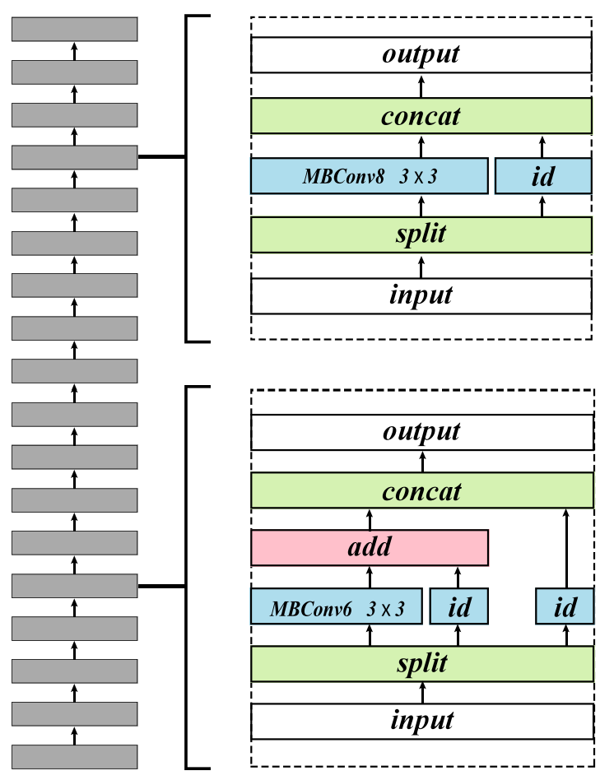
Previous Studies
Fast and Practical Neural Architecture Search using directed acyclic graph architecture containing for vertex features such as: element-wise addition, concat operation, split operation, identity mapping, edge operations as convolution.
This Photo by Unknown Author is licensed under CC BY

Slide 7
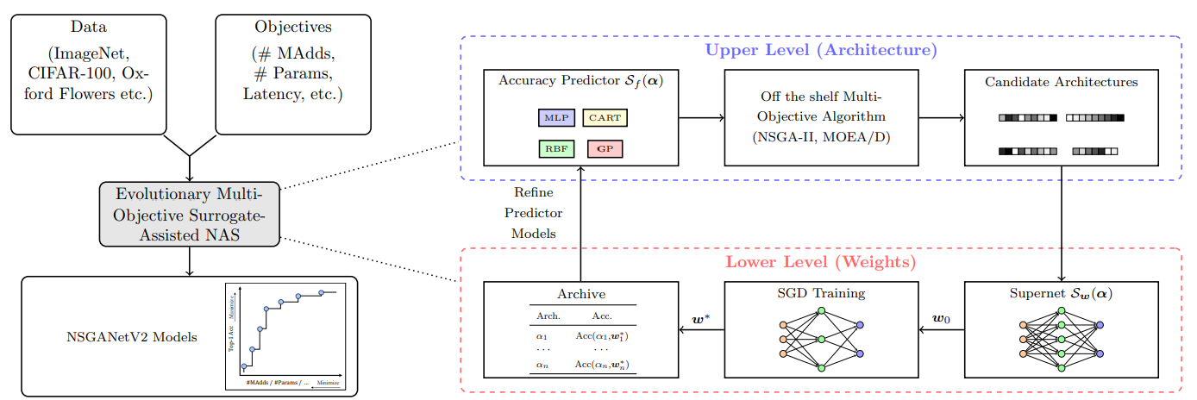
Previous Studies
Surrogate-Assisted Neural Architecture Search is used for generating task specific models. Surrogate level and weight level through supernet. NAS is typically treated as a bi-level optimization problem, where an inner optimization loops over the weights of the network for a given architecture, while the outer optimization loops over the network architecture itself.
This Photo by Unknown Author is licensed under CC BY

Slide 8

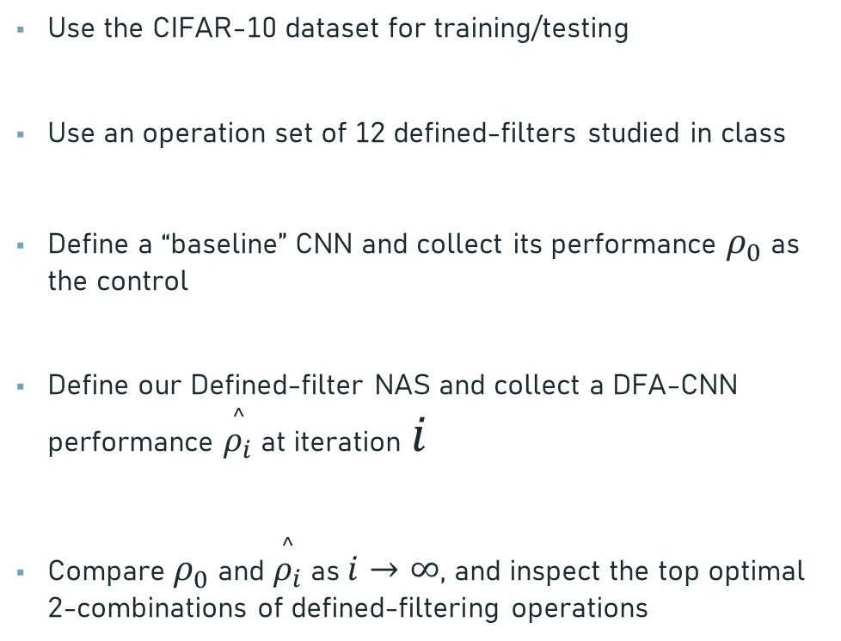
Problem Setups
How is it different from implemented methods?
Use the CIFAR-10 dataset for training/testing
Use an operation set of 12 defined-filters studied in class
Define a “baseline” CNN and collect its performance $ρ_{0}$ as the control
Define our Defined-filter NAS and collect a DFA-CNN performance $\overset{^}{ρ_{i}}$ at iteration $i$
Compare $ρ_{0}$ and $\overset{^}{ρ_{i}}$ as $i→∞$, and inspect the top optimal 2-combinations of defined-filtering operations

Slide 9
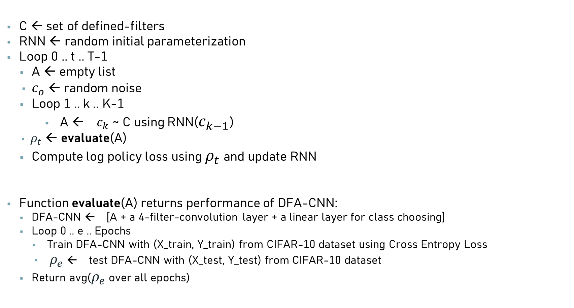
Our NAS main process (pseudo-code)
How are we going to achieve it?
C ← set of defined-filters
RNN ← random initial parameterization
Loop 0 .. t .. T-1
A ← empty list
$c_{o}$ ← random noise
Loop 1 .. k .. K-1
A ← $c_{k}$ ~ C using RNN($c_{k−1}$)
$ρ_{t}$ ← evaluate(A)
Compute log policy loss using $ρ_{t}$ and update RNN
Function evaluate(A) returns performance of DFA-CNN:
DFA-CNN ← [A + a 4-filter-convolution layer + a linear layer for class choosing]
Loop 0 .. e .. Epochs
Train DFA-CNN with (X_train, Y_train) from CIFAR-10 dataset using Cross Entropy Loss
$ρ_{e}$ ← test DFA-CNN with (X_test, Y_test) from CIFAR-10 dataset
Return avg($ρ_{e}$ over all epochs)

Slide 10
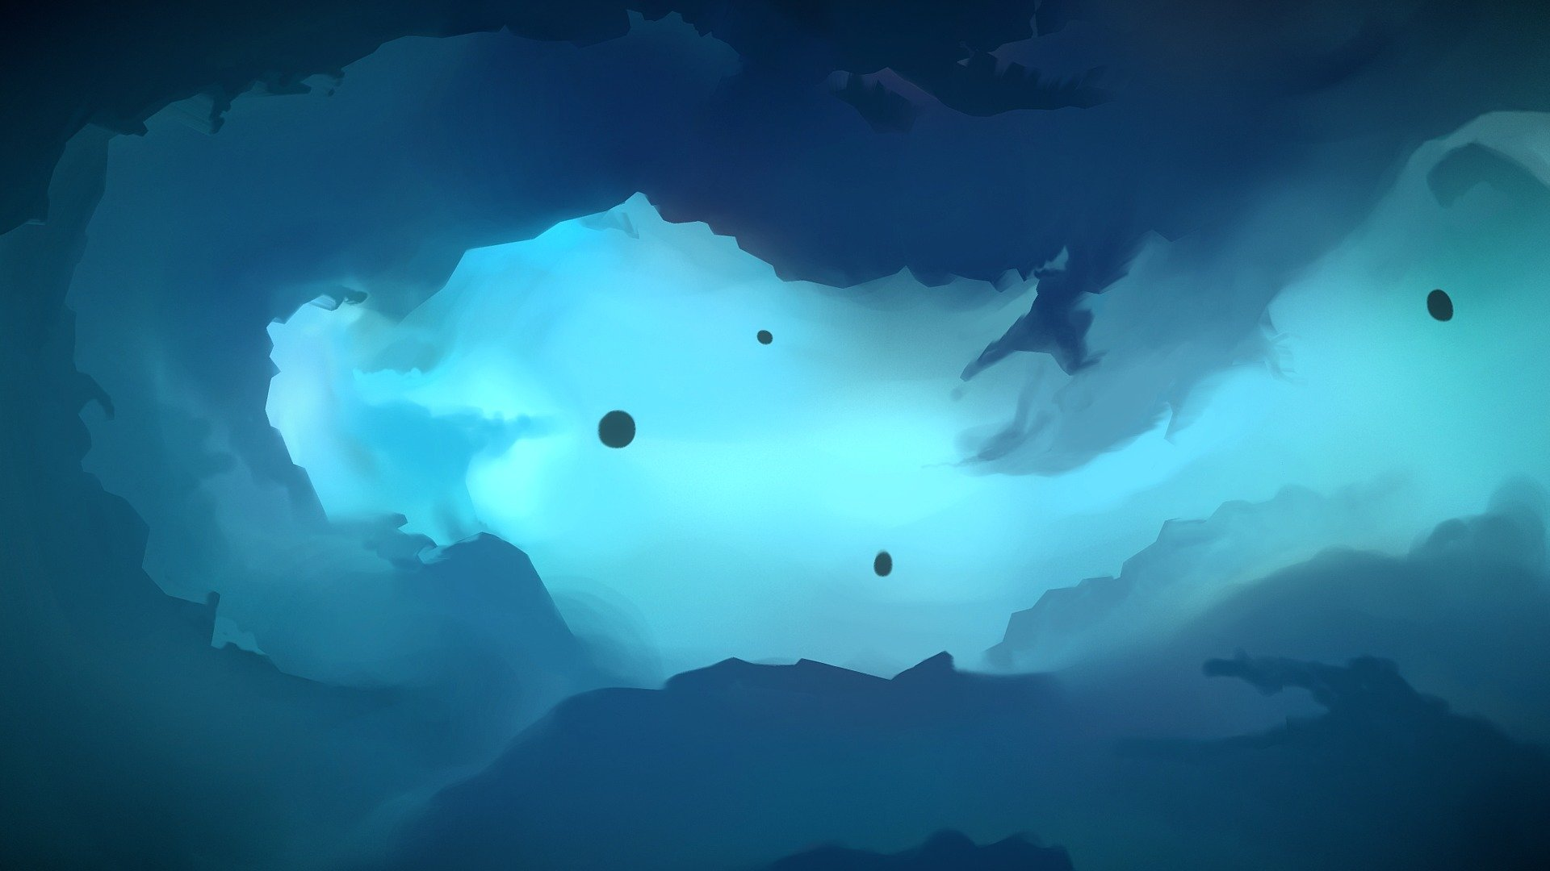
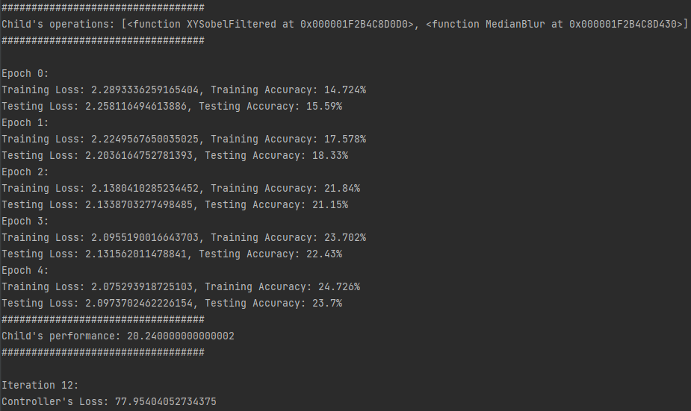
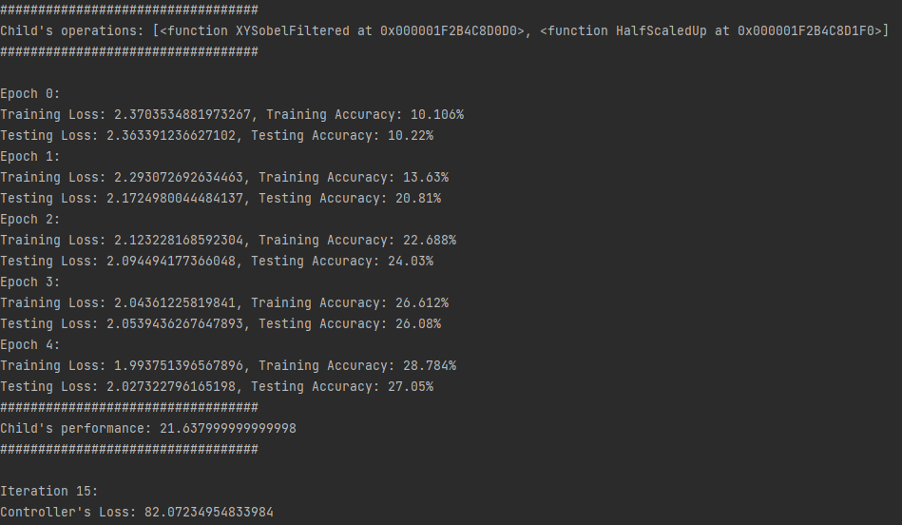
Results
This Photo by Unknown Author is licensed under CC BY

Slide 11

Assumptions
Gray-scaled CIFAR-10 images is analogous in the context of CNN fitting w.r.t. their RGB format
There exists no performance upper-bound when the complexity of the model is scaled up
5 epochs is enough for DFA-CNNs to express their generalization capabilities
Instead of yielding the last performance, we average the performance over epochs to inspect the convergence rate aided by the defined-filters

