Slide 1
TESTBED2 SUMMARY

Slide 2
5G SA RAN design and implementation study is completed
RAN/Core/Infra equipment procurement finalized
Openstack/VMWare/OSM/VM deployment
5G SA E2E; 2 x DNNs
VITAL-5G platform hosted in ORO
3 x VMs
VPN connectivity between ORO & partners
stil in definition of network interfaces
2 slice manual implementation
Performance validated
Device validation in SA – ongoing
1 device validated HUA CPE Pro2
Service slice automation – ongoing
API call for UE/SIM provisioning
Monitoring solution - ongoing

Slide 3
Use case 1: Programmable data plane for smart grid / eBPF Telemetry (SealedGrid)
Use case description
Challenge to be solved
What information is needed
Other competitors (uniqueness of solution)

Slide 4
Use case 2: SSI (self sovereign identity) + smart grids (SealedGrid)
Use case description
Challenge to be solved
What information is needed
Other competitors (uniqueness of solution)

Slide 5
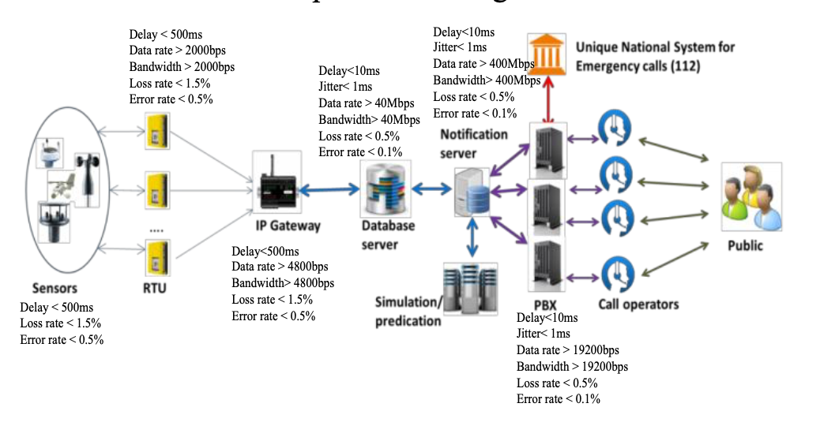
Use case 3: Time Sensitive Networks for IoT (VITAL-5G, Sealed Grid, SWITCH)
Goal: Minimum end-to-end (event to alert) delay
Traditional solution: app-level metrics (disaster early warning)
Research opportunity: Network level telemetry
Article on Beia’s Switch use-case: https://doi.org/10.5281/zenodo.1162888

Slide 6
Use case 4: Blockchain + GraphSense (DEFRAUDIFy)
GraphSense (https://graphsense.info) is an open-source solution with enables the granular analysis of cryptocurrency ledgers.
Each deployment consists of multiple components:
Ingestion - Blockchain clients
Storage - Database (Cassandra)
Transformation - (Spark)
Visualisation - APIs and Dashboards
Very processing intensive application (TBs of storage, and 100s of GB of RAM).
Intensive communication between components
Optimization opportunities at both processing and network level
(10Gbps links are used in the reference deployment)

Slide 7
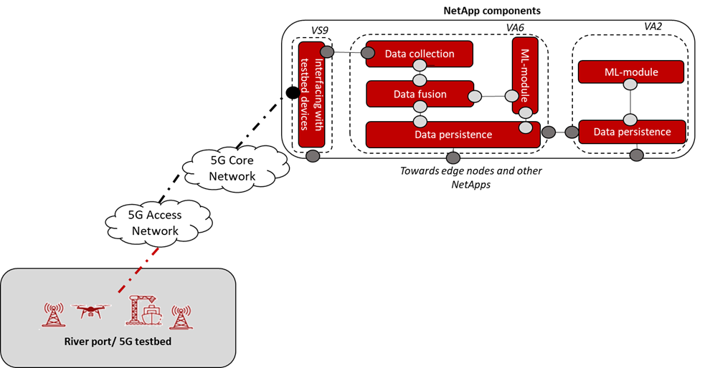
Use case 5: Telemetry + Service Function Chaining/NetApps (VITAL-5G)
Use case description
Challenge to be solved
What information is needed
Other competitors (uniqueness of solution)

Slide 8
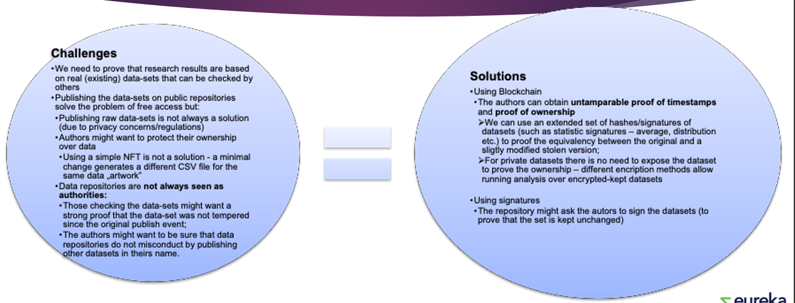
Use case 6: open data and blockchain (SMARDY)
Use-case Data-Transparency & Open-Proprietary Data Marketplace

