Slide 1
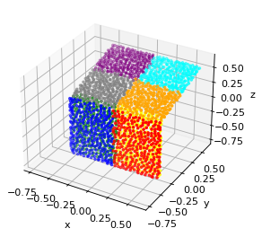
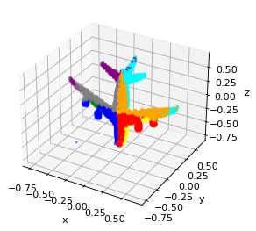
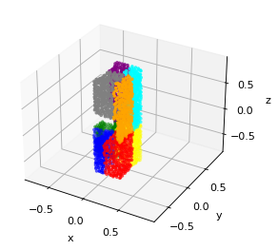
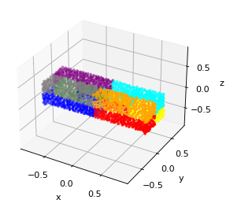
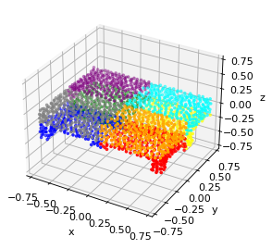
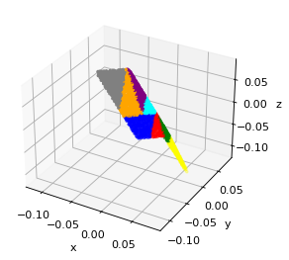
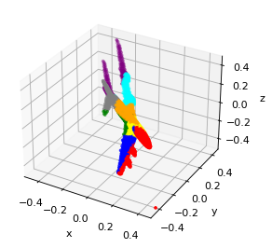
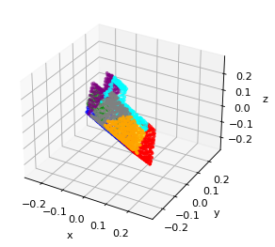
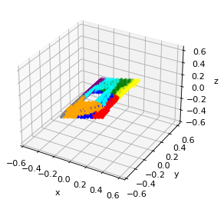
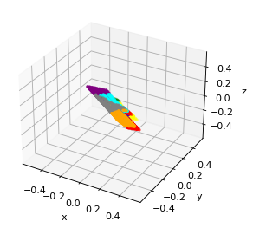
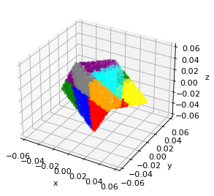
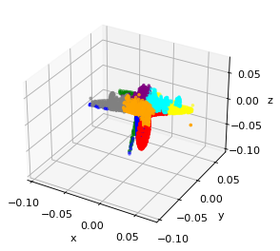
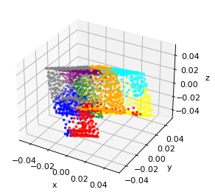
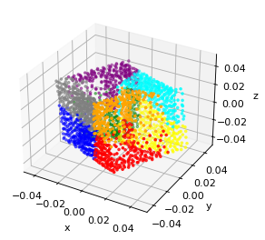
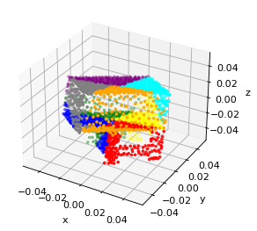
Original
Transformed
“Normalized”

Slide 2









Initial Point Feature
Logits for Segmentation
Input
Skip Connections
Point Feature
$$n×3$$
$$n×3$$
$$n×3$$
$$n×8$$
$$n×d$$
$$n×C_{s}$$
Pre-align
Align
MLP
K-D Tree Bottom-up Flow
K-D Tree Top-down Flow
MLP Classifier
$$1×D$$
$$1×D$$
Point Cloud Feature
Logits for Classification
MLP Classifier
$$1×C$$

Slide 3
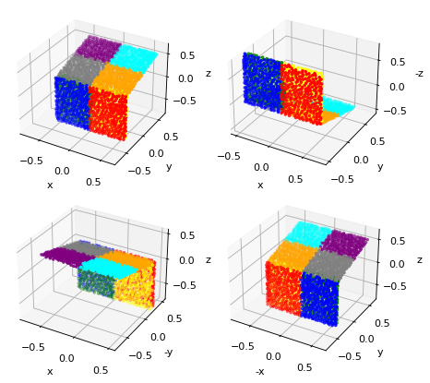
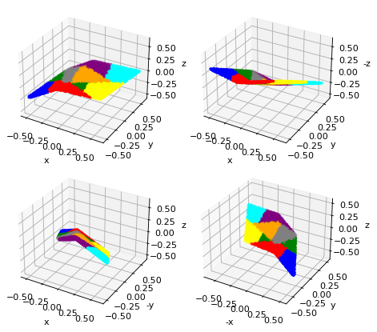
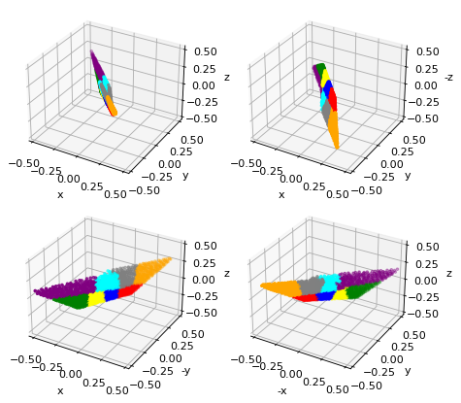
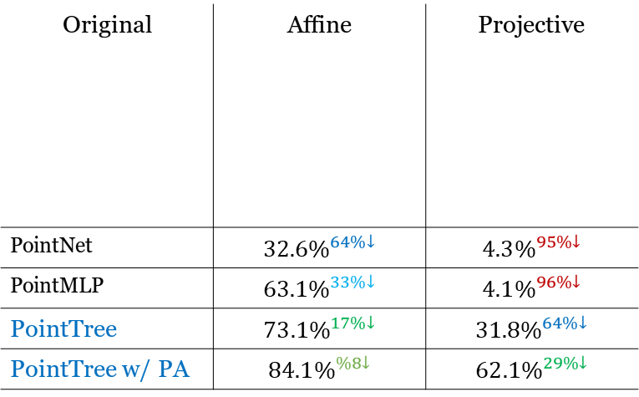
S
Original | Affine | Projective
PointNet | $$32.6\%^{64\%↓}$$ | $$4.3\%^{95\%↓}$$
PointMLP | $$63.1\%^{33\%↓}$$ | $$4.1\%^{96\%↓}$$
PointTree | $$73.1\%^{17\%↓}$$ | $$31.8\%^{64\%↓}$$
PointTree w/ PA | $$84.1\%^{\%8↓}$$ | $$62.1\%^{29\%↓}$$
B
A
C
D
E
F
H
G
{
A
B
C
D
E
F
G
H
(a)
(b)

Slide 4
S
Point Cloud
Original K-D Tree
Relaxed K-D Tree
Relaxed K-D Tree on Rotated Point Cloud
S
S
S

Slide 7
Encoder
Segmentation Model

Slide 8
(a)
(b)

Slide 9
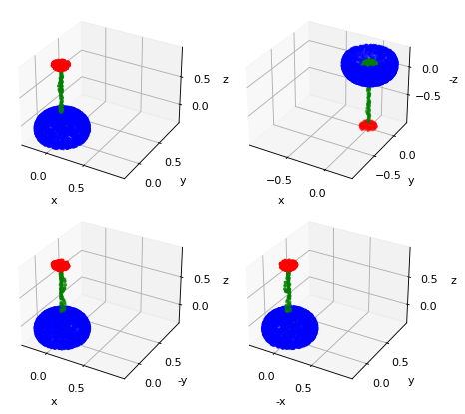
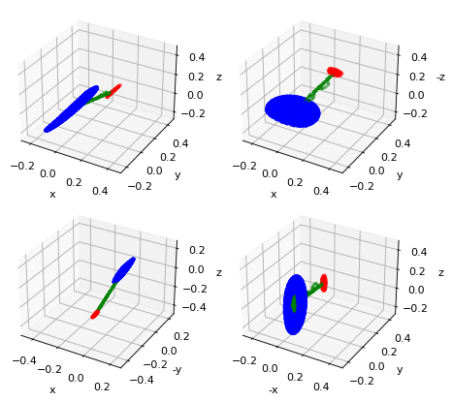
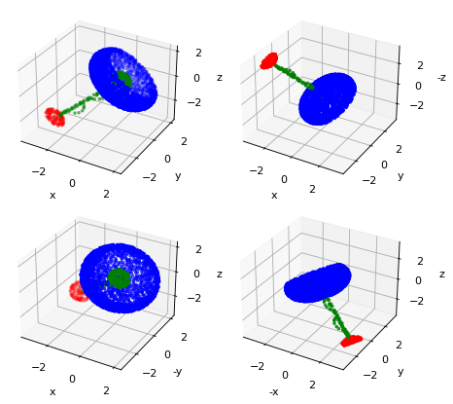


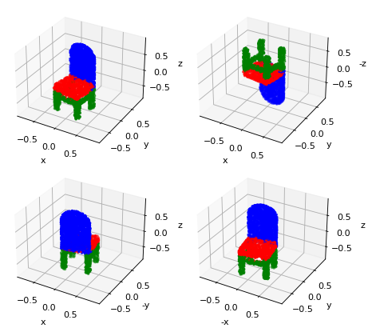
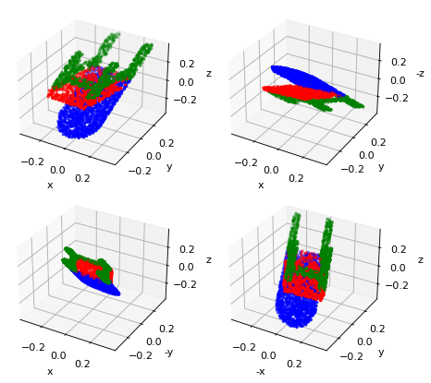
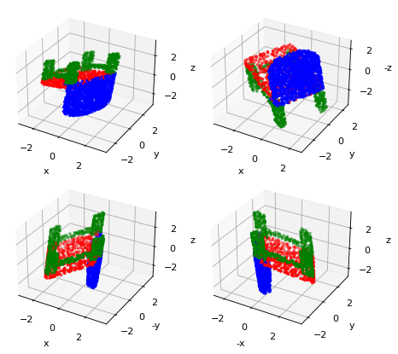
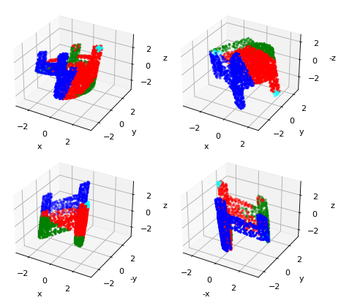
Original (GT) | Affine (GT) | Affine w/ PA (GT) | Baseline (PointNet) | PointTree

Slide 10







Initial Point Feature
Input
$$n×3$$
$$n×3$$
T-Net
$$n×3$$
$$n×8$$
Point Cloud Feature
Logits for Classification
Pre-align
MLP
K-D Tree Bottom-up Flow
MLP Classifier
$Align$ment Affine
$$3×3$$
$$1×D$$
$$1×C$$
$$⊗$$
Construct Relaxed K-D Tree

Slide 11




PointTree Def
Initial Point Feature
Input
T-Net
$$n×3$$
$$n×3$$
$$n×3$$
$$n×8$$
Point Cloud Feature
Logits for Classification
Pre-align
$$⊗$$
MLP
K-D Tree Bottom-up Flow
MLP Classifier
$$1×D$$
$$1×C$$
$Align$ment Affine
$$3×3$$
$$⊗$$
Construct Relaxed K-D Tree

Slide 12






Initial Point Feature
Intermediate Point Feature
Input
Skip Connections
$$n×3$$
$$n×3$$
T-Net
$$n×3$$
$$n×8$$
$$n×d$$
$$n×8$$
Point Cloud Feature
Logits for Classification
Pre-align
MLP
K-D Tree Bottom-up Flow
K-D Tree Top-down Flow
MLP
K-D Tree Bottom-up Flow
MLP Classifier
$Align$ment Affine
$$3×3$$
$$1×D$$
$$1×D$$
$$⊕$$
$$1×D$$
$$1×C$$
Point Cloud Feature
$$⊗$$
Skip Connection
Construct Relaxed K-D Tree

Slide 13
