Slide 1
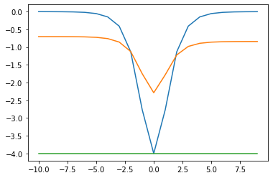
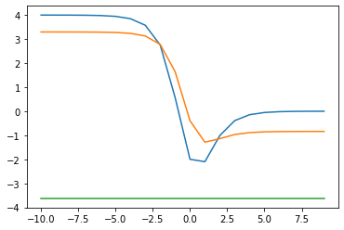
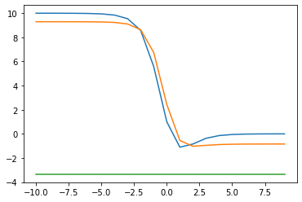
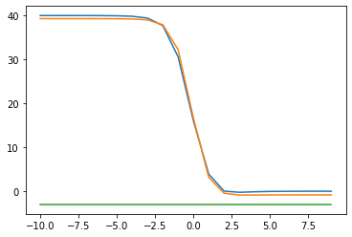










$$d=0$$
$$E$$
$$d=2$$
-Classical
$$E$$
-Quantum
-Exact
-Classical
-Quantum
-Exact
$$g$$
$$g$$
$$E$$
$$d=5$$
-Classical
$$E$$
$$d=20$$
-Classical
-Quantum
-Quantum
-Exact
-Exact
$$g$$
$$g$$

