Slide 1
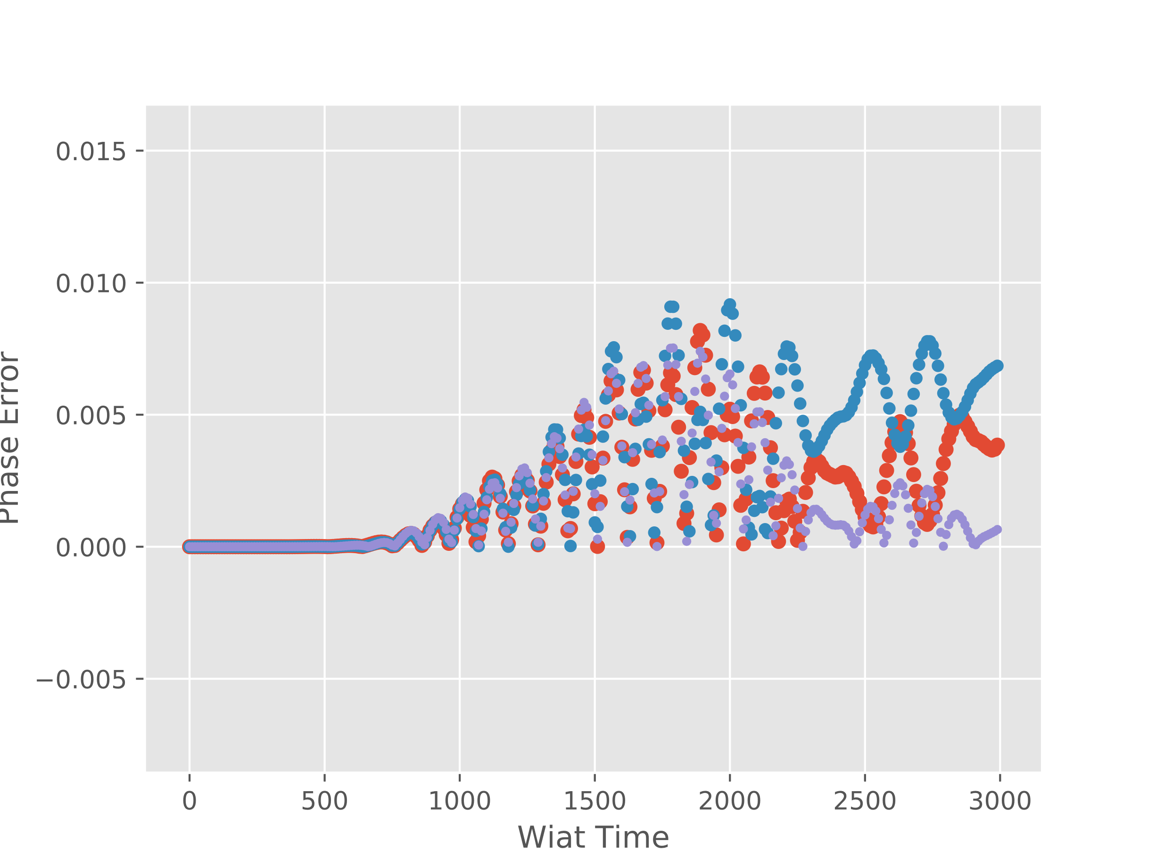
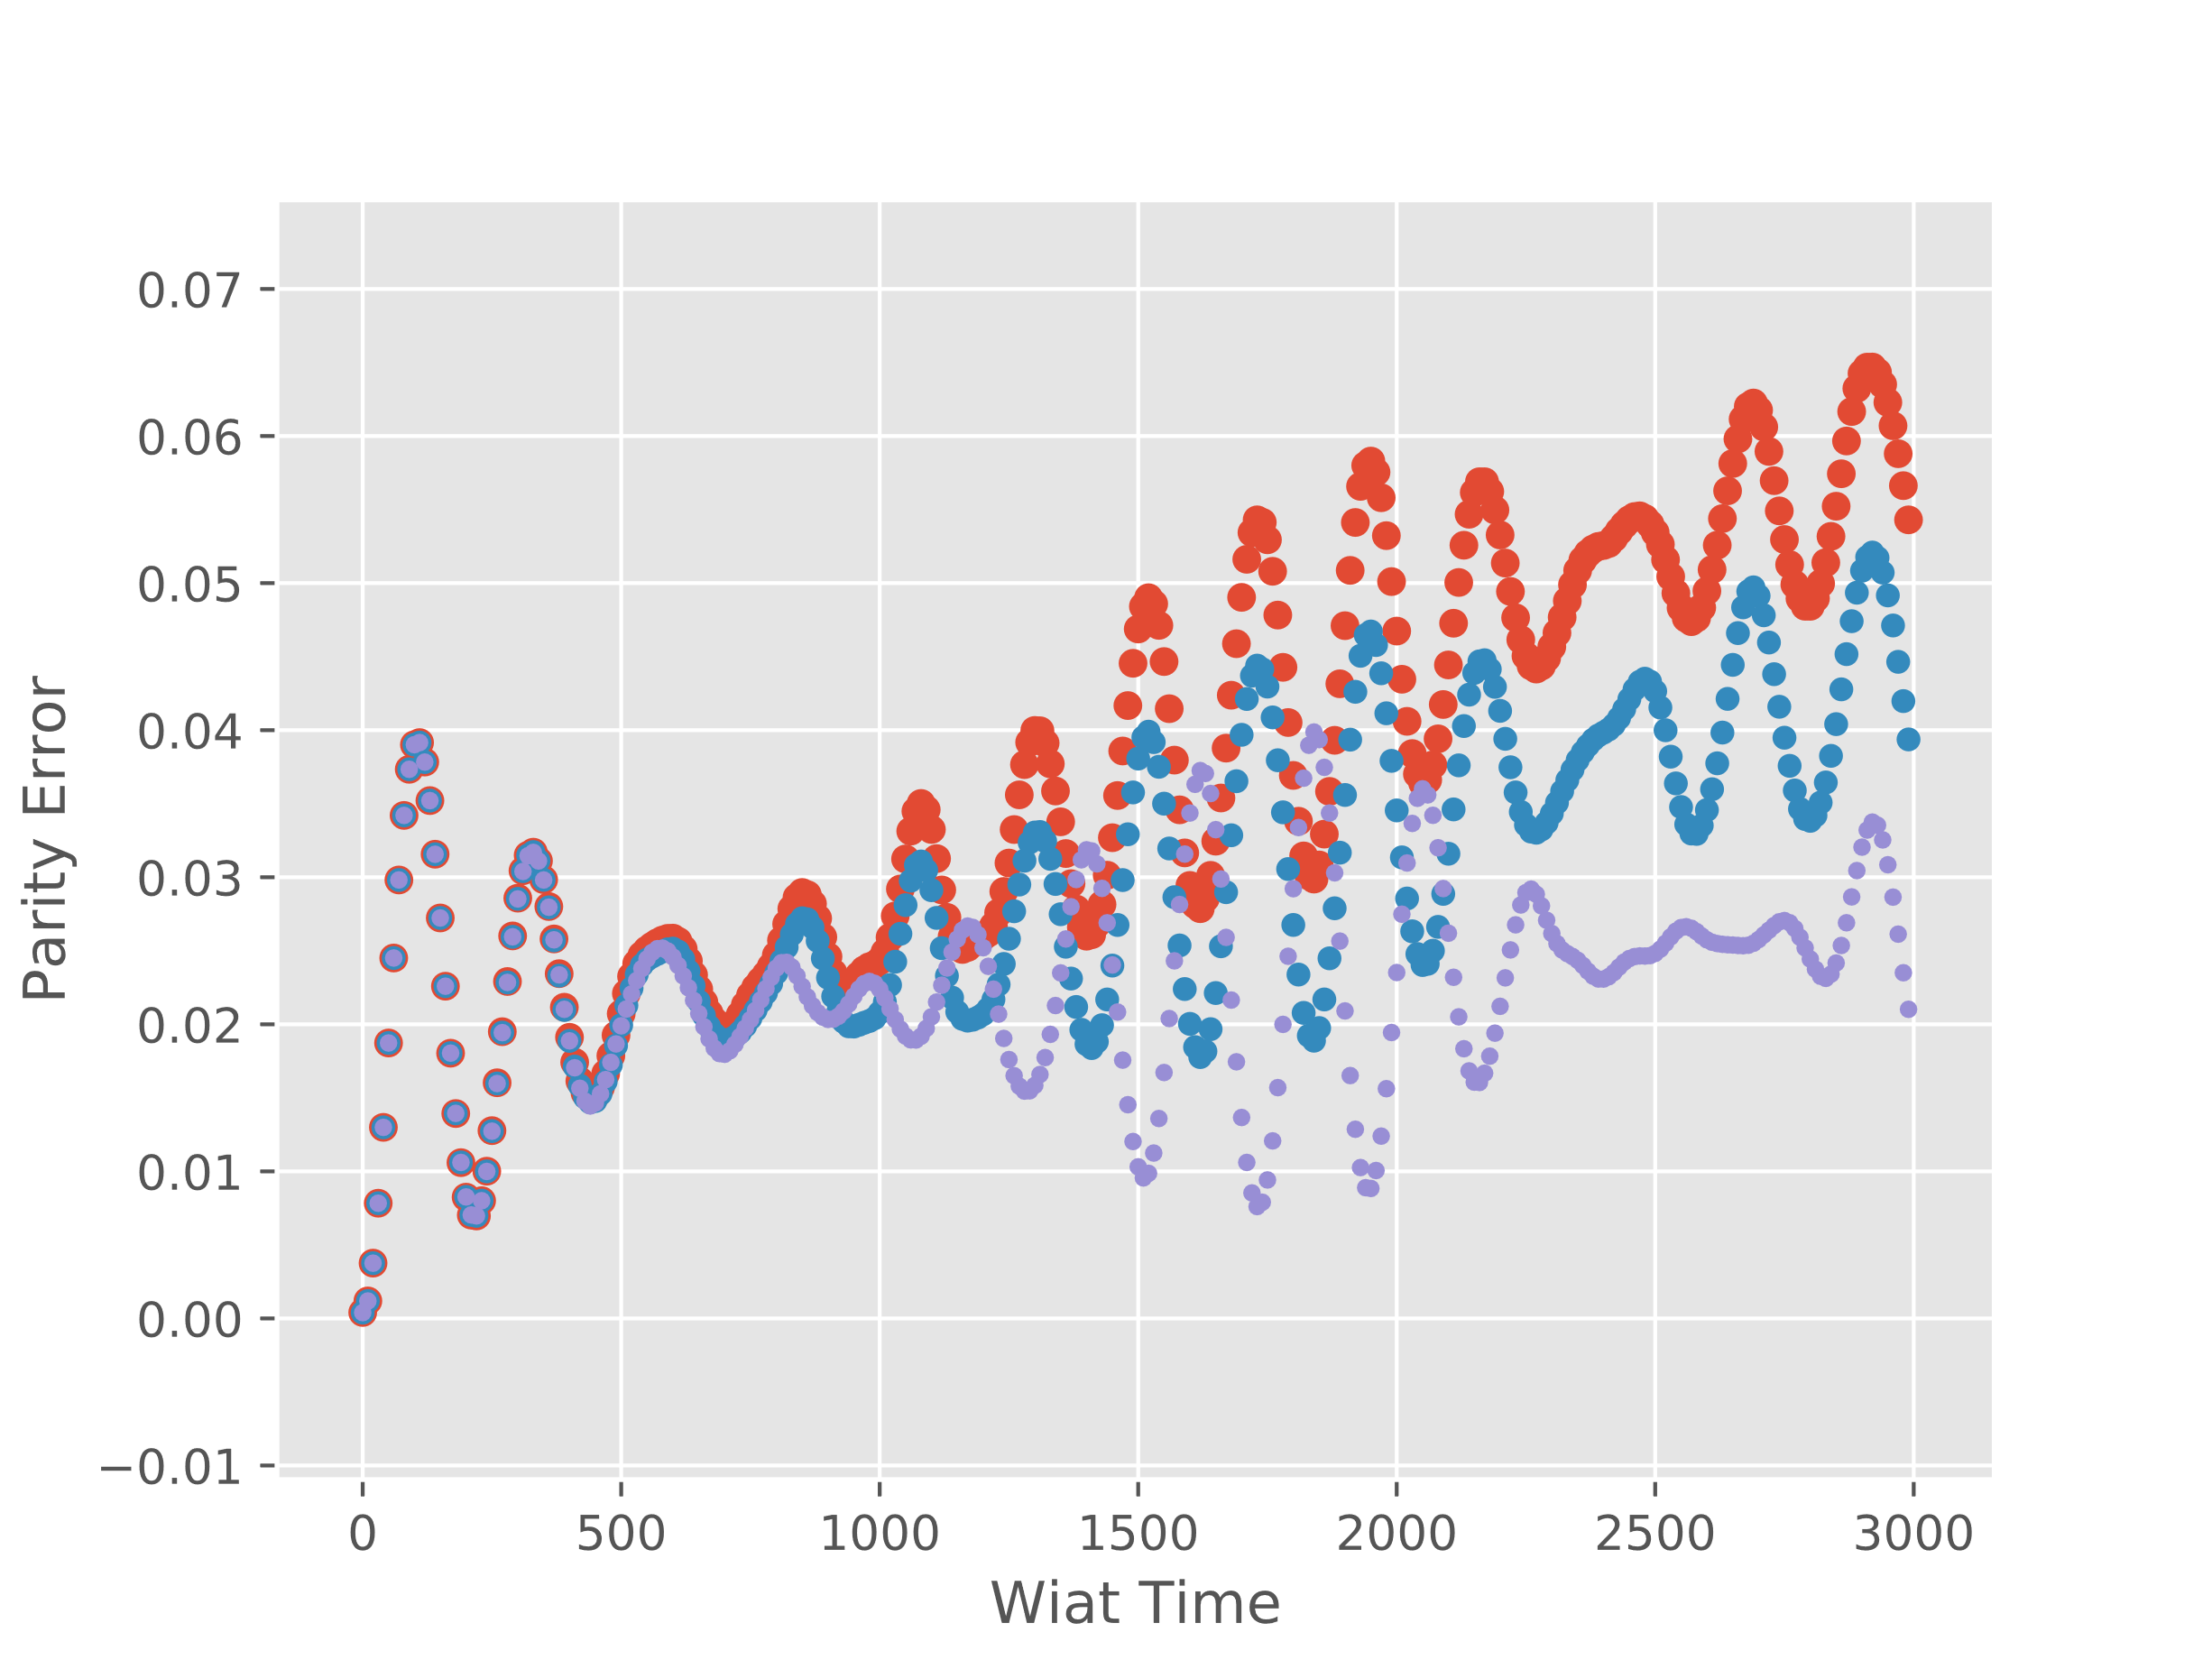
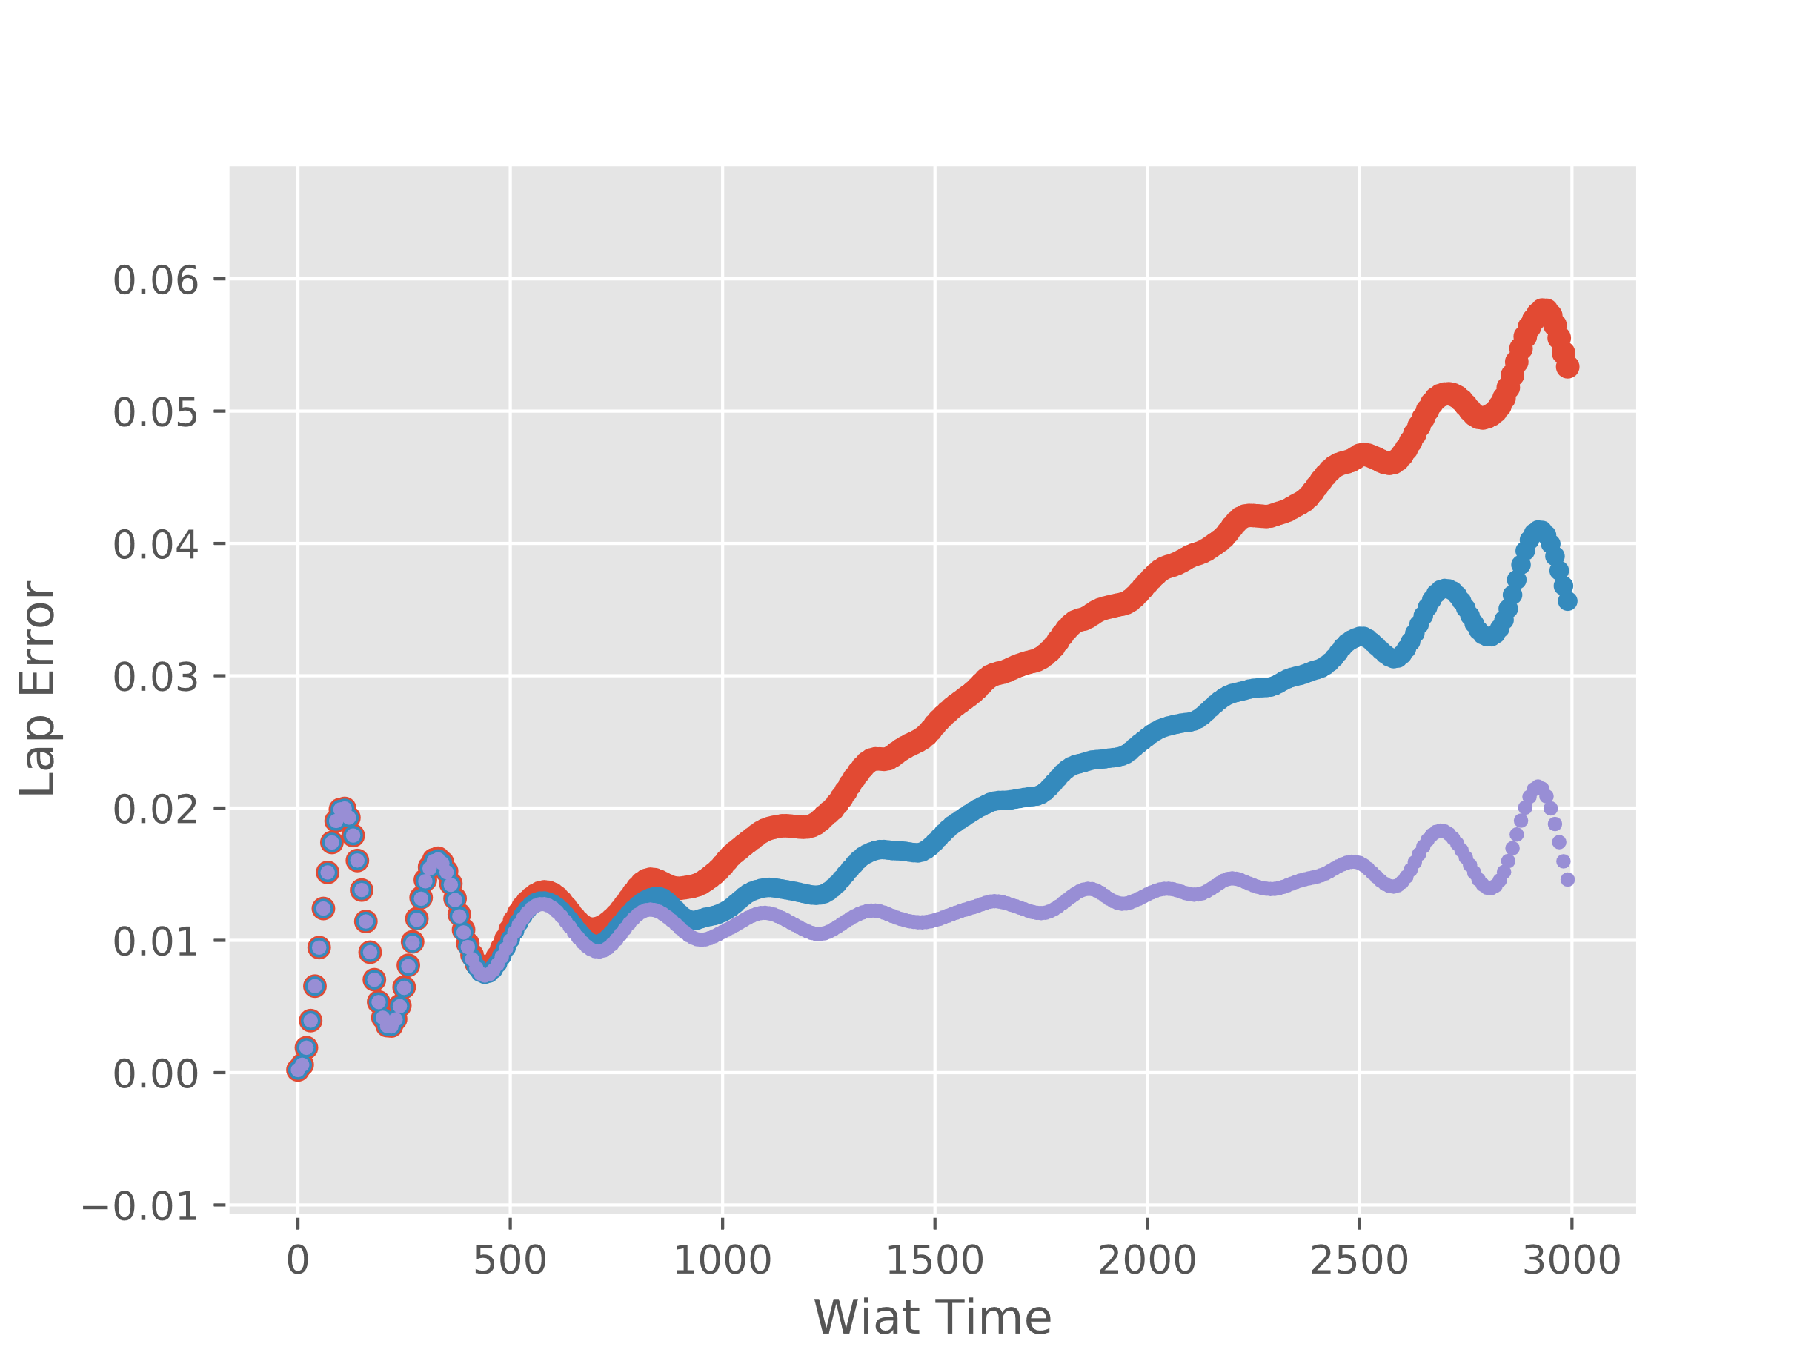

L=26, t=1.0, $Δ=0.7$, $μ=0.2,$ Vmax=0.1
n=10 (8,L-8)
n=6 (10,L-10)
n=2 (L/2-1,L/2)

