Slide 1
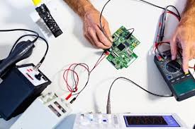
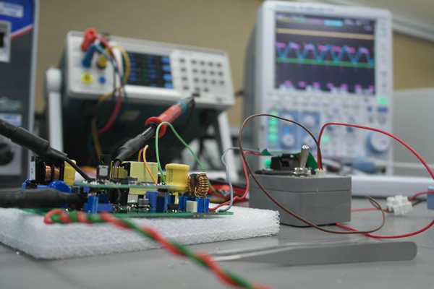
TESTS
PROTOTYPE TEST
Test conducted on first unit developed by firm as per relevant specification.
TYPE TEST
Test shall be carried out to prove confirmation with requirement or specification.
ACCEPTANCE TEST
These are carried out by inspecting authority at the manufacter’s premises on sample taken from a lot.
ROUTINE TEST
Routine test shall be performed by the manufacturers on each complete unit of the same type and result shall be submitted to inspecting agency

Slide 2
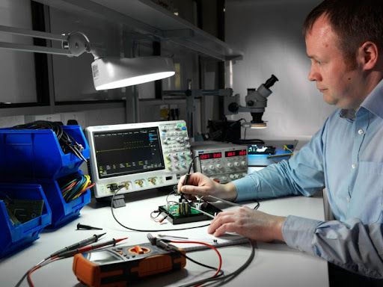
Inhouse Test
Virtual and Dimension check
Checking of purchase document of led
Insulation resistance test
HV test
Over Voltage Protection test
Wattage measurement
Short circuit Protection
Reverse Polarity
Lux measurement

Slide 3
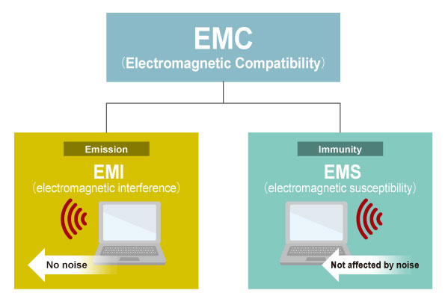
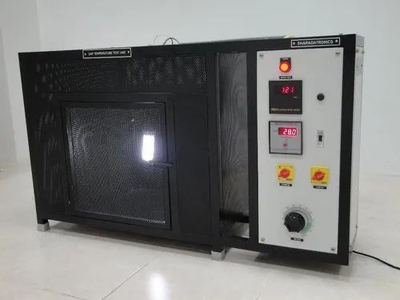
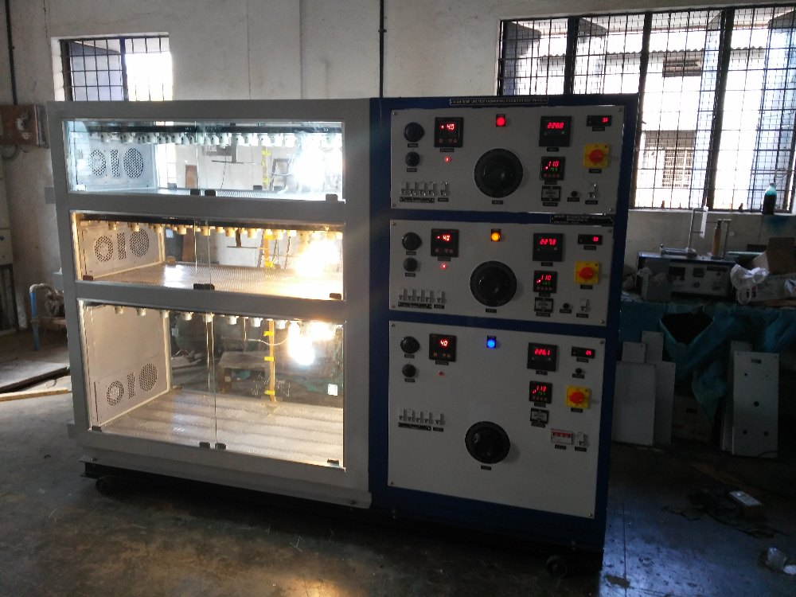
Third Party Test
Surge Protection
Temperature rise Test
Ra colour rendering test
Fire retardant test
Test for ip protection
Vibration and shock check
Environmental test
Life test
EMI/EMC Test
Endurance Test

