Slide 1

SINGLE-PHASE PFC CONVERTER TOPOLOGIES FOR MEDIUM POWER EV CHARGER APPLICATIONS
PRESENTED BY
PAGALA HARSHINI – 202144
MRITYUNJAY – 202169
VISHNU PRIYA – 202168
Under the Guidance of
Prof B.L. NARASIMHARAJU
Professor & HoD, EED, NITW
DEPARTMENT OF ELECTRICAL ENGINEERING
NATIONAL INSTITUTE OF TECHNOLOGY WARANGAL

Slide 2
CONTENTS
1
INTRODUCTION
2
PAST WORK
3
12
10
PHASE SHIFT FULL BRIDGE CONVERTER CONTROL LOGIC
SIMULATION RESULTS
CONCLUSION
BLOCK DIAGRAM REPRESENTATION OF PROPOSED MODEL
4
CIRCUIT DIAGRAM OF PROPOSED MODEL
5
INTERLEAVED BOOST CONVERTER DESIGN ANALYSIS
11
TOPOLOGY SELECTION ADVANTAGES
6
8
INTERLEAVED BOOST CONVERTER CONTROL LOGIC
9
PHASE SHIFT FULL BRIDGE CONVERTER DESIGN ANALYSIS
13
14
FUTURE PLANS
REFERENCES

Slide 3
INTRODUCTION
The EVs will play a vital role in achieving a sustainable transportation system by reducing fossil fuel dependency and greenhouse gas (GHG) emissions.
When EV is Supplied from the utility grid there is a need to convert AC Voltage of the grid to DC voltage to charge the EV batteries.
Different power converters like AC – DC are widely used to regulate the output voltage with the variation of load current and input voltage.
When EV is charged from the utility grid conventional AC-DC converter act as a nonlinear load drawing peaky current from a supply and results in a very poor input power factor.
Presently, there is increasing demands of high power factor and low total harmonic distortion in the current drawn from the utility grid.
The converter present at the input AC side which converts alternating current (AC) into direct current (DC), plays a crucial part of an electric car battery charging system, in improving the power factor and reducing the total harmonic distortion.

Slide 4
PAST WORK

Slide 5
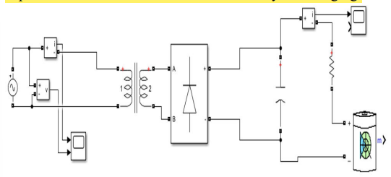
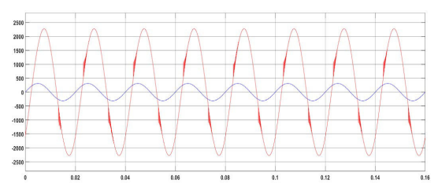
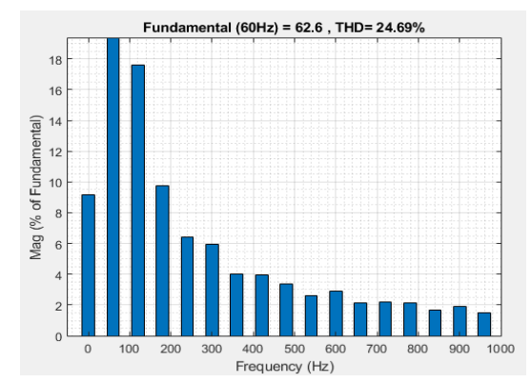
BATTERY CHARGING SYSTEM WITHOUT PFC
Fig 1(a) : Circuit Diagram
Fig 1(b) : Input Voltage and Current waveforms
Fig 1(c) .: FFT Input current
This circuit uses a Transformer connected to an AC source which increases the voltage to the desired output level. The output of the transformer is then connected to a full bridge rectifier to convert the AC voltage to DC. The capacitor connected at the end of the rectifier then smoothens the output voltage by reducing the amount of ripple. The output of the capacitor is then connected to the EV battery for charging.

Slide 6
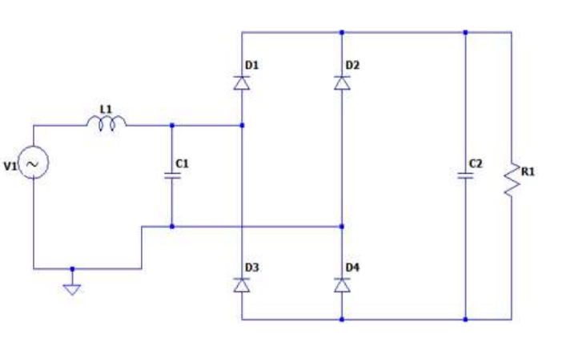
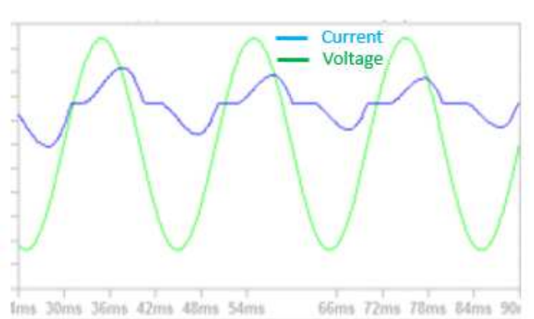
PASSIVE POWER CORRECTION
IEC STANDARDS
NEAR UNITY PF
THD
< 5 %
Fig 2(a) : Circuit Diagram
Fig 2(b) : Input Voltage and Current waveforms
 | NO PFC | PASSIVE PFC
COST | Low | Low
SIZE | Small | Small
OUTPUT RIPPLE | Very Big | Big
EMI | No | No
THD | >40% | 15% - 40%
PF | <0.5 | 0.5 – 0.8
ACTIVE POWER FACTOR CORRECTION
TABLE 1 : NO PFC AND PASSIVE PFC COMPARISION

Slide 7
OBJECTIVES OF THE PROJECT
IEC STANDARDS
NEAR UNITY PF
THD
< 5 %
1
Achieve PFC over a wide variations of input Variations
2
Maintaining THD < 5%
3
Maintaining Stiff Regulated DC Voltage at the Output
4.
Accurate Control Mechanism for Regulation of Output Voltage
APPLICATION
SPECIFICATION | LEVEL 1 | LEVEL 2
CHARGING POWER | 1.44 kW – 1.9 kW | 1.9kW – 3.5 kW
CHARGER TYPE | ONBOARD | ONBOARD
VOLTAGE SUPPLY | SINGLE PHASE AC (120V – 230 V) | SINGLE PHASE AC (120V – 230V )

Slide 8
Establishing Optimised Topology
Developing the Control Logic
Formulating Mathematical Equations
Simulink Model
Parameter Variation
APPROACH AND METHODOLOGY

Slide 9
COMPARISION OF VARIOUS EV CHARGING TOPOLOGIES
COMPONENTS | BOOST | INTERLEAVED | BRIDEGELESS BUCK BOOST PFC | SEPIC
DIODES | 5 | 7 | 2 | 5
MOSFET | 1 | 2 | 1 | 1
INDUCTOR | 1 | 2 | 1 | 1
CAPACITOR | 1 | 1 | 2 | 2
BRIDGE RECTIFIER | YES | YES | NO | YES
MODE | CCM | CCM | DCM | DCM
POWER | MEDIUM | HIGH | LOW-MEDIUM | HIGH
CONTROL LOOPS | 2 | 2 | 1 | 1
SENSORS | 2 | 2 | 1 | 1
CONTROL CKT | ACM | ACM | VOLTAGE CONTROL | VOLTAGE CONTROL

Slide 10
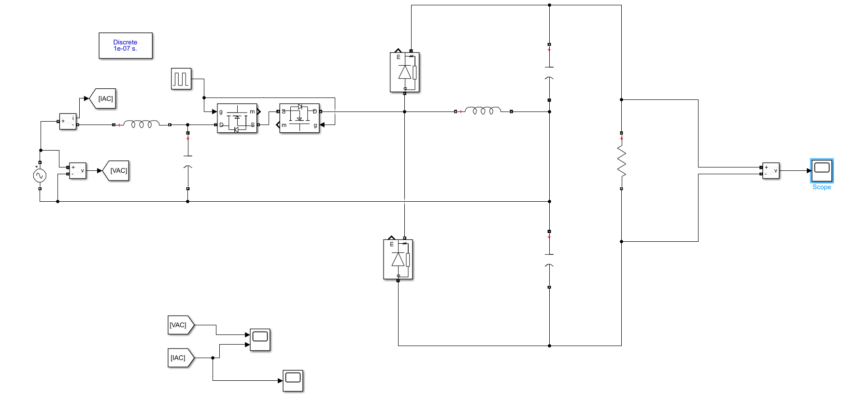
PAST WORK
SIMULATION RESULTS
Fig 3(a):BRIDGELESS BUCK BOOST CIRCUIT DIAGRAM

Slide 11
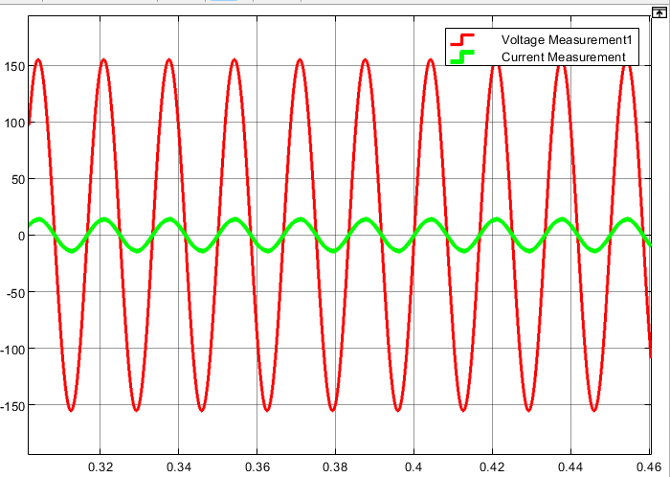
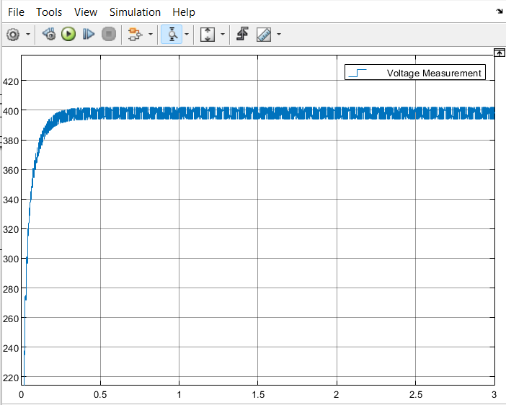
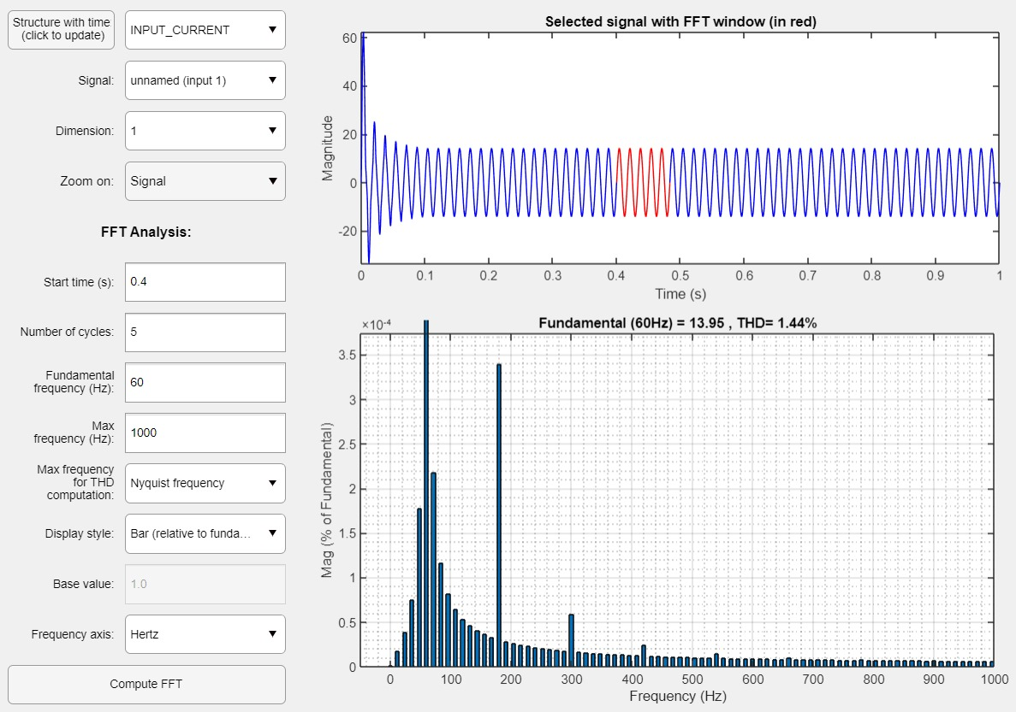
Fig 3(b):INPUT VOLTAGE AND INPUT CURRENT WAVEFORMS
Fig 3 (d) :OUTPUT VOLTAGE WAVEFORM
 | RESULT
POWER FACTOR | NEARLY UNITY
THD | 1.44 %
TABLE 2 : RESULTS
Fig 3(c) : FFT ANALYSIS OF INPUT CURRENT

Slide 12
PROPOSED SYSTEM

Slide 13
BLOCK DIAGRAM OF PROPOSED SYSTEM
AC VOLTAGE SOURCE
AC – DC INTERLEAVED BOOST CONVERTER
PHASE SHIFTED FULL BRIDGE CONVERTER
LOAD
(EV BATTERY)
CONTROL CIRCUIT FOR
IBC
CONTROL CIRCUIT FOR
PSFBC

Slide 14
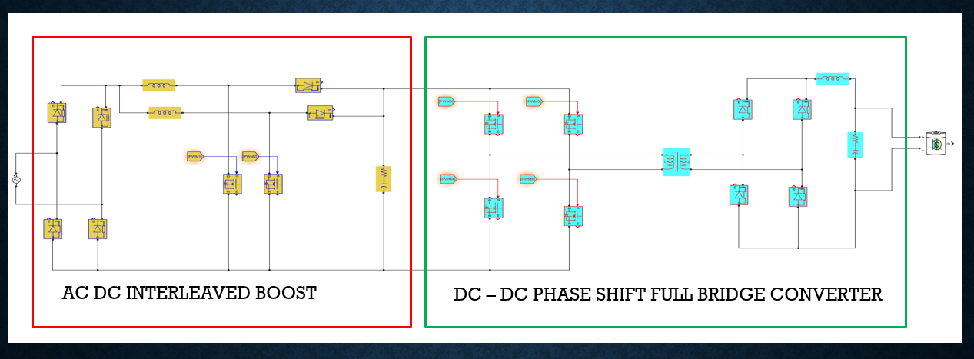
CIRCUIT DIAGRAM OF PROPOSED SYSTEM
PWM GIVEN TO BOTH INTERLEAVED BOOST CONVERTER AND PHASE SHIFT FULL BRIDGE CONVERTER BY CLOSED LOOP CONTROL LOGIC

Slide 15
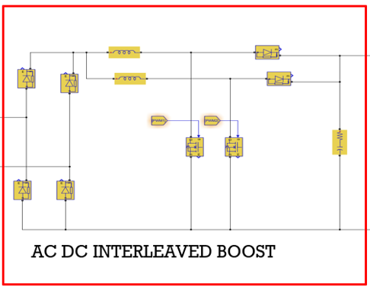
INTERLEAVED BOOST POWER FACTOR CORRECTION TOPOLOGY
Fig 5 : Circuit Diagram
In the Interleaved Boost power factor correction topology 2 boost converters are connected in parallel operating 180 degree out of phase.
The input current is sum of the inductor currents which are in Parallel
The Boost Switching motion tends to cancel out the out of phase ripple currents of the inductors,reducing the input ripple current
Paralleled Semiconductor switches are a benefit of the interleaved boost converter
The Switching Frequency becomes two times because switches operated in 180 degree out of phase result in lower input current ripple, reducing the need for input EMI Filter.
Output capacitor stress is decreased by the suppression of output voltage ripple. This Topology can handle more power than conventional Boost Converter

Slide 16
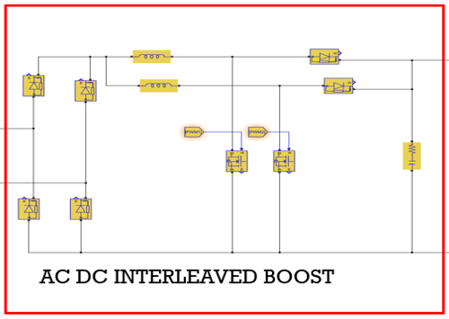



INTERLEAVED BOOST CONVERTER DESIGN ANALYSIS
Power Output from Converter ($P_{out })$ = 2000W
Output Voltage from Converter ( $V_{out })$ = 400 V
Inductor Current Ripple Percentage (${ I}_{Lripple\%} )$ = 40%
Capacitor Voltage Ripple Percentage ( $V_{Cripple\% })$= 1%
Switching Frequency of the Converter ( $f_{sw}$ ) = 5000 Hz
$I_{out}=\frac{P_{out }}{V_{out}}$ =$\frac{2000}{400}$ = 5A
$$I_{ripple}=\frac{40}{100}∗5=2A$$
$D=\frac{V_{O}−V_{INmin}}{V_{O}}$ $=\frac{400−\sqrt{2}∗200}{400}$ = 0.29
$$L_{min}=\frac{V_{IN min}∗D_{max}}{f_{sw}∗I_{ripple}}=\frac{2000∗0.29}{5000∗2}=5.8mH$$
$$C≥\frac{P_{out}}{4∗f_{supply}∗V_{C}∗∆V_{C}}$$
$$C≥\frac{2000}{4∗π∗50∗400∗4}$$
$$C≥1986μF$$

Slide 17
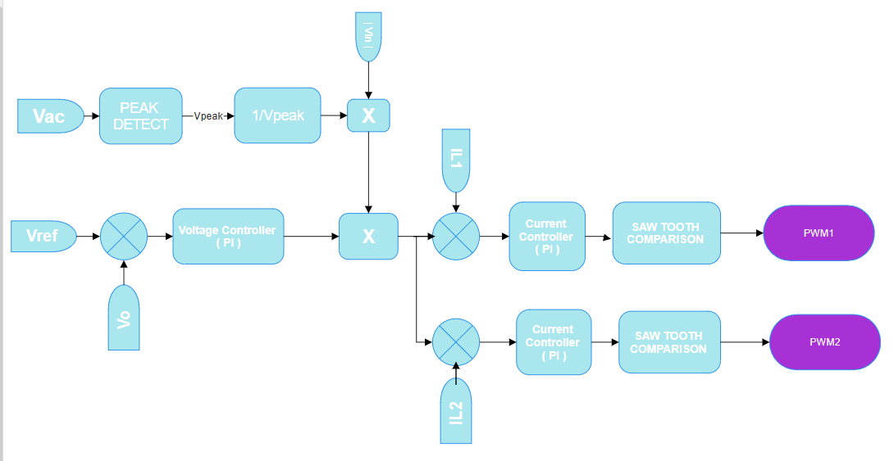
CONTROL LOGIC FOR INTERLEAVE BOOST CONVERTER
AVERAGE CURRENT CONTROL METHOD

Slide 18
CONTROL CIRCUIT HAS TWO LOOPS
OUTER –VOLTAGE CONTROL LOOP
Regulates the Voltage at Certain Level
INNER -- CURRENT CONTROL LOOP
Current to Follow the Sinusoidal Input Voltage
AVERAGE CURRENT CONTROL METHOD
Here output voltage ($V_{o}$) is compared with the reference voltage ($V_{o}^{∗}$) and the error of this is given to the PI controller block.
Here output voltage (𝑉_𝑜) is compared with the reference voltage (𝑉_𝑜^∗) and the error of this is given to the PI controller block.
The output of the PI block is multiplied with rectified voltage
$\frac{{| V}_{in} |}{V_{peak}}$ to generate reference inductor current in phase with supply.
The output of the PI block is multiplied with rectified voltage
(〖| 𝑉〗_𝑖𝑛 |)/𝑉_𝑝𝑒𝑎𝑘 to generate reference inductor current in phase with supply.
Then inductor currents ($I_{l1 }and I_{l2}$) is compared with the reference inductor current ($I_{L}^{∗}$) and then an error is given to the PI controller of the inner loop.
Then inductor currents (𝐼_(𝑙1 ) 𝑎𝑛𝑑 𝐼_𝑙2) is compared with the reference inductor current (𝐼_𝐿^∗) and then an error is given to the PI controller of the inner loop.
The output of the PI controller is the duty (d) that is obtained after comparison with the saw tooth carrier signal for PWM generation.

Slide 19
TUNNING OF PI CONTROLLER
 | RISE TIME | OVERSHOOT % | SETTLING TIME | STEADY STATE ERROR
Proportional Gain ( K_{P} ) | DECREASE | INCREASE | SMALL CHANGE | DECREASE
Integral Gain ( K_{I} ) | DECREASE | INCREASE | INCREASE | ELIMINATES

Slide 20
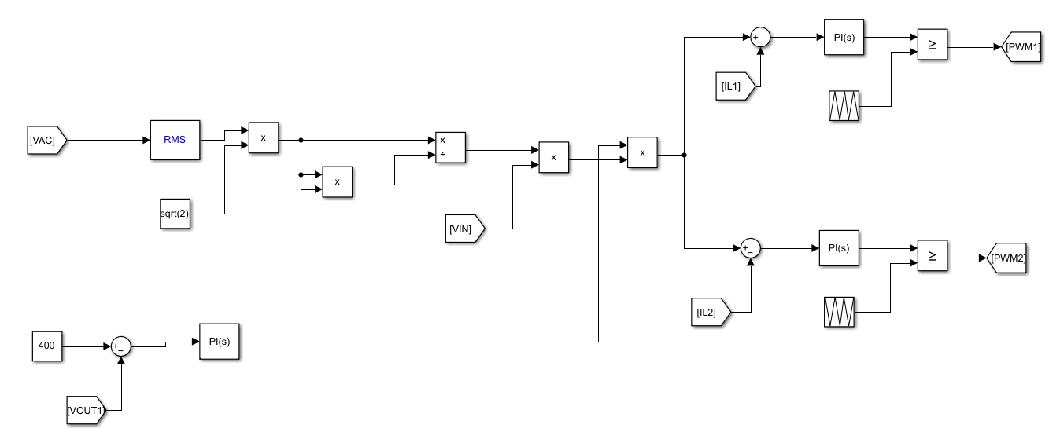
CONTROL STRATEGY FOR INTERLEAVE BOOST CONVERTER
MATLAB IMPLEMENTATION

Slide 21
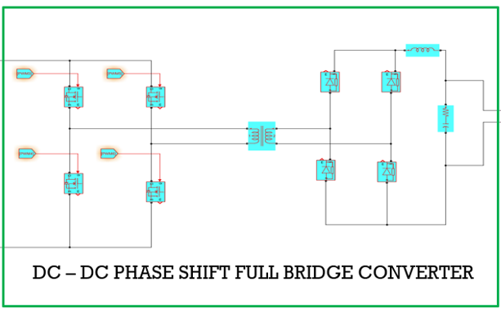
PHASE SHIFT FULL BRIDGE CONVERTER TOPOLOGY
The phase-shifted full bridge (PSFB) converter is a highly suitable topology specifically designed for electric vehicle (EV) charger applications, offering efficient and reliable power conversion with precise control over the output voltage.
The PSFB converter configuration consists of a full bridge circuit on both the primary and secondary sides.
The primary side includes four high-power switches, typically insulated gate bipolar transistors (IGBTs), while the secondary side incorporate full bridge.
These switches are connected to a high-frequency transformer that provides galvanic isolation between the input grid and the EV battery.
The PSFB converter operates by controlling the phase shift between the bridge leg switching signals.
This phase shift is precisely regulated using a phase-shift control circuit, ensuring optimal power transfer and accurate output voltage regulation

Slide 22


PHASE SHIFT FULL BRIDGE CONVERTER DESIGN ANALYSIS
$${Output voltage of Converter ( V}_{O} )=2∗V_{c}∗n∗D$$
n$=\frac{N_{s}}{N_{P}}=\frac{70}{400}=0.175$
$$D=\frac{V_{O}}{2∗V_{c}∗n}=\frac{48}{2∗400∗0.175}=0.324$$
$$V_{L}=V_{in}∗\left(\frac{N_{s}}{N_{p}}\right)−V_{O}$$
$V_{L}=400∗0.175−48=22 V$
$${Inductor Current Ripple Percentage ( I}_{Lripple }\%)= 2\%$$
$$I_{Lripple}=\left(\frac{2000}{48}\right)∗0.02=0.833$$
$$L= V_{L}∗\frac{{DT}_{s}}{I_{Lripple}}$$
$$L=\frac{22∗0.324}{50000∗0.833}=170∗{10}^{−6}=170μH$$
$$C=\frac{I_{Lripple}∗D}{f_{s}∗V_{Cripple}}$$
$Capacitor Voltage Ripple Percentage ( V_{Cripple\% }$) = 1 %
$$C=\frac{0.833∗0.342}{50000∗0.48}$$
$$C=12μF$$

Slide 23
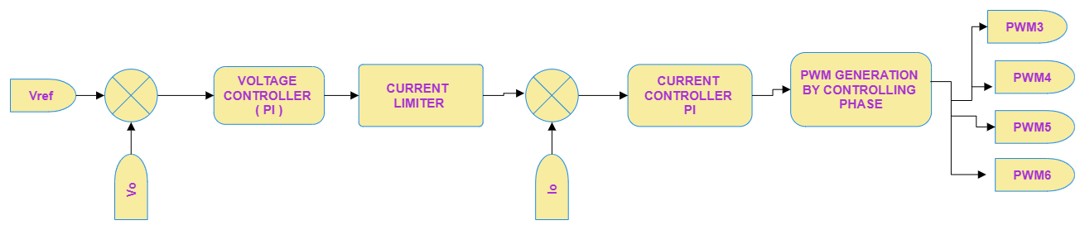
CONTROL ALGORITHM FOR PSFB CONVERTER
BLOCK DIAGRAM REPRESENTATION

Slide 24
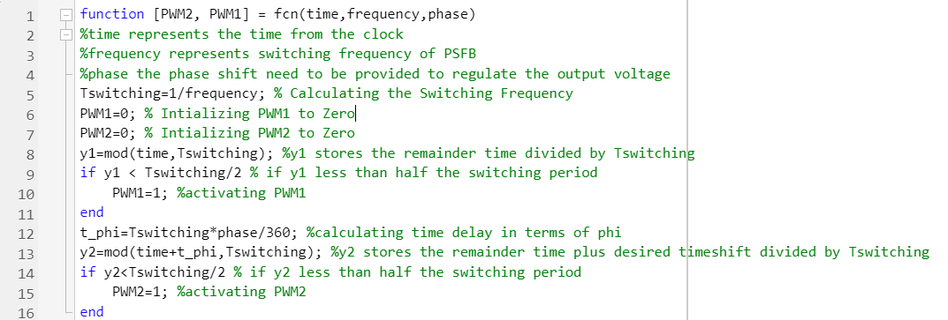
CODE FOR OUTPUT VOLTAGE REGULATION BASED ON PHASE SHIFT

Slide 25
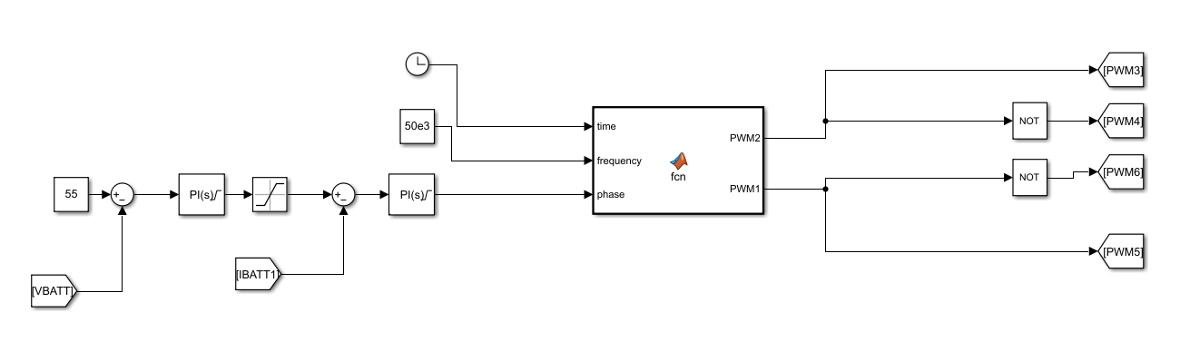
CONTROL STRATEGY FOR PSFB CONVERTER
MATLAB IMPLEMENTATION

Slide 26
PARAMETERS DESIGNED FOR BATTERY CHARGING MODEL FOR PFC
PARAMETER | VALUE
Supply Voltage | 230 V
Input Inductors of IBC | 6 mH
DC Link Voltage | 400 V
DC Link Capacitance | 1990 µF
Transformer Ratio | 0.175
Inductance of PSFB | 170 µH
Capacitance of PSFB | 12 µF
Switching Frequency of IBC | 5000 Hz
Switching Frequency of PSFB | 50 kHz
Battery Specifications | 48 V , 150 Ah

Slide 27
SIMULATION RESULTS

Slide 28
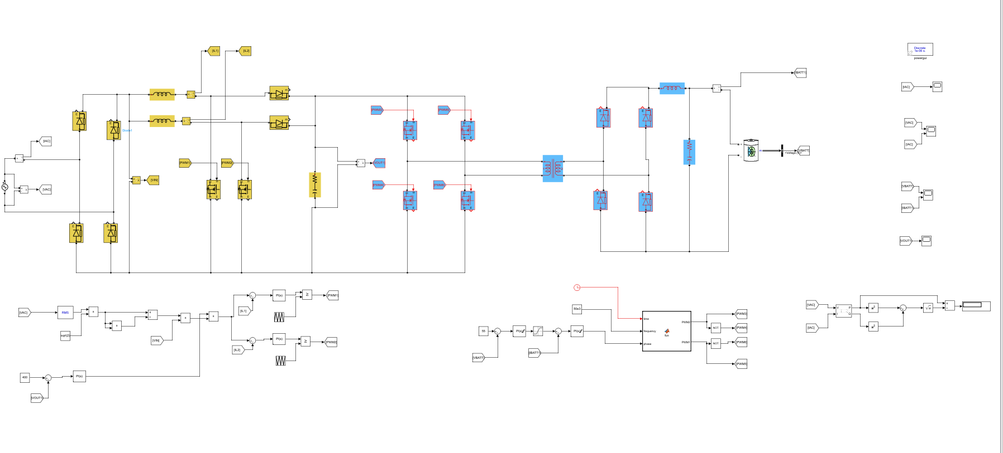
CIRCUIT DIAGRAM OF PROPOSED MODEL

Slide 29
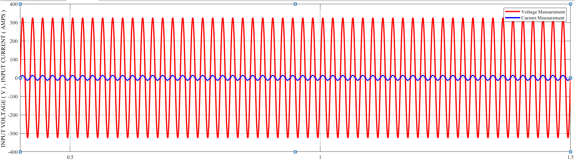
INPUT VOLTAGE AND INPUT CURRENT

Slide 30
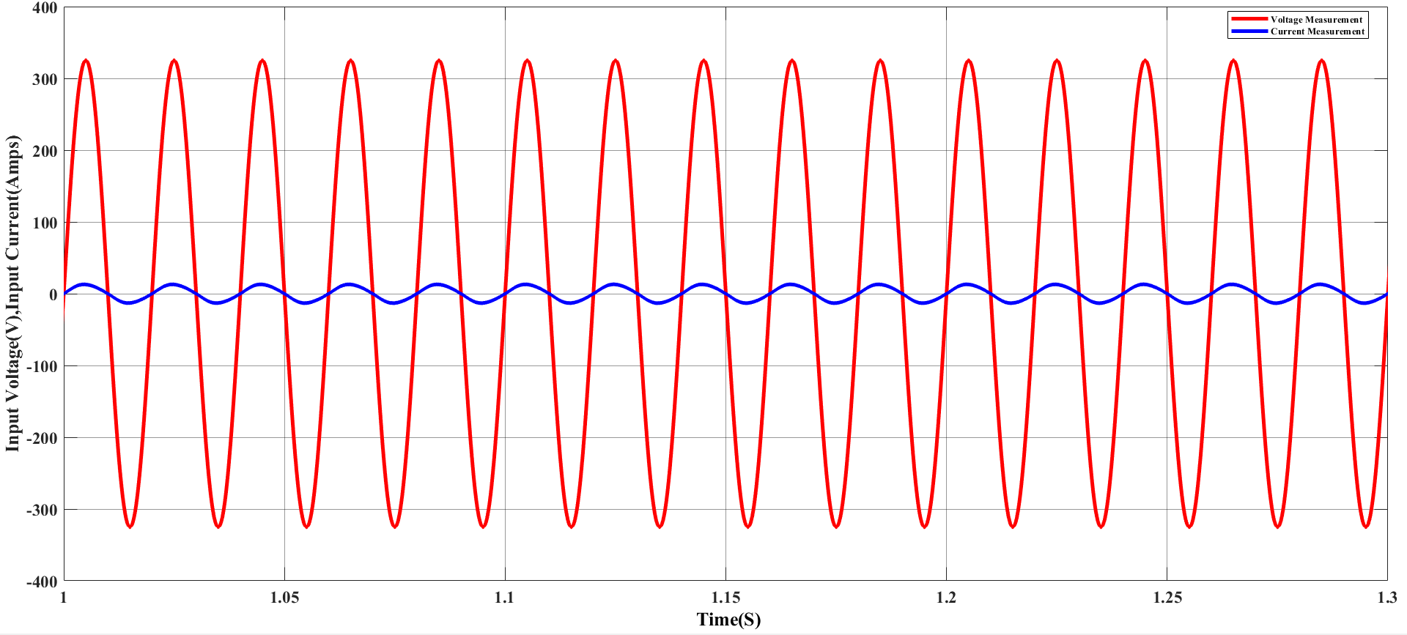
STEADY STATE INPUT VOLTAGE AND INPUT CURRENT

Slide 31
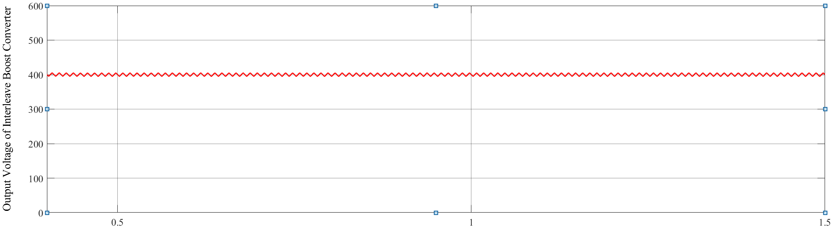
OUTPUT VOLTAGE
Output Voltage of Interleaved Boost Converter Regulated at 400V

Slide 32
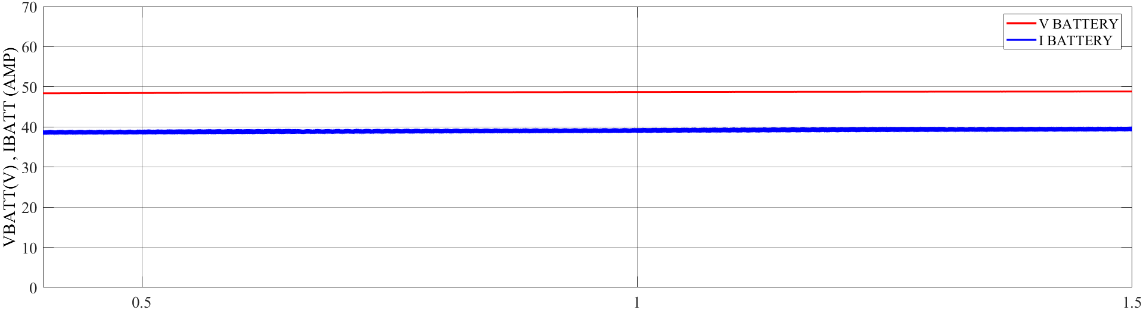
IBATTERY AND VBATTERY
Output Voltage of PSFB VBATT Regulated at 48V
Load Current IBATT Regulated at 40.5 AMPS

Slide 33
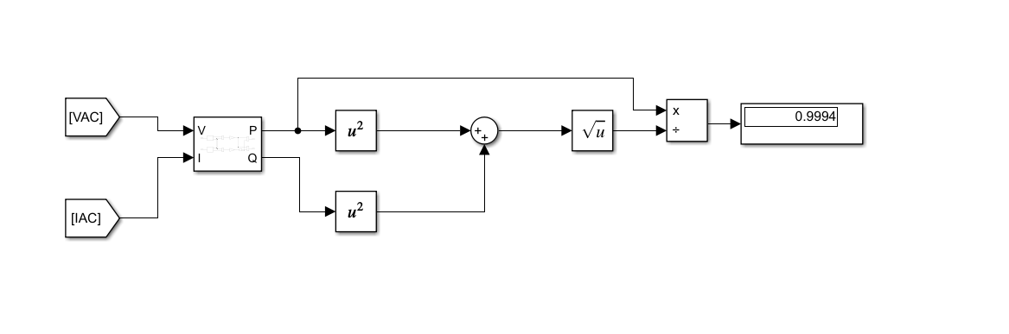
POWER FACTOR MEASUREMENT BLOCK

Slide 34
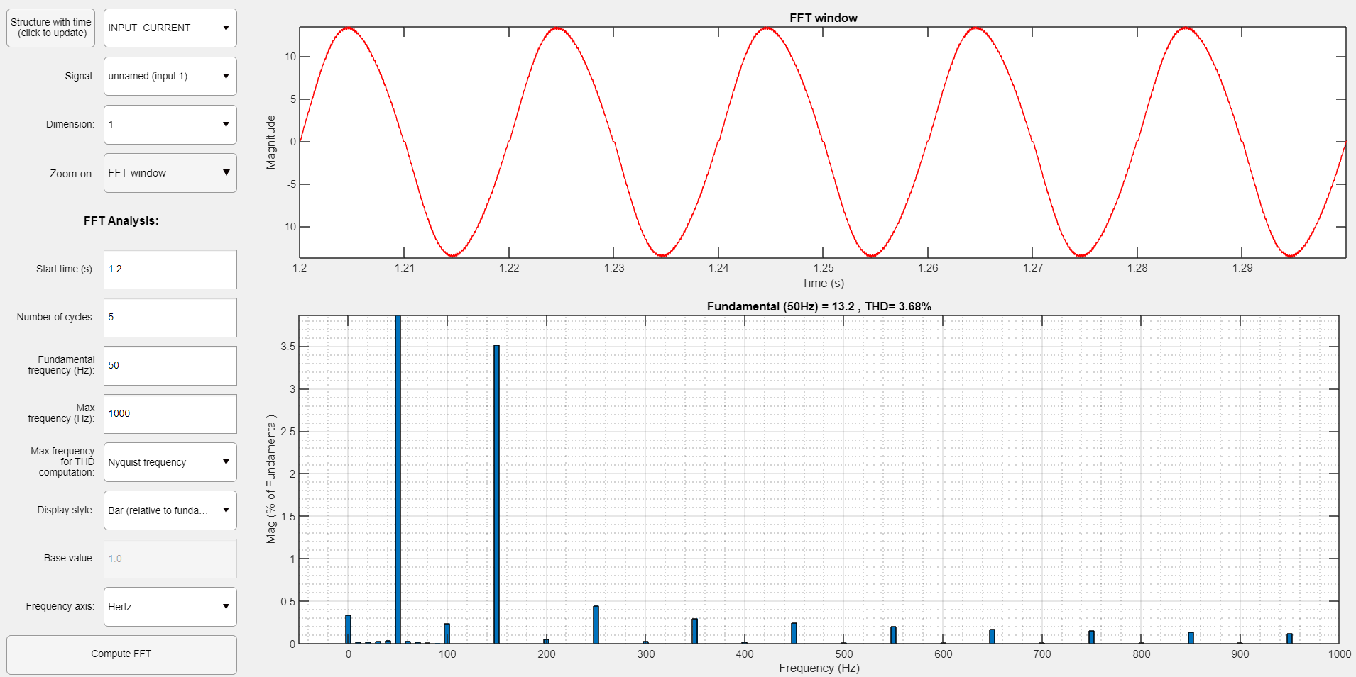
THD ANALYSIS OF INPUT CURRENT

Slide 35
RESULTS
DIMENSION | OBTAINED RESULT
POWER FACTOR | 0.9994
THD % | 3.68 %
IEC STANDARDS
NEAR UNITY PF
THD
< 5 %
PROPOSED TOPOLOGY SATISFIED IEC STANDARDS

Slide 36
TOPOLOGY SELECTION ADVANTAGES
In the employed EV Charger topology , On the primary side of the system, we have an interleaved boost converter.
The interleaved boost converter has the advantage of paralleling the switching devices.
Cancelling the ripple at the output while effectively increasing the switching frequency, it also reduces stress on the output capacitor, hence reducing the filter size.
As the wattage rating rises, it is frequently necessary to connect converters in a cascaded manner. Interleaving two boost converters is frequently used in highpower applications to enhance performance and decrease the size of the PFC device.
Furthermore, for higher current applications and voltage step-ups, the currents flowing through the switches become mere fractions of the supply current.
The second stage of the charger is a DC-to-DC converter.
It regulates the charging and discharging of the vehicle, here on the secondary side, regulation is achieved with the phase shift full bridge rectifier (PSFB) maintaining the power flow control to the battery.
PSFB provides galvanic isolation between the input grid and the EV battery.
The charger’s ability to accommodate various battery types, wide input voltage range, and substantial current output contribute to the advancement of sustainable transportation while reducing dependency on fossil fuel.

Slide 37
CONCLUSION
The proposed design of interleaved boost converters with PFC presents a suitable solution for high-power applications such as EV chargers.
The foremost aim of the PFC interleaved converter is to keep supply current distortion and harmonics free with a well-regulated DC link voltage, The PFC output voltage, Vc , acts as an input of the PSFB converter, which charges the EV battery.
By employing multiple boost converter modules operating in parallel, interleaved boost converters can distribute the load current among these modules, thereby reducing current stress on each module.
The PSFB converter operates by controlling the phase shift between Bridge legs . This phase shift is precisely regulated using a phase-shift control circuit, ensuring optimal power transfer and accurate output voltage regulation.
The PSFB converter’s high efficiency and ability to operate at high switching frequencies contribute to its compact design and increased power density. Smaller and lighter magnetic components such as transformers and inductors can be utilized, making it ideal for EV charger applications where space and weight considerations are important.
The combined implementation of these two converter topologies proved to be advantageous in terms of efficient energy conversion and ensuring dependable charging operation.

Slide 38
FUTURE PLANS
Analysis of Various Control Circuits Peak Current Control, Hysteresis Control, Conventional Borderline Control Method, Programming Rule Derivation.
Analysis of Various closed-loop Techniques for EV Charging applications.
Establishing a linkage between resonating inductors and capacitors and configuring a Phase-Shifted Full Bridge (PSFB) topology to facilitate soft switching.
PSFB converter with magnetic inductance utilizes additional inductors to store energy and facilitate Zero Voltage Switching (ZVS). This inclusion improves efficiency, reduces losses, and enhances power handling capabilities. It also enables higher switching frequencies, resulting in a more compact and efficient design.
Continue the literature survey on different topologies and optimize the circuit further.
Hardware Implementation of the Proposed Model.

Slide 39
REFERENCES
M. R. Khalid, I. A. Khan, S. Hameed, M. S. J. Asghar and J. -S. Ro, ”A Comprehensive Review on Structural Topologies, Power Levels, Energy Storage Systems, and Standards for Electric Vehicle Charging Stations and Their Impacts on Grid,” in IEEE Access, vol. 9, pp. 128069-128094, 2021, doi: 10.1109/ACCESS.2021.3112189
R. Pandey and B. Singh, ”A Power Factor Corrected Electric Vehicle Battery Charger Using Boost Converter,” 2018 8th IEEE India International Conference on Power Electronics (IICPE), 2018, pp. 1-6, doi: 10.1109/IICPE.2018.8709526.
T. Nussbaumer, K. Raggl and J. W. Kolar, ”Design Guidelines for Interleaved Single-Phase Boost PFC Circuits,” in IEEE Transactions on Industrial Electronics, vol. 56, no. 7, pp. 2559-2573, July 2009, doi: 10.1109/TIE.2009.2020073.
Khaligh and M. D’Antonio, "Global Trends in High-Power On-Board Chargers for Electric Vehicles,“ IEEE Transactions on Vehicular Technology, vol. 68, no. 4, pp. 3306-3324, 2019.
"Limits for harmonic current emissions," International Standard, IEC 61000-3-2, 2000.
M. Yilmaz and P. T. Krein, "Review of Battery Charger Topologies, Charging Power Levels, and Infrastructure for Plug-In Electric and Hybrid Vehicles," IEEE Transactions on Power Electronics, vol. 28, no. 5, pp. 2151-2169, 2013.

Slide 40
7) R. Pandey and B. Singh, "A Power Factor Corrected LLC Resonant Converter for Electric Vehicle Charger Using Cuk Converter," 2018 IEEE International Conference on Power Electronics, Drives and Energy Systems (PEDES), Chennai, India, 2018, pp. 1-6, doi: 10.1109/PEDES.2018.8707550.
8) Dingsihao Lyu, Thiago Batista Soeiro, and Pavol Bauer, “Impacts of Different Charging Strategies on the Electric Vehicle Battery Charger Circuit Using Phase-Shift Full-Bridge Converter”, 2021 IEEE 19th International Power Electronics and Motion Control Conference (PEMC).
9) U. Sharma and B. Singh, "A Bidirectional Bridgeless Converter-Based Electric Vehicle Charger," in IEEE Transactions on Industry Applications, doi: 10.1109/TIA.2023.3317359.
10) R. Patil and R. T. Ugale, "Comparative Study of Single-phase Power Factor Correction Topologies for Electric Vehicle Battery Charger Based on Boost Converter," 2022 IEEE Conference on Interdisciplinary Approaches in Technology and Management for Social Innovation (IATMSI), Gwalior, India, 2022, pp. 1-5, doi: 10.1109/IATMSI56455.2022.10119337.
11) B. Hussein, N. Abdi and A. Massoud, "Single-Phase SEPIC-based Power Factor Correction for Electric Vehicles Charging," 2021 IEEE 11th IEEE Symposium on Computer Applications & Industrial Electronics (ISCAIE), Penang, Malaysia, 2021, pp. 180-184, doi: 10.1109/ISCAIE51753.2021.9431824.

Slide 41
THANK YOU

Slide 42
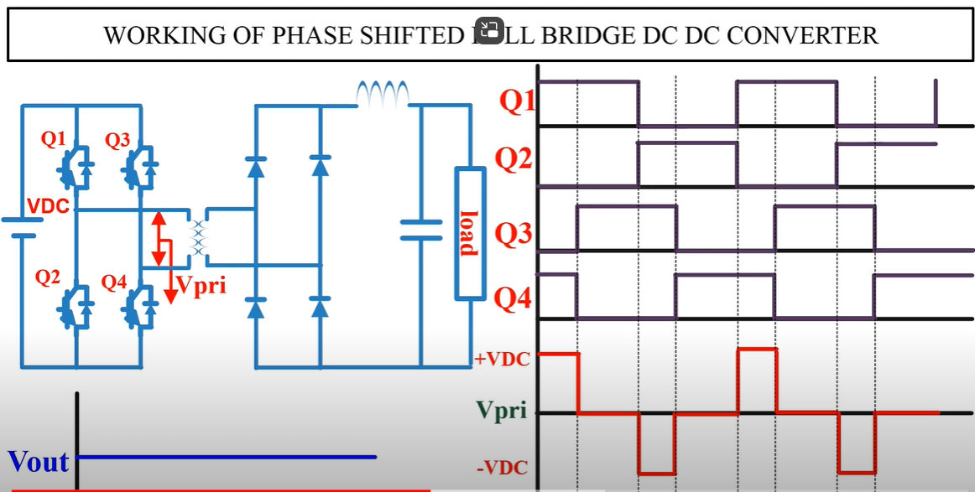
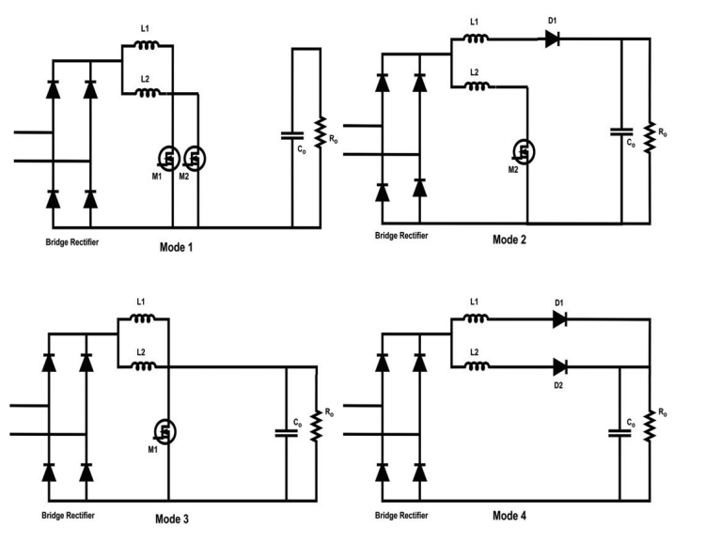
JUST FOR REFERENCE

