Slide 1
Use of Artificial Neural Networks to identify Fake Profiles
A Mini Project
By Batch Number 13:
Khaja Mubashiruddin - 207R1A05L6
P. Bharat Simha Reddy – 207R1A05N5
Gadde Sayi Khushhal - 207R1A05L0
Under the Guidance of S. Aparna

Slide 2
Table of Contents
Introduction
Existing System
Proposed System
Hardware and Software Requirements
Novelty of our Project
Architecture, Modules and UML Diagrams
Results
Conclusion and Future Scope
References

Slide 3

The Problem Statement
To detect and identify fake accounts from social media websites using machine learning algorithms (Specifically ANN – Artificial Neural Networks).

Slide 4
01
Introduction →

Slide 5
Abstract
In this project, machine learning, namely an artificial neural network to determine what are the chances that Facebook friend request is authentic or not is used.
The classes and libraries involved are outlined and the sigmoid function, how the weights are determined and used.
Finally, the parameters of the social network page which are utmost important in the provided solution are considered.

Slide 6
02
The Existing System →

Slide 7
The Existing System
The ever-increasing dependency on computer technology has left the average citizen vulnerable to crimes such as data breaches and possible identity theft. At this time, there is little incentive for social networks to improve their data security.
Malicious users create fake profiles to phish login information from unsuspecting users.
These counterfeit profiles bait unsuspecting users with pictures of people that are considered attractive.
Once the user accepts the request, the owner of the phony profile will spam friend requests to anyone this user is a friend.

Slide 8
Disadvantages of the Existing System
False Positives: Legitimate user accounts can be mistakenly flagged as fake.
Privacy Concerns: Users may have concerns about their online activities being monitored.
Adaptability of Fake Profiles: Fake profiles evolve to evade detection methods.
Cat-and-Mouse Game: Ongoing battle as fake account creators adapt.
User Reporting Bias: Reliance on user reports can lead to false flags and biases.

Slide 9
03
The Proposed System →

Slide 10
The Proposed System
In this project using Artificial Neural Networks we are identifying whether given account details are from genuine or fake users.
ANN algorithm will be trained with all previous users fake and genuine account data and then whenever we gave new test data then that ANN train model will be applied on new test data to identify whether given new account details are from genuine or fake users.

Slide 11
The Proposed System
To train ANN algorithm we are using below details from social networks:
Account Age, Gender, User Age, Link Desc, Status
Count, Friend Count, Location, Location IP, Status
All fake users main intention is to send friend request to normal users to hack their machine or to steal their data and never they will have many number of posts or have many following friends and their account age also will have less number of years.
This Facebook profile data we downloaded from Facebook website and using this data to train ANN model.

Slide 12
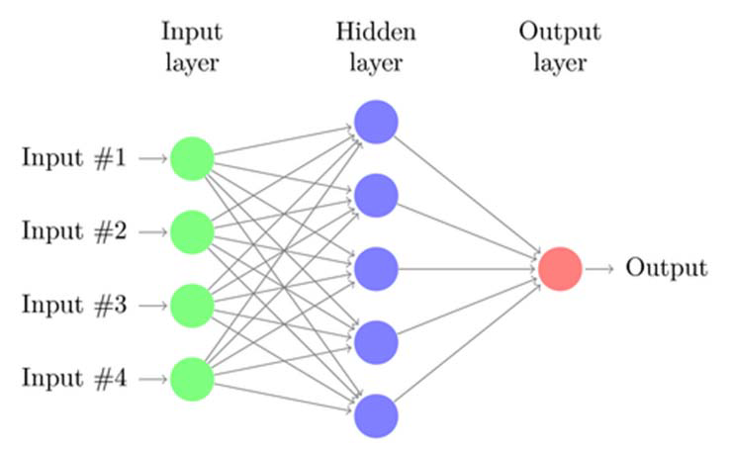
Sample Model

Slide 13
The Advantages of our Proposed System
Using ANNs to identify fake profiles has several benefits. Firstly, ANNs can process large amounts of data quickly and accurately, making it possible to identify fake profiles in real-time.
Secondly, ANNs can learn and adapt to new types of fake profiles, making them more effective than traditional rule-based methods.
Finally, ANNs can reduce the workload of human moderators by flagging suspicious profiles for further investigation.

Slide 14
04
Hardware and Software Requirements →

Slide 15
Hardware Requirements →
Processor : Any Update Processor
Ram : Min 4 GB
Hard Disk : Min 100 GB

Slide 16
Software Requirements →
Operating System : Windows family
Technology : Python 3.6
IDE : PyCharm

Slide 17
05
The Novelty of our Project→

Slide 18
Novelty of Our Project
The use of artificial neural networks to identify fake profiles is a machine learning technique that uses an artificial neural network to analyze Facebook friend requests and determine their authenticity.
The importance of considering the parameters of the social network page, such as user activity and history, to ensure the effectiveness of the proposed solution is highlighted.
Overall, our solution offers a novel and effective approach to addressing the problem of fake profiles in social media.

Slide 19
06
Architecture, Modules and UML Diagrams →

Slide 20
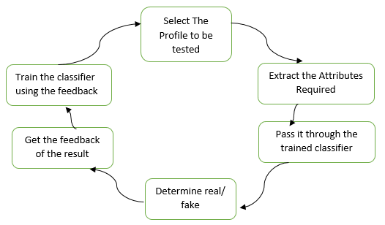
System Architecture

Slide 21
Modules
Upload Dataset
Preprocess Dataset
Run ANN Algorithm
Generate Accuracy and Loss Graph
Open the prediction results

Slide 22
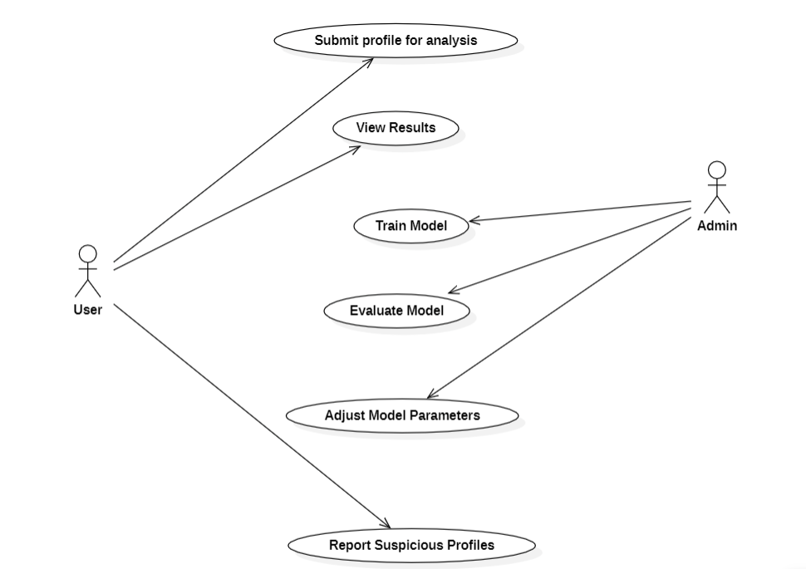
Use Case Diagram

Slide 23
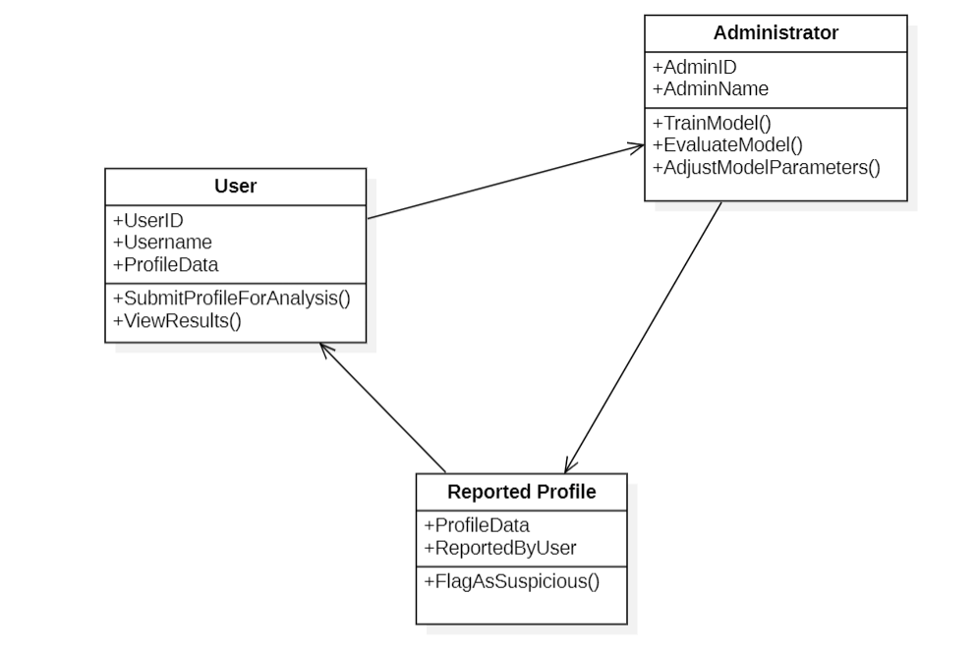
Class Diagram

Slide 24
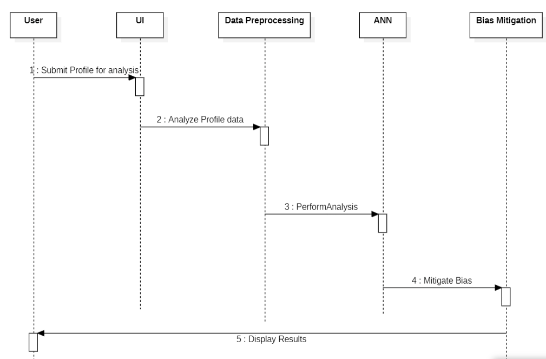
Sequence Diagram

Slide 25
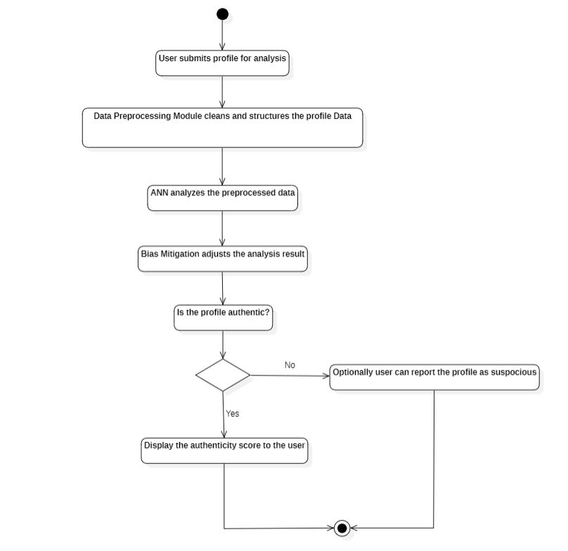
Activity Diagram

Slide 26
07
Results →

Slide 27
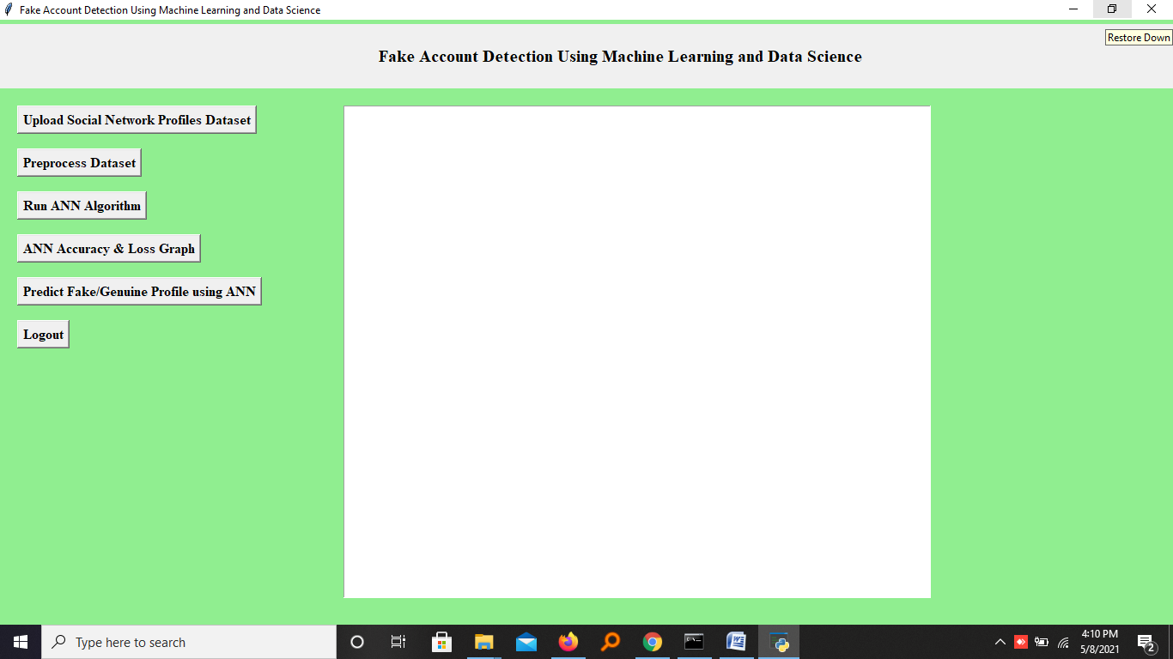
Screenshots
In above screen click on ‘Upload Social Network Profiles Dataset’ button and upload dataset

Slide 28
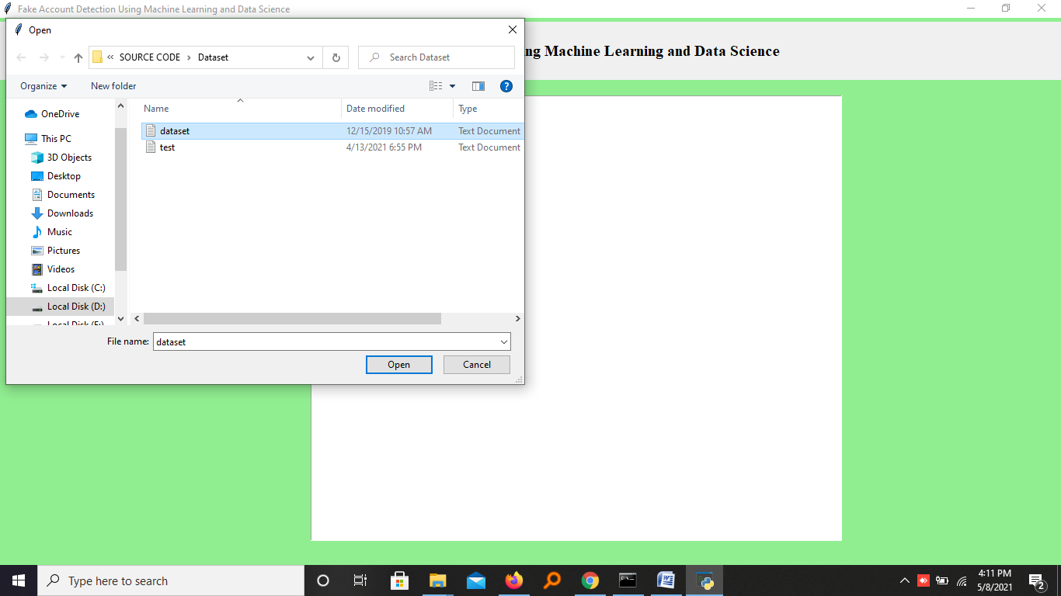
Screenshots
In above screen selecting and uploading ‘dataset.txt’ file and then click on ‘Open’ button to load dataset and to get below screen

Slide 29

Screenshots
In above screen dataset loaded and displaying few records from dataset and now click on ‘Preprocess Dataset’ button to remove missing values and to split dataset into train and test part

Slide 30
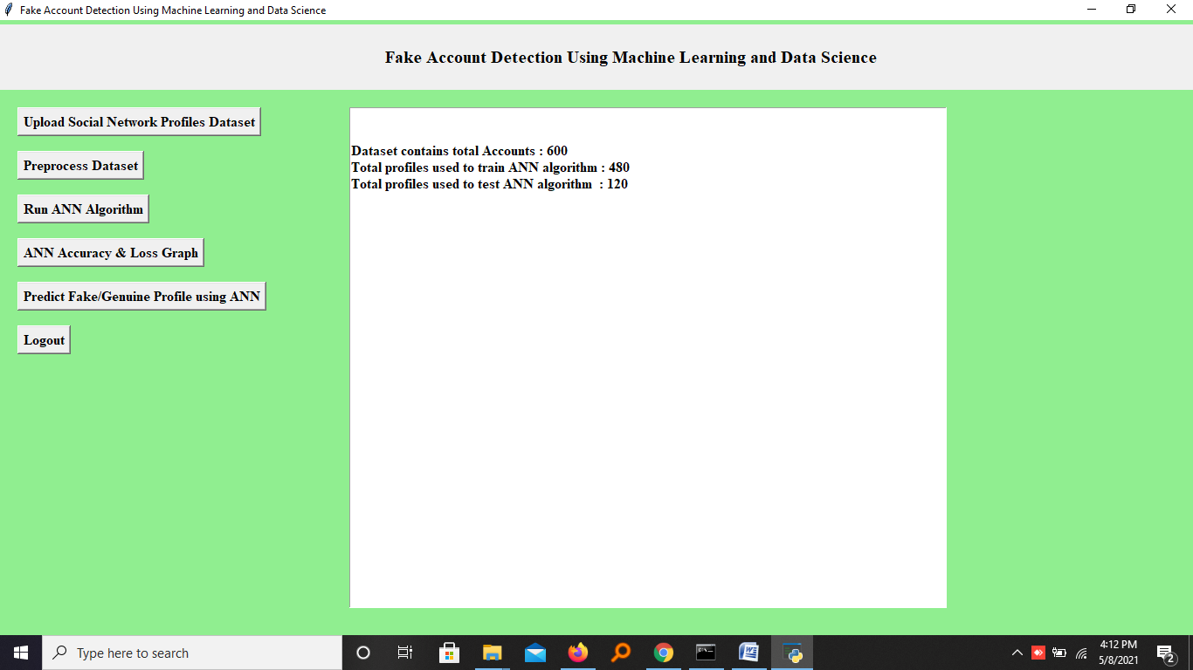
Screenshots
In above screen we can see dataset contains total 600 records and application using 480 records for training and 120 records to test ANN and now dataset is ready and now click on ‘Run ANN Algorithm’ button to ANN algorithm

Slide 31
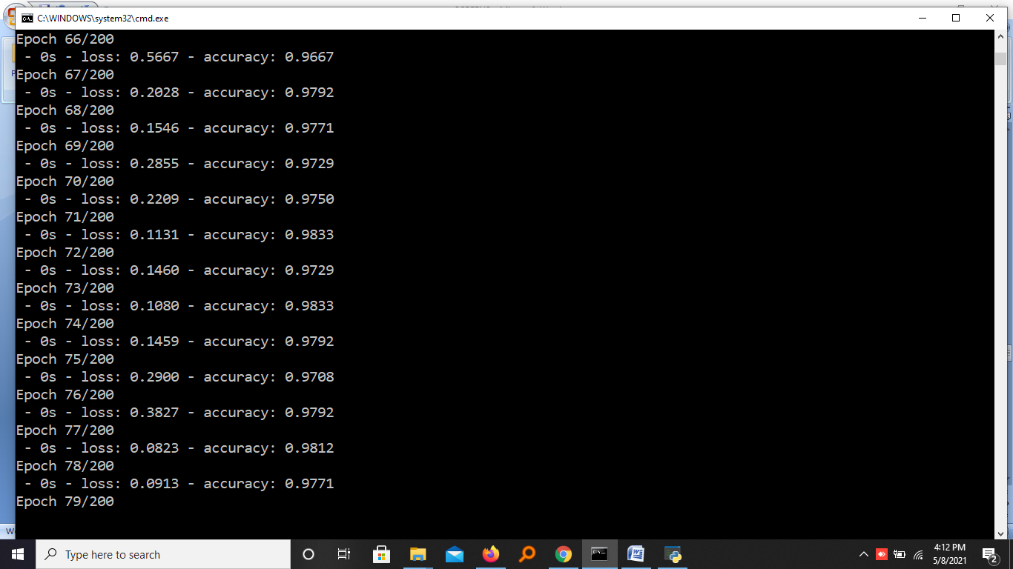
Screenshots
In above screen we can see ANN start iterating model generation and at each increasing epoch we can see accuracy is getting increase and loss getting decrease.

Slide 32
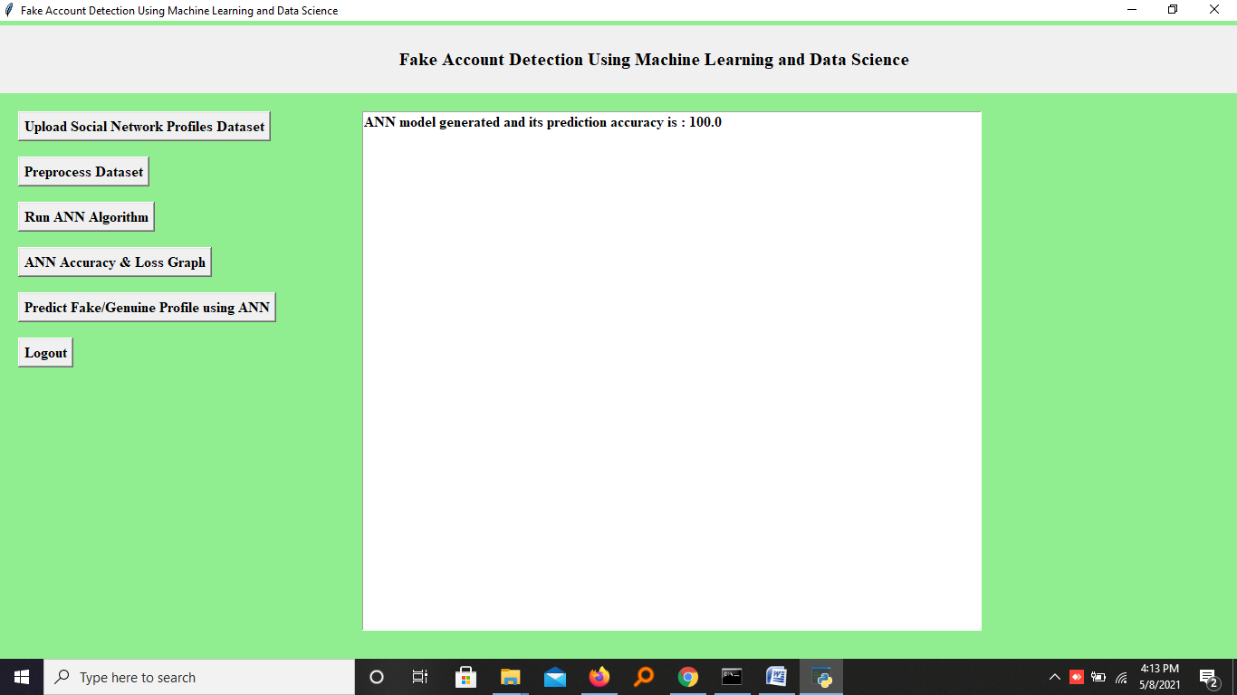
Screenshots
In above screen ANN model generated and now click on ‘ANN Accuracy & Loss Graph’ button to get below graph

Slide 33
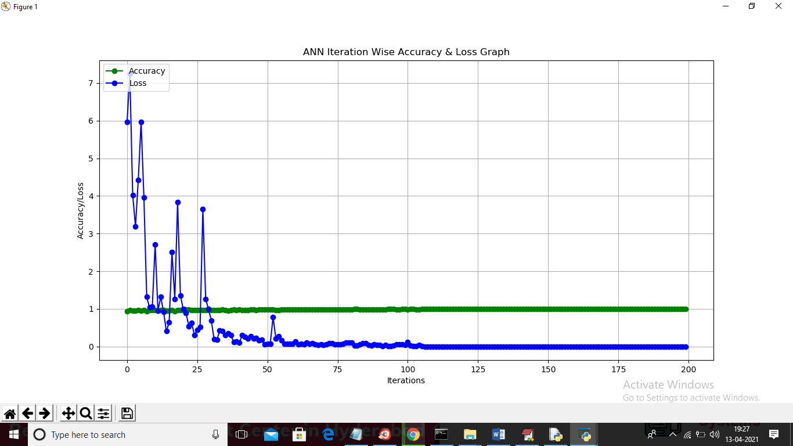
Screenshots
In above graph x-axis represents epoch and y-axis represents accuracy/loss value and in above graph green line represents accuracy and blue line represents loss value and we can see accuracy was increase from 0.90 to 1 and loss value decrease from 7 to 0.1. Now model is ready and now click on ‘Predict Fake/Genuine Profile using ANN’ button to upload test data and then ANN will predict below result

Slide 34

Screenshots
In above screen we are selecting and uploading ‘test.txt’ file and then click on ‘Open’ button to load test data and to get below prediction result

Slide 35
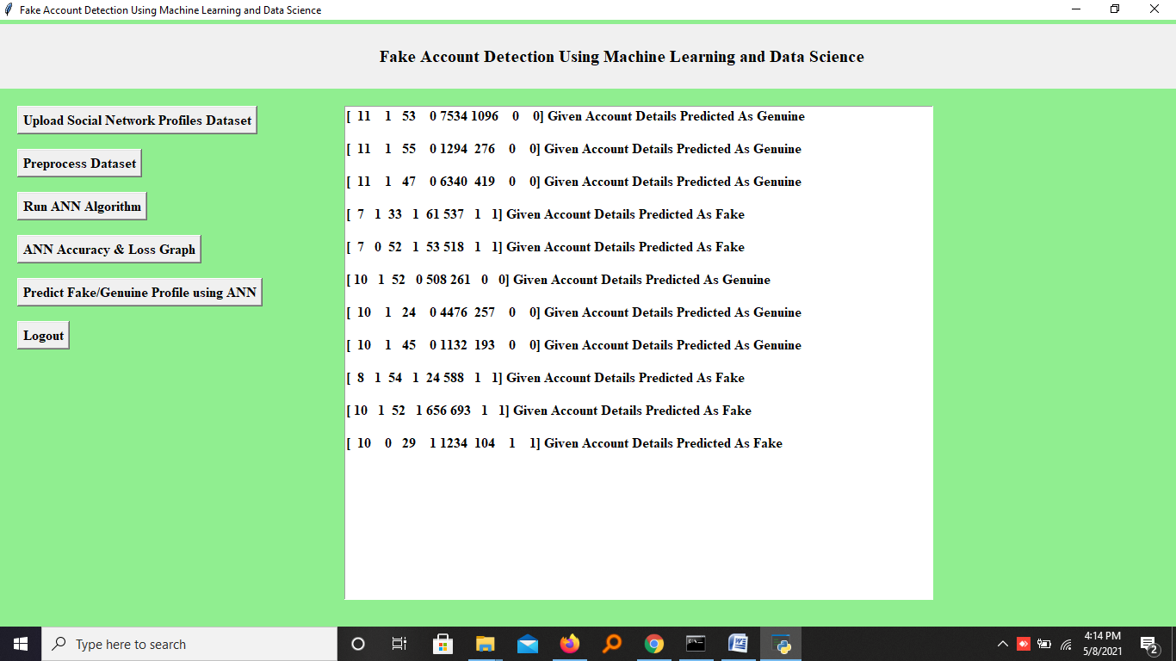
Screenshots
In above screen in square bracket we can see uploaded test data and after square bracket we can see ANN prediction result as genuine or fake

Slide 36
Sample Code
from tkinter import messagebox
from tkinter import *
from tkinter import simpledialog
import tkinter
import matplotlib.pyplot as plt
import numpy as np
from tkinter import ttk
from tkinter import filedialog
import pandas as pd
from sklearn.model_selection import train_test_split
from keras.models import Sequential
from keras.layers.core import Dense,Activation,Dropout
from keras.callbacks import EarlyStopping
from sklearn.preprocessing import OneHotEncoder
from keras.optimizers import Adam
from keras.utils.np_utils import to_categorical

Slide 37
main = Tk()
main.title("Fake Account Detection Using Machine Learning and Data Science")
main.geometry("1300x1200")
main.config(bg="lightgreen")
global filename
global X, Y
global X_train, X_test, y_train, y_test
global accuracy
global dataset
global model
def loadProfileDataset():
global filename
global dataset
outputarea.delete('1.0', END)
filename = filedialog.askopenfilename(initialdir="Dataset")
outputarea.insert(END,filename+" loaded\n\n")
dataset = pd.read_csv(filename)
outputarea.insert(END,str(dataset.head()))

Slide 38
08
Conclusion and Future Scope →

Slide 39
Conclusion
We use machine learning, namely an artificial neural network to determine what are the chances that a friend request is authentic are or not. Each equation at each neuron (node) is put through a Sigmoid function. We use a training data set by Facebook or other social networks. This would allow the presented deep learning algorithm to learn the patterns of bot behavior by back propagation, minimizing the final cost function and adjusting each neuron's weight and bias.

Slide 40
Future Scope
Multilingual and Cross-Platform Support: Extend the system's capabilities to detect fake profiles in multiple languages and across various social media platforms, making it more versatile and widely applicable.
Continuous Learning and Model Updates: Implement mechanisms for continuous learning and model updates. Incorporate feedback from user reports and evolving tactics of fake profile creators to improve detection accuracy.
Real-Time Profile Analysis: Explore the possibility of real-time profile analysis, enabling users to assess the authenticity of profiles as they encounter them in their online interactions.

Slide 41
09
References →

Slide 42
References
[1] Kumud Patel; Sudhanshu Agrahari; Saijshree Srivastava “Survey on Fake Profile Detection on Social Sites by Using Machine Learning Algorithm 2020 8th International Conference on Reliability, Infocom Technologies and Optimization (Trends and Future Directions) (ICRITO) Year: 2020 | Conference Paper | Publisher: IEEE
[2] “Keynote Speech 2: Detecting fake news and profiling fake news spreaders and conspiracy propagators” 2021 12th International Conference on Information and Communication Systems (ICICS) Year: 2021 | Conference Paper | Publisher: IEEE
[3] Samuel Delgado Muñoz; Edward Paul Guillén Pinto “A dataset for the detection of fake profiles on social networking services” 2020 International Conference on Computational Science and Computational Intelligence (CSCI) Year: 2020 | Conference Paper | Publisher: IEEE

Slide 43
References
[4] Pradeep Kumar Roy; Shivam Chahar “Fake Profile Detection on Social Networking Websites: A Comprehensive Review” IEEE Transactions on Artificial Intelligence Year: 2020 | Volume: 1, Issue: 3 | Journal Article | Publisher: IEEE
[5] P Sowmya; Madhumita Chatterjee “Detection of Fake and Clone accounts in Twitter using Classification and Distance Measure Algorithms” 2020 International Conference on Communication and Signal Processing (ICCSP) Year: 2020 | Conference Paper | Publisher: IEEE
[6] Padmaveni Krishnan;D. John Aravindhar; Palagati Bhanu Prakash Reddy “Finite Automata for Fake Profile Identification in Online Social Networks” 2020 4th International Conference on Intelligent Computing and Control Systems (ICICCS) Year: 2020 | Conference Paper | Publisher: IEEE

Slide 44
Thanks!
Feel free to ask any questions

