Slide 1
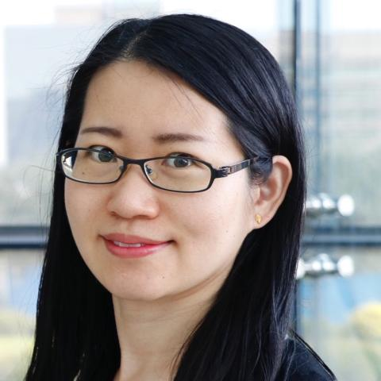
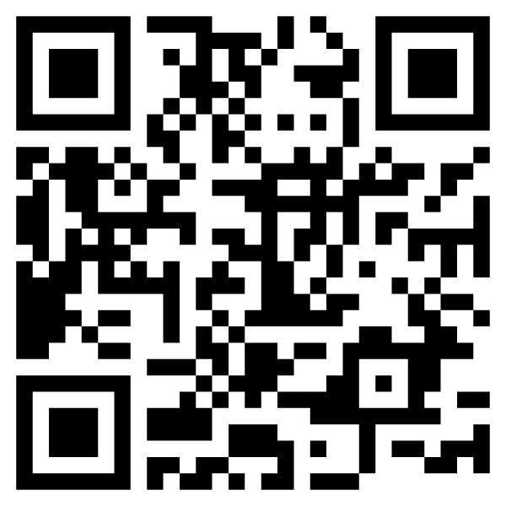
Weekly Immunology Online Seminars #232
Future seminars: https://immunezoom.github.io
Understanding T-cell Immunity Against Infection and Cancer Using a Systems Immunology Approach
Chen Yao, Ph.D.
UTSW
Host: Chuan Wu
Mar 27, 9pm (EST)
Mar 28, 9am (Beijing Time)
Zoom ID: 161 0803 2958

