Slide 1

Share The Meal
Bringing Technology to The Society

Slide 2
More than 9k children go to sleep hungry everyday (Mumbai)
More than a 100 million go to sleep hungry in entire India
Existential NGOs collect food from special occasions, for the needy. Some have online sponsorship program that are unintuitive or unnoticed

Slide 3
The Aim
Develop an analytic engine-backed application
That lets citizens donate money worth one or more meals to selected charitable NGOs
These NGOs in turn feed the tracked hungry street children

Slide 4
Share The Meal
Audience: Common man using smartphones
Facilities needed: A smartphone with the users; a simple interactive panel at the NGO side
Technologies adapted: Java (or equivalent), Web languages for Portal, Cloud service (basic subscription) & Machine Learning modules as needed.
What, Whom and How?

Slide 5
Share The Meal
Smartphone Application
Prediction-based cloud engine
Web portal (NGO-side)
The modules of this project

Slide 6
Functions (As A User)
The user will provide
Profile details
Income-tax slab
Wallet details (for payment)
The user can
Choose among multiple donation-packages
One time
For a week
For a month (& so)
Choose repetition
One-off
Weekly
Monthly
Check the Food-donation status

Slide 7
Functions (As The NGO portal admin)
The admin of the Web Portal will
Be authenticated
Update the status of the meal-donation across regions
Feed the statistics
No. of children fed
No. of children under their radar
Misc values

Slide 8
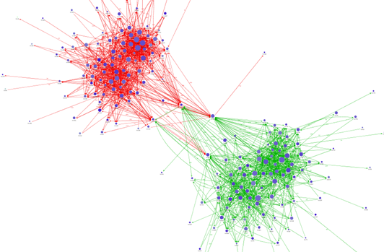
Data mining & Predictive Analysis

Slide 9
The Aim
Use Clustering and (a branch of data mining) to categorize users based on various attributes. Make use of Predictive Analysis on the clusters to predict donation amount for each user. Thus, recommend intuitive donation schemes to user at correct times
Anomaly detection
Digital verification for NGO-authentication

Slide 10
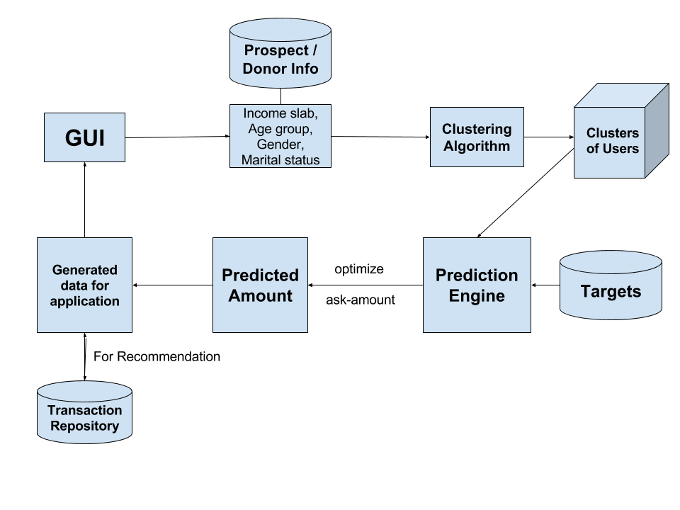

Slide 11
Data Mining & ML
Supervised Machine Learning
We train the algorithm with labelled training sets
Un-supervised Machine Learning
No labels, lack of enough classifying data from user
We shall use 'Clustering Algorithms'
usage-driven, through analysing current and past data elements (facts).

Slide 12
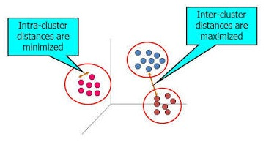
Clustering - Classification of Users
To separate data into 'clusters' that has similar data points, while dissimilarity between clusters is high
Easy to form clusters based on numeric values
Each cluster has a centroid
Distance between centroids == Distaces between clusters

Slide 13
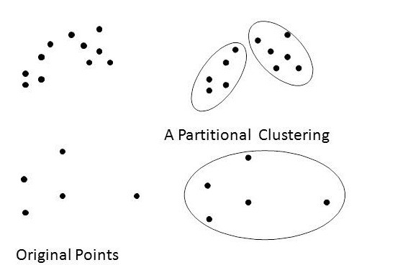
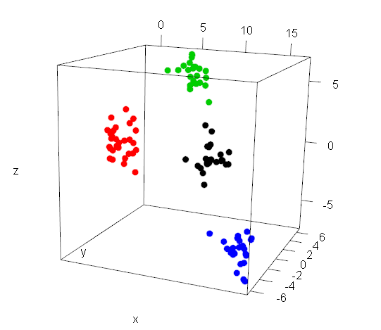
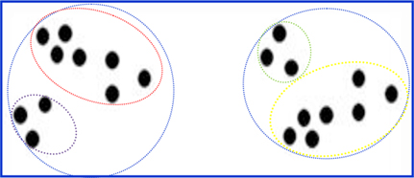
Partitional clustering
n data points, d dimensional space
k clusters formed
Hierarchical clustering

Slide 14
Common Algos = NOT sufficient
Attribute types:
1. numeric (income slab, age)
2. categorical (marital status, gender)
Common algorithms work either on numeric or categorical
Partition: inappropriate parameters may connect categorical items together in a cluster
Hierarchical: distance between centroids a poor estimate of similarity

Slide 15
Algorithmic Approaches
2-Step Clustering
Step 1
Construct relationships among the categorical attributes
Hence, convert to numeric attributes
Step 2
Use hierarchical clustering algorithms to data-set
ROCK Robust Clustering
Form clusters (categorized & numeric)
Use transactions (records of attributes) to cluster donors
Will create levels for numerical attribute
Boolean or arbitrary domain for categorical attributes

Slide 16
Our Approach
Income slab will be assigned level label ( eg. Level 1=lowest income slab
Level n= highest income slab)
Similarly age groups will be assigned level labels
Marital status and gender will be assigned Boolean (1 and 0) labels
Each record will be then assigned a k-tuple representing points in a k-dimensional space

Slide 17
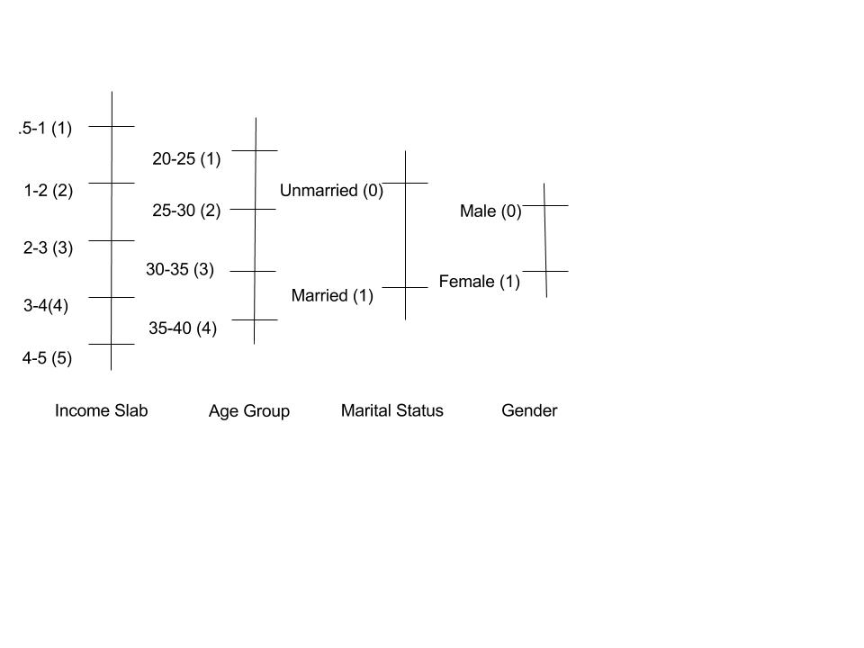

Slide 18
Income (Million) | Age | Martial Status | Gender | User
1.2 | 20 | Unmarried | Male | 1
3.7 | 29 | Married | Female | 2
4.2 | 40 | Married | Male | 3
1.8 | 25 | Unmarried | Female | 4
User 1 (2,1,0,1)
User 2 (4,2,1,0)
User 3(5, 4,0,1)
User 4(2,1,0,1)

Slide 19
Clustering algorithm
A point's neighbours are those points that are considerably similar to it.
Let sim(pi, pj) be a similarity function that is normalized and captures the closeness between the pair of points \ pi and pj i.e. sim(pi,pj)>theta
In the above equation, theta is a user-defined parameter that can be used to control how close a pair
Links: link(pi, pj) is the number of common neighbours between pi and pj
Notion of links :link(pi, pj) to be the number of common neighbours between pi and pj .
From the denition of links, it follows that if link(pi,pj) is large, then it is more probable that pi and pj belong to the same cluster.
From previous example user 1 and user 4 will belong to the same cluster

Slide 20
Predicting Donation costs
To maximize donor-relationship by optimizing the ask amount
Display the most practical amount for donation to the user
Uncover qualified prospect donors
Suggest re-donations / schemes following old patterns
Use manufactured clusters to optimize prediction forumla

Slide 21
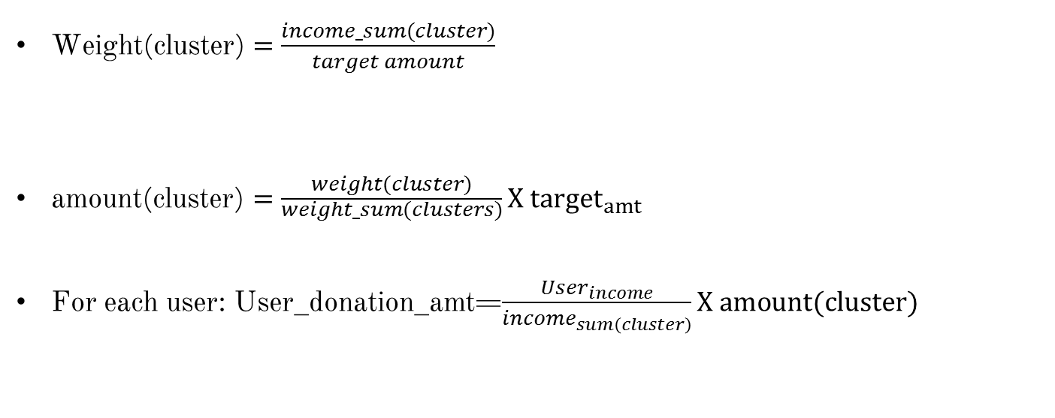
Prediction algorithm
$\text{Weight}\text{(}\text{cluster}\text{)}=\frac{income_sum(cluster)}{target amount}$
amount$\text{(}\text{cluster}\text{)}=\frac{weight(cluster)}{\begin{aligned}weight_sum(clusters) \\ \end{aligned}}X {target}_{amt}$
For each user: User_donation_amt=$\frac{User_{income}}{income_{sum\left(cluster\right)}}X amount(cluster)$

Slide 22
Miscellaneous points
For ML, tools like Microsoft Azure Studio can be used
For Digital Verification, various ML APIs can be used
Recommendations based on the list of active Facebook friends of the user, and their donations, can be made
Prediction / calculation of statistics of Now-&-Then statistics of hunger-struck children can be displayed (tentative)
Apart from hunger-driven activities, Emergency Alerts and related donations can be fed into the application on a later stage.

Slide 23
Final Year Project from BTech Computer
VJTI, Mumbai
Parshva Shah -- 131070018
Shasvat Desai -- 131070060
Akash Janjal -- 131070062
Saurabh Mardikar -- 131070063
Project guide – Prof. S.C.Shravane

