Slide 1
Welcome to the summer of code
Week 1: Jupyter
Week 2: version control with github
Week 3: R
Week 4: R
Week 5: R
Week 6: R
Week 7: R
Week 8: R

Slide 2
Why Jupyter?
Executing code on Partners
Viewing figures directly
Literate programming: working with chunks

Slide 3
Pt 1: installation

Slide 4

Password-less ssh access into ErisOne
https://slowkow.com/notes/ssh-tutorial/
Instead of this
This

Slide 5
Problem 1: no permissions to copy RSA public key into authorized_keys
If you try to execute this command but cannot
You may not have access to authorized_keys on the server. To check if this is the case, ssh into erisone and execute:
cd ~/.ssh;ll
If you see that the authorized_keys is owned by root (highlighted below)
-rw-------. 1 root root 1379 Jun 14 2018 authorized_keys
You can changed this with
cp authorized_keys tmp; mv tmp authorized_keys
Now Kamil’s command should work

Slide 6
Erisone specific aliases
In your local computer, copy the following text into ~/.ssh/config. Change only User from ‘ik936’ to your erisone username.
Host eris1n2 eris1n3 rgs03 rgs04 rgs05 rgs06 rgs07 rgs08 rgs09 rgs10 rgs11
PubkeyAuthentication yes
IdentityFile ~/.ssh/id_rsa
User ik936
ForwardX11 no
Hostname %h.research.partners.org
Host cn001 cn002 cn003 cn004 cn005 cn006 cn007 cn008 cn009 cn010 cn044 cn045 yocto001
PubkeyAuthentication yes
IdentityFile ~/.ssh/id_rsa
User ik936
ForwardX11 no
ProxyCommand ssh -q rgs10 nc %h %p

Slide 7
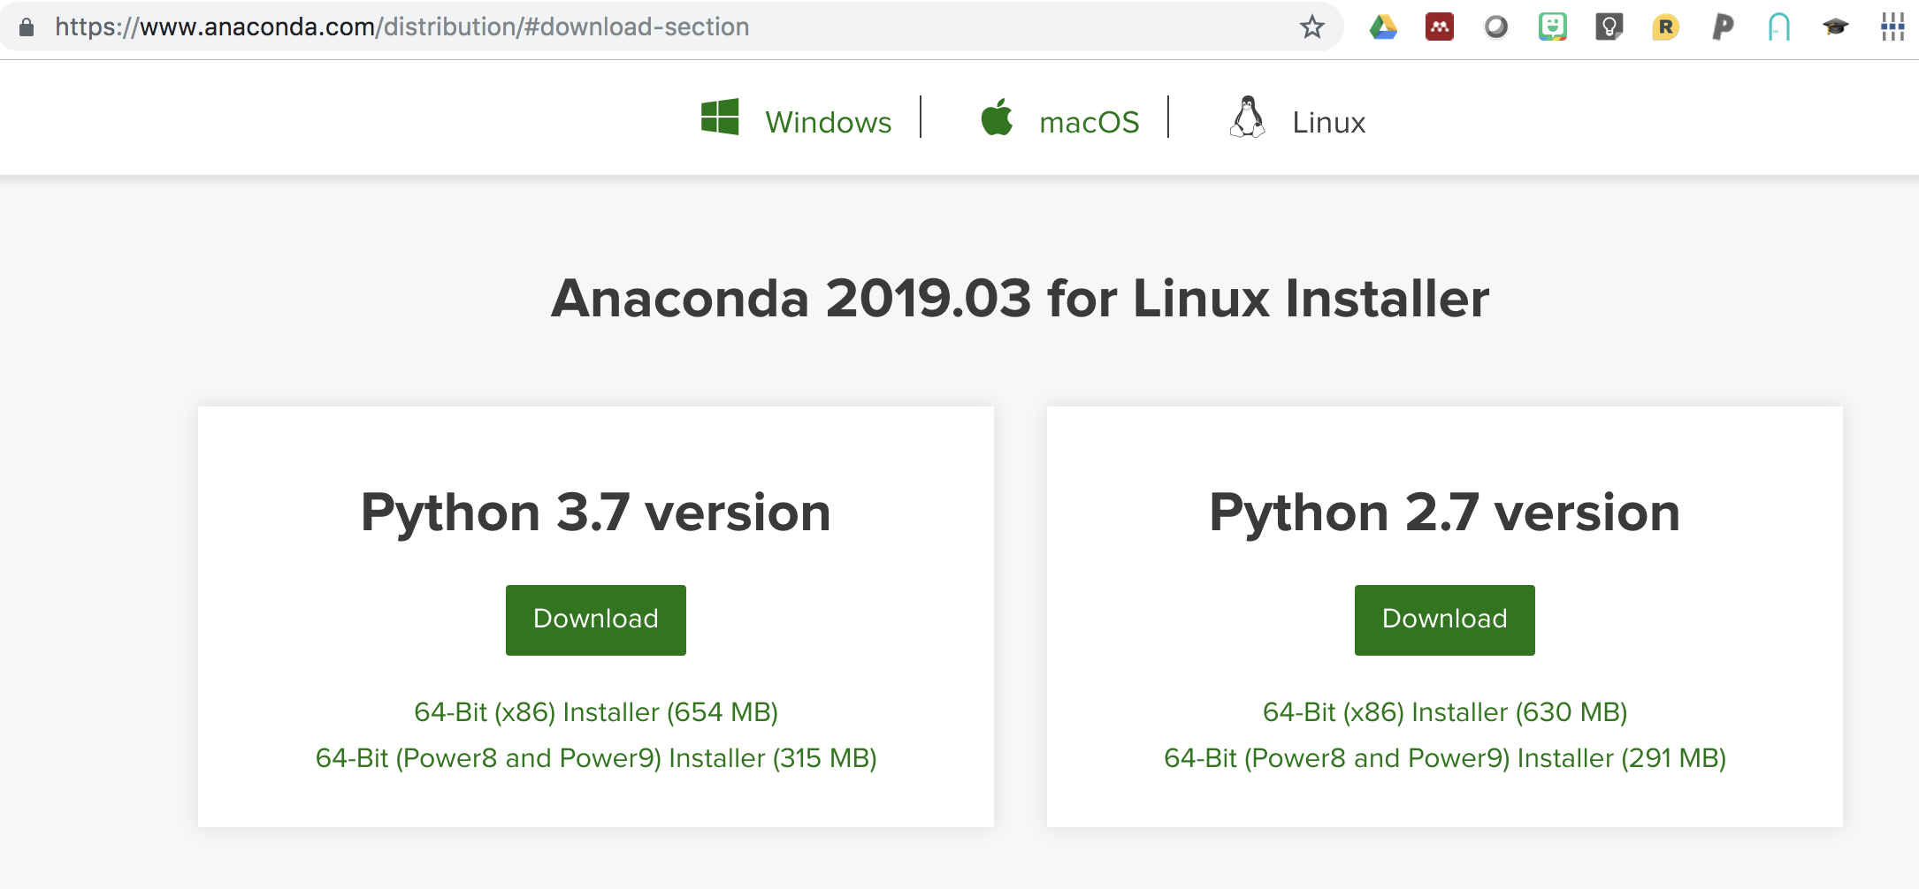
Anaconda package manager

Slide 8
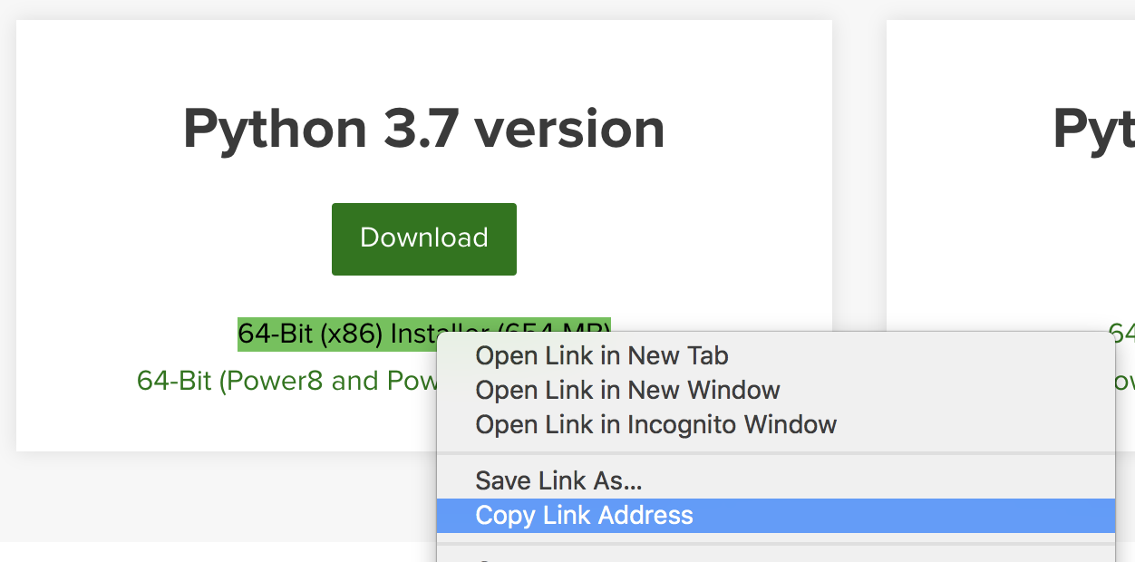
To install anaconda on erisone:
Get the download URL to download the linux installer from the website
In erisone, download conda
wget <CONDA URL>
Now you will have an executable installation file, some like
Anaconda3-2019.03-Linux-x86_64.sh
To make it executable, change permissions:
chmod a+x Anaconda3-2019.03-Linux-x86_64.sh
Then run the installer!
./Anaconda3-2019.03-Linux-x86_64.sh

Slide 9
Use conda to install 3 key packages
tmux, to keep your remote session alive
conda install -c conda-forge tmux
jupyter lab, to run jupyter lab
conda install -c conda-forge jupyterlab
nodejs, to install jupyter lab extensions
conda install -c conda-forge nodejs

Slide 10
To be able to run R with jupyter
We need the IRKernel
library(devtools)
devtools::install_github(‘CRAN/IRkernel’)
IRkernel::installspec()
(optional) keep multiple R kernels
IRkernel::installspec(name=’R36’, displayname=‘R36’)
(optional) install your own version of R through conda
conda install -c r r

Slide 11
Let’s boot it up!
(local) Log into compute node on partners
ssh cn008
2. (remote) Start instance of jupyter lab
tmux
jupyter lab --no-browser --port=8888
3. (local) Open remote connection
ssh -N -L 8888:localhost:8888 cn008
4. (local) Access jupyter through web browser
http://localhost:8888/lab

Slide 12
Files and tabs
txt, terminal, .R, .ipynb
Create new view for output

Slide 13
Organizing a notebook
Markdown, code, and raw
Shortcut for markdown chunk
Example 1: exploring single cell data
Example 2: reproducible paper analyses

Slide 14
Figures!!!
figure size
Saving and copying figures
Patchwork library
library(devtools)
install_github(xxxxxxx/patchwork)

Slide 15
Exporting notebook to other formats
html
pdf
Rmarkdown

