Slide 1
Customized Discounting
Budhacks : NITK Surathkal
Nisarg Bipin Shah

Slide 2
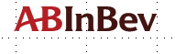

Table of Contents
Key Drivers & Feature Engineering
Exploratory Data Analysis & Statistical Testing
Data Preparation
Machine Learning Modelling
Results – Predicted Discounts & Profitability Bar Charts
Product demo
SWOT analysis
Q&A
Appendix

Slide 3
Key Drivers
Feature Engineering
Discounting based on customer growth
Expected Gross Turn Over , Product Volume in coming years
Market Capitalization , Industry Growth , Expected Future Growth of POC
Product Profitability
Inventory Clearance Factor for a product
Profitability behind a unit sell of product
Attracting Customers
Reward Loyal Customers
Lure new customers with high growth potential
Market Capitalization
Relative Volume ordered by POC in 2019
Market defined by segment , sub-segment, province, sdfc-tier, poc-image
Expected Future Growth
past growth + market capitalisation * average market growth
Expected GTO & Volume Product
Based on 2019 GTO & Expected growth in POC , compute GTO for next year
Order size
Volume of product ordered over the max volume of that product ordered by any POC
Inventory Lingering Index
Based on max discount offered on product & max discount offered on any product
Also on how greater order size is than minimum order size for discount
Product Profitability Indicator
Mean discount offered for a product over the maximum mean discount offered to any product
Customer Loyalty Indicator
Depends on market Capitalization & order size
Upper Limit of Discount
Based on product profitability , growth potential of POC as determined by Expected GTO & order size
Data Insights & division idea
99.8% of orders have GTO less than 50,000
Total Discount , GTO , Volume , Taxes has a highly right skewed distribution.
Dominant features for discounts differ for orders with GTO above 50,000 & those below 50,000
Dividing dataset into 3 parts based on GTO & modelling them separately is an ideal solution to tackle differences : GTO<10k , GTO between 10k & 50k , GTO>50k

Slide 4
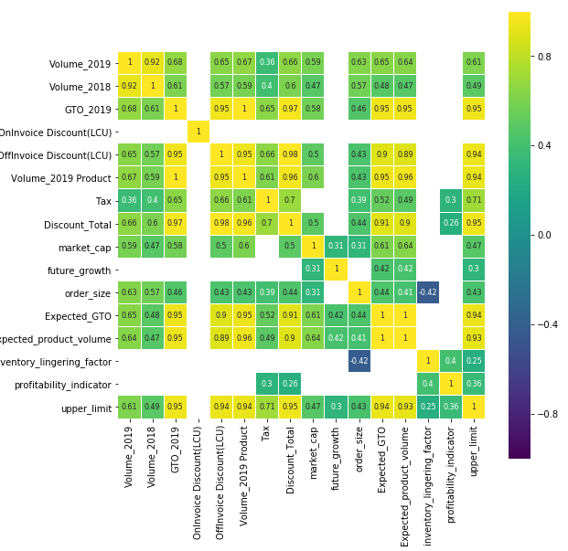
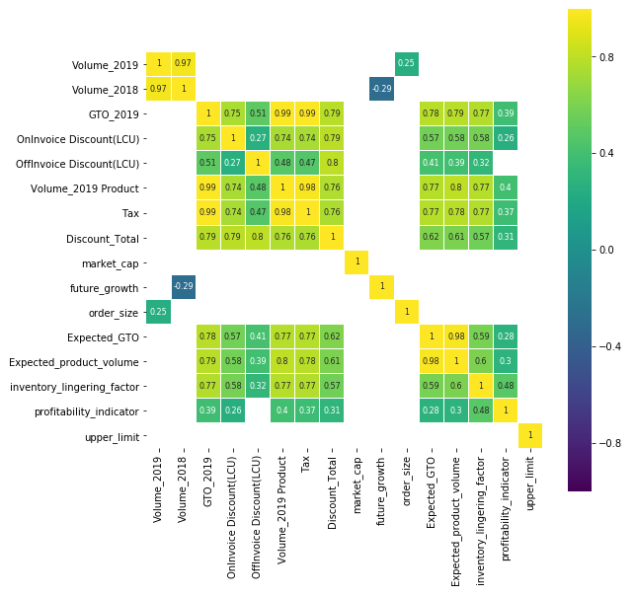
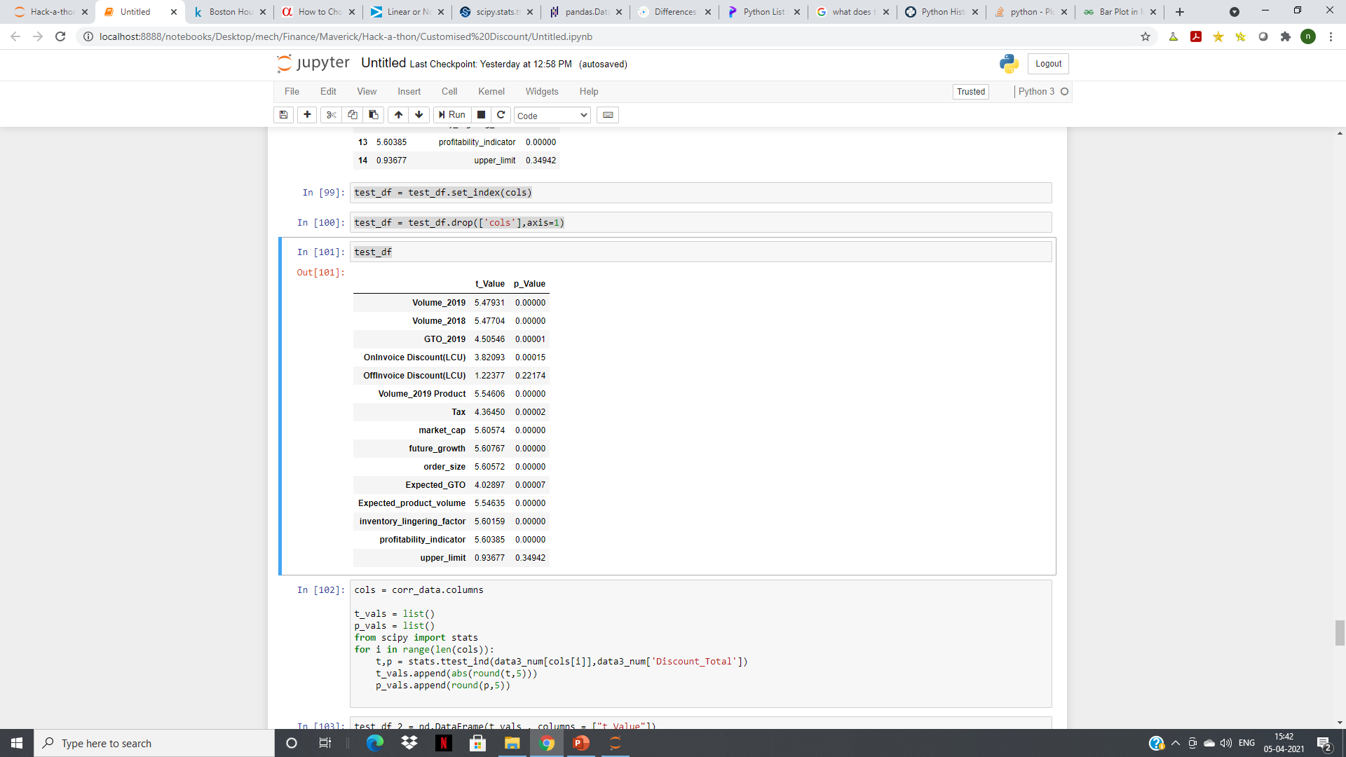
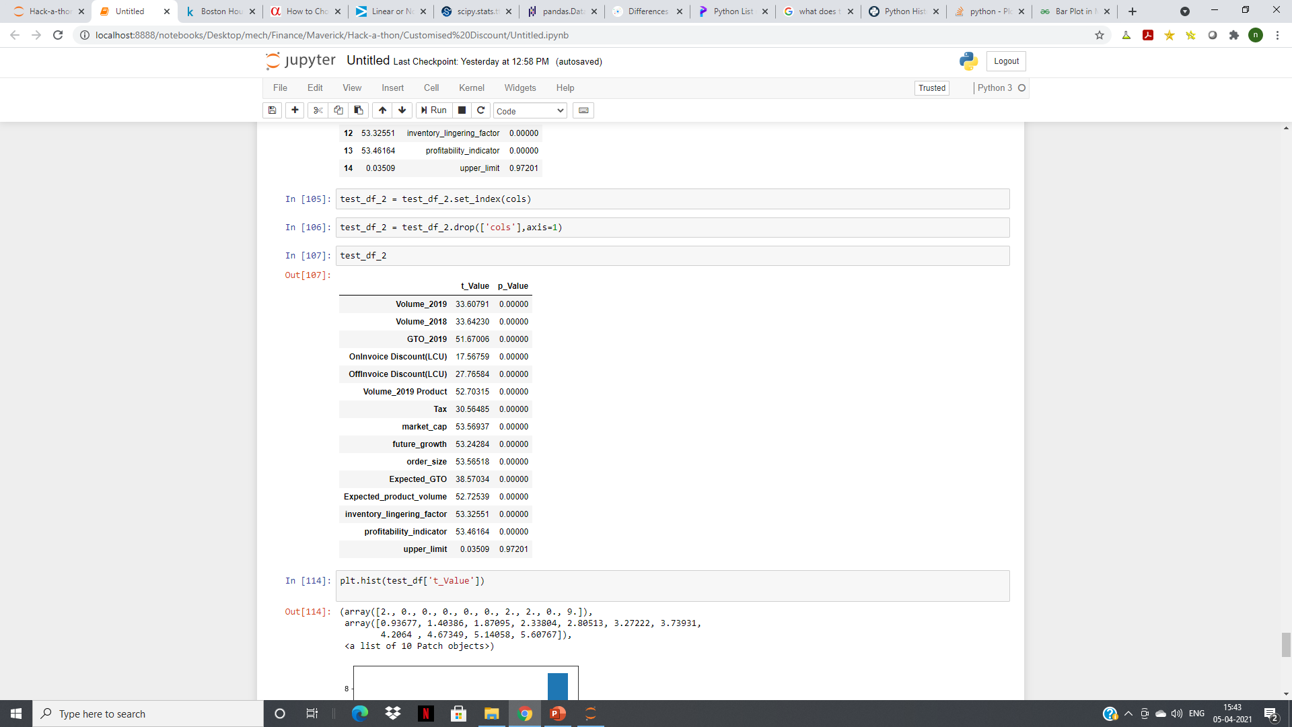
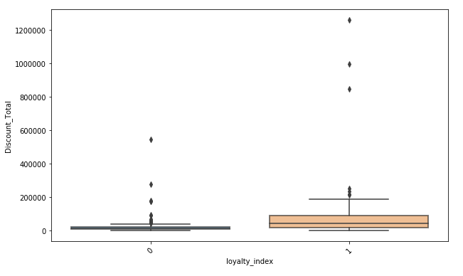
Exploratory Data Analysis
Statistical Testing
GTO>50,000 GTO<50,000
Fig shows the dominant numeric features & correlation heat map for both datasets
``` Loyalty Index – A dominant feature feature engineered categorical var variable and it’s impact on Total_D Total Discount for GTO<50,000 da data. Other dominant categorical feature are sdfc tier , poc image & & returnalility for GTO<50,000. Fo For GTO>50,000 , these categorica categorical variables don’t have separative dominance
GTO>50,000 GTO<50,000
p-value < 0.05 shows statistical significance & higher absolute t-Value shows evidence against null hypothesis.
OffInvoice Discount , upper_limit isn’t statistically significant in GTO>50k & upper_limit in GTO<50k data
System Design
Data Preparation
Data Division
ML Modelling
Results on web app
Tech Stack : Python , Flask , Data Science Libraries : Pandas , Numpy , Scikit-learn , Tensorflow , Keras , XGBoost , lightGBM , matplotlib , scipy , Heroku for deployment

Slide 5
Data Preparation
Upper Limit = (Average Discount on Product Set * (GTO of POC for that Product / Average GTO for Product)) * (Expected GTO / Current GTO) * 1.2
Term 1 : Product Profitability factor Term 2 : Growth of POC 1.2 : Scaling factor
Upper Limit defines maximum total discount that can be given to POC such that company is profitable
Upper limit is used to find out the data where discounts are given correctly and ones where correction is required
Training Data : Correctly discounted data where Total Discount given is less than upper limit
Test Data : Incorrectly discounted data where Total Discount given is greater than upper limit
Train Machine Learning Models based on training data and correct the wrongly discounted test data
Predict Total Discount , On Invoice Discount & then add the remaining to Off Invoice Discount
Divide dataset into 3 parts : GTO<10k , GTO in range(10k,50k) , GTO>50k

Slide 6
Machine Learning Modelling
Identifying Features
Identifying Best ML Model
Hyperparameter Tuning
Params : p value , t value , adjusted R squared scores
Params
Training Mean Squared Error , Adjusted R squared scores
Training data is where discounts are correctly given and Training MSE should be minimised.
Using Adjusted R squared scores helps identify overfitting.
Models Tested
Linear Regression, Lasso , Ridge , Random Forest Regressor , CART , Gradient Boosting Regressor
CART gives minimum training MSE but has less average 10 fold Cross Validation scores indicating overfit
Gradient boosting Regressor is the best considering both the parameters & hence is used
Algorithm : Bayesian Search CV
For Total Discount
Low GTO Data
'Volume_2019' , 'Volume_2018' , 'Expected_GTO' , 'Expected_product_volume', 'profitability_indicator' , 'upper_limit' ,'sdfc_Tier' , 'loyalty_index' , 'Returnalility', 'market_cap’
Mid GTO Data
'Volume_2019' , 'Volume_2018' ,'Volume_2019 Product' ,'Expected_GTO','Expected_product_volume' , 'profitability_indicator' , 'upper_limit' ,'sdfc_Tier' , 'loyalty_index' , 'Returnalility', 'inventory_lingering_factor’, 'market_cap’, 'order_size’
High GTO Data
'Volume_2019' , 'Volume_2018' ,'Volume_2019 Product' ,'Expected_GTO','Expected_product_volume' , 'profitability_indicator' , 'upper_limit’,'inventory_lingering_factor','order_size’
For On Invoice Discounts
All features from Total Discount are used to predict On Invoice Discount
Data for time demanded by POC to pay for the order will be valuable in predicting On Invoice Discounts
Search space
['loss'] = ['ls', 'lad', 'huber', 'quantile']
['learning_rate’] = [0.05,0.1,0.15,0.2,0.25,0.3]
['n_estimators'] = [50,100,150,200,250,300,350,400]
No of boostings performed , larger number gives better performance but can lead to overfitting
['subsample'] = [0.6,0.8,1]
Choosing sub-sample less than 1 leads to reduction in variance and increase in bias
['criterion'] = ['friedman_mse', 'mse']
['max_depth'] = [2,3,4,5,6,7,8]
Max depth of individual regressors , best value depends on input data
['max_features'] = ['auto', 'sqrt', 'log2']

Slide 7
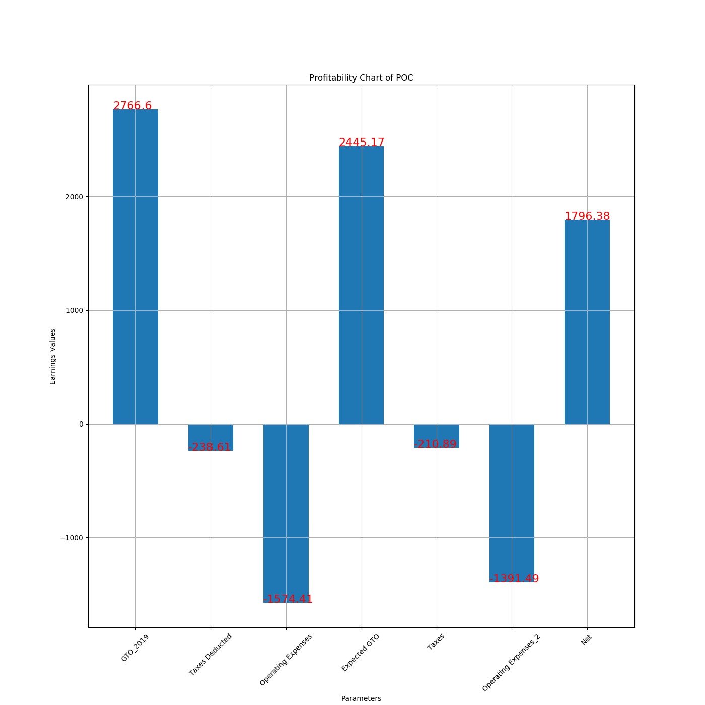
Results – Predicted Discounts & Profitability Waterfall Charts
Case 1 :
Over discounted , low growth customer
Row no 63 in data.xlsx file
Discount given : 809.9
We found that upper limit of discount for this customer is 737
Profitability chart analysis for this customer suggests that net expected profit after 2 years will be 1796 (based on GTO & Expected GTO)
Our Machine Learning Model recommends :
Total Discount : 360.73
On Invoice Discount : 235.53
Off Invoice Discount : 125.2
Operating expenses are calculated as a fraction of GTO based on the expected profit margin of product
Profit Margin = (Average Discount given for product Set / Average GTO for product Set) * 1.5

Slide 8
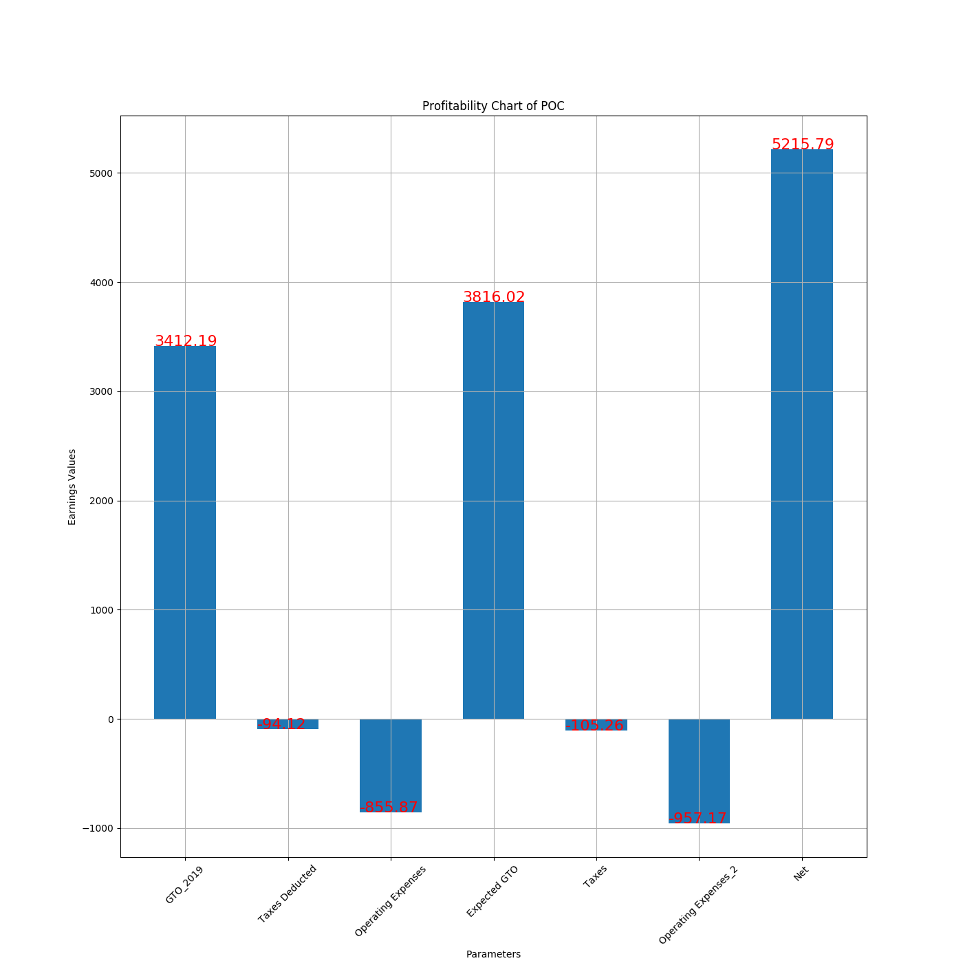
Results – Predicted Discounts & Profitability Waterfall Charts
Case 2 :
Good Profit Margin Product , High Growth POC
Row no 10 in data.xlsx file
Discount given : 1050.98
Upper Limit of discount for this POC : 2265
Net Expected Profit in 2 years : 5215.79
Our Machine Learning Model recommends :
Total Discount : 1126.93
On Invoice Discount : 70
Off Invoice Discount : 1056.93
We recommend luring the customer with little higher discount because
High Profit Margin of Product Set Ordered
High Growth Potential of POC

Slide 9
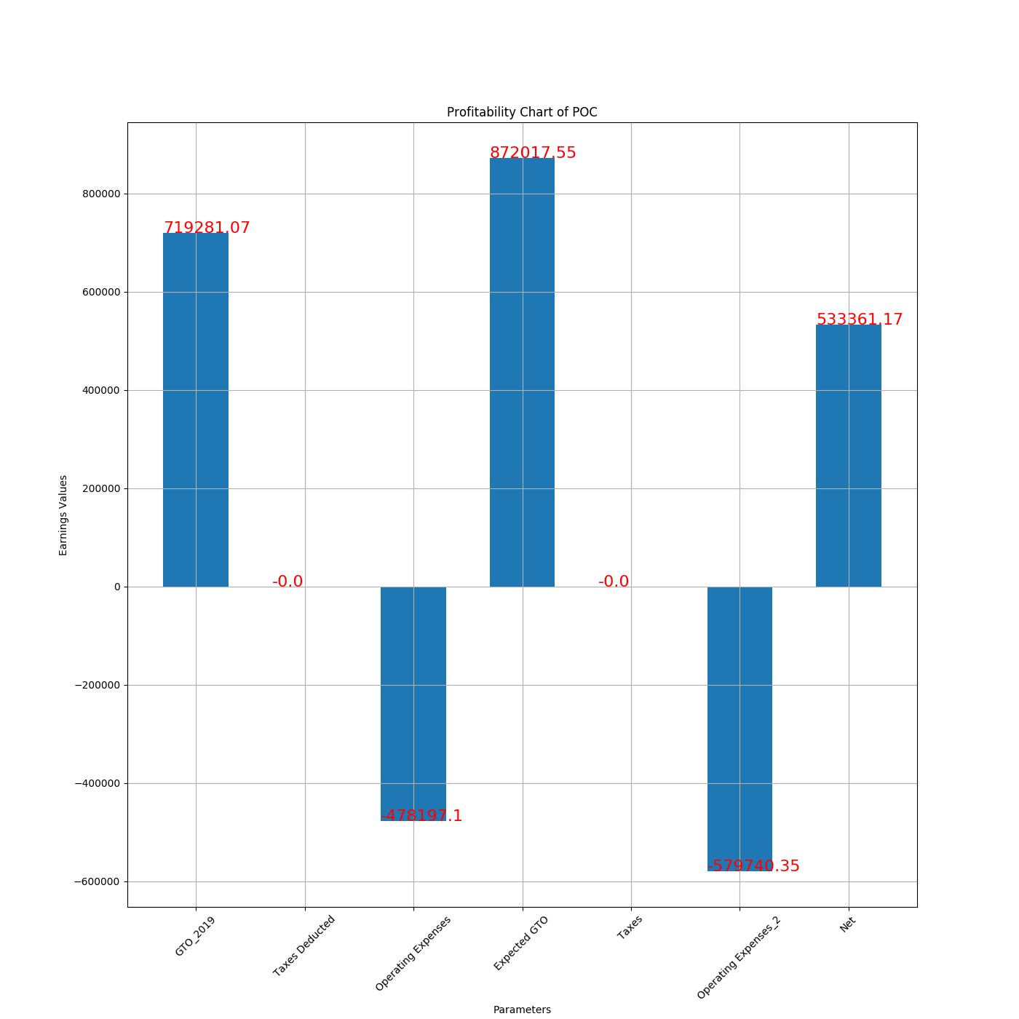
Results – Predicted Discounts & Profitability Waterfall Charts
Case 3 :
High GTO , High Growth POC but over discounted
Row no 2593 in data.xlsx file
Discount given : 236965.79
Upper Limit of discount for this POC : 233821.6
Net Expected Profit in 2 years : 533361
Our Machine Learning Model recommends :
Total Discount : 185463.87
On Invoice Discount : 160734.45
Off Invoice Discount : 24729.42
We recommend lowering the discount offered to POC as estimated profit margin associated with the product set is low

Slide 10
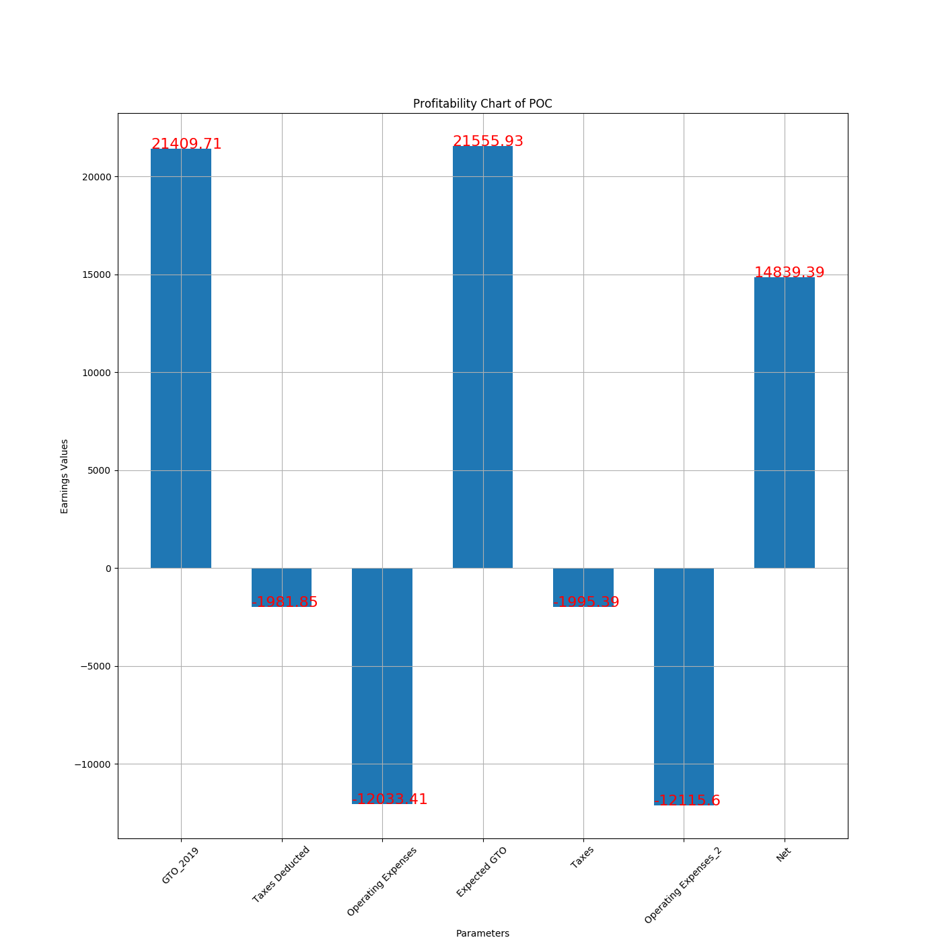
Results – Predicted Discounts & Profitability Waterfall Charts
Case 4 :
Mid GTO , Growth POC under discounted
Row no 28431 in data.xlsx file
Discount given : 1678.21
Upper Limit of discount for this POC : 6563
Net Expected Profit in 2 years : 14839
Our Machine Learning Model recommends :
Total Discount : 2766.21
On Invoice Discount : 2766.21
Off Invoice Discount : 0
We recommend luring this customer with more discount because of high growth potential , mid – high GTO order & relatively good profit margins on product

Slide 11
DEMO

Slide 12

Prototype SWOT Analysis
Scalability of Prototype
Accurate Modelling based on key drivers
Ability to identify correctly predicted discounts & correct wrong ones
Profitability bar chart outputs : appropriate way to visualize discounts for stakeholders
Easy to use UI & ease of accessibility
Strengths
Deploy on ABI Cloud
Expand to other ABI Zones
Weaknesses
Unavailability of some data to predict On Invoice Discounts
Opportunities
Threats

Slide 13
Appendix

Slide 14
Useful Links
Heroku Deployed Web App Link
https://customiseddiscounts.herokuapp.com/
GitHub Repository Link (Currently Private , can be made public as per instructions)
https://github.com/imnisarg/customDisc
Support Documentation
https://docs.google.com/document/d/1vrAyoDBGkFrpg9JhXgJM68Qi4ux1iFU0chQSgm14SdM/edit?usp=sharing

