Slide 1

A project on Automatic Washing Machine Simulator
Nitin Kumar Patel 0201IP191051 Jabalpur Engineering College, Jabalpur, Madhya Pradesh
Mentor :- Submitted to :-
Rajani B Shinde Emertxe Information Technologies

Slide 2
Contents
Introduction
Project Scope
Theoretical Analysis
Results
Advantages
Disadvantages
Conclusion

Slide 3
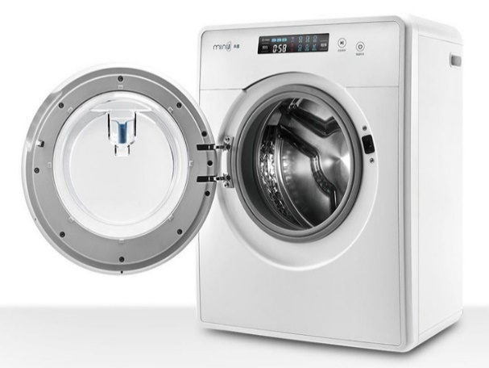
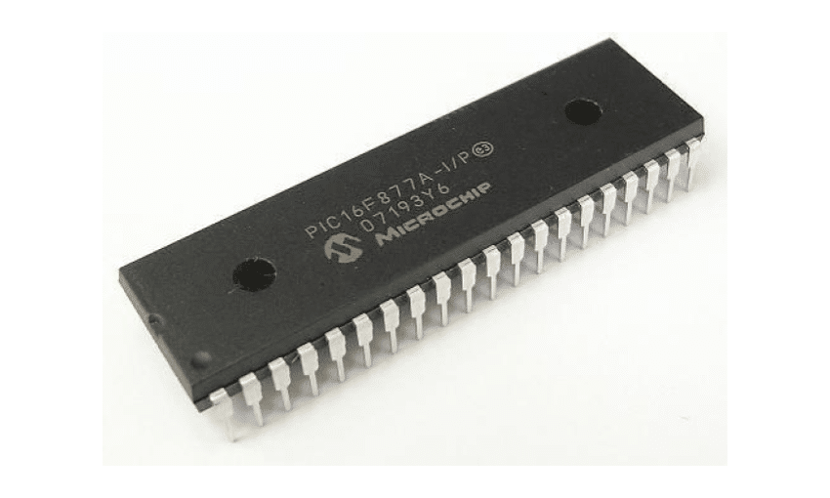
Introduction
Washing machines are the devices which are used for
cleaning of the clothes without a person rubbing, scrubbing
or beating the clothes by oneself and getting dirty. Washing
machines have an important place in the modern society.
We build a simple washing machine wash, rinse and spin
timer using microcontroller PIC16F877A. Microcontrollers
and microprocessors are used to control various electronic
devices such as cellular phones, laptops, monitoring systems,
controlling systems etc. Microcontrollers and microprocessors
are used to perform repetitive operations exactly the same
way time after time.

Slide 4
Project Scope
Project Description - In this project we have implemented a washing machine simulator which is based on embedded systems. Under which we have worked on PICSimLab, MPLABxIDE and PIC16F877A microcontroller using basic C programming.
Project Deliverables - As an output of this project we have to create an interface for users to wash their clothes or dry them according to their fabric by allowing them to choose washing modes and water level.
Stake Holders - The project is designed for the users or customers to load their clothes in the machine, start the cycle and walk away so that they can save their time and carry out another task.

Slide 5
Theoretical Analysis
Embedded systems – Any combination of hardware and software which is intended to do a specific task can be called as “Embedded systems”.
Examples :- Microwave oven, Washing Machine, Camera, Robot etc.
Types :-
Stand – alone
Real Time
Networked
Mobile

Slide 6
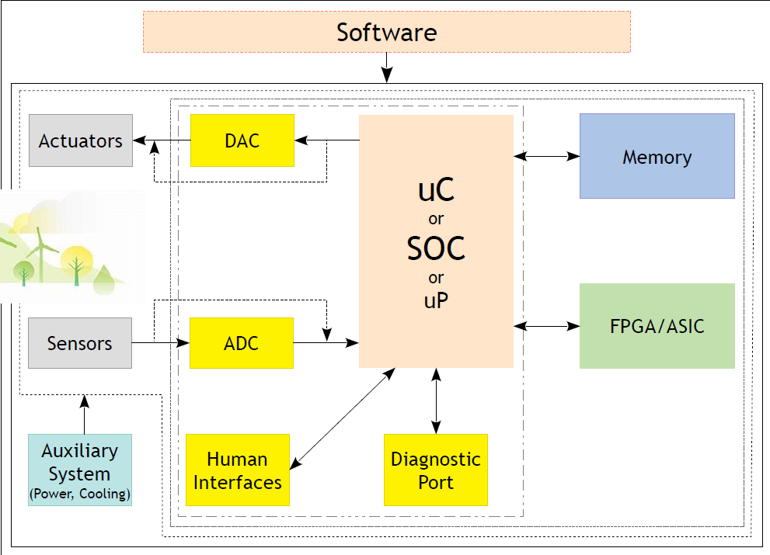
Components of an embedded systems

Slide 7
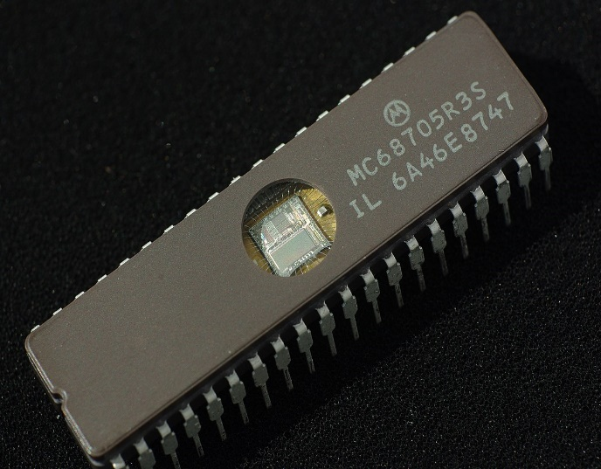
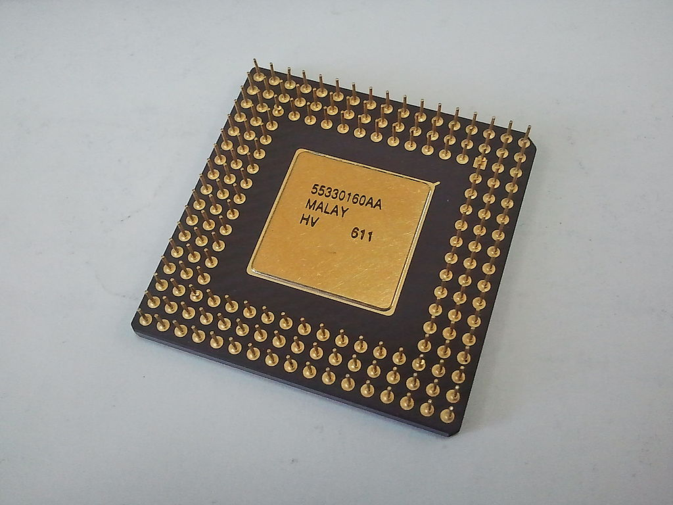
Microcontrollers vs Microprocessors
μC μP
All components on a single chip All components are separated
Less flexible More Flexible
Less design complexity More design complexity
The microcontroller has more registers The microprocessor has less registers

Slide 8
Block Diagram
MPLABxIDE CLCD
PIC16F877A FAN
Digital
keys
BUZZER

Slide 9
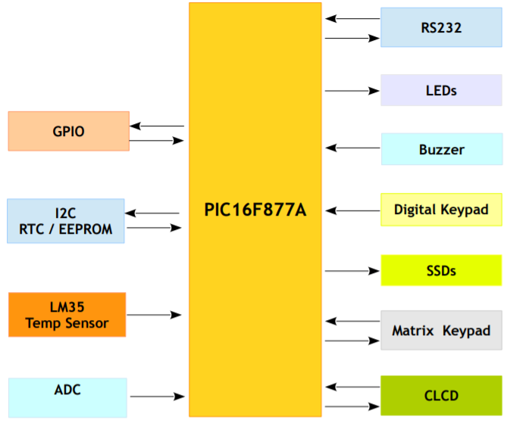
Software Designing
PICSimLab - PICSimLab is a realtime emulator of
development boards with integrated MPLABX/avr-gdb
debugger. PICSimLab supports some picsim
microcontrollers and some simavr microcontrollers.
PICSimLab have integration with MPLABX/Arduino
IDE for programming the boards microcontrollers.
PICSimlab supports several devices (spare parts)
that can be connected to the boards for simulation.
As for example DC motor, LCD etc.
PICSimLab Architecture

Slide 10
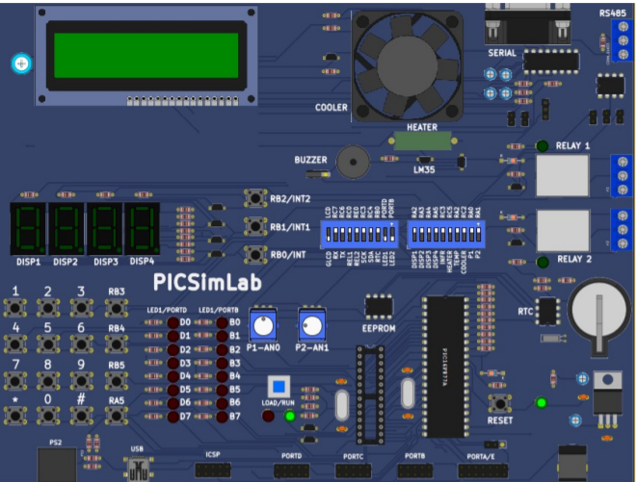
PICSimLab board and It’s parts – PICSimLab consists
total 5 Ports PORTA, PORTB, PORTC, PORTD and
PORTE. There are many hardware devices on it
Which follows as : -
LEDs
Digital Keypad
Interrupts
Timers
Clock I/O PICSimLab Board
SSDs
CLCD
Matrix Keypad
Analog Inputs

Slide 11
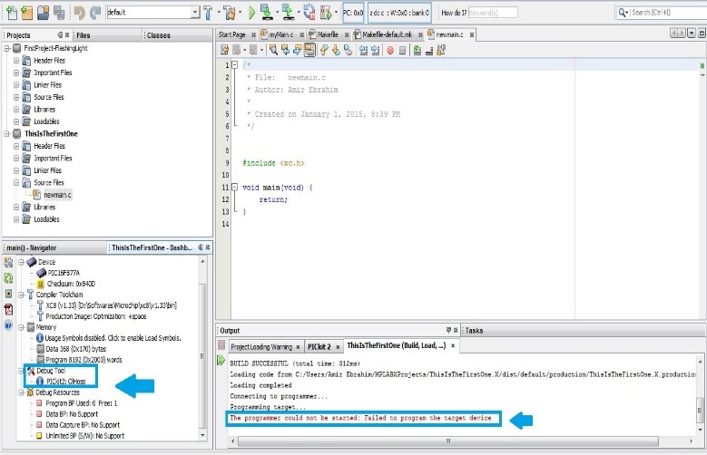
MPLABxIDE - Microchip Technology MPLAB® X Integrated Development Environment (IDE) is an expandable, highly configurable software program that incorporates powerful tools to enable designers to discover, configure, develop, debug, and qualify embedded designs for most Microchip Microcontrollers (MCUs) and Digital Signal Controllers (DSCs).
The flexible and customizable MPLAB X IDE interface
allows you to have multiple debug tools connected
to your computer at the same time. You can select any
tool you desire for a specific project or configuration
within a project.
MPLABxIDE Interface

Slide 12
Advantages
A washing machine is a huge time saver over hand washing.
A washing machine eliminates the effort needed to wash clothes. With hand washing, you must use physical effort to get the clothes clean and scrub vigorously to remove stains.
Washing machines are available in a range of sizes, Different sizes allow you to fill them to the top with clothing or load larger items such as sheets and large comforters.
washing machines operate much easier now anyone can use a washing machine

Slide 13
Disadvantages
It takes too much power, detergent powder and water.
The quality of the clothes reduces.
It takes too much time to wash, rinse and dry the clothes.
More expensive.

Slide 14
Results
Starting Interface for users
Press Switch 5 to power on
Washing Programs Display

Slide 15
Water level display
Confirmation to start the function
Program and Timer display

Slide 16
Countdown timer, start and pause screen
Door open warning
Program completion Display

Slide 17
Conclusion
After going through all the advantages and disadvantages of the automatic washing machine, alternative way of washing clothes which is quick, cost effective and eco-friendly is really very helpful to all of us.

Slide 18
Thankyou

