Slide 1
ACADEMIC LESSON
APPLICATION LETTER
Prepared for classroom discussion and guided study
Learning objectives • Key concepts • Discussion prompts

Slide 2
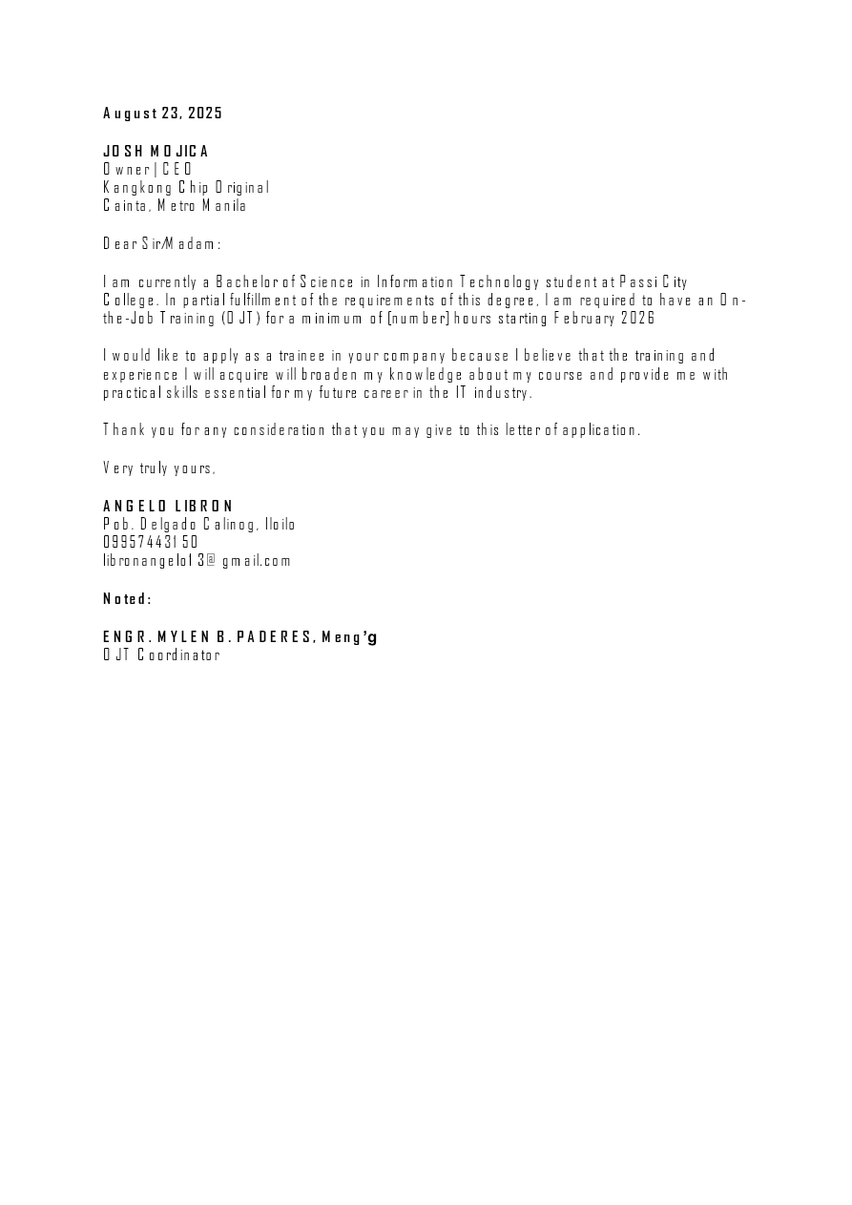
APPLICATION LETTER.pdf | Page 1 of 1
Notes:
Extracted text from source page 1: August 23, 2025 JOSH MOJICA Owner | CEO Kangkong Chip Original Cainta, Metro Manila Dear Sir/Madam: I am currently a Bachelor of Science in Information Technology student at Passi City College. In partial fulfillment of the requirements of this degree, I am required to have an On- the-Job Training (OJT) for a minimum of [number] hours starting February 2026 I would like to apply as a trainee in your company because I believe that the training and experience I will acquire will broaden my knowledge about my course and provide me with practical skills essential for my future career in the IT industry. Thank you for any consideration that you may give to this letter of application. Very truly yours, ANGELO LIBRON Pob. Delgado Calinog, Iloilo 09957443150 libronangelo13@gmail.com Noted: ENGR. MYLEN B. PADERES, Meng’g OJT Coordinator

