Slide 1
ACADEMIC LESSON
JOANNE CLARRISE OPEÑA(UPDATED RESUME)
Prepared for classroom discussion and guided study
Learning objectives • Key concepts • Discussion prompts

Slide 2
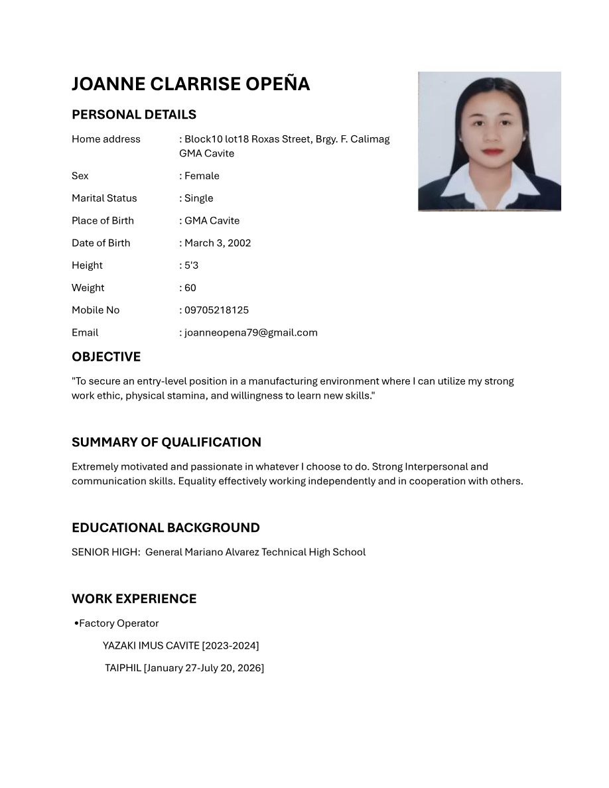
JOANNE CLARRISE OPEÃA(UPDATED RESUME).pdf | Page 1 of 2
Notes:
Extracted text from source page 1: JOANNE CLARRISE OPEÑA PERSONAL DETAILS Home address : Block10 lot18 Roxas Street, Brgy. F. Calimag GMA Cavite Sex : Female Marital Status : Single Place of Birth : GMA Cavite Date of Birth : March 3, 2002 Height : 5'3 Weight : 60 Mobile No : 09705218125 Email : joanneopena79@gmail.com OBJECTIVE "To secure an entry-level position in a manufacturing environment where I can utilize my strong work ethic, physical stamina, and willingness to learn new skills." SUMMARY OF QUALIFICATION Extremely motivated and passionate in whatever I choose to do. Strong Interpersonal and communication skills. Equality effectively working independently and in cooperation with others. EDUCATIONAL BACKGROUND SENIOR HIGH: General Mariano Alvarez Technical High School WORK EXPERIENCE •Factory Operator YAZAKI IMUS CAVITE [2023-2024] TAIPHIL [January 27-July 20, 2026]

Slide 3
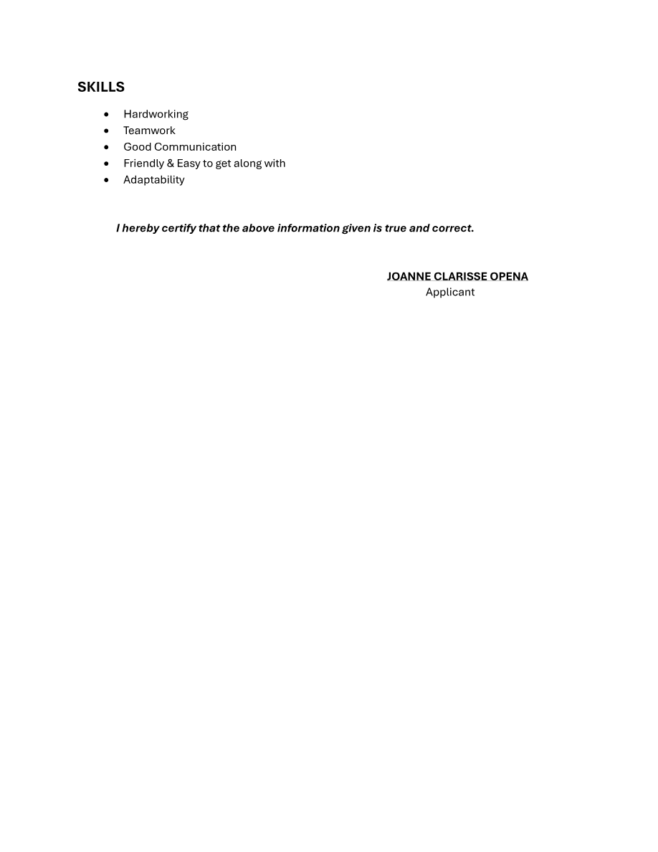
JOANNE CLARRISE OPEÃA(UPDATED RESUME).pdf | Page 2 of 2
Notes:
Extracted text from source page 2: SKILLS • Hardworking • Teamwork • Good Communication • Friendly & Easy to get along with • Adaptability I hereby certify that the above information given is true and correct. JOANNE CLARISSE OPENA Applicant

