Slide 1
ACADEMIC LESSON
MENDOZA, ROSHEL G. (RESUME)
Prepared for classroom discussion and guided study
Learning objectives • Key concepts • Discussion prompts

Slide 2
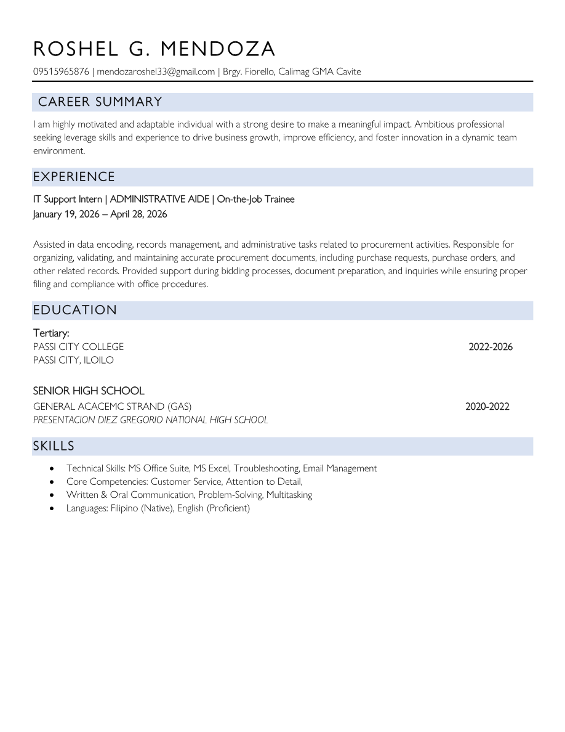
MENDOZA, ROSHEL G. (RESUME).pdf | Page 1 of 1
Notes:
Extracted text from source page 1: R O S H E L G . M E N D O Z A 09515965876 | mendozaroshel33@gmail.com | Brgy. Fiorello, Calimag GMA Cavite C AR EER SUM M AR Y I am highly motivated and adaptable individual with a strong desire to make a meaningful impact. Ambitious professional seeking leverage skills and experience to drive business growth, improve efficiency, and foster innovation in a dynamic team environment. E X PE RI E NC E IT Support Intern | ADMINISTRATIVE AIDE | On-the-Job Trainee January 19, 2026 – April 28, 2026 Assisted in data encoding, records management, and administrative tasks related to procurement activities. Responsible for organizing, validating, and maintaining accurate procurement documents, including purchase requests, purchase orders, and other related records. Provided support during bidding processes, document preparation, and inquiries while ensuring proper filing and compliance with office procedures. ED UC ATI O N Tertiary: PASSI CITY COLLEGE 2022-2026 PASSI CITY, ILOILO SENIOR HIGH SCHOOL GENERAL ACACEMC STRAND (GAS) 2020-2022 PRESENTACION DIEZ GREGORIO NATIONAL HIGH SCHOOL S KI L L S • Technical Skills: MS Office Suite, MS Excel, Troubleshooting, Email Management • Core Competencies: Customer Service, Attention to Detail, • Written & Oral Communication, Problem-Solving, Multitasking • Languages: Filipino (Native), English (Proficient)

