Slide 1
ACADEMIC LESSON
MJCIS_Volume 15_Issue 2_Pages 45-55
Prepared for classroom discussion and guided study
Learning objectives • Key concepts • Discussion prompts

Slide 2
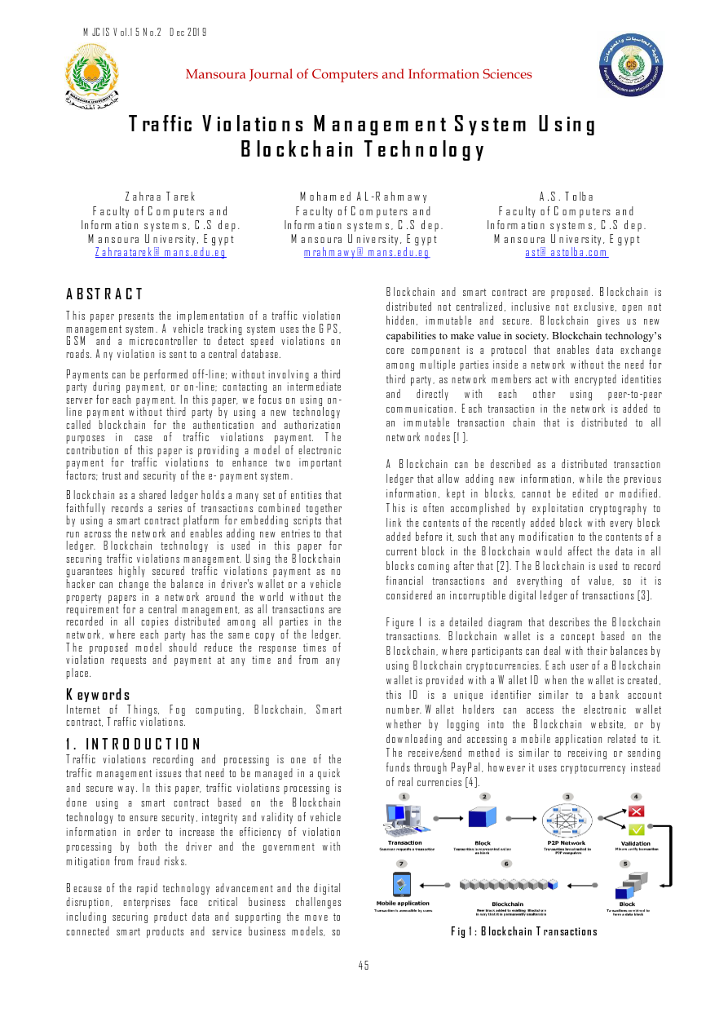
MJCIS_Volume 15_Issue 2_Pages 45-55.pdf | Page 1 of 11
Notes:
Extracted text from source page 1: MJCIS Vol.15 No.2 Dec 2019 ` Mansoura Journal of Computers and Information Sciences Traffic Violations Management System Using Blockchain Technology Zahraa Tarek Mohamed AL-Rahmawy A.S. Tolba Faculty of Computers and Faculty of Computers and Faculty of Computers and Information systems, C.S dep. Information systems, C.S dep. Information systems, C.S dep. Mansoura University, Egypt Mansoura University, Egypt Mansoura University, Egypt Zahraatarek@mans.edu.eg mrahmawy@mans.edu.eg ast@astolba.com Blockchain and smart contract are proposed. Blockchain is ABSTRACT distributed not centralized, inclusive not exclusive, open not This paper presents the implementation of a traffic violation hidden, immutable and secure. Blockchain gives us new management system. A vehicle tracking system uses the GPS, capabilities to make value in society. Blockchain technology’s GSM and a microcontroller to detect speed violations on core component is a protocol that enables data exchange roads. Any violation is sent to a central database. among multiple parties inside a network without the need for Payments can be performed off-line; without involving a third third party, as network members act with encrypted identities party during payment, or on-line; contacting an intermediate and directly with each other using peer-to-peer server for each payment. In this paper, we focus on using on- communication. Each transaction in the network is added to line payment without third party by using a new technology called blockchain for the authentication and authorization an immutable transaction chain that is distributed to all purposes in case of traffic violations payment. The network nodes [1]. contribution of this paper is providing a model of electronic payment for traffic violations to enhance two important A Blockchain can be described as a distributed transaction factors; trust and security of the e- payment system. ledger that allow adding new information, while the previous Blockchain as a shared ledger holds a many set of entities that information, kept in blocks, cannot be edited or modified. faithfully records a series of transactions combined together This is often accomplished by exploitation cryptography to by using a smart contract platform for embedding scripts that link the contents of the recently added block with every block run across the network and enables adding new entries to that added before it, such that any modification to the contents of a ledger. Blockchain technology is used in this paper for current block in the Blockchain would affect the data in all securing traffic violations management. Using the Blockchain blocks coming after that [2]. The Blockchain is used to record guarantees highly secure d traffic violations payment as no financial transactions and everything of value, so it is hacker can change the balance in driver's wallet or a vehicle property papers in a network around the world without the considered an incorruptible digital ledger of transactions [3]. requirement for a central management, as all transactions are recorded in all copies distributed amon g all parties in the Figure 1 is a detailed diagram that describes the Blockchain network, where each party has the same copy of the ledger. transactions. Blockchain wallet is a concept based on the The proposed model should reduce the response times of Blockchain, where participants can deal with their balances by violation requests and payment at any time and from any using Blockchain cryptocurrencies. Each user of a Blockchain place. wallet is provided with a Wallet ID when the wallet is created, Keywords this ID is a unique identifier similar to a bank account Internet of Things, Fog computing, Blockchain, Smart number. Wallet holders can access the electronic wallet contract, Traffic violations. whether by logging into the Blockchain website, or by downloading and accessing a mobile application related to it. 1. INTRODUCTION The receive/send method is similar to receiving or sending Traffic violations recording and processing is one of the funds through PayPal , however it uses cryptocurrency instead traffic management issues that need to be managed in a quick of real currencies [4]. and secure way. In this paper, traffic violations processing is done using a smart contract based on the Blockchain technology to ensure security, integrity and validity of vehicle information in order to increase the efficiency of violation processing by both the driver and the government with mitigation from fraud risks. Because of the rapid technology advancement and the digital disruption, enterprises face critical business challenges including securing product data and supporting the move to connected smart products and service business models, so Fig 1: Blockchain Transactions 45

Slide 3
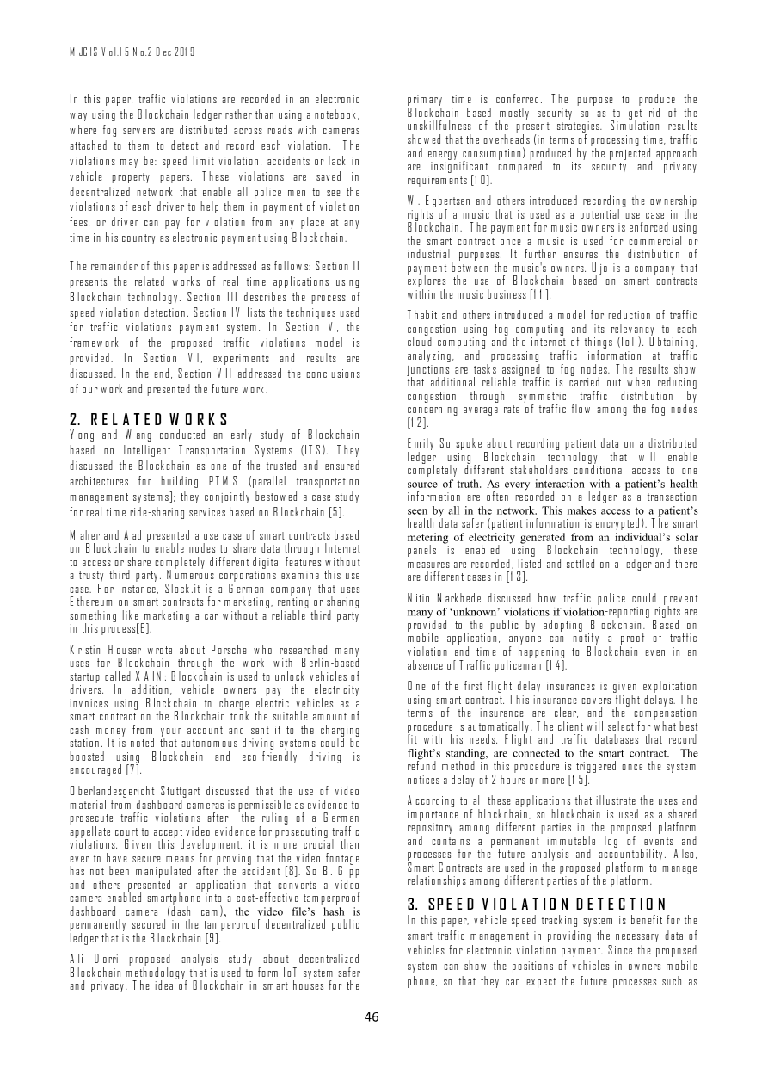
MJCIS_Volume 15_Issue 2_Pages 45-55.pdf | Page 2 of 11
Notes:
Extracted text from source page 2: MJCIS Vol.15 No.2 Dec 2019 In this paper, traffic violations are recorded in an electronic primary time is conferred. The purpose to produce the way using the Blockchain ledger rather than using a notebook, Blockchain based mostly security so as to get rid of the unskillfulness of the present strategies. Simulation results where fog servers are distributed across roads with cameras showed that the overheads (in terms of processing time, traffic attached to them to detect and record each violation. The and energy consumption) produced by the projected approach violations may be: speed limit violation, accidents or lack in are insignificant compared to its security and privacy vehicle property papers. These violations are saved in requirements [10]. decentralized network that enable all police men to see the W. Egbertsen and others introduced recording the ownership violations of each driver to help them in payment of violation rights of a music that is used as a potential use case in the fees, or driver can pay for violation from any place at any Blockchain. The payment for music owners is enforced using time in his country as electronic payment using Blockchain. the smart contract once a music is used for commercial or industrial purposes. It further ensures the distribution of The remainder of this paper is addressed as follows: Section II payment between the music's owners. Ujo is a company that presents the related works of real time applications using explores the use of Blockchain based on smart contracts Blockchain technology. Section III describes the process of within the music business [11]. speed violation detection. Section IV lists the techniques used Thabit and others introduced a model for reduction of traffic for traffic violations payment system. In Section V, the congestion using fog computing and its relevancy to each framework of the proposed traffic violations model is cloud computing and the internet of things (IoT). Obtaining, analyzing, and processing traffic information at traffic provided. In Section VI, experiments and results are junctions are tasks assigned to fog nodes. The results show discussed. In the end, Section VII addressed the conclusions that additional reliable traffic is carried out when reducing of our work and presented the future work. congestion through symmetric traffic distribution by concerning average rate of traffic flow among the fog nodes 2. RELATED WORKS [12]. Yong and Wang conducted an early study of Blockchain Emily Su spoke about recording patient data on a distributed based on Intelligent Transportation Systems (ITS). They ledger using Blockchain technology that will enable discussed the Blockchain as one of the trusted and ensured completely different stakeholders conditional access to one architectures for building PTMS (parallel transportation source of truth. As every interaction with a patient’s health management systems]; they conjointly bestowed a case study information are often recorded on a ledger as a transaction for real time ride-sharing services based on Blockchain [5]. seen by all in the network. This makes access to a patient’s health data safer (patient information is encrypted). The smart Maher and Aad presented a use case of smart contracts based metering of electricity generated from an individual’s solar on Blockchain to enable nodes to share data through Internet panels is enabled using Blockchain technology, these to access or share completely different digital features without measures are recorded, listed and settled on a ledger and there a trusty third party. Numerous corporations examine this use are different cases in [13]. case. For instance, Slock.it is a German company that uses Nitin Narkhede discussed how traffic police could prevent Ethereum on smart contracts for marketing, renting or sharing many of ‘unknown’ violations if violation-reporting rights are something like marketing a car without a reliable third party provided to the public by adopting Blockchain. Based on in this process[6]. mobile application, anyone can notify a proof of traffic Kristin Houser wrote about Porsche who researched many violation and time of happening to Blockchain even in an uses for Blockchain through the work with Berlin-based absence of Traffic policeman [14]. startup called XAIN: Blockchain is used to unlock vehicles of One of the first flight delay insurances is given exploitation drivers. In addition, vehicle owners pay the electricity using smart contract. This insurance covers flight delays. The invoices using Blockchain to charge electric vehicles as a terms of the insurance are clear, and the compensation smart contract on the Blockchain took the suitable amount of procedure is automatically. The client will select for what best cash money from your account and sent it to the charging fit with his needs. Flight and traffic databases that record station. It is noted that autonomous driving systems could be flight’s standing, are connected to the smart contract. The boosted using Blockchain and eco-friendly driving is refund method in this procedure is triggered once the system encouraged [7]. notices a delay of 2 hours or more [15]. Oberlandesgericht Stuttgart discussed that the use of video According to all these applications that illustrate the uses and material from dashboard cameras is permissible as evidence to importance of blockchain, so blockchain is used as a shared prosecute traffic violations after the ruling of a German repository among different parties in the proposed platform appellate court to accept video evidence for prosecuting traffic and contains a permanent immutable log of events and violations. Given this development, it is more crucial than processes for the future analysis and accountability. Also, ever to have secure means for proving that the video footage Smart Contracts are used in the proposed platform to manage has not been manipulated after the accident [8]. So B. Gipp relationships among different parties of the platform. and others presented an application that converts a video camera enabled smartphone into a cost-effective tamperproof 3. SPEED VIOLATION DETECTION dashboard camera (dash cam), the video file’s hash is In this paper, vehicle speed tracking system is benefit for the permanently secured in the tamperproof decentralized public smart traffic management in providing the necessary data of ledger that is the Blockchain [9]. vehicles for electronic violation payment. Since the proposed Ali Dorri proposed analysis study about decentralized system can show the positions of vehicles in owners mobile Blockchain methodology that is used to form IoT system safer phone, so that they can expect the future processes such as and privacy. The idea of Blockchain in smart houses for the 46

Slide 4
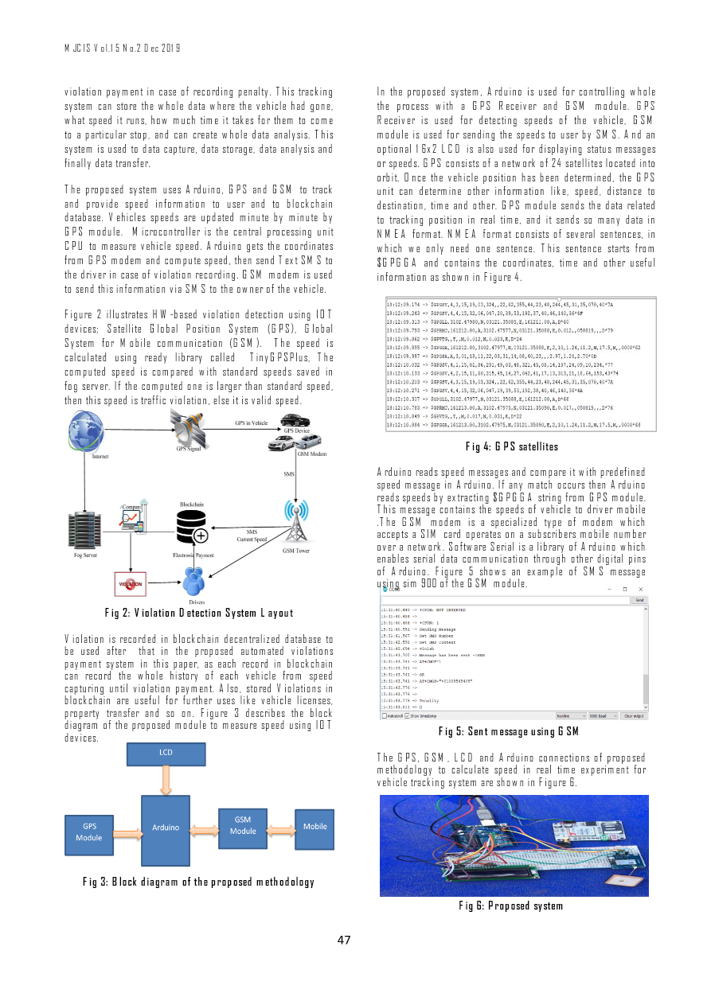
MJCIS_Volume 15_Issue 2_Pages 45-55.pdf | Page 3 of 11
Notes:
Extracted text from source page 3: MJCIS Vol.15 No.2 Dec 2019 violation payment in case of recording penalty. This tracking In the proposed system, Arduino is used for controlling whole system can store the whole data where the vehicle had gone, the process with a GPS Receiver and GSM module. GPS what speed it runs, how much time it takes for them to come Receiver is used for detecting speeds of the vehicle, GSM to a particular stop, and can create whole data analysis. This module is used for sending the speeds to user by SMS. And an system is used to data capture, data storage, data analysis and optional 16x2 LCD is also used for displaying status messages finally data transfer. or speeds. GPS consists of a network of 24 satellites located into orbit. Once the vehicle position has been determined, the GPS The proposed system uses Arduino, GPS and GSM to track unit can determine other information like, speed, distance to and provide speed information to user and to blockchain destination, time and other. GPS module sends the data related database. Vehicles speeds are updated minute by minute by to tracking position in real time, and it sends so many data in GPS module. Microcontroller is the central processing unit NMEA format. NMEA format consists of several sentences, in CPU to measure vehicle speed. Arduino gets the coordinates which we only need one sentence. This sentence starts from from GPS modem and compute speed, then send Text SMS to $GPGGA and contains the coordinates, time and other useful the driver in case of violation recording. GSM modem is used information as shown in Figure 4. to send this information via SMS to the owner of the vehicle. Figure 2 illustrates HW-based violation detection using IOT devices; Satellite Global Position System (GPS), Global System for Mobile communication (GSM). The speed is calculated using ready library called TinyGPSPlus , The computed speed is compared with standard speeds saved in fog server. If the computed one is larger than standard speed, then this speed is traffic violation, else it is valid speed. Fig 4: GPS satellites Arduino reads speed messages and compare it with predefined speed message in Arduino. If any match occurs then Arduino reads speeds by extracting $GPGGA string from GPS module. This message contains the speeds of vehicle to driver mobile . The GSM modem is a specialized type of modem which accepts a SIM card operates on a subscribers mobile number over a network. Software Serial is a library of Arduino which enables serial data communication through other digital pins of Arduino. Figure 5 sh ows an example of SMS message using sim 900 of the GSM module. Fig 2: Violation Detection System Layout Violation is recorded in blockchain decentralized database to be used after that in the proposed automated violations payment system in this paper, as each record in blockchain can record the whole history of each vehicle from speed capturing until violat ion payment. Also, stored Violations in blockchain are useful for further uses like vehicle licenses, property transfer and so on. Figure 3 describes the block diagram of the proposed module to measure speed using IOT Fig 5: Sent message using GSM devices. The GPS, GSM, LCD and Arduino connections of proposed methodology to calculate speed in real time experiment for vehicle tracking system are shown in Figure 6. Fig 3: Block diagram of the proposed methodology Fig 6: Proposed system 47

Slide 5
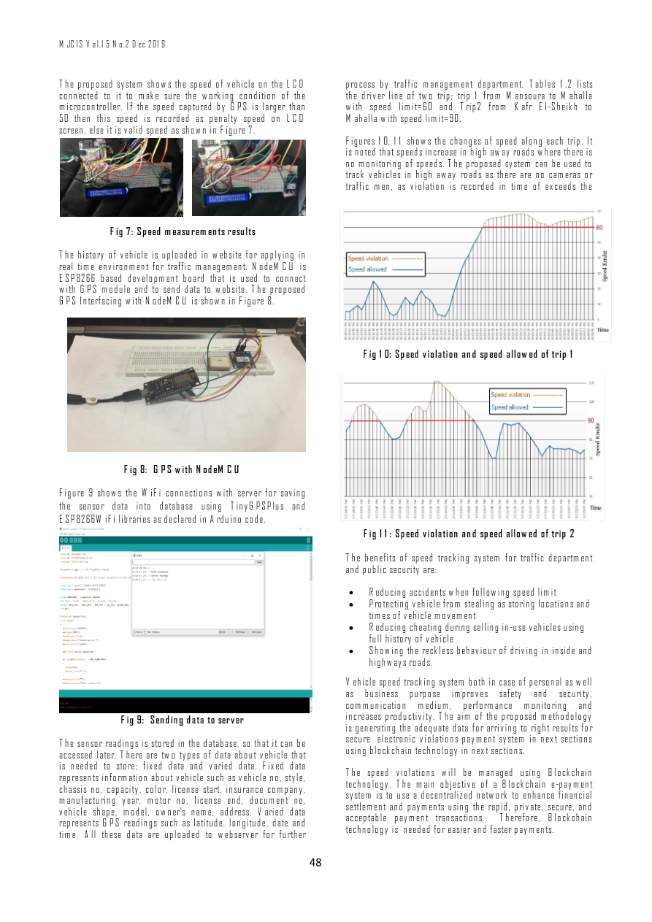
MJCIS_Volume 15_Issue 2_Pages 45-55.pdf | Page 4 of 11
Notes:
Extracted text from source page 4: MJCIS Vol.15 No.2 Dec 2019 The proposed system shows the speed of vehicle on the LCD process by traffic management department. Tables 1 ,2 lists connected to it to make sure the working condition of the the driver line of two trip ; trip 1 from Mansoura to Mahalla microcontroller. If the speed captured by GPS is larger than with speed limit=60 and Trip2 from Kafr El - Sheikh to 50 then this speed is recorded as penalty speed on LCD Mahalla with speed limit=90. screen, else it is valid speed as shown in Figure 7. Figures 10, 11 shows the changes of speed along each trip. It is noted that speeds increase in high away roads where there is no monitoring of speeds. The proposed system can be used to track vehicles in high away roads as there are no cameras or traffic men, as violation is recorded in time of exceeds the limit speeds. In addition to, this system can save full vehicle history from locations, speeds, dates and times of vehicle walking. Fig 7: Speed measurements results The history of vehicle is uploaded in website for applying in real time environment for traffic management. NodeMCU is ESP8266 based development board that is used to connect with GPS module and to send data to website. The proposed GPS Interfacing with NodeMCU is shown in Figure 8. Fig 10: Speed violation and speed allowed of trip 1 Fig 8: GPS with NodeMCU Figure 9 shows the WiFi connections with server for saving the sensor data into database using TinyGPSPlus and ESP8266WiFi libraries as declared in Arduino code. Fig 11: Speed violation and speed allowed of trip 2 The benefits of speed tracking system for traffic department and public security are: • Reducing accidents when following speed limit • Protecting vehicle from stealing as storing locations and times of vehicle movement • Reducing cheating during selling in-use vehicles using full history of vehicle • Showing the reckless behaviour of driving in inside and highways roads. Vehicle speed tracking system both in case of personal as well as business purpose improves safety and security, communication medium, performance monitoring and increases productivity. The aim of the proposed methodology Fig 9: Sending data to server is generating the adequate data for arriving to right results for secure electronic violations payment system in next sections The sensor readings is stored in the database, so that it can be using blockchain technology in next sections . accessed later. There are two types of data about vehicle that is needed to store; fixed data and varied data. Fixed data The speed violations will be managed using Blockchain represents information about vehicle such as vehicle no, style, technology. The main objective of a Blockchain e-payment chassis no, capacity, color, license start, insurance company, system is to use a decentralized network to enhance financial manufacturing year, motor no, license end, document no, settlement and payments using the rapid, private, secure, and vehicle shape, model, owner's name, address. Varied data acceptable payment transactions. Therefore, Blockchain represents GPS readings such as latitude, longitude , date and technology is needed for easier and faster payments. time. All these data are uploaded to webserver for further 48

Slide 6
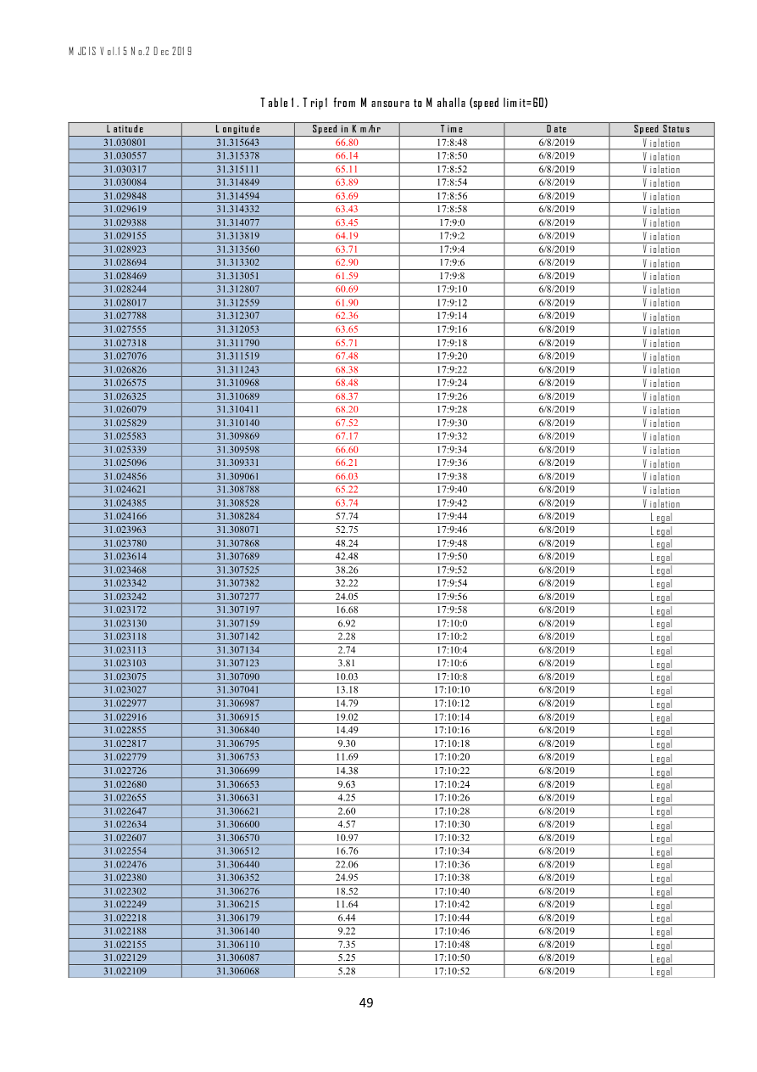
MJCIS_Volume 15_Issue 2_Pages 45-55.pdf | Page 5 of 11
Notes:
Extracted text from source page 5: MJCIS Vol.15 No.2 Dec 2019 Table 1. Trip1 from Mansoura to Mahalla (speed limit=60) Speed Status Date Time Speed in Km/hr Longitude Latitude Violation 2019 / 8 / 6 17:8:48 66.80 31.315643 31.030801 Violation 2019 / 8 / 6 17:8:50 66.14 31.315378 31.030557 Violation 2019 / 8 / 6 17:8:52 65.11 31.315111 31.030317 Violation 2019 / 8 / 6 17:8:54 63.89 31.314849 31.030084 Violation 2019 / 8 / 6 17:8:56 63.69 31.314594 31.029848 Violation 2019 / 8 / 6 17:8:58 63.43 31.314332 31.029619 Violation 2019 / 8 / 6 17:9:0 63.45 31.314077 31.029388 Violation 2019 / 8 / 6 17:9:2 64.19 31.313819 31.029155 Violation 2019 / 8 / 6 17:9:4 63.71 31.313560 31.028923 Violation 2019 / 8 / 6 17:9:6 62.90 31.313302 31.028694 Violation 2019 / 8 / 6 17:9:8 61.59 31.313051 31.028469 Violation 2019 / 8 / 6 17:9:10 60.69 31.312807 31.028244 Violation 2019 / 8 / 6 17:9:12 61.90 31.312559 31.028017 Violation 2019 / 8 / 6 17:9:14 62.36 31.312307 31.027788 Violation 2019 / 8 / 6 17:9:16 63.65 31.312053 31.027555 Violation 2019 / 8 / 6 17:9:18 65.71 31.311790 31.027318 Violation 2019 / 8 / 6 17:9:20 67.48 31.311519 31.027076 Violation 2019 / 8 / 6 17:9:22 68.38 31.311243 31.026826 Violation 2019 / 8 / 6 17:9:24 68.48 31.310968 31.026575 Violation 2019 / 8 / 6 17:9:26 68.37 31.310689 31.026325 Violation 2019 / 8 / 6 17:9:28 68.20 31.310411 31.026079 Violation 2019 / 8 / 6 17:9:30 67.52 31.310140 31.025829 Violation 2019 / 8 / 6 17:9:32 67.17 31.309869 31.025583 Violation 2019 / 8 / 6 17:9:34 66.60 31.309598 31.025339 Violation 2019 / 8 / 6 17:9:36 66.21 31.309331 31.025096 Violation 2019 / 8 / 6 17:9:38 66.03 31.309061 31.024856 Violation 2019 / 8 / 6 17:9:40 65.22 31.308788 31.024621 Violation 2019 / 8 / 6 17:9:42 63.74 31.308528 31.024385 Legal 2019 / 8 / 6 17:9:44 57.74 31.308284 31.024166 Legal 2019 / 8 / 6 17:9:46 52.75 31.308071 31.023963 Legal 2019 / 8 / 6 17:9:48 48.24 31.307868 31.023780 Legal 2019 / 8 / 6 17:9:50 42.48 31.307689 31.023614 Legal 2019 / 8 / 6 17:9:52 38.26 31.307525 31.023468 Legal 2019 / 8 / 6 17:9:54 32.22 31.307382 31.023342 Legal 2019 / 8 / 6 17:9:56 24.05 31.307277 31.023242 Legal 2019 / 8 / 6 17:9:58 16.68 31.307197 31.023172 Legal 2019 / 8 / 6 17:10:0 6.92 31.307159 31.023130 Legal 2019 / 8 / 6 17:10:2 2.28 31.307142 31.023118 Legal 2019 / 8 / 6 17:10:4 2.74 31.307134 31.023113 Legal 2019 / 8 / 6 17:10:6 3.81 31.307123 31.023103 Legal 2019 / 8 / 6 17:10:8 10.03 31.307090 31.023075 Legal 2019 / 8 / 6 17:10:10 13.18 31.307041 31.023027 Legal 2019 / 8 / 6 17:10:12 14.79 31.306987 31.022977 Legal 2019 / 8 / 6 17:10:14 19.02 31.306915 31.022916 Legal 2019 / 8 / 6 17:10:16 14.49 31.306840 31.022855 Legal 2019 / 8 / 6 17:10:18 9.30 31.306795 31.022817 Legal 2019 / 8 / 6 17:10:20 11.69 31.306753 31.022779 Legal 2019 / 8 / 6 17:10:22 14.38 31.306699 31.022726 Legal 2019 / 8 / 6 17:10:24 9.63 31.306653 31.022680 Legal 2019 / 8 / 6 17:10:26 4.25 31.306631 31.022655 Legal 2019 / 8 / 6 17:10:28 2.60 31.306621 31.022647 Legal 2019 / 8 / 6 17:10:30 4.57 31.306600 31.022634 Legal 2019 / 8 / 6 17:10:32 10.97 31.306570 31.022607 Legal 2019 / 8 / 6 17:10:34 16.76 31.306512 31.022554 Legal 2019 / 8 / 6 17:10:36 22.06 31.306440 31.022476 Legal 2019 / 8 / 6 17:10:38 24.95 31.306352 31.022380 Legal 2019 / 8 / 6 17:10:40 18.52 31.306276 31.022302 Legal 2019 / 8 / 6 17:10:42 11.64 31.306215 31.022249 Legal 2019 / 8 / 6 17:10:44 6.44 31.306179 31.022218 Legal 2019 / 8 / 6 17:10:46 9.22 31.306140 31.022188 Legal 2019 / 8 / 6 17:10:48 7.35 31.306110 31.022155 Legal 2019 / 8 / 6 17:10:50 5.25 31.306087 31.022129 Legal 2019 / 8 / 6 17:10:52 5.28 31.306068 31.022109 49

Slide 7
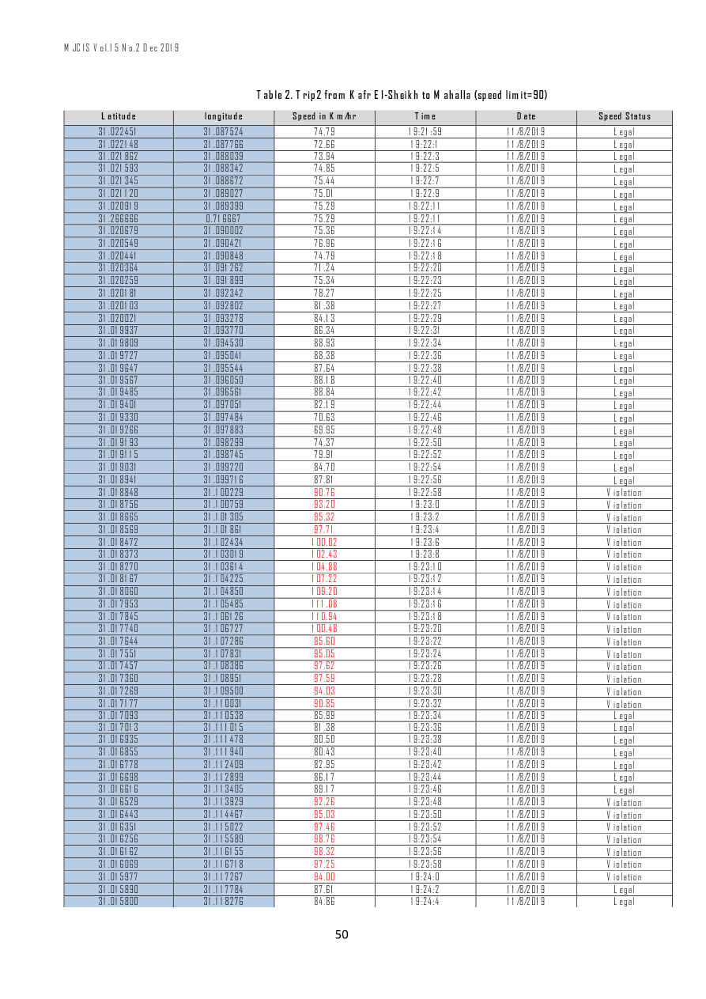
MJCIS_Volume 15_Issue 2_Pages 45-55.pdf | Page 6 of 11
Notes:
Extracted text from source page 6: MJCIS Vol.15 No.2 Dec 2019 Table 2. Trip2 from Kafr El-Sheikh to Mahalla (speed limit=90) Speed Status Date Time Speed in Km/hr longitude Latitude Legal 11/8/2019 19:21:59 74.79 31.087524 31.022451 Legal 11/8/2019 19:22:1 72.66 31.087766 31.022148 Legal 11/8/2019 19:22:3 73.94 31.088039 31.021862 Legal 11/8/2019 19:22:5 74.85 31.088342 31.021593 Legal 11/8/2019 19:22:7 75.44 31.088672 31.021345 Legal 11/8/2019 19:22:9 75.01 31.089027 31.021120 Legal 11/8/2019 19:22:11 75.29 31.089399 31.020919 Legal 11/8/2019 19:22:11 75.29 0.716667 31.266666 Legal 11/8/2019 19:22:14 75.36 31.090002 31.020679 Legal 11/8/2019 19:22:16 76.96 31.090421 31.020549 Legal 11/8/2019 19:22:18 74.79 31.090848 31.020441 Legal 11/8/2019 19:22:20 71.24 31.091262 31.020364 Legal 11/8/2019 19:22:23 75.34 31.091899 31.020259 Legal 11/8/2019 19:22:25 78.27 31.092342 31.020181 Legal 11/8/2019 19:22:27 81.38 31.092802 31.020103 Legal 11/8/2019 19:22:29 84.13 31.093278 31.020021 Legal 11/8/2019 19:22:31 86.34 31.093770 31.019937 Legal 11/8/2019 19:22:34 88.93 31.094530 31.019809 Legal 11/8/2019 19:22:36 88.38 31.095041 31.019727 Legal 11/8/2019 19:22:38 87.64 31.095544 31.019647 Legal 11/8/2019 19:22:40 88.18 31.096050 31.019567 Legal 11/8/2019 19:22:42 88.84 31.096561 31.019485 Legal 11/8/2019 19:22:44 82.19 31.097051 31.019401 Legal 11/8/2019 19:22:46 70.63 31.097484 31.019330 Legal 11/8/2019 19:22:48 69.95 31.097883 31.019266 Legal 11/8/2019 19:22:50 74.37 31.098299 31.019193 Legal 11/8/2019 19:22:52 79.91 31.098745 31.019115 Legal 11/8/2019 19:22:54 84.70 31.099220 31.019031 Legal 11/8/2019 19:22:56 87.81 31.099716 31.018941 Violation 11/8/2019 19:22:58 90.76 31.100229 31.018848 Violation 11/8/2019 19:23:0 93.20 31.100759 31.018756 Violation 11/8/2019 19:23:2 95.32 31.101305 31.018665 Violation 11/8/2019 19:23:4 97.71 31.101861 31.018569 Violation 11/8/2019 19:23:6 100.02 31.102434 31.018472 Violation 11/8/2019 19:23:8 102.43 31.103019 31.018373 Violation 11/8/2019 19:23:10 104.88 31.103614 31.018270 Violation 11/8/2019 19:23:12 107.22 31.104225 31.018167 Violation 11/8/2019 19:23:14 109.20 31.104850 31.018060 Violation 11/8/2019 19:23:16 111.08 31.105485 31.017953 Violation 11/8/2019 19:23:18 110.94 31.106126 31.017845 Violation 11/8/2019 19:23:20 100.48 31.106727 31.017740 Violation 11/8/2019 19:23:22 95.60 31.107286 31.017644 Violation 11/8/2019 19:23:24 95.05 31.107831 31.017551 Violation 11/8/2019 19:23:26 97.62 31.108386 31.017457 Violation 11/8/2019 19:23:28 97.59 31.108951 31.017360 Violation 11/8/2019 19:23:30 94.03 31.109500 31.017269 Violation 11/8/2019 19:23:32 90.85 31.110031 31.017177 Legal 11/8/2019 19:23:34 85.99 31.110538 31.017093 Legal 11/8/2019 19:23:36 81.38 31.111015 31.017013 Legal 11/8/2019 19:23:38 80.50 31.111478 31.016935 Legal 11/8/2019 19:23:40 80.43 31.111940 31.016855 Legal 11/8/2019 19:23:42 82.95 31.112409 31.016778 Legal 11/8/2019 19:23:44 86.17 31.112899 31.016698 Legal 11/8/2019 19:23:46 89.17 31.113405 31.016616 Violation 11/8/2019 19:23:48 92.26 31.113929 31.016529 Violation 11/8/2019 19:23:50 95.03 31.114467 31.016443 Violation 11/8/2019 19:23:52 97.46 31.115022 31.016351 Violation 11/8/2019 19:23:54 98.76 31.115589 31.016256 Violation 11/8/2019 19:23:56 98.32 31.116155 31.016162 Violation 11/8/2019 19:23:58 97.25 31.116718 31.016069 Violation 11/8/2019 19:24:0 94.00 31.117267 31.015977 Legal 11/8/2019 19:24:2 87.61 31.117784 31.015890 Legal 11/8/2019 19:24:4 84.86 31.118276 31.015800 50

Slide 8
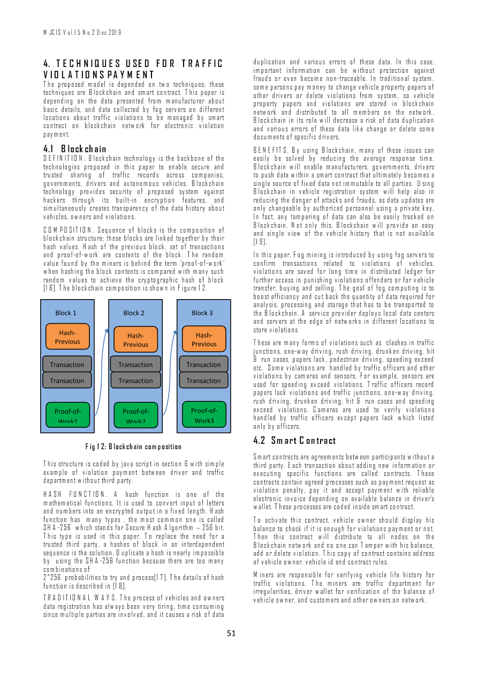
MJCIS_Volume 15_Issue 2_Pages 45-55.pdf | Page 7 of 11
Notes:
Extracted text from source page 7: MJCIS Vol.15 No.2 Dec 2019 duplication and various errors of these data. In this case, 4. TECHNIQUES USED FOR TRAFFIC important information can be without protection against VIOLATIONS PAYMENT frauds or even become non-traceable. In traditional system, The proposed model is depended on two techniques; these some persons pay money to change vehicle property papers of techniques are Blockchain and smart contract. This paper is other drivers or delete violations from system, so vehicle depending on the data presented from manufacturer about property papers and violations are stored in blockchain basic details, and data collected by fog servers on different network and distributed to all members on the network. locations about traffic violations to be managed by smart Blockchain in its role will decrease a risk of data duplication contract on blockchain network for electronic violation and various errors of these data like change or delete some payment. documents of specific drivers. 4.1 Blockchain BENEFITS. By using Blockchain, many of these issues can DEFINITION. Blockchain technology is the backbone of the easily be solved by reducing the average response time. technologies proposed in this paper to enable secure and Blockchain will enable manufacturers, governments, drivers trusted sharing of traffic records across companies, to push data within a smart contract that ultimately becomes a governments, drivers and autonomous vehicles. Blockchain single source of fixed data not immutable to all parties. Using technology provides security of proposed system against Blockchain in vehicle registration system will help also in hackers through its built-in encryption features, and reducing the danger of attacks and frauds, as data updates are simultaneously creates transparency of the data history about only changeable by authorized personnel using a private key. vehicles, owners and violations. In fact, any tampering of data can also be easily tracked on Blockchain. Not only this, Blockchain will provide an easy COMPOSITION. Sequence of blocks is the composition of and single view of the vehicle history that is not available blockchain structure; these blocks are linked together by their [19]. hash values. Hash of the previous block, set of transactions and proof-of-work are contents of the block. The random In this paper, Fog mining is introduced by using fog servers to value found by the miners is behind the term 'proof-of-work' confirm transactions related to violations of vehicles. when hashing the block contents is compared with many such violations are saved for long time in distributed ledger for random values to achieve the cryptographic hash of block further access in punishing violations offenders or for vehicle [16]. The blockchain composition is shown in Figure 12. transfer, buying and selling. The goal of fog computing is to boost efficiency and cut back the quantity of data required for analysis, processing and storage that has to be transported to the Blockchain. A service provider deploys local data centers Block 1 Block 2 Block 3 and servers at the edge of networks in different locations to store violations Hash - Hash- Hash- These are many forms of violations such as clashes in traffic Previous Previous Previous junctions, one-way driving, rush driving, drunken driving, hit 1 1 1 & run cases, papers lack, pedestrian driving, speeding exceed Transaction Transaction Transaction etc. Some violations are handled by traffic officers and other violations by cameras and sensors. For example, sensors are Transaction Transaction Transaction used for speeding exceed violations. Traffic officers record papers lack violations and traffic junctions, one-way driving, rush driving, drunken driving, hit & run cases and speeding exceed violations. Cameras are used to verify violations Proof - of - Proof - of - Proof - of - handled by traffic officers except papers lack which listed Work1 Work2 Work3 only by officers. 4.2 Smart Contract Fig 12: Blockchain composition Smart contracts are agreements between participants without a This structure is coded by java script in section 6 with simple third party. Each transaction about adding new information or example of violation payment between driver and traffic executing specific functions are called contracts. These department without third party. contracts contain agreed processes such as payment request as violation penalty, pay it and accept payment with reliable HASH FUNCTION. A hash function is one of the electronic invoice depending on available balance in driver's mathematical functions. It is used to convert input of letters wallet. These processes are coded inside smart contract. and numbers into an encrypted output in a fixed length. Hash function has many types , the most common one is called To activate this contract, vehicle owner should display his SHA-256 which stands for Secure Hash Algorithm – 256 bit. balance to check if it is enough for violations payment or not. This type is used in this paper. To replace the need for a Then this contract will distribute to all nodes on the trusted third party, a hashes of block in an interdependent Blockchain network and no one can Tamper with his balance, sequence is the solution. Duplicate a hash is nearly impossible add or delete violation. This copy of contract contains address by using the SHA-256 function because there are too many of vehicle owner, vehicle id and contract rules. combinations of Miners are responsible for verifying vehicle life history for 2^256 probabilities to try and process[17]. The details of hash traffic violations. The miners are traffic department for function is described in [18]. irregularities, driver wallet for verification of the balance of TRADITIONAL WAYS. The process of vehicles and owners vehicle owner, and customers and other owners on network. data registration has always been very tiring, time consuming since multiple parties are involved, and it causes a risk of data 51

Slide 9
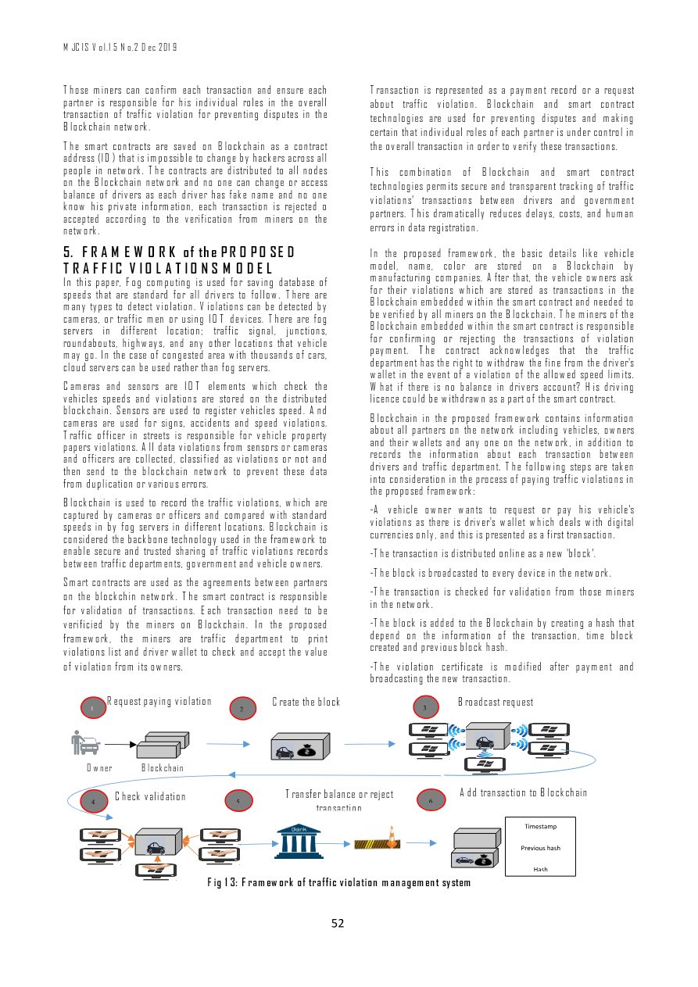
MJCIS_Volume 15_Issue 2_Pages 45-55.pdf | Page 8 of 11
Notes:
Extracted text from source page 8: MJCIS Vol.15 No.2 Dec 2019 Those miners can confirm each transaction and ensure each Transaction is represented as a payment record or a request partner is responsible for his individual roles in the overall about traffic violation. Blockchain and smart contract transaction of traffic violation for preventing disputes in the technologies are used for preventing disputes and making Blockchain network. certain that individual roles of each partner is under control in The smart contracts are saved on Blockchain as a contract the overall transaction in order to verify these transactions. address (ID) that is impossible to change by hackers across all people in network. The contracts are distributed to all nodes This combination of Blockchain and smart contract on the Blockchain network and no one can change or access technologies permits secure and transparent tracking of traffic balance of drivers as each driver has fake name and no one violations' transactions between drivers and government know his private information, each transaction is rejected o partners. This dramatically reduces delays, costs, and human accepted according to the verification from miners on the errors in data registration. network . 5. FRAMEWORK of the PROPOSED In the proposed framework, the basic details like vehicle model, name, color are stored on a Blockchain by TRAFFIC VIOLATIONS MODEL manufacturing companies. After that, the vehicle owners ask In this paper, Fog computing is used for saving database of for their violations which are stored as transactions in the speeds that are standard for all drivers to follow. There are Blockchain embedded within the smart contract and needed to many types to detect violation. Violations can be detected by be verified by all miners on the Blockchain. The miners of the cameras, or traffic men or using IOT devices. There are fog Blockchain embedded within the smart contract is responsible servers in different location; traffic signal, junctions, for confirming or rejecting the transactions of violation roundabouts, highways, and any other locations that vehicle payment. The contract acknowledges that the traffic may go. In the case of congested area with thousands of cars, department has the right to withdraw the fine from the driver's cloud servers can be used rather than fog servers. wallet in the event of a violation of the allowed speed limits. Cameras and sensors are IOT elements which check the What if there is no balance in drivers account? His driving vehicles speeds and violations are stored on the distributed licence could be withdrawn as a part of the smart contract. blockchain. Sensors are used to register vehicles speed. And Blockchain in the proposed framework contains information cameras are used for signs, accidents and speed violations. about all partners on the network including vehicles, owners Traffic officer in streets is responsible for vehicle property and their wallets and any one on the network, in addition to papers violations. All data violations from sensors or cameras records the information about each transaction between and officers are collected, classified as violations or not and drivers and traffic department. The following steps are taken then send to the blockchain network to prevent these data into consideration in the process of paying traffic violations in from duplication or various errors. the proposed framework: Blockchain is used to record the traffic violations, which are -A vehicle owner wants to request or pay his vehicle's captured by cameras or officers and compared with standard violations as there is driver's wallet which deals with digital speeds in by fog servers in different locations. Blockchain is currencies only, and this is presented as a first transaction. considered the backbone technology used in the framework to enable secure and trusted sharing of traffic violations records -The transaction is distributed online as a new 'block'. between traffic departments, government and vehicle owners. -The block is broadcasted to every device in the network. Smart contracts are used as the agreements between partners -The transaction is checked for validation from those miners on the blockchin network. The smart contract is responsible in the network. for validation of transactions. Each transaction need to be verificied by the miners on Blockchain. In the proposed -The block is added to the Blockchain by creating a hash that depend on the information of the transaction, time block framework, the miners are traffic department to print created and previous block hash. violations list and driver wallet to check and accept the value of violation from its owners. -The violation certificate is modified after payment and broadcasting the new transaction. Create the block Broadcast request Request paying violation 2 3 1 Owner Blockchain Add transaction to Blockchain Transfer balance or reject Check validation 4 5 6 transaction Timestamp Previous hash Hash Fig 13: Framework of traffic violation management system 52

Slide 10
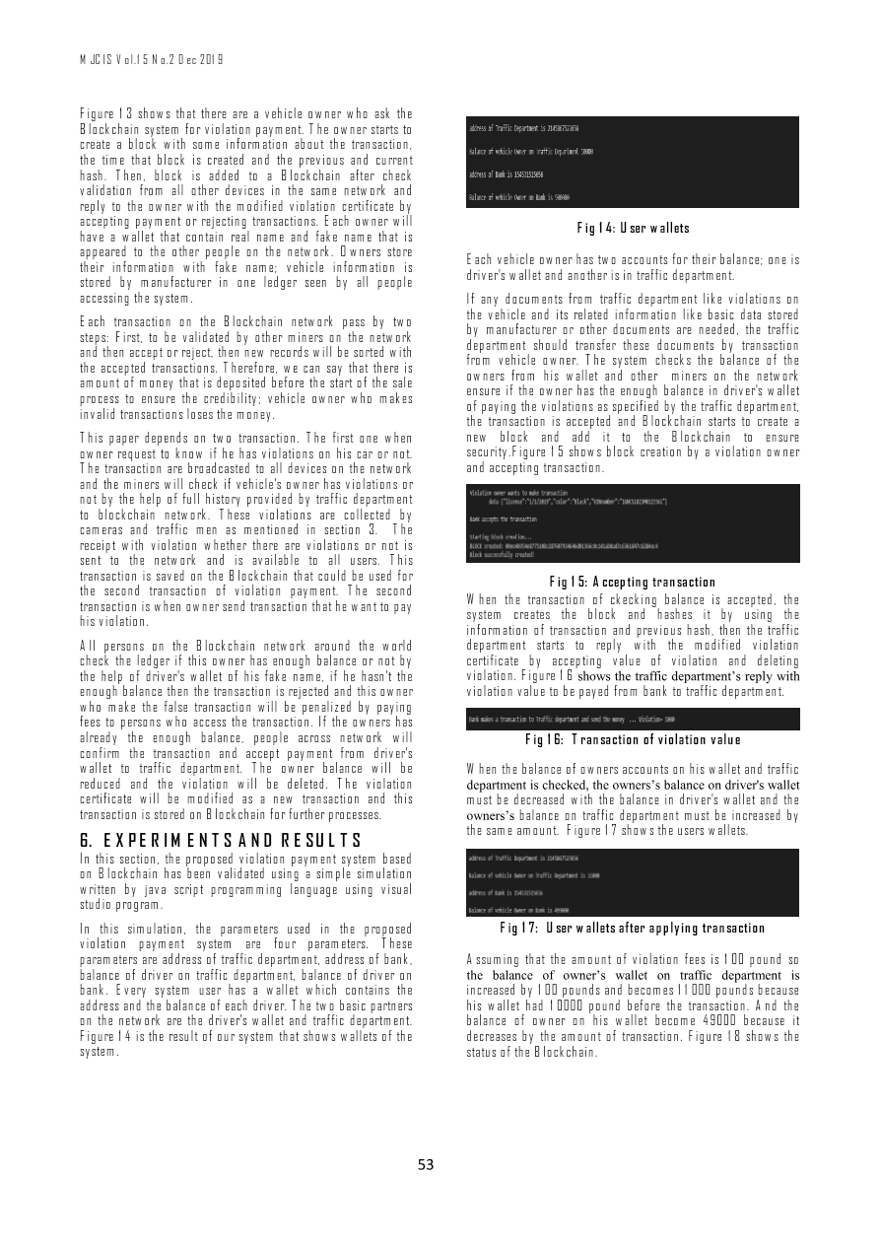
MJCIS_Volume 15_Issue 2_Pages 45-55.pdf | Page 9 of 11
Notes:
Extracted text from source page 9: MJCIS Vol.15 No.2 Dec 2019 Figure 13 shows that there are a vehicle owner who ask the Blockchain system for violation payment. The owner starts to create a block with some information about the transaction, the time that block is created and the previous and current hash. Then, block is added to a Blockchain after check validation from all other devices in the same network and reply to the owner with the modified violation certificate by accepting payment or rejecting transactions. Each owner will Fig 14: User wallets have a wallet that contain real name and fake name that is appeared to the other people on the network. Owners store Each vehicle owner has two accounts for their balance; one is their information with fake name; vehicle information is driver's wallet and another is in traffic department. stored by manufacturer in one ledger seen by all people accessing the system. If any documents from traffic department like violations on the vehicle and its related information like basic data stored Each transaction on the Blockchain network pass by two by manufacturer or other documents are needed, the traffic steps: First, to be validated by other miners on the network department should transfer these documents by transaction and then accept or reject, then new records will be sorted with from vehicle owner. The system checks the balance of the the accepted transactions. Therefore, we can say that there is owners from his wallet and other miners on the network amount of money that is deposited before the start of the sale ensure if the owner has the enough balance in driver's wallet process to ensure the credibility; vehicle owner who makes of paying the violations as specified by the traffic department, invalid transactions loses the money. the transaction is accepted and Blockchain starts to create a This paper depends on two transaction. The first one when new block and add it to the Blockchain to ensure owner request to know if he has violations on his car or not. security.Figure 15 shows block creation by a violation owner The transaction are broadcasted to all devices on the network and accepting transaction. and the miners will check if vehicle's owner has violations or not by the help of full history provided by traffic department to blockchain network. These violations are collected by cameras and traffic men as mentioned in section 3. The receipt with violation whether there are violations or not is sent to the network and is available to all users. This transaction is saved on the Blockchain that could be used for Fig 15: Accepting transaction the second transaction of violation payment. The second When the transaction of ckecking balance is accepted, the transaction is when owner send transaction that he want to pay system creates the block and hashes it by using the his violation. information of transaction and previous hash, then the traffic All persons on the Blockchain network around the world department starts to reply with the modified violation check the ledger if this owner has enough balance or not by certificate by accepting value of violation and deleting the help of driver's wallet of his fake name, if he hasn't the violation. Figure 16 shows the traffic department’s reply with enough balance then the transaction is rejected and this owner violation value to be payed from bank to traffic department. who make the false transaction will be penalized by paying fees to persons who access the transaction. If the owners has already the enough balance, people across network will Fig 16: Transaction of violation value confirm the transaction and accept payment from driver's wallet to traffic department. The owner balance will be When the balance of owners accounts on his wallet and traffic reduced and the violation will be deleted. The violation department is checked, the owners’s balance on driver's wallet certificate will be modified as a new transaction and this must be decreased with the balance in driver's wallet and the transaction is stored on Blockchain for further processes. owners’s balance on traffic department must be increased by the same amount. Figure 17 shows the users wallets. 6. EXPERIMENTS AND RESULTS In this section, the proposed violation payment system based on Blockchain has been validated using a simple simulation written by java script programming language using visual studio program. In this simulation, the parameters used in the proposed Fig 17: User wallets after applying transaction violation payment system are four parameters. These parameters are address of traffic department, address of bank, Assuming that the amount of violation fees is 100 pound so balance of driver on traffic department, balance of driver on the balance of owner’s wallet on traffic department is bank. Every system user has a wallet which contains the increased by 100 pounds and becomes 11000 pounds because address and the balance of each driver. The two basic partners his wallet had 10000 pound before the transaction. And the on the network are the driver's wallet and traffic department. balance of owner on his wallet become 49000 because it Figure 14 is the result of our system that shows wallets of the decreases by the amount of transaction. Figure 18 shows the system. status of the Blockchain. 53

Slide 11
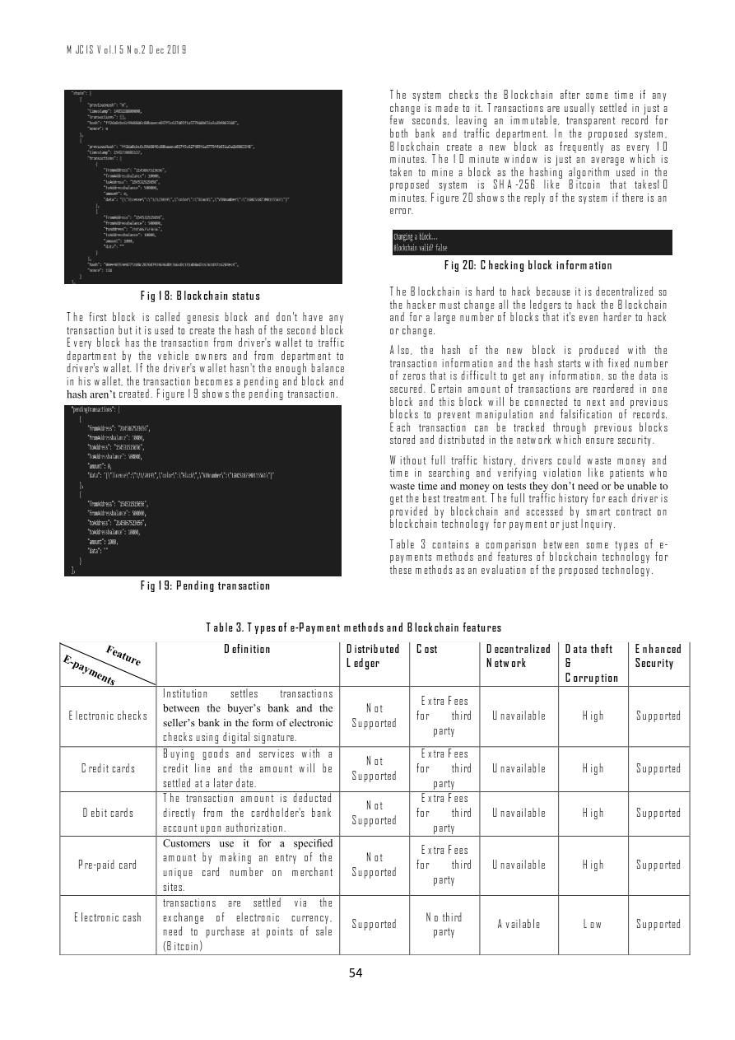
MJCIS_Volume 15_Issue 2_Pages 45-55.pdf | Page 10 of 11
Notes:
Extracted text from source page 10: MJCIS Vol.15 No.2 Dec 2019 The system checks the Blockchain after some time if any change is made to it. Transactions are usually settled in just a few seconds, leaving an immutable, transparent record for both bank and traffic department. In the proposed system, Blockchain create a new block as frequently as every 10 minutes. The 10 minute window is just an average which is taken to mine a block as the hashing algorithm used in the proposed system is SHA-256 like Bitcoin that takes10 minutes. Figure 20 shows the reply of the system if there is an error. Fig 20: Checking block information The Blockchain is hard to hack because it is decentralized so Fig 18: Blockchain status the hacker must change all the ledgers to hack the Blockchain The first block is called genesis block and don't have any and for a large number of blocks that it's even harder to hack transaction but it is used to create the hash of the second block or change. Every block has the transaction from driver's wallet to traffic Also, the hash of the new block is produced with the department by the vehicle owners and from department to transaction information and the hash starts with fixed number driver's wallet. If the driver's wallet hasn't the enough balance of zeros that is difficult to get any information, so the data is in his wallet, the transaction becomes a pending and block and secured. Certain amount of transactions are reordered in one hash aren’t created. Figure 19 shows the pending transaction. block and this block will be connected to next and previous blocks to prevent manipulation and falsification of records. Each transaction can be tracked through previous blocks stored and distributed in the network which ensure security. Without full traffic history, drivers could waste money and time in searching and verifying violation like patients who waste time and money on tests they don’t need or be unable to get the best treatment. The full traffic history for each driver is provided by blockchain and accessed by smart contract on blockchain technology for payment or just Inquiry. Table 3 contains a comparison between some types of e- payments methods and features of blockchain technology for these methods as an evaluation of the proposed technology. Fig 19: Pending transaction Table 3. Types of e-Payment methods and Blockchain features Definition Distributed Cost Decentralized Data theft Enhanced Ledger Network & Security Corruption Institution settles transactions Extra Fees between the buyer’s bank and the Not Electronic checks for third Unavailable High Supported seller’s bank in the form of electronic Supported party checks using digital signature. Buying goods and services with a Extra Fees Not Credit cards credit line and the amount will be for third Unavailable High Supported Supported settled at a later date. party The transaction amount is deducted Extra Fees Not Debit cards directly from the cardholder's bank for third Unavailable High Supported Supported account upon authorization. party Customers use it for a specified Extra Fees amount by making an entry of the Not Pre-paid card for third Unavailable High Supported unique card number on merchant Supported party sites. transactions are settled via the Electronic cash exchange of electronic currency, No third Supported Available Low Supported need to purchase at points of sale party (Bitcoin) 54

Slide 12
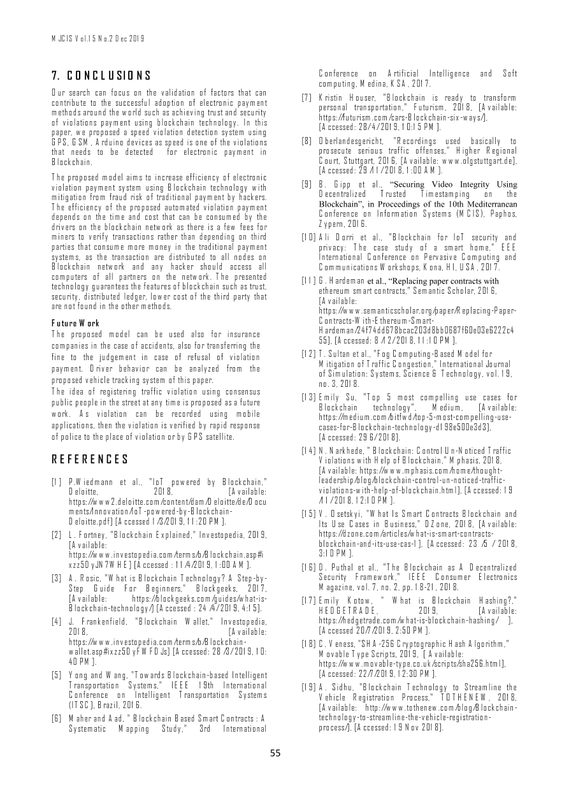
MJCIS_Volume 15_Issue 2_Pages 45-55.pdf | Page 11 of 11
Notes:
Extracted text from source page 11: MJCIS Vol.15 No.2 Dec 2019 Conference on Artificial Intelligence and Soft 7. CONCLUSIONS computing, Medina, KSA, 2017. Our search can focus on the validation of factors that can [7] Kristin Houser, "Blockchain is ready to transform contribute to the successful adoption of electronic payment personal transportation," Futurism, 2018, [Available: methods around the world such as achieving trust and security https://futurism.com/cars-Blockchain-six-ways/ ], of violations payment using blockchain technology. In this [Accessed: 28/ 4/ 2019, 10:15 PM]. paper, we proposed a speed violation detection system using GPS, GSM, Arduino devices as speed is one of the violations [8] Oberlandesgericht, "Recordings used basically to that needs to be detected for electronic payment in prosecute serious traffic offenses," Higher Regional Blockchain. Court, Stuttgart, 2016, [Available: www.olgstuttgart.de ], [Accessed: 29 /11/ 2018, 1:00 AM]. The proposed model aims to increase efficiency of electronic [9] B. Gipp et al., “Securing Video Integrity Using violation payment system using Blockchain technology with Decentralized Trusted Timestamping on the mitigation from fraud risk of traditional payment by hackers. Blockchain”, in Proceedings of the 10th Mediterranean The efficiency of the proposed automated violation payment Conference on Information Systems (MCIS), Paphos, depends on the time and cost that can be consumed by the Zypern, 2016. drivers on the blockchain network as there is a few fees for miners to verify transactions rather than depending on third [10] Ali Dorri et al., "Blockchain for IoT security and parties that consume more money in the traditional payment privacy: The case study of a smart home," EEE systems, as the transaction are distributed to all nodes on International Conference on Pervasive Computing and Blockchain network and any hacker should access all Communications Workshops, Kona, HI, USA, 2017. computers of all partners on the network . The presented [11] G. Hardeman et al., “Replacing paper contracts with technology guarantees the features of blockchain such as trust, ethereum smart contracts," Semantic Scholar, 2016, security, distributed ledger, lower cost of the third party that [Available: are not found in the other methods. https:// www.semanticscholar.org/paper/Replacing - Paper - Contracts - With - Ethereum - Smart - Future Work Hardeman/24f74dd678bcac203d8bb0687f60e03e6222c4 The proposed model can be used also for insurance 55 ] , [Accessed: 8 /12/ 2018 , 11:10 PM ] . companies in the case of accidents, also for transferring the [12] T. Sultan et al., "Fog Computing-Based Model for fine to the judgement in case of refusal of violation Mitigation of Traffic Congestion," International Journal payment. Driver behavior can be analyzed from the of Simulation: Systems, Science & Technology, vol. 19, proposed vehicle tracking system of this paper. no. 3, 2018. The idea of registering traffic violation using consensus [13] Emily Su, "Top 5 most compelling use cases for public people in the street at any time is proposed as a future Blockchain technology", Medium, [Available: work. As violation can be recorded using mobile https://medium.com/bitfwd/top-5-most-compelling-use- applications, then the violation is verified by rapid response cases-for-Blockchain-technology-d198e500e3d3 ], of police to the place of violation or by GPS satellite. [Accessed: 29 6/ 2018]. [14] N. Narkhede, " Blockchain: Control Un-Noticed Traffic REFERENCES Violations with Help of Blockchain," Mphasis, 2018, [Available: https://www.mphasis.com/home/thought- [1] P.Wiedmann et al., "IoT powered by Blockchain," leadership/blog/blockchain-control-un-noticed-traffic- Deloitte, 2018, [Available: violations-with-help-of-blockchain.html], [Accessed: 19 https://www2.deloitte.com/content/dam/Deloitte/de/Docu /11/ 2018, 12:10 PM]. ments/Innovation/IoT-powered-by-Blockchain- [15] V. Osetskyi, "What Is Smart Contracts Blockchain and Deloitte.pdf] [Accessed 1/3/2019, 11:20 PM]. Its Use Cases in Business," DZone, 2018, [Available: [2] L. Fortney, "Blockchain Explained," Investopedia, 2019, https://dzone.com/articles/what-is-smart-contracts- [Available: blockchain-and-its-use-cas-1], [Accessed: 23 /5 / 2018, https://www.investopedia.com/terms/b/Blockchain.asp#i 3:10 PM]. xzz5DyJN7WHE] [Accessed : 11/4/2019, 1:00 AM]. [16] D. Puthal et al., "The Blockchain as A Decentralized [3] A. Rosic, "What is Blockchain Technology? A Step-by- Security Framework," IEEE Consumer Electronics Step Guide For Beginners," Blockgeeks, 2017, Magazine, vol. 7, no. 2, pp. 18-21, 2018. [Available: https://blockgeeks.com/guides/what-is- [17] Emily Kotow, " What is Blockchain Hashing?," Blockchain-technology/] [Accessed : 24 /4/ 2019, 4:15]. HEDGETRADE, 2019, [Available: [4] J. Frankenfield, "Blockchain Wallet," Investopedia, https://hedgetrade.com/what-is-blockchain-hashing/ ], 2018, [Available: [Accessed 20/7/2019, 2:50 PM]. https://www.investopedia.com/terms/b/Blockchain- [18] C. Veness, "SHA-256 Cryptographic Hash Algorithm," wallet.asp#ixzz5DyFWFDJs] [Accessed: 28 /3/ 2019, 10: Movable Type Scripts, 2019, [ Available: 40 PM]. https://www.movable-type.co.uk/scripts/sha256.html ], [5] Yong and Wang, "Towards Blockchain-based Intelligent [Accessed: 22/7/2019, 12:30 PM]. Transportation Systems," IEEE 19th International [19] A. Sidhu, "Blockchain Technology to Streamline the Conference on Intelligent Transportation Systems Vehicle Registration Process," TOTHENEW, 2018, (ITSC], Brazil, 2016. [Available: http://www.tothenew.com/blog/Blockchain- [6] Maher and Aad, " Blockchain Based Smart Contracts : A technology-to-streamline-the-vehicle-registration- Systematic Mapping Study," 3rd International process/], [Accessed: 19 Nov 2018]. 55

