Slide 1
ACADEMIC LESSON
A_Device_for_Integrated_Traffic_Violatio
Prepared for classroom discussion and guided study
Learning objectives • Key concepts • Discussion prompts

Slide 2
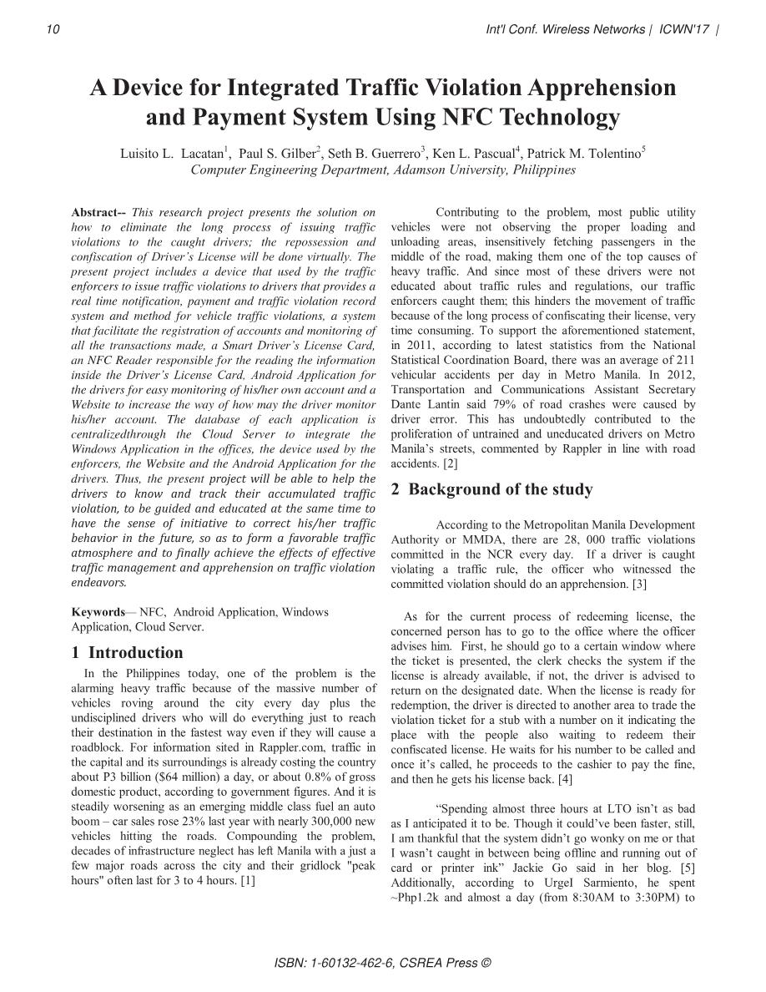
A_Device_for_Integrated_Traffic_Violatio.pdf | Page 1 of 7
Notes:
Extracted text from source page 1: 10 Int'l Conf. Wireless Networks | ICWN'17 | A Device for Integrated Traffic Violation Apprehension and Payment System Using NFC Technology 1 2 3 4 5 Luisito L. Lacatan , Paul S. Gilber , Seth B. Guerrero , Ken L. Pascual , Patrick M. Tolentino Computer Engineering Department, Adamson University, Philippines Abstract-- This research project presents the solution on Contributing to the problem, most public utility how to eliminate the long process of issuing traffic vehicles were not observing the proper loading and violations to the caught drivers; the repossession and unloading areas, insensitively fetching passengers in the confiscation of Driver’s License will be done virtually. The middle of the road, making them one of the top causes of present project includes a device that used by the traffic heavy traffic. And since most of these drivers were not enforcers to issue traffic violations to drivers that provides a educated about traffic rules and regulations, our traffic real time notification, payment and traffic violation record enforcers caught them; this hinders the movement of traffic system and method for vehicle traffic violations, a system because of the long process of confiscating their license, very that facilitate the registration of accounts and monitoring of time consuming. To support the aforementioned statement, all the transactions made, a Smart Driver’s License Card, in 2011, according to latest statistics from the National an NFC Reader responsible for the reading the information Statistical Coordination Board, there was an average of 211 inside the Driver’s License Card, Android Application for vehicular accidents per day in Metro Manila. In 2012, the drivers for easy monitoring of his/her own account and a Transportation and Communications Assistant Secretary Website to increase the way of how may the driver monitor Dante Lantin said 79% of road crashes were caused by his/her account. The database of each application is driver error. This has undoubtedly contributed to the centralizedthrough the Cloud Server to integrate the proliferation of untrained and uneducated drivers on Metro Windows Application in the offices, the device used by the Manila’ s streets, commented by Rappler in line with road enforcers, the Website and the Android Application for the accidents. [2] drivers. Thus, the present project will be able to help the 2 Background of the study drivers to know and track their accumulated traffic violation, to be guided and educated at the same time to have the sense of initiative to correct his/her traffic According to the Metropolitan Manila Development behavior in the future, so as to form a favorable traffic Authority or MMDA, there are 28, 000 traffic violations atmosphere and to finally achieve the effects of effective committed in the NCR every day. If a driver is caught traffic management and apprehension on traffic violation violating a traffic rule, the officer who witnessed the endeavors. committed violation should do an apprehension. [3] Keywords — NFC, Android Application, Windows As for the current process of redeeming license, the Application, Cloud Server. concerned person has to go to the office where the officer advises him. First, he should go to a certain window where 1 Introduction the ticket is presented, the clerk checks the system if the In the Philippines today, one of the problem is the license is already available, if not, the driver is advised to alarming heavy traffic because of the massive number of return on the designated date. When the license is ready for vehicles roving around the city every day plus the redemption, the driver is directed to another area to trade the undisciplined drivers who will do everything just to reach violation ticket for a stub with a number on it indicating the their destination in the fastest way even if they will cause a place with the people also waiting to redeem their roadblock. For information sited in Rappler.com, traffic in confiscated license. He waits for his number to be called and the capital and its surroundings is already costing the country once it’s called, he proceeds to the cashier to pay the fine, about P3 billion ($64 million) a day, or about 0.8% of gross and then he gets his license back. [4] domestic product, according to government figures. And it is steadily worsening as an emerging middle class fuel an auto “Spending almost three hours at LTO isn’t as bad boom – car sales rose 23% last year with nearly 300,000 new as I anticipated it to be. Though it could’ve been faster, still, vehicles hitting the roads. Compounding the problem, I am thankful that the system didn’t go wonky on me or that decades of infrastructure neglect has left Manila with a just a I wasn’t caught in between being offline and r unning out of few major roads across the city and their gridlock "peak card or printer ink” Jackie Go said in her blog. [5] hours" often last for 3 to 4 hours. [1] Additionally, according to UrgeI Sarmiento, he spent ~Php1.2k and almost a day (from 8:30AM to 3:30PM) to ISBN: 1-60132-462-6, CSREA Press ©

Slide 3
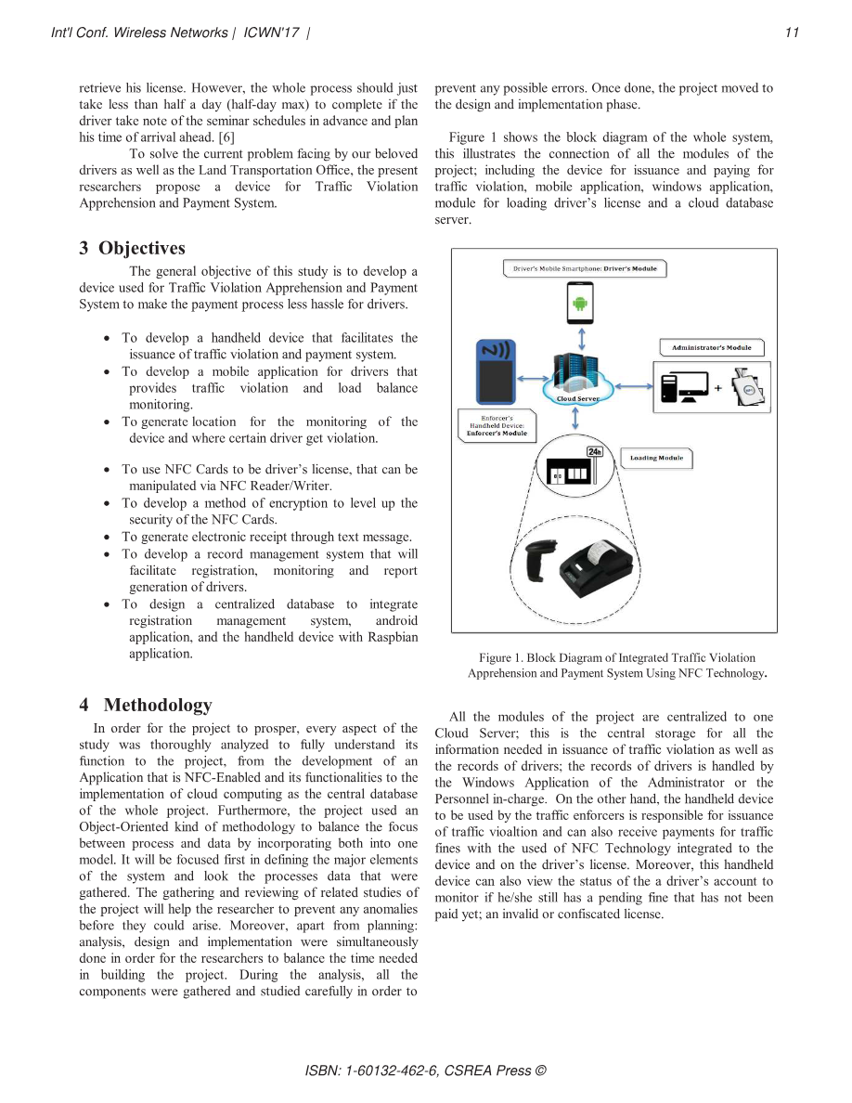
A_Device_for_Integrated_Traffic_Violatio.pdf | Page 2 of 7
Notes:
Extracted text from source page 2: Int'l Conf. Wireless Networks | ICWN'17 | 11 retrieve his license. However, the whole process should just prevent any possible errors. Once done, the project moved to take less than half a day (half-day max) to complete if the the design and implementation phase. driver take note of the seminar schedules in advance and plan his time of arrival ahead. [6] Figure 1 shows the block diagram of the whole system, To solve the current problem facing by our beloved this illustrates the connection of all the modules of the drivers as well as the Land Transportation Office, the present project; including the device for issuance and paying for researchers propose a device for Traffic Violation traffic violation, mobile application, windows application, Apprehension and Payment System. module for loading driver’s license and a cloud database server. 3 Objectives The general objective of this study is to develop a device used for Traffic Violation Apprehension and Payment System to make the payment process less hassle for drivers. x To develop a handheld device that facilitates the issuance of traffic violation and payment system. x To develop a mobile application for drivers that provides traffic violation and load balance monitoring. x To generate location for the monitoring of the device and where certain driver get violation. x To use NFC Cards to be driver’s license, that can be manipulated via NFC Reader/Writer. x To develop a method of encryption to level up the security of the NFC Cards. x To generate electronic receipt through text message. x To develop a record management system that will facilitate registration, monitoring and report generation of drivers. x To design a centralized database to integrate registration management system, android application, and the handheld device with Raspbian application. Figure 1. Block Diagram of Integrated Traffic Violation Apprehension and Payment System Using NFC Technology . 4 Methodology All the modules of the project are centralized to one In order for the project to prosper, every aspect of the Cloud Server; this is the central storage for all the study was thoroughly analyzed to fully understand its information needed in issuance of traffic violation as well as function to the project, from the development of an the records of drivers; the records of drivers is handled by Application that is NFC-Enabled and its functionalities to the the Windows Application of the Administrator or the implementation of cloud computing as the central database Personnel in-charge. On the other hand, the handheld device of the whole project. Furthermore, the project used an to be used by the traffic enforcers is responsible for issuance Object-Oriented kind of methodology to balance the focus of traffic vioaltion and can also receive payments for traffic between process and data by incorporating both into one fines with the used of NFC Technology integrated to the model. It will be focused first in defining the major elements device and on the driver’s license. Moreover, this handheld of the system and look the processes data that were device can also view the status of t he a driver’s account to gathered. The gathering and reviewing of related studies of monitor if he/she still has a pending fine that has not been the project will help the researcher to prevent any anomalies paid yet; an invalid or confiscated license. before they could arise. Moreover, apart from planning: analysis, design and implementation were simultaneously done in order for the researchers to balance the time needed in building the project. During the analysis, all the components were gathered and studied carefully in order to ISBN: 1-60132-462-6, CSREA Press ©

Slide 4
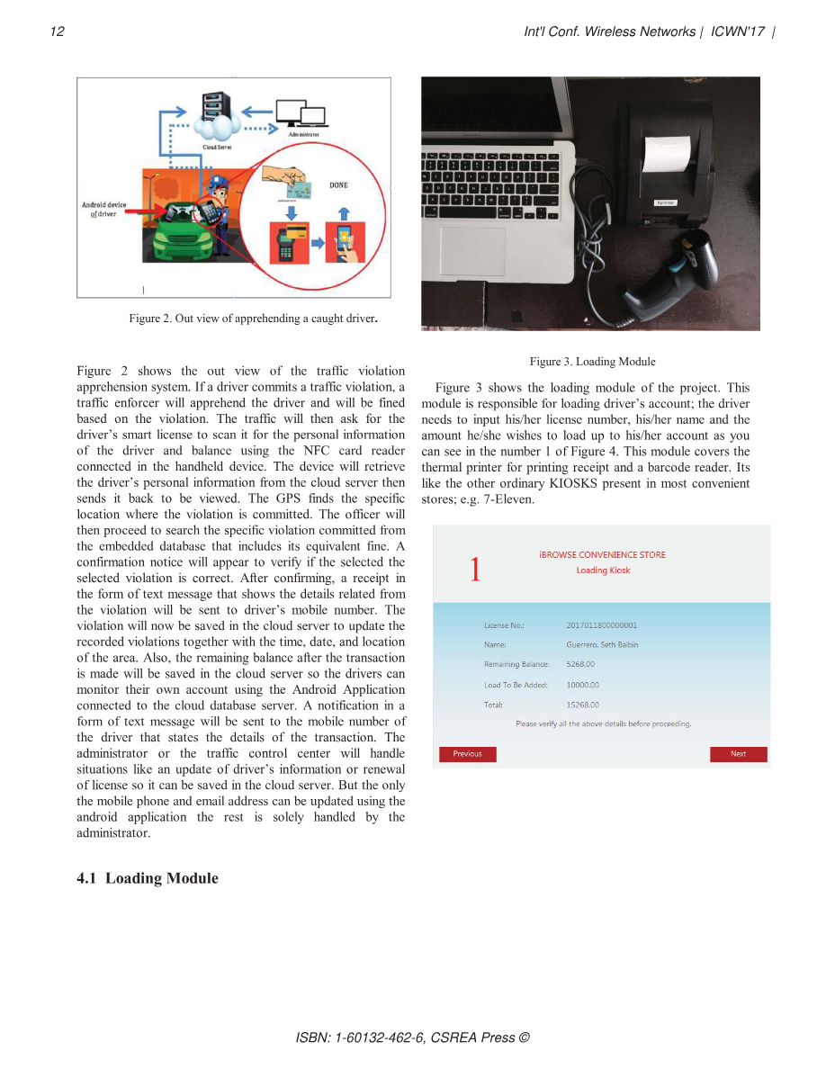
A_Device_for_Integrated_Traffic_Violatio.pdf | Page 3 of 7
Notes:
Extracted text from source page 3: 12 Int'l Conf. Wireless Networks | ICWN'17 | Figure 2. Out view of apprehending a caught driver . Figure 3. Loading Module Figure 2 shows the out view of the traffic violation apprehension system. If a driver commits a traffic violation, a Figure 3 shows the loading module of the project. This traffic enforcer will apprehend the driver and will be fined module is responsible for loading driver’s account; the driver based on the violation. The traffic will then ask for the needs to input his/her license number, his/her name and the driver’s smart license to scan it for the personal information amount he/she wishes to load up to his/her account as you of the driver and balance using the NFC card reader can see in the number 1 of Figure 4. This module covers the connected in the handheld device. The device will retrieve thermal printer for printing receipt and a barcode reader. Its the driver’s personal information from the cloud server then like the other ordinary KIOSKS present in most convenient sends it back to be viewed. The GPS finds the specific stores; e.g. 7-Eleven. location where the violation is committed. The officer will then proceed to search the specific violation committed from the embedded database that includes its equivalent fine. A confirmation notice will appear to verify if the selected the selected violation is correct. After confirming, a receipt in 1 the form of text message that shows the details related from the violation will be sent to driver’s mobile number. The violation will now be saved in the cloud server to update the recorded violations together with the time, date, and location of the area. Also, the remaining balance after the transaction is made will be saved in the cloud server so the drivers can monitor their own account using the Android Application connected to the cloud database server. A notification in a form of text message will be sent to the mobile number of the driver that states the details of the transaction. The administrator or the traffic control center will handle situations like an update of driver’s information or renewal of license so it can be saved in the cloud server. But the only the mobile phone and email address can be updated using the android application the rest is solely handled by the administrator. 4.1 Loading Module ISBN: 1-60132-462-6, CSREA Press ©

Slide 5
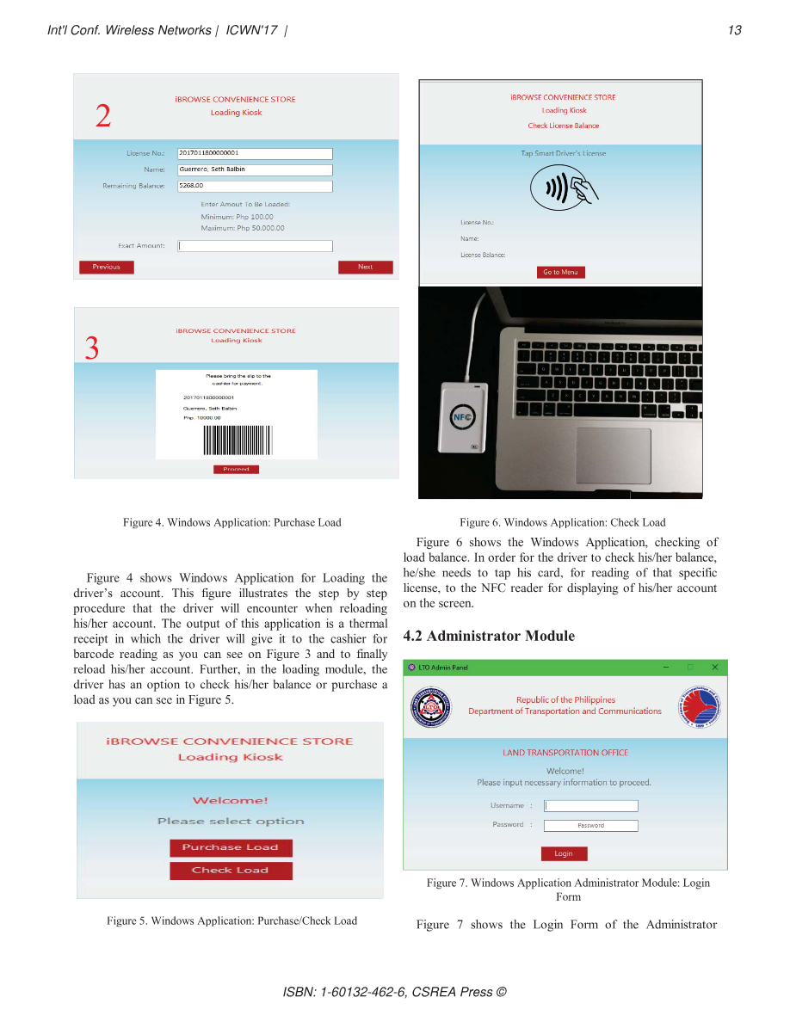
A_Device_for_Integrated_Traffic_Violatio.pdf | Page 4 of 7
Notes:
Extracted text from source page 4: Int'l Conf. Wireless Networks | ICWN'17 | 13 2 3 Figure 4. Windows Application: Purchase Load Figure 6. Windows Application: Check Load Figure 6 shows the Windows Application, checking of load balance. In order for the driver to check his/her balance, he/she needs to tap his card, for reading of that specific Figure 4 shows Windows Application for Loading the license, to the NFC reader for displaying of his/her account driver’s account. This figure illustrates the step by step on the screen. procedure that the driver will encounter when reloading his/her account. The output of this application is a thermal receipt in which the driver will give it to the cashier for 4.2 Administrator Module barcode reading as you can see on Figure 3 and to finally reload his/her account. Further, in the loading module, the driver has an option to check his/her balance or purchase a load as you can see in Figure 5. Figure 7. Windows Application Administrator Module: Login Form Figure 5. Windows Application: Purchase/Check Load Figure 7 shows the Login Form of the Administrator ISBN: 1-60132-462-6, CSREA Press ©

Slide 6
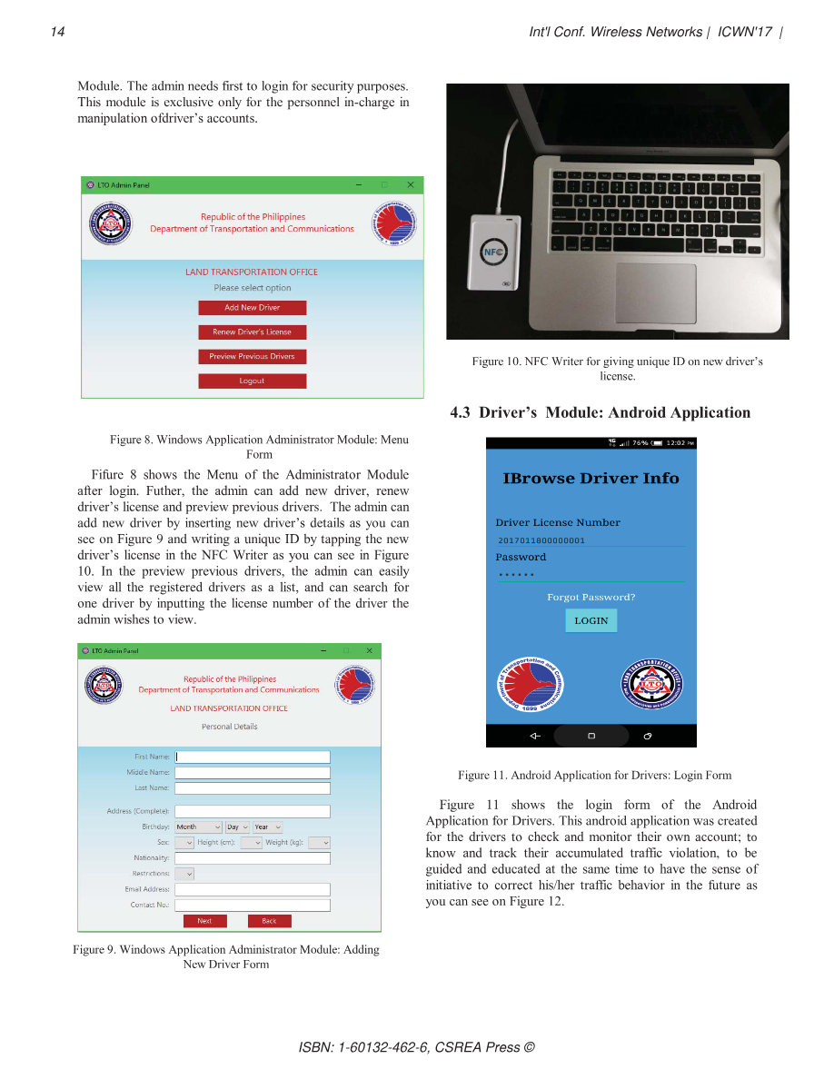
A_Device_for_Integrated_Traffic_Violatio.pdf | Page 5 of 7
Notes:
Extracted text from source page 5: 14 Int'l Conf. Wireless Networks | ICWN'17 | Module. The admin needs first to login for security purposes. This module is exclusive only for the personnel in-charge in manipulation of driver’s accounts. Figure 10. NFC Writer for giving unique ID on new driver’s license. 4.3 D river’s Module: Android Application Figure 8. Windows Application Administrator Module: Menu Form Fifure 8 shows the Menu of the Administrator Module after login. Futher, the admin can add new driver, renew driver’s license and preview previous drivers. The admin can add new driver by inserting new driver ’s details as you can see on Figure 9 and writing a unique ID by tapping the new driver’s license in the NFC Writer as you can see in Figure 10. In the preview previous drivers, the admin can easily view all the registered drivers as a list, and can search for one driver by inputting the license number of the driver the admin wishes to view. Figure 11. Android Application for Drivers: Login Form Figure 11 shows the login form of the Android Application for Drivers. This android application was created for the drivers to check and monitor their own account; to know and track their accumulated traffic violation, to be guided and educated at the same time to have the sense of initiative to correct his/her traffic behavior in the future as you can see on Figure 12. Figure 9. Windows Application Administrator Module: Adding New Driver Form ISBN: 1-60132-462-6, CSREA Press ©

Slide 7
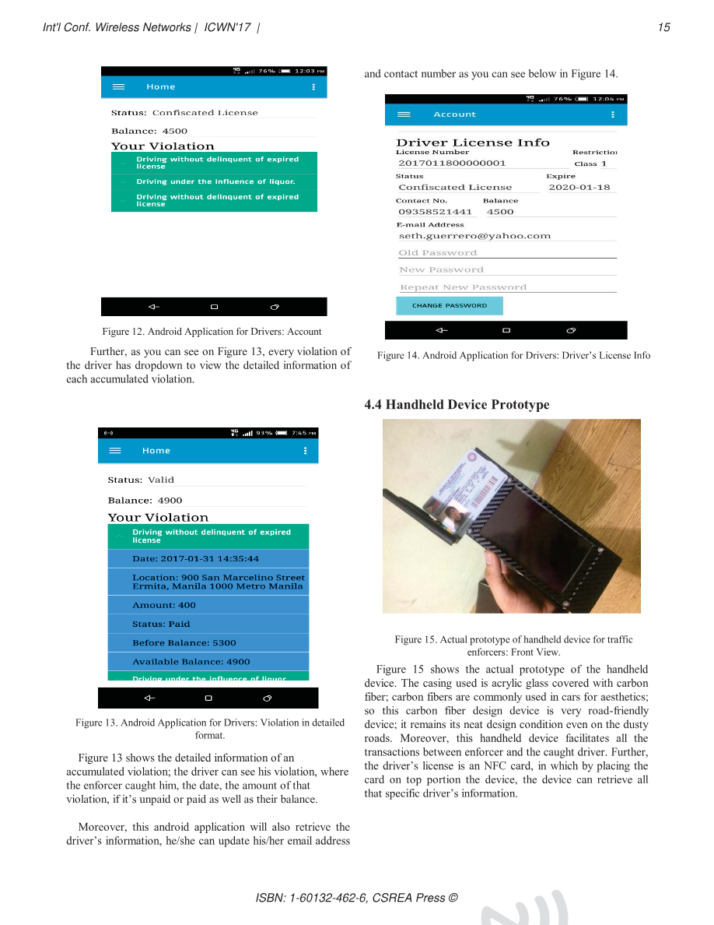
A_Device_for_Integrated_Traffic_Violatio.pdf | Page 6 of 7
Notes:
Extracted text from source page 6: Int'l Conf. Wireless Networks | ICWN'17 | 15 and contact number as you can see below in Figure 14. Figure 12. Android Application for Drivers: Account Further, as you can see on Figure 13, every violation of Figure 14. Android Application for Drivers: Driver’s Lic ense Info the driver has dropdown to view the detailed information of each accumulated violation. 4.4 Handheld Device Prototype Figure 15. Actual prototype of handheld device for traffic enforcers: Front View. Figure 15 shows the actual prototype of the handheld device. The casing used is acrylic glass covered with carbon fiber; carbon fibers are commonly used in cars for aesthetics; so this carbon fiber design device is very road-friendly device; it remains its neat design condition even on the dusty Figure 13. Android Application for Drivers: Violation in detailed format. roads. Moreover, this handheld device facilitates all the transactions between enforcer and the caught driver. Further, Figure 13 shows the detailed information of an t he driver’s license is an NFC card, in which by placing the accumulated violation; the driver can see his violation, where card on top portion the device, the device can retrieve all the enforcer caught him, the date, the amount of that that specific driver’s information. violation, if it’s unpaid or paid as well as their balance. Moreover, this android application will also retrieve the driver’s information, he/she can update his/her email address ISBN: 1-60132-462-6, CSREA Press ©

Slide 8
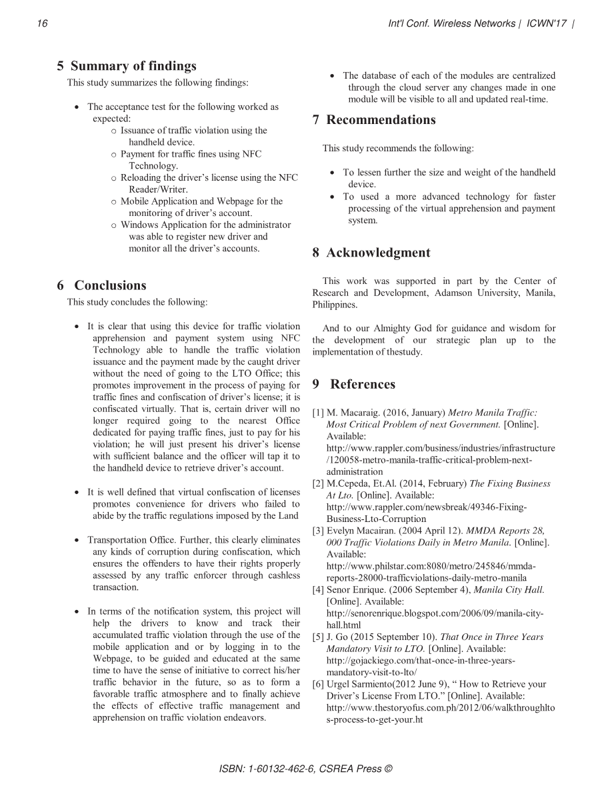
A_Device_for_Integrated_Traffic_Violatio.pdf | Page 7 of 7
Notes:
Extracted text from source page 7: 16 Int'l Conf. Wireless Networks | ICWN'17 | 5 Summary of findings x The database of each of the modules are centralized This study summarizes the following findings: through the cloud server any changes made in one module will be visible to all and updated real-time. x The acceptance test for the following worked as expected: 7 Recommendations o Issuance of traffic violation using the handheld device. This study recommends the following: o Payment for traffic fines using NFC Technology. x To lessen further the size and weight of the handheld o Reloading the driver’s license using the NFC device. Reader/Writer. x To used a more advanced technology for faster o Mobile Application and Webpage for the processing of the virtual apprehension and payment monitoring of dr iver’s account. system. o Windows Application for the administrator was able to register new driver and monitor all the driver’s accounts. 8 Acknowledgment This work was supported in part by the Center of 6 Conclusions Research and Development, Adamson University, Manila, This study concludes the following: Philippines. x It is clear that using this device for traffic violation And to our Almighty God for guidance and wisdom for apprehension and payment system using NFC the development of our strategic plan up to the Technology able to handle the traffic violation implementation of thestudy. issuance and the payment made by the caught driver without the need of going to the LTO Office; this promotes improvement in the process of paying for 9 References traffic fines and confiscation o f driver’s license; it is confiscated virtually. That is, certain driver will no [1] M. Macaraig. (2016, January) Metro Manila Traffic: longer required going to the nearest Office Most Critical Problem of next Government. [Online]. dedicated for paying traffic fines, just to pay for his Available: violation; he will just present his driver’s license http://www.rappler.com/business/industries/infrastructure with sufficient balance and the officer will tap it to /120058-metro-manila-traffic-critical-problem-next- the handheld device to retrieve driver’s account. administration [2] M.Cepeda, Et.Al. (2014, February) The Fixing Business x It is well defined that virtual confiscation of licenses At Lto. [Online]. Available: promotes convenience for drivers who failed to http://www.rappler.com/newsbreak/49346-Fixing- abide by the traffic regulations imposed by the Land Business-Lto-Corruption [3] Evelyn Macairan. (2004 April 12). MMDA Reports 28, x Transportation Office. Further, this clearly eliminates 000 Traffic Violations Daily in Metro Manila. [Online]. any kinds of corruption during confiscation, which Available: ensures the offenders to have their rights properly http://www.philstar.com:8080/metro/245846/mmda- assessed by any traffic enforcer through cashless reports-28000-trafficviolations-daily-metro-manila transaction. [4] Senor Enrique. (2006 September 4), Manila City Hall. [Online]. Available: x In terms of the notification system, this project will http://senorenrique.blogspot.com/2006/09/manila-city- help the drivers to know and track their hall.html accumulated traffic violation through the use of the [5] J. Go (2015 September 10). That Once in Three Years mobile application and or by logging in to the Mandatory Visit to LTO. [Online]. Available: Webpage, to be guided and educated at the same http://gojackiego.com/that-once-in-three-years- time to have the sense of initiative to correct his/her mandatory-visit-to-lto/ traffic behavior in the future, so as to form a [6] Urgel Sarmiento(2012 June 9), “ How to Retrieve your favorable traffic atmosphere and to finally achieve Driver’s License From LTO.” [Online]. Available: the effects of effective traffic management and http://www.thestoryofus.com.ph/2012/06/walkthroughlto apprehension on traffic violation endeavors. s-process-to-get-your.ht ISBN: 1-60132-462-6, CSREA Press ©

