Slide 1
Mini Learning Management System
A small-scale academic LMS for course management, learning workflow, and progress tracking
Fundamental Project 2 Defense
Student: Pham Ngoc Huy Hoan (23IT.B062)
Core idea
Supervisor: Do Cong Duc, M.Sc.
Build a practical LMS prototype with real authentication, database, storage, role-based workflows, and progress tracking.
Da Nang, June 3, 2026
MiniLMS | Fundamental Project 2
1

Slide 2
Presentation Agenda
The presentation follows the same order as the report and the live demo.
1
Problem and objectives
Defense focus
2
System analysis and roles
Explain every feature from requirement to UI, API, database table, and access rule.
3
Architecture and database design
4
Implementation results
5
Live demo flow
6
Conclusion and future work
MiniLMS | Fundamental Project 2
2

Slide 3
Problem and Objectives
MiniLMS focuses on essential LMS workflows instead of commercial platform complexity.
Online learning needs organized course content and user management.
A static course list is not enough for a full-stack project.
The system must support authentication, role separation, database design, and learning progress.
The project target is a small but complete academic LMS prototype.
Main objective
Implement a complete web application where instructors manage courses, students learn lessons, and administrators manage users.
Technical objective
Use React for the interface and Supabase for authentication, PostgreSQL database access, and Storage uploads.
Academic objective
Make the system easy to explain using roles, use cases, UML diagrams, ERD, testing, and live demo data.
MiniLMS | Fundamental Project 2
3

Slide 4
Scope and User Roles
The system has three main roles with clear responsibilities.
Student
Instructor
Administrator
Browse catalog Search and filter courses Enroll in a course Open lesson player Mark lessons complete
Create and edit courses Manage metadata and outcomes Upload course cover image Add lesson outline Preview course content
View system statistics View role distribution Manage user roles Monitor platform data Prevent self role loss
Out of scope: quiz, assignment submission, certificate generation, payment, discussion, and advanced analytics.
MiniLMS | Fundamental Project 2
4

Slide 5
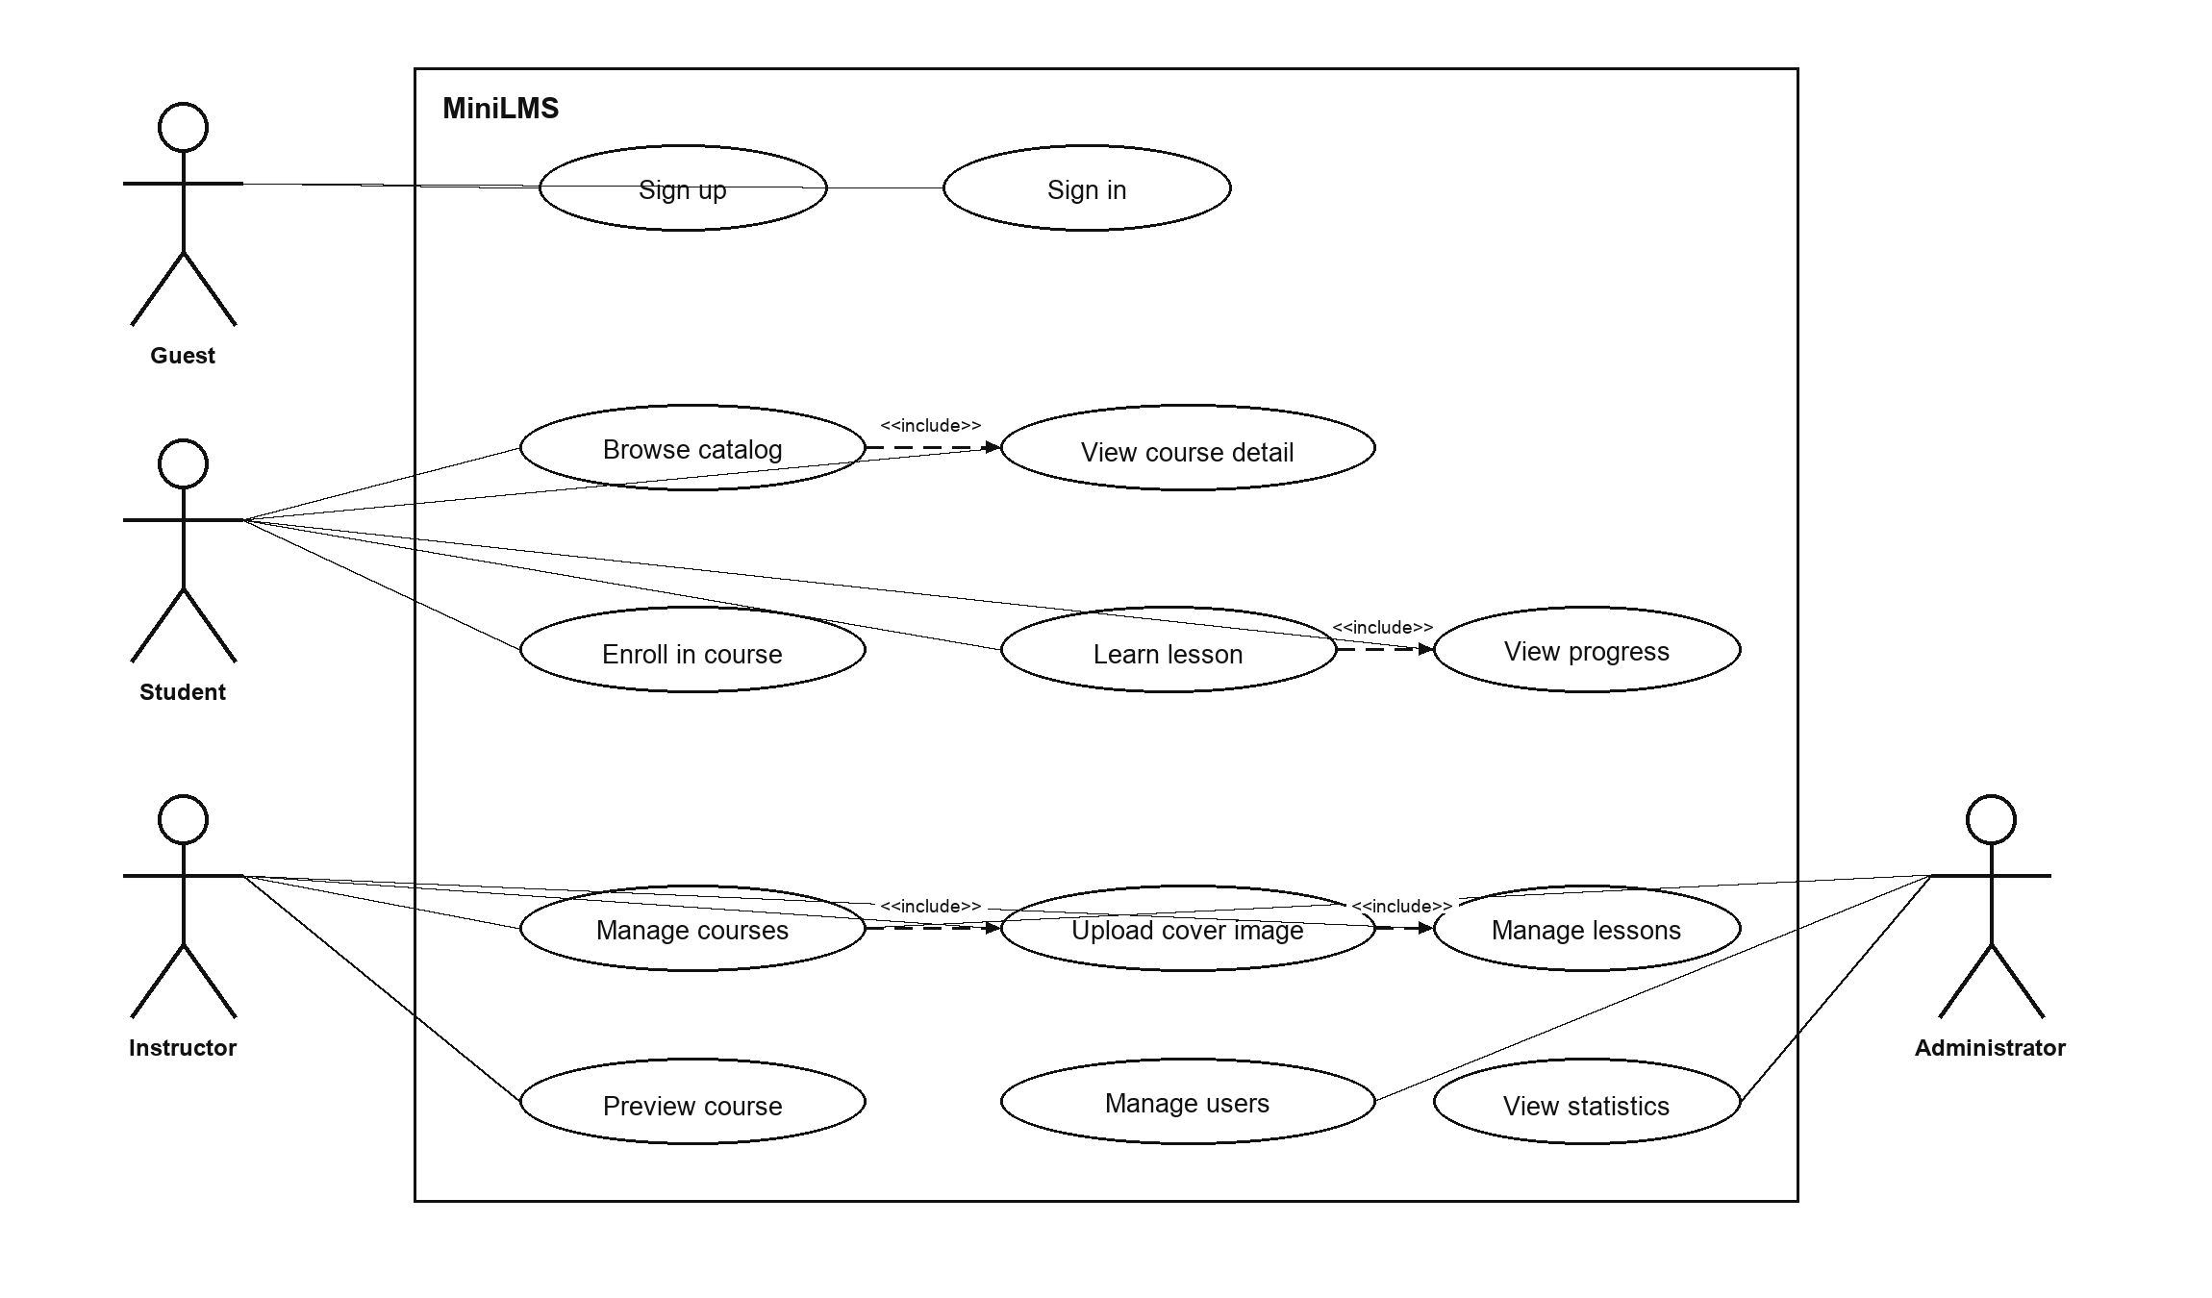
Use Case Overview
The use case model separates learning, authoring, and administration functions.
Guest can sign up and sign in.
Student performs the learning workflow.
Instructor manages course content.
Administrator manages roles and system overview.
The use case boundary keeps the project scope explainable.
MiniLMS | Fundamental Project 2
5

Slide 6
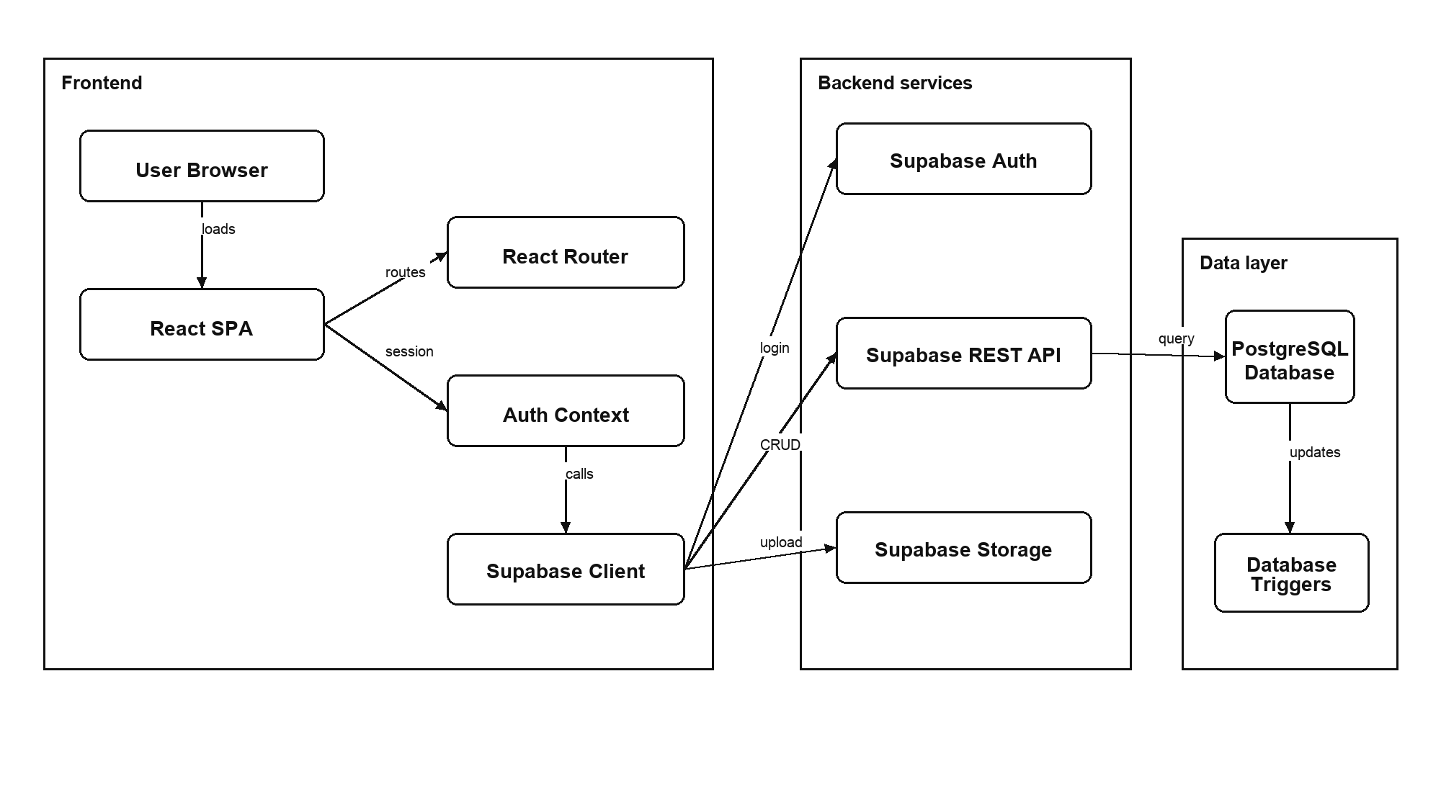
System Architecture
React handles the client layer; Supabase provides backend services and PostgreSQL storage.
Frontend
React, Vite, React Router, Tailwind CSS. It renders pages, forms, protected routes, and the lesson player.
Backend service
Supabase Auth manages sessions. Supabase API connects the browser to PostgreSQL and Storage.
Database
PostgreSQL stores profiles, courses, lessons, enrollments, and lesson completions with constraints and triggers.
MiniLMS | Fundamental Project 2
6

Slide 7
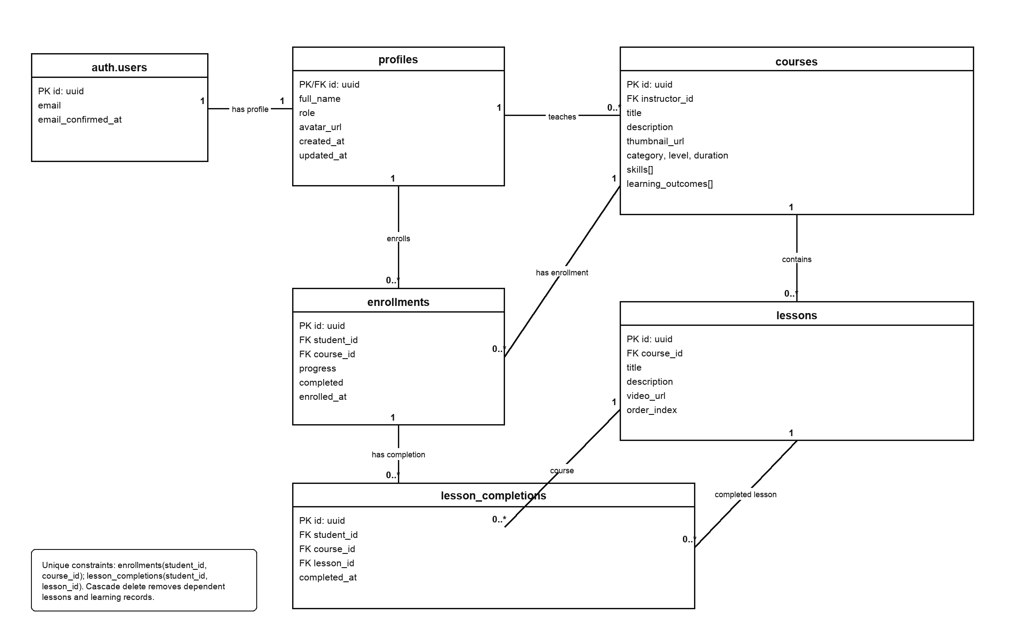
Database Design
The database keeps user roles, course content, enrollment, and progress data consistent.
`profiles` extends authenticated users with name and role.
`courses` belongs to an instructor.
`lessons` belongs to a course and uses `order_index`.
`enrollments` stores student-course relationship and progress.
`lesson_completions` stores each completed lesson as evidence.
Key idea: detailed completions are stored separately from summarized progress.
MiniLMS | Fundamental Project 2
7

Slide 8
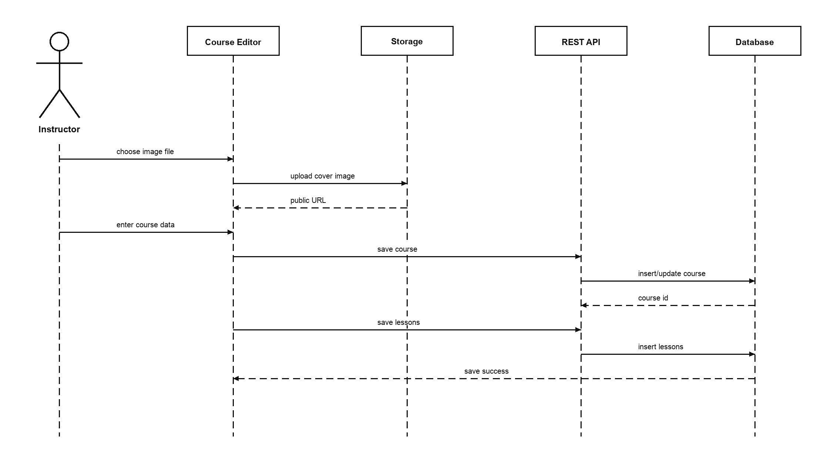
Instructor Workflow
Course authoring includes metadata, curriculum, image upload, and preview.
Open Manage and choose Create or Edit.
Maintain title, description, category, level, duration, skills, and outcomes.
Add lessons with title, note, and YouTube video URL.
Upload cover image to `course-covers` Storage bucket.
Save public image URL in `courses.thumbnail_url`.
Why this matters
This proves the project supports content authoring, not only course viewing.
MiniLMS | Fundamental Project 2
8

Slide 9
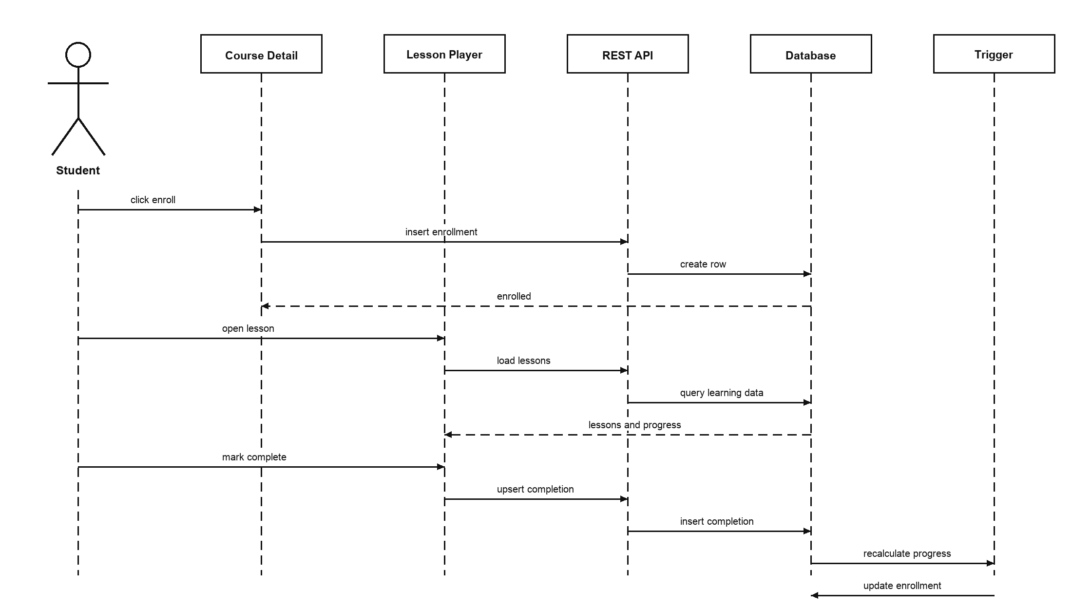
Student Learning and Progress Tracking
Progress is calculated from completed lesson records.
Student opens Course Detail and enrolls.
System creates one row in `enrollments`.
Student opens Lesson Player.
Completing a lesson inserts into `lesson_completions`.
Progress = completed lessons / total lessons × 100.
Important point
The system knows which lessons were completed, not only the final percentage.
MiniLMS | Fundamental Project 2
9

Slide 10
Administration and Role-Based Access
Administrator functions complete the three-role LMS model.
Dashboard shows role-specific data after sign in.
Admin page shows users, courses, enrollments, and completed enrollments.
Role distribution table supports quick system overview.
User table allows role update for platform management.
Self role change is blocked to avoid losing admin access.
Frontend protection
Protected routes control which screens each role can open.
Database protection
Access policies check important read and write operations at database level.
Data integrity
Foreign keys, unique constraints, and cascade delete prevent invalid or orphaned data.
MiniLMS | Fundamental Project 2
10

Slide 11
Implementation Results
The main modules were implemented and tested with prepared demo data.
Module | Result
Authentication | Sign in, sign up, sign out, profile loading
Course catalog | Search, category filter, level filter, course detail
Course management | Create, edit, delete, preview courses and lessons
Learning workflow | Enroll, open lessons, mark complete, update progress
Administration | Statistics, role distribution, user role update
Storage | Course cover upload and public URL saving
Lint and production build passed.
Seed data prepares three demo accounts.
Database schema includes tables, constraints, triggers, storage bucket, and access rules.
The app uses real Supabase data, not mock data.
MiniLMS | Fundamental Project 2
11

Slide 12
Conclusion and Future Work
MiniLMS meets the core requirement of a complete web application with front-end and back-end.
Completed a small LMS with three roles: student, instructor, and administrator.
Implemented real authentication, database relationships, storage upload, and learning progress tracking.
Prepared UML diagrams, ERD, report, seed data, and live demo flow.
The project is explainable from requirement to UI, database, and testing result.
Future work
Quizzes, assignments, grading, certificates, comments, notifications, analytics, file attachments, and automated tests.
MiniLMS | Fundamental Project 2
13

