Slide 1

Ingreedy
The personal sous-chef for leftover ingredients

Slide 2
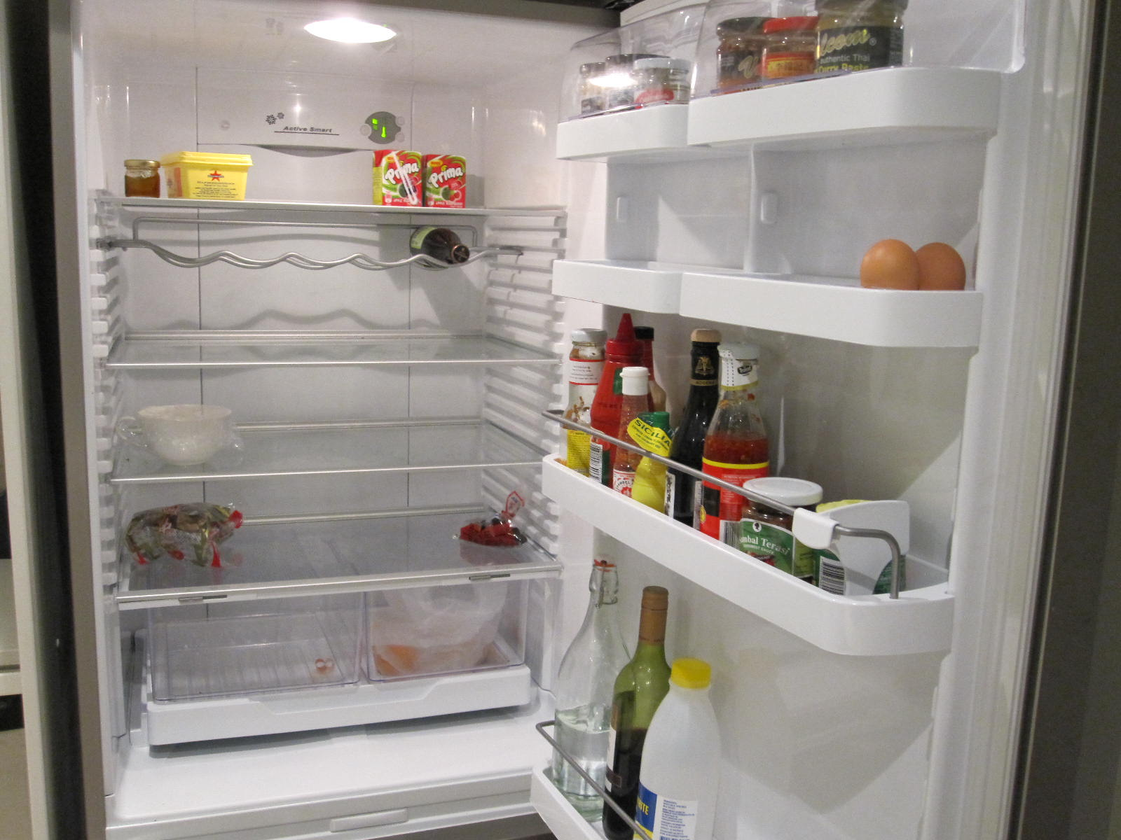

We’ve all been here

Slide 3

Using unloved ingredients was never easier
Why neglect what you have in your kitchen? Ingreedy can help you:
Save money
Be environmentally friendly
Make delicious meals to impress your friends! (if you have any)

Slide 4
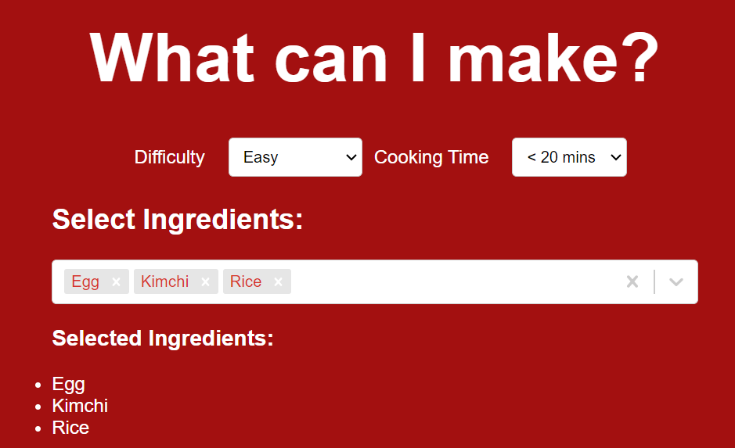
How it works

Slide 5
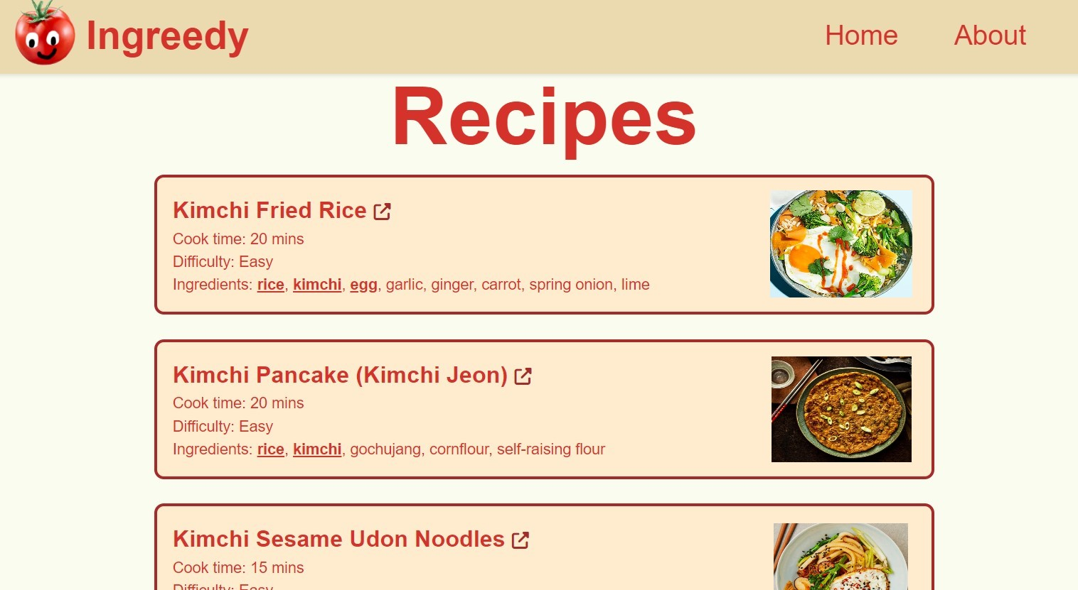
How it works

Slide 6
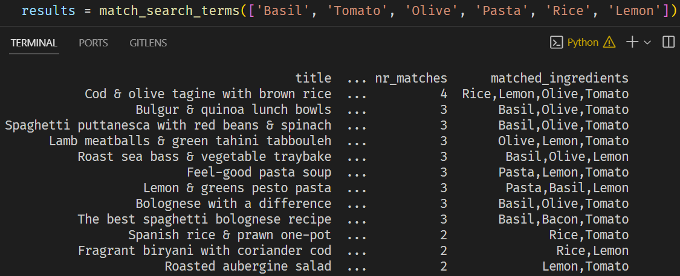
How it works

Slide 7
Data scraping
Using BeautifulSoup
Scraped recipes from BBC GoodFood (scalability)
Also scraped ingredients from BBC GoodFood’s list of ingredients

Slide 8
Backend
Python Script takes the list of ingredients scraped from BBC GoodFood and matches each ingredient to one in the list of ingredients
e.g. 2 onions, finely chopped -> onion
bunch of fresh parsley -> parsley
Upon search, another function matches search terms to ingredient keywords in recipes

Slide 9
Ingreedy
The ordinary persons sue chef to making use of left over ingredients

Slide 10
Ingreedy
The ordinary persons sue chef to making use of left over ingredients

