Slide 1

Ingreedy
The personal sue-chef for leftover ingredients

Slide 2
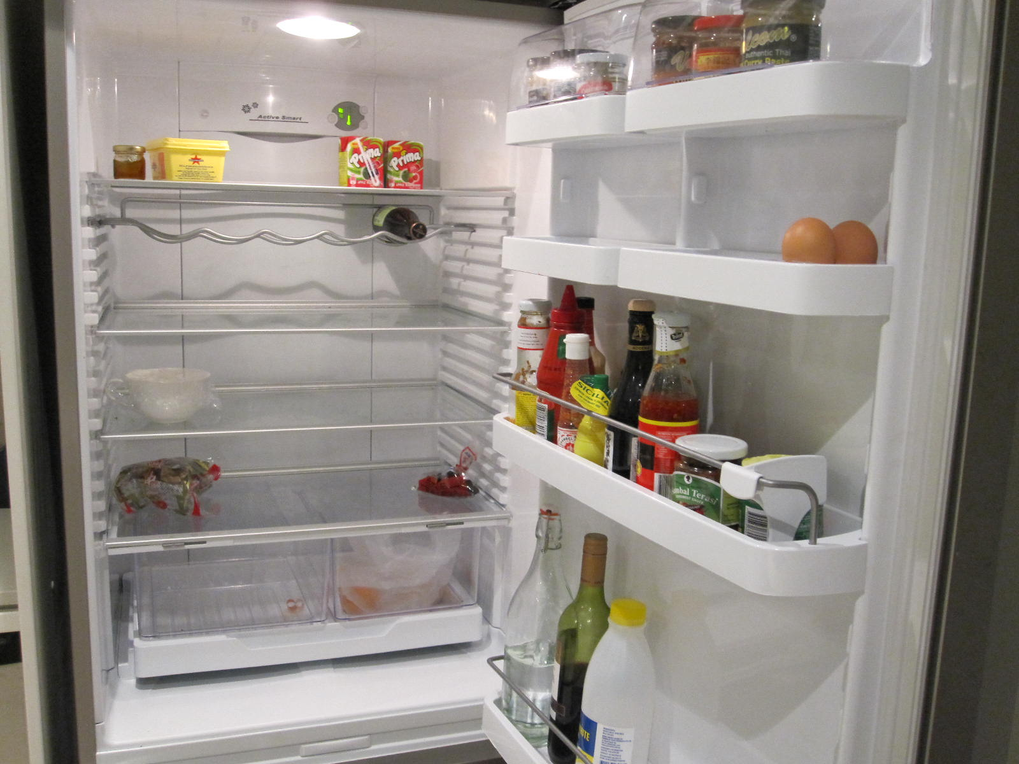

We’ve all been here

Slide 3
Using unloved ingredients was never easier
Why neglect what you have in your kitchen? Ingreedy can help you:
Save money
Be environmentally friendly
Make delicious meals to impress your friends! (if you have any)

Slide 4
Ingreedy
The ordinary persons sue chef to making use of left over ingredients

Slide 5
Ingreedy
The ordinary persons sue chef to making use of left over ingredients

