Slide 1
Distributed Evolutionary Algorithms
Alex Waterman
Merolin Christie

Slide 2
An Overview of Darwinian Evolution

Slide 3
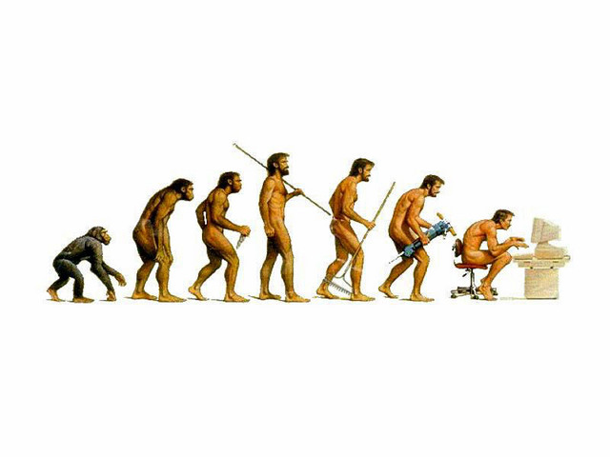
Selection
Slow change of genetic alleles.
Selection pressures.
Survival of the fittest.
Fit individuals breed, non fit individuals die.

Slide 4
Mutation
Individuals are a product of their parents.
However, they will differ slightly.
Individuals “mutate” when they are bred from their parents.
Mutation occurs in two ways.
Point mutations.
Crossover mutations.

Slide 5
Survival and Reproduction
An individual will either survive and produce offspring or it wont.
- It will pass its (possibly) good genes on.
If an individual dies before reproducing, it did not pass on its (possibly bad) genes.
An individual's survival is dependent on its genes; thus over all, individuals with good genes are more likely to pass on their genes.

Slide 6
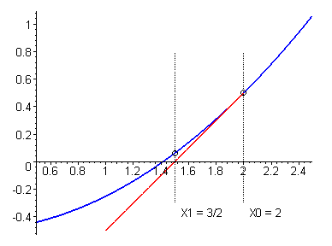
Optimization Algorithms
Newtons Algorithm
Simulated Annealing
Genetic Algorithms (very similar to evolutionary algorithms).

Slide 7
Optimization Example
Suppose we want to solve for a root of a polynomial.
One could use a closed form solution
Newton's is as follows:

Slide 8
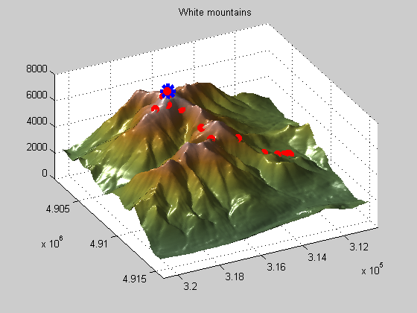
Generalizations
Newton's Algorithm works well for well defined problems.
However, for some problems it would have issues.
Try and use a gradient based search algorithm to find the highest peak here and you will be sad.

Slide 9
Why Is Evolution an Optimization Algorithm?
Looking at the picture to the right we see evolution in action (a gross oversimplification though)
Evolution roughly speaking, is a parallel search through a solution space.
The hope is that we evolve towards optimal solutions in the solution space

Slide 10
The Algorithm
1. Generate a list of initial solutions.
2. Determine the fitness of each solution with an objective fitness function.
3. Breed a new generation of solutions by picking randomly picking solutions with a tendency to pick the better solutions.
4. Randomly replace bad solutions with the newly generated solutions.
5. Rinse and repeat: go back to (2).

Slide 11
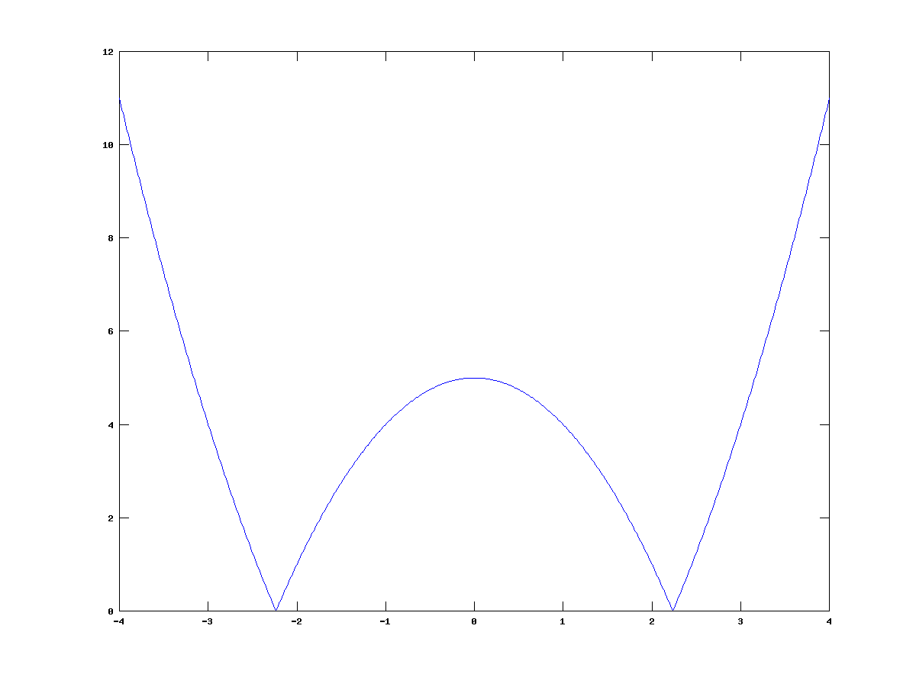
Can we solve the sqrt(5)?
Need two things:
1. Objective fitness function
2. A mutation operator
Mutation is trivial
Fitness not so much...

Slide 12
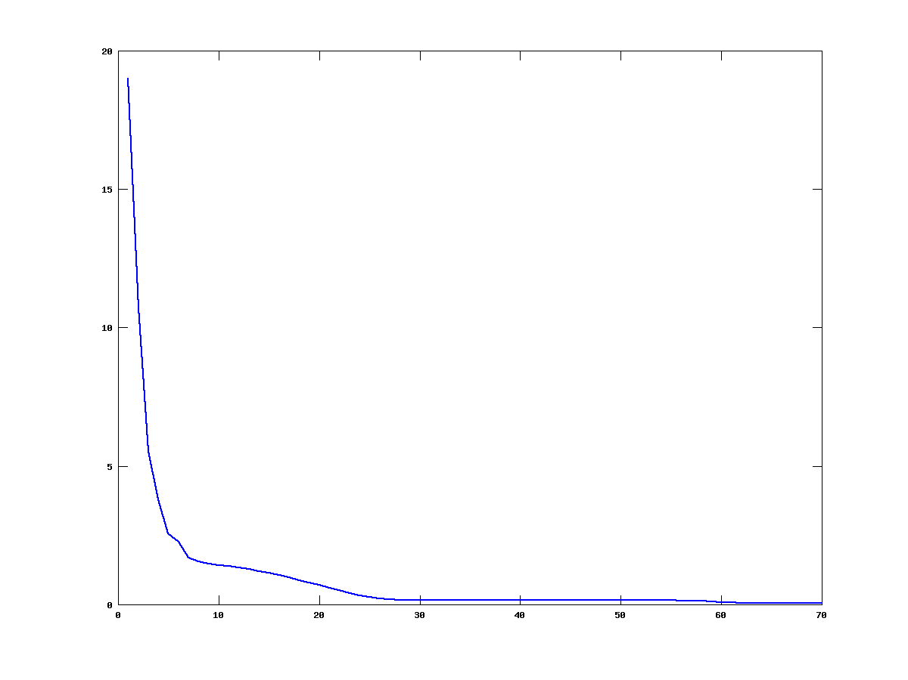
The sqrt(5) is approximately 2.2361
With a mutation variance of
.0001 it took 1001 generations to get an average fitness <
.001.
Best offered solution:
2.236068
Graph of the average fitness with respect to generations on the right.
Algorithm parameters:
Population size: 200
Solution variance: 0.0001
Initial Solution Range: (-10, 10)
Reproduction rate: .25
Breed fitness: .25

Slide 13
Metrics for Evolutionary Algorithms
Generations per unit time (seconds).
- Naturally arises from the problem. Answers how fast we are computing.
- Does not completely describe how much
useful computation we are doing.
Generations till convergence; or change in fitness per generation.
- Measures how much closer we are to an
optima compared to last generation.

Slide 14
Convergence
Some Ways For Determining Convergence
Average fitness of the population:
If the population's fitness (on average) monotonically decreases then
we can say convergence happens when the average fitness
population goes below a certain threshold.
Overall best solution:
Once you find a solution that is good enough (what ever that may be)
you have converged.
We will use average population for the root finder:
Better understanding of the algorithms average required run time you
wont win the lottery (pick the right solution randomly during an early
generation).

Slide 15
Fitness Functions (Redux)
Fitness functions allow the unambiguous comparison of individual solutions.
One can determine which solution is more likely to survive and reproduce based on this function.
The ultimate goal of any evolutionary algorithm is to maximize (or minimize) this function.
Solutions that have a bad fitness are removed from the gene pool.
The fitness function works like a comparitor function in a search algorithm; in this way evolutionary algorithms (and all optimization algorithms) are like search algorithms.

Slide 16
Mutation (Redux)
Mutation is critical to convergence rates. The higher the mutation rate, typically, the faster convergence occurs.
Ideally one wants to have the broadest search of the solution space.
The premise of mutation is this: given a solution, somewhere nearby is a better solution.

Slide 17
Sqrt(5) Mutation
The solutions values are modified by delta
delta is a random variable centered at s with range v.

Slide 18
To Sum Up Mutation Variance
Using a random (or maybe normal) distribution allows both a wide search and fine search.
Having a large mutation variance leads to fast convergence.
But a large mutation variance hurts our ability to really hone in on the exact solution.
One possible solution to this issue: let the mutation variance depend of solution variance. That is to say as the solutions get more bunched to together, shrink the mutation variance.
This would allow wide search to start off with, but once we get closer to a solution allow for a more precise search.

Slide 19
Local Optimas
The peaks are all local optima.
Except for one which is the optimal optima.
How do we avoid the local optimas?

Slide 20
Crossover
Cross over occurs when two parents share their genes with their progeny.
Based in biological processes.
Causes solutions to jump around the solution space.

Slide 21
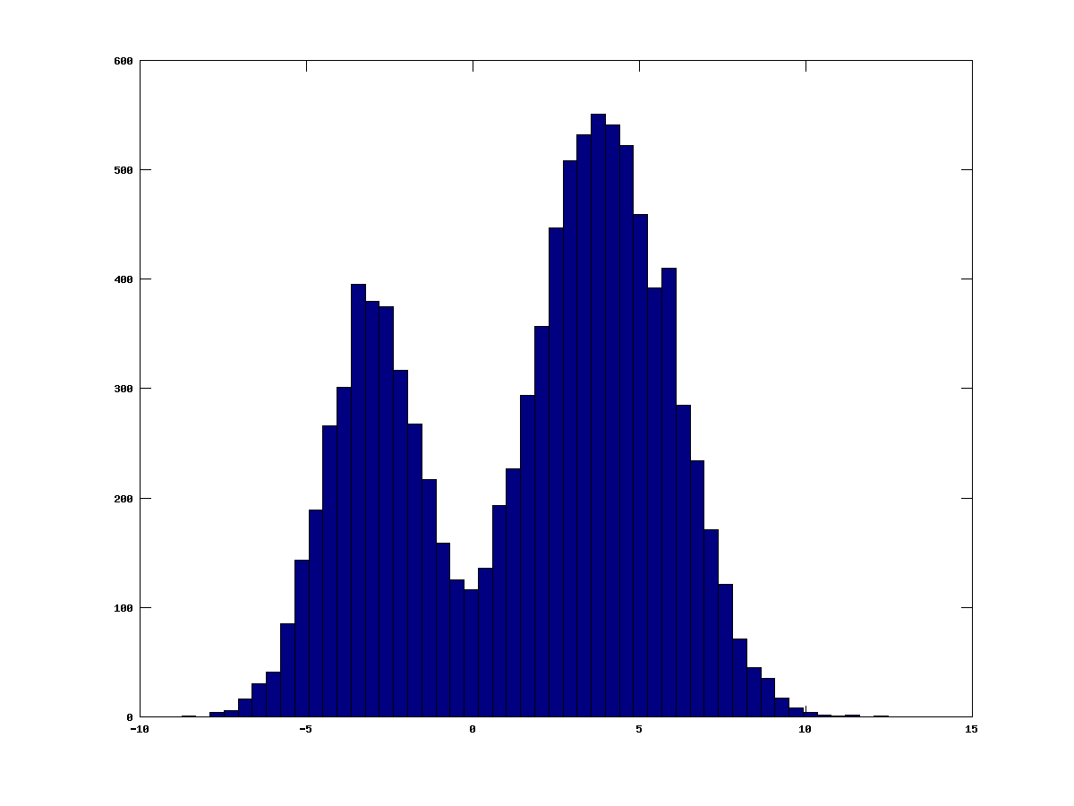
Putting It All Together
Solving mixture problems.
A mixture of random variables can be solved by a maximum likelihood estimate.
Lets just assume each random variable follows a normal distribution for simplicity.

Slide 22
Maximum Likelihood Estimates
Given a data set generated from a normal random variable:
Find the parameters for the normal: μ and σ

Slide 23
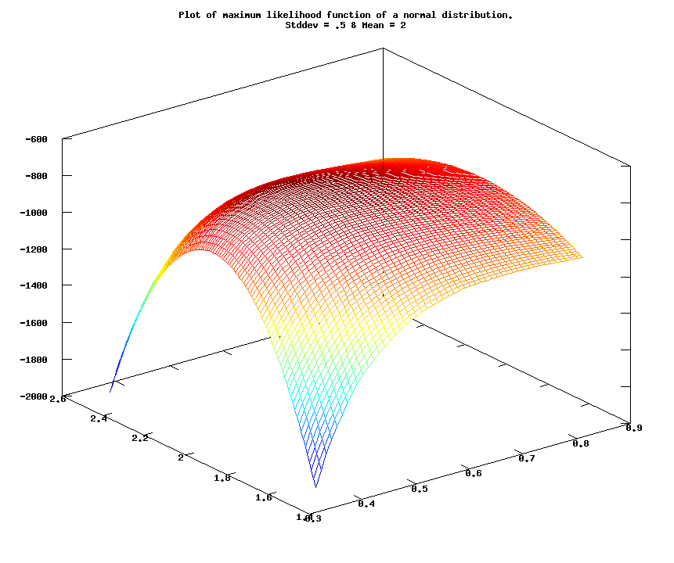
Mesh Of A Single Normal Parameter Space

Slide 24
Mixtures of Normal Distributions
Suppose we have a data set that appears to be comprised of n normal distributions:
The larger the MLE, the better our parameters. Thus the fitness function can be written as follows:
For sufficiently large K this will never dip below 0, thus this can be used as our fitness function.

Slide 25
Solution Layout
A solution is defined as follows:
/*
* A struct to hold private data for each solution.
*/
struct mixture_solution {
double *mu; /* List of mus for each distribution. */
double *sigma; /* List of stddevs for each distribution. */
double *prob; /* Probability for the given distribution. */
int len; /* How many distributions we have. */
/* Store this once we have calculated the result so we dont have to do
* it again. */
int solved;
double mle;
};

Slide 26
Mutation Of A Solution
int mutate(solution_t *par1, solution_t *par2, solution_t *dest){
int i;
double d_mu, d_sigma;
init(dest);
cross_over(par1, par2, dest); /* This is important. */
for ( i = 0; i < norms_len; i++){
/* Generate some random deltas. */
erand48_r(cntr->rstate, &cntr->rdata, &d_mu);
erand48_r(cntr->rstate, &cntr->rdata, &d_sigma);
/* Now fit them into the variance window. */
d_mu = (d_mu * norms[i].mu_var) - (norms[i].mu_var/2);
d_sigma = (d_sigma * norms[i].sigma_var) - (norms[i].sigma_var/2);
/* Add the changes in. */
ms->mu[i] += d_mu;
ms->sigma[i] += d_sigma;
}
/* Mutate the probability here... */
}

Slide 27
And The Fitness Function
double fitness(solution_t *solution){
int i;
double mle;
double fitness = 0.0;
struct mixture_solution *ms = solution->private.ptr;
if ( ms->solved )
return ms->mle;
/* For each data point, calculate the MLE estimate. Then take the log, and
* finally add it into our fitness value. */
for ( i = 0; i < sample_count; i++){
mle = _do_mle_point_estimate(ms, samples[i]);
fitness += log(mle);
}
/* Since we want a value close to zero, we simply take an arbitrary ceiling
* value for the fitnees, and return the distance the computed MLE is from
* that fitness. */
ms->solved = 1;
ms->mle = FITNESS_CEILING - fitness;
return ms->mle;
}

Slide 28
Parallel Characteristics
Generations per second speed up is pretty good.
Some slow down due to non perfect load balance.
Possible memory allocation pit falls
Lockless vs locked memory allocation:
malloc() by default will aquire a lock to the current arena.
Locked malloc is multiple thread safe: prevent concurrent allocation/ modification of internal data structures.
This is slow if there are a lot of memory allocations.
malloc() is way more sophisticated than we really need.

Slide 29
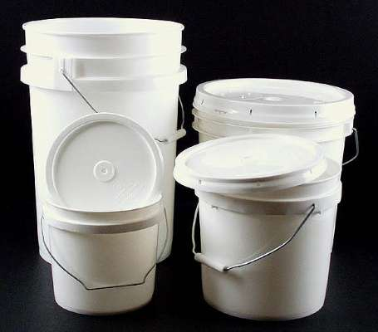
Multiple Memory Bucket Approach
Avoid expensive lock operations.
Is thread safe (sort of).
Each thread gets its own bucket from which it can allocate.
Implementation is extremely fast.
However: with great speed comes major limitations:
  Unable to allocate different sized chunks
  Must know the bucket you want to alloc from ahead of time.
balloc: 1 bit per allocation of overhead; malloc: 4/8 bytes depending on pointer width (32/64 bits).
void *balloc(struct bucket_table *tbl, int bucket);
void bfree(struct bucket_table *tbl, int bucket, void *ptr);

Slide 30
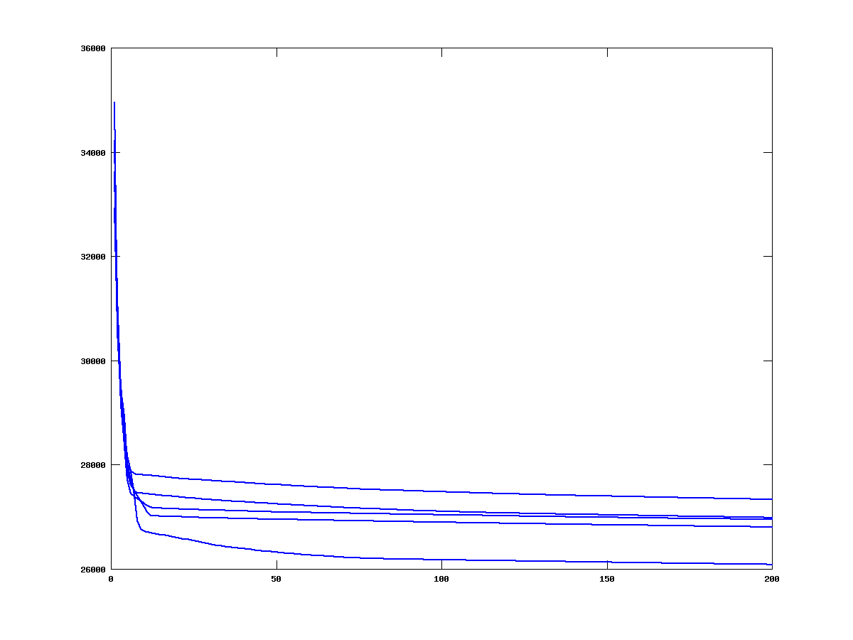
Threads Go Up, Gene Pool Goes Down
As the number of threads increase the size of the gene pools goes down.
Smaller gene pool: slower convergence.
This means a program can have more threads but converge slower.
Is this really a speedup?

Slide 31
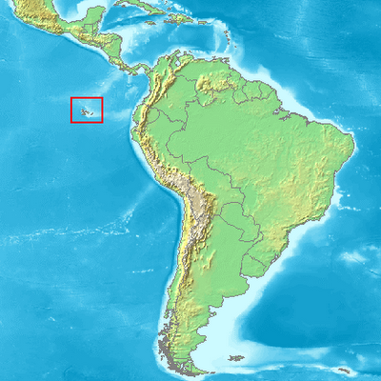
Geographic Speciation
Isolated populations have a tendency to evolve different ways.
Occurs for multiple reasons:
  Different selection pressures.
  New niches found.
We can attempt to disperse the isolated populations in an attempt to counter this.
  Like a hurricane blowing mocking birds across the pacific to the Galapagos Islands.

Slide 32
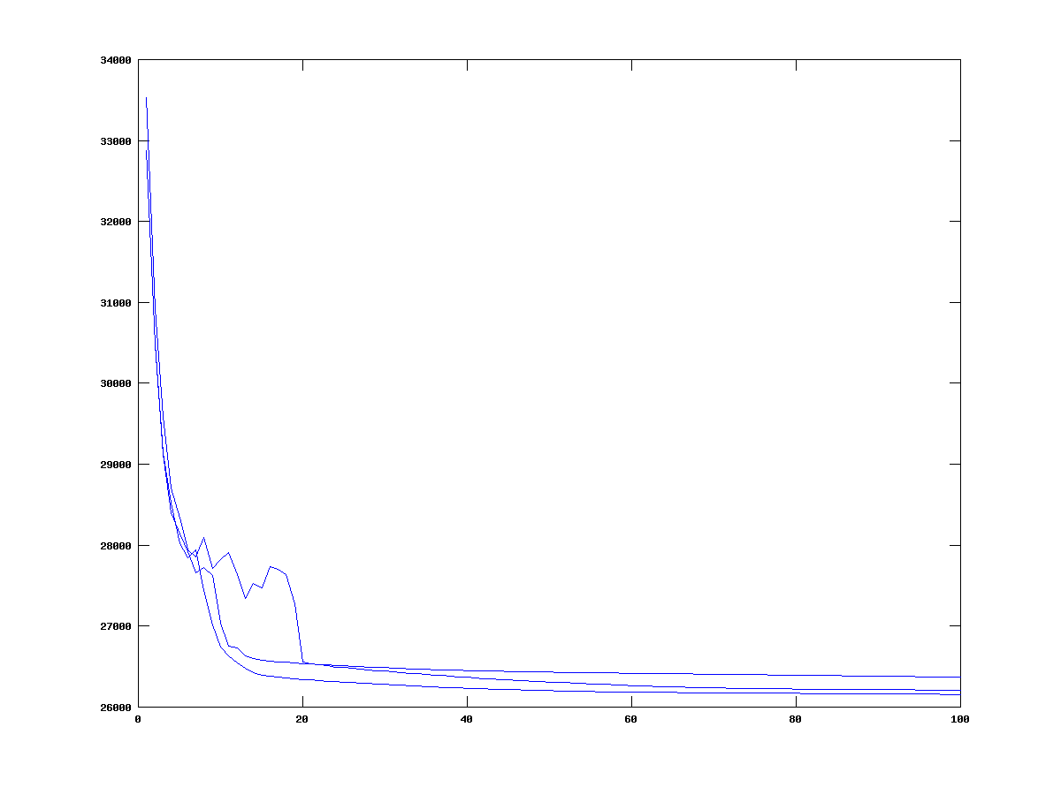
How Well Does Gene Dispersal Work?
Naturally, the algorithm is susceptible to random fluctuations.
However, if the amount of dispersal done is large enough, the many separated populations act like one population.

Slide 33
Other Distribution Patterns For Evolutionary Algorithms
Distributed cluster based algorithms
  Run the algorithm sequentially, but queue each fitness calculation such that they can be individually farmed out to other processors.
  Works well for fitness functions that run other programs and then parse the output of said program.
  Does not work well for something like a root finding algorithm: network overhead would vastly outweigh the computation.

Slide 34
Questions?

