Slide 1
Simple CRUD-Based Product and User Management System
By : John Paul J. Litrero

Slide 2
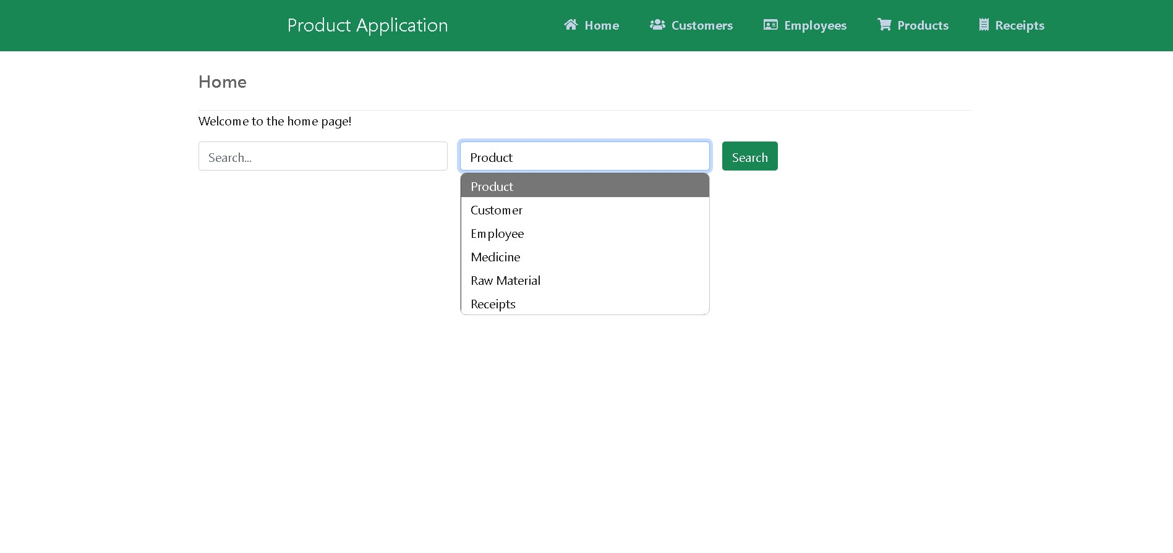
The home page of my CRUD app allows users to search any category like products or medicines and quickly find specific details about items, such as brand, or use.

Slide 3
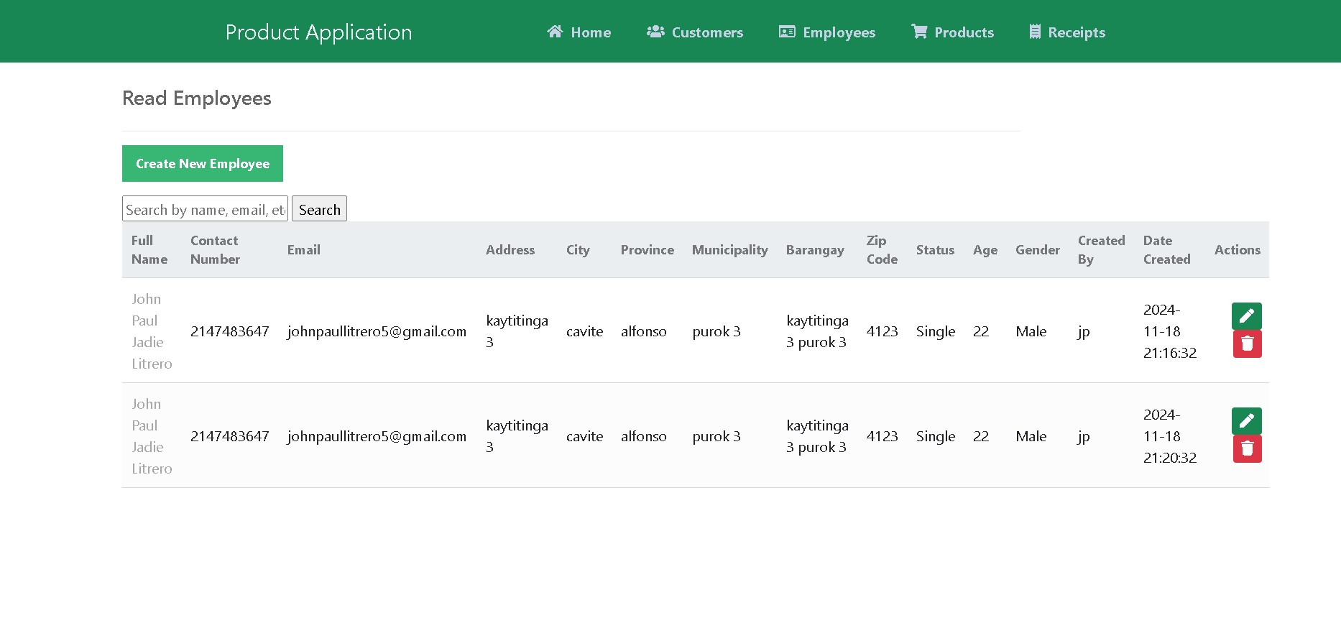
On the Employees page, you can create, view, edit, and delete employee information directly from the interface.

Slide 4
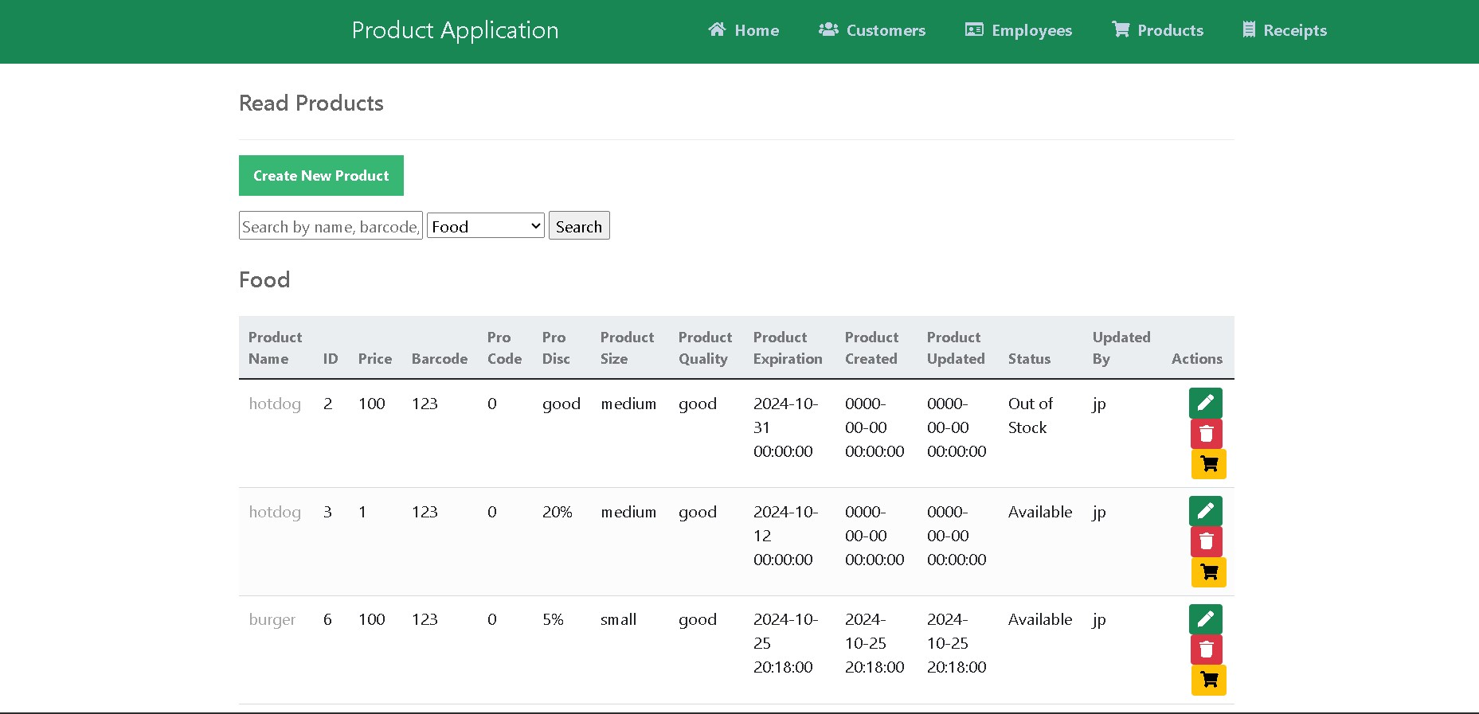
This page allows you to create, edit, or delete products and process purchases. You can also choose the product type such as food, medicine, or raw materials.

Slide 5
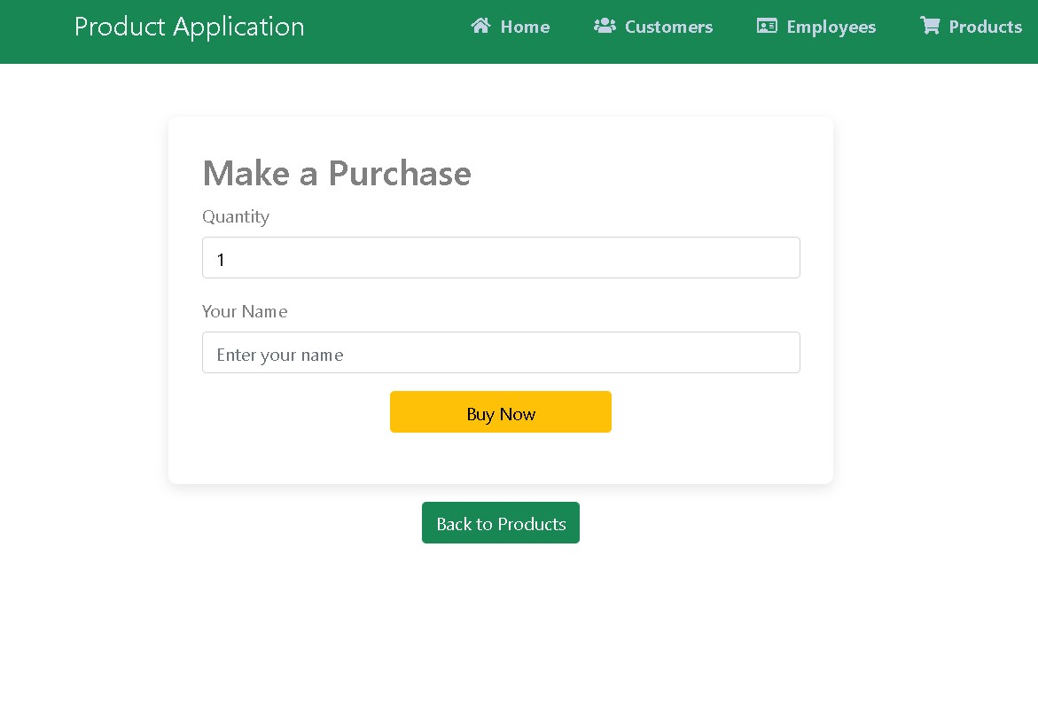
When you click "Add to Cart," you're taken to the buy section where you can enter the quantity you want and optionally provide your name.

Slide 6
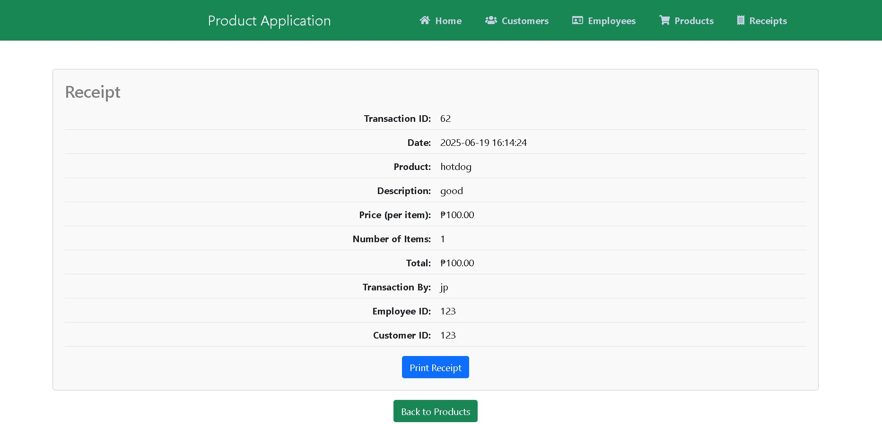
Once you click Buy, your receipt is generated. You can go back to add more items or print the receipt.

Slide 7
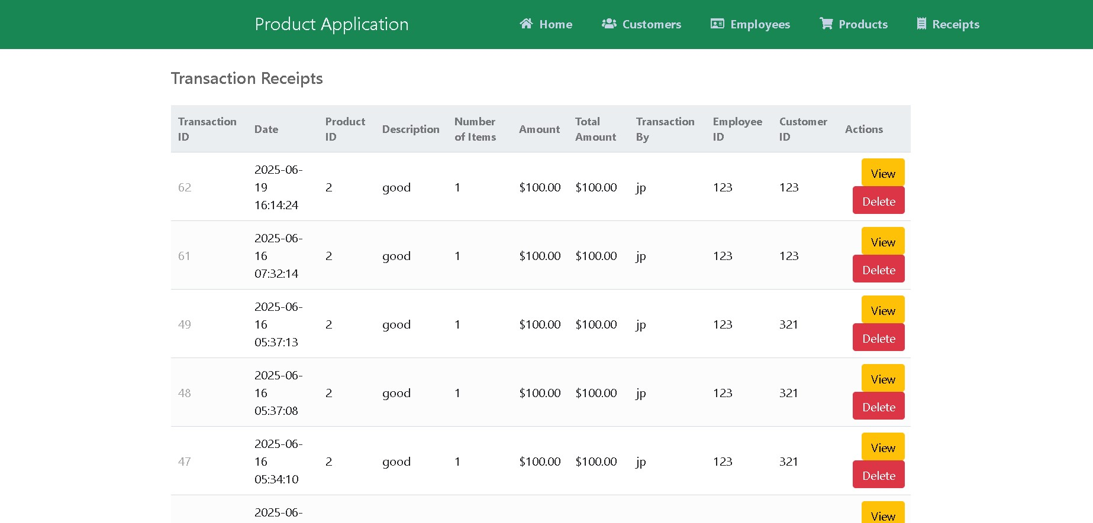
This page lists all transaction receipts. You can view detailed receipts or delete them if needed.

Slide 8
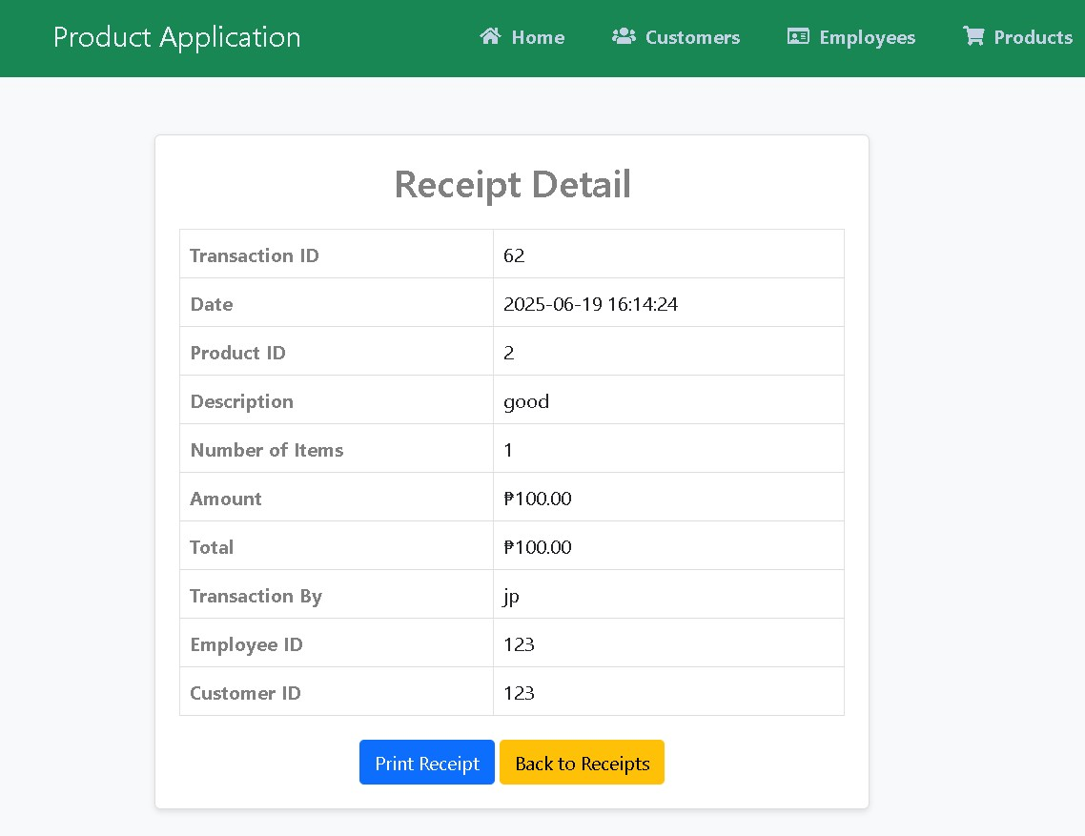
This section displays the full receipt details after a purchase. You can go back to the previous page or print the receipt directly.

