Slide 1

Diabetes Risk Assessment for women
Ifeanyi Osuchukwu, Samuel Yoon, Jintong Hou

Slide 2
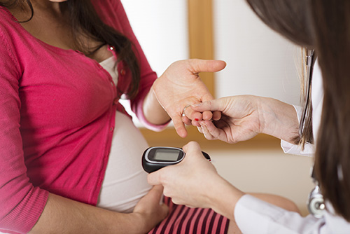
Background - Diabetes and Women
Centers for Disease Control and Prevention (CDC):
Diabetes increases the risk of heart disease by about four times in women but only about two times in men.
Worse outcomes after a heart attack.
Higher risk of other diabetes-related complications such as blindness, kidney disease, and depression.
Poor control of diabetes during pregnancy increases the chances for birth defects and other problems for the pregnancy.
Prevalence: 9.5% in 2020, U.S.
Management of Diabetes for women
https://www.cdc.gov

Slide 3
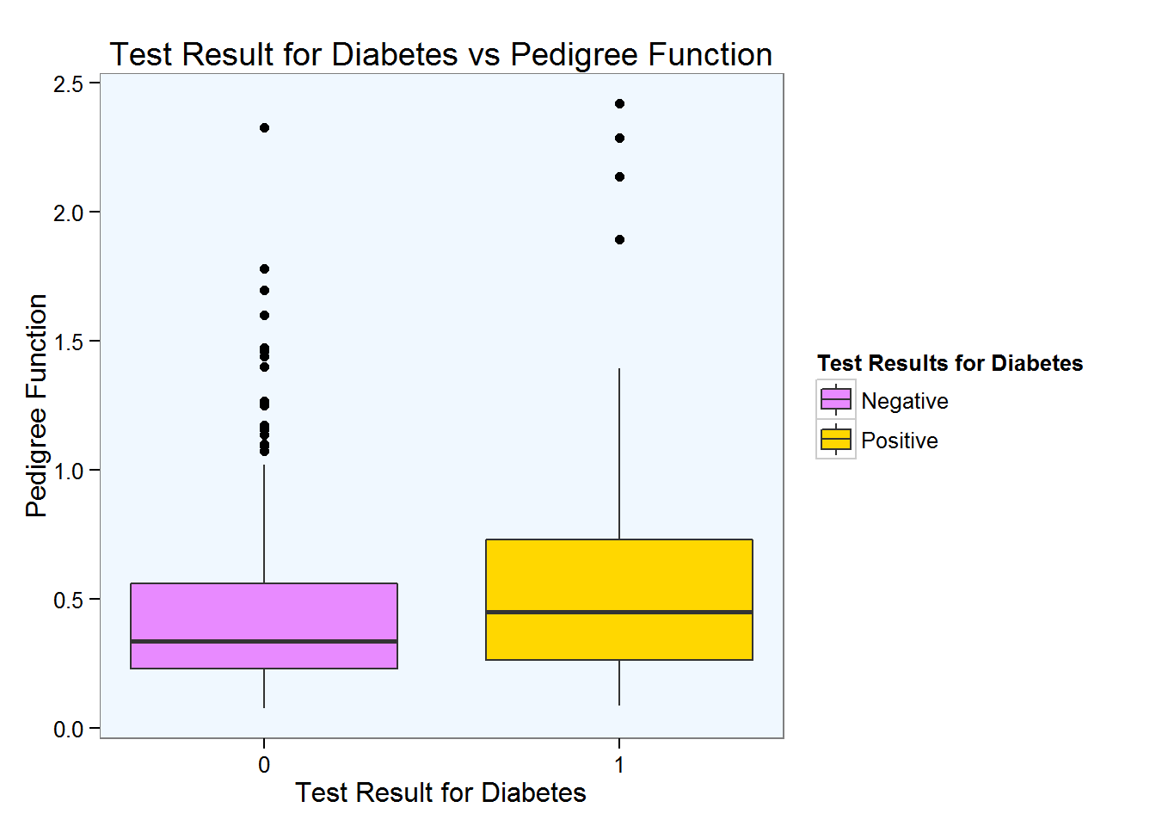
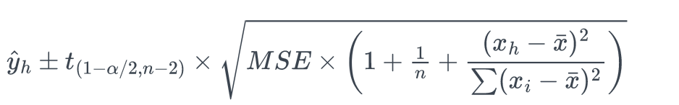
System
Women with gestational diabetes are at 7 times greater risk of developing type 2 diabetes than are women without gestational diabetes. [1]
Family history, overweight, and elder age are all known factors associated with diabetes.[2]
Maintaining the records of woman is essential for perinatal instructions.
Factors may confound each other, examining the effect of different combinations of predictors may help physicians get better understanding of the factors and predicted risk.
The Diabetes pedigree function: higher values associated with higher risk of diabetes [3]
Estimating risk based on samples from the target population. Larger sample size may improve predicting precision.
Source: Inbar Kodesh
https://online.stat.psu.edu/stat501/lesson/3/3.3

Slide 4
Goals
Enter new records for individual woman
Make changes to existing records
Calculate risk to develop diabetes for individual women using up to date data
Help researchers explore associations between factors and diabetes.
Target user: Physicians.
If a woman has a higher risk to develop diabetes, physicians may instruct the individual to pay more attention to her health and provide necessary instructions to prevent the development of diabetes for the individual.

Slide 5
Experiments and Methods
3 major stages
Input data(Data acquisition)
Calculate Risk(Data analysis)
Search and update record(Data maintenance)
Dataset
Initial data: as a start, the first 200 records were imported from part of the pima dataset (National Institute of Diabetes and Digestive and Kidney Diseases.)
Outcome variable: diabetes, 1=yes, 0=no
Predictors: Number of pregnancies, Glucose(mg/dL), BMI (kg/m²), Diabetes pedigree function value, and age.
Other fields: id, First name, last name, and survey year.

Slide 6
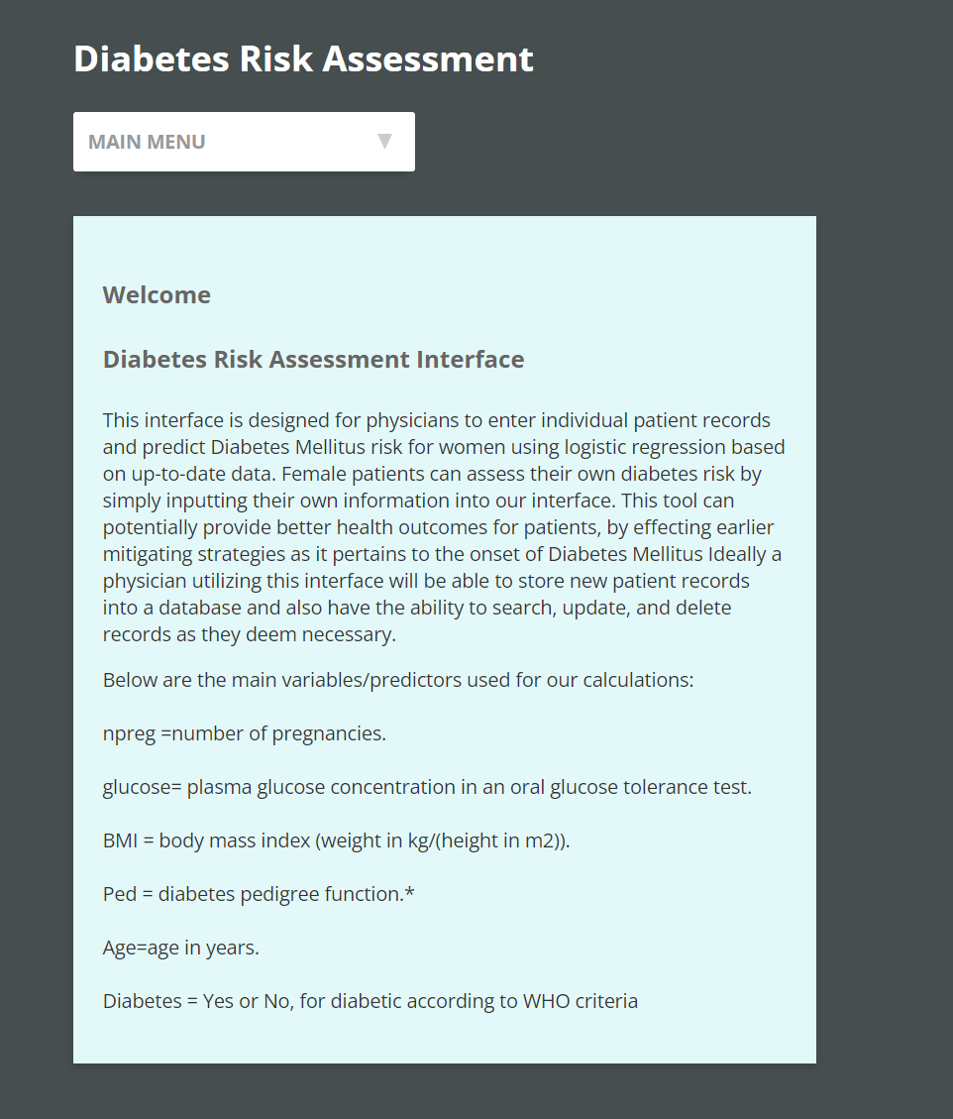
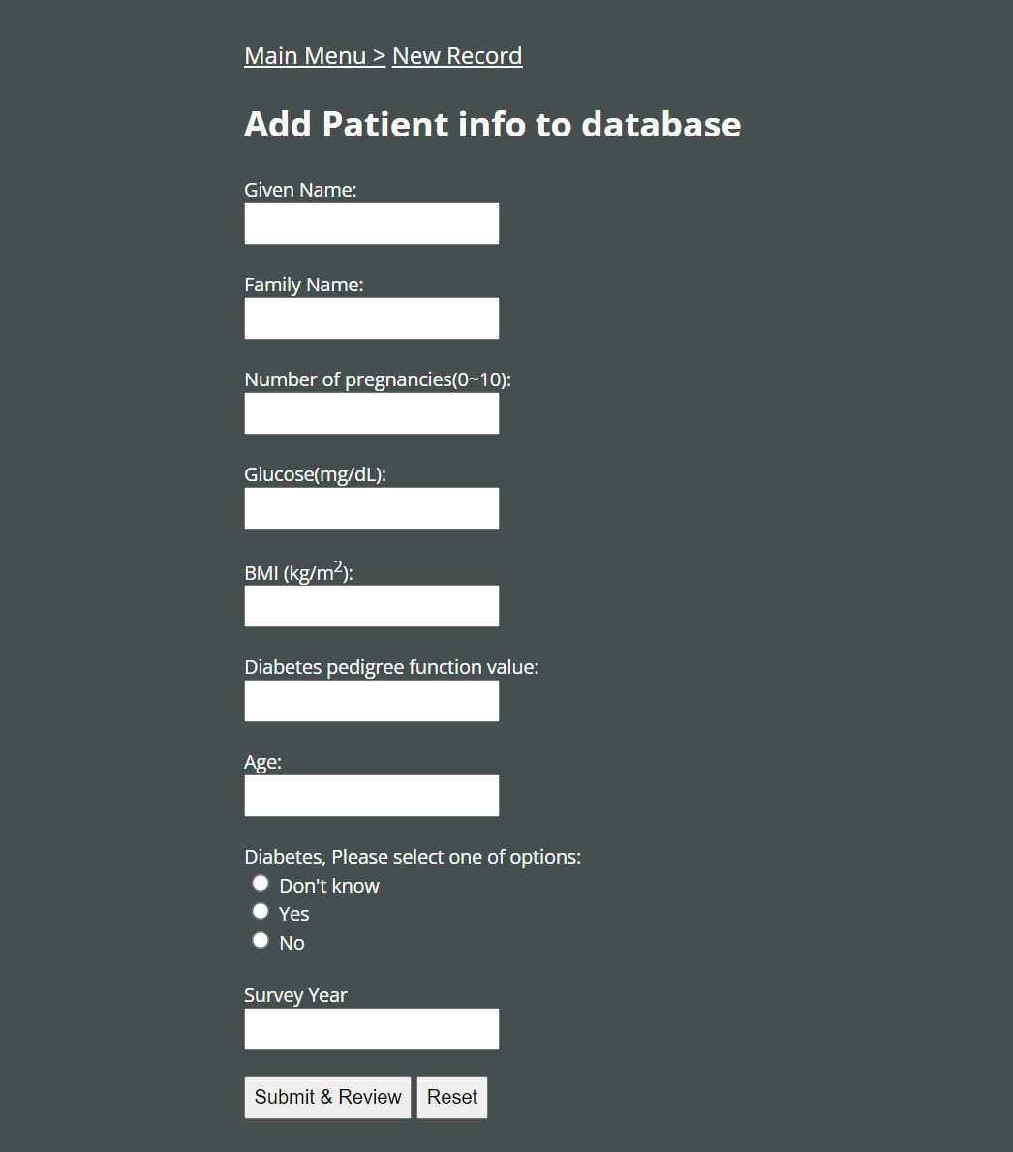
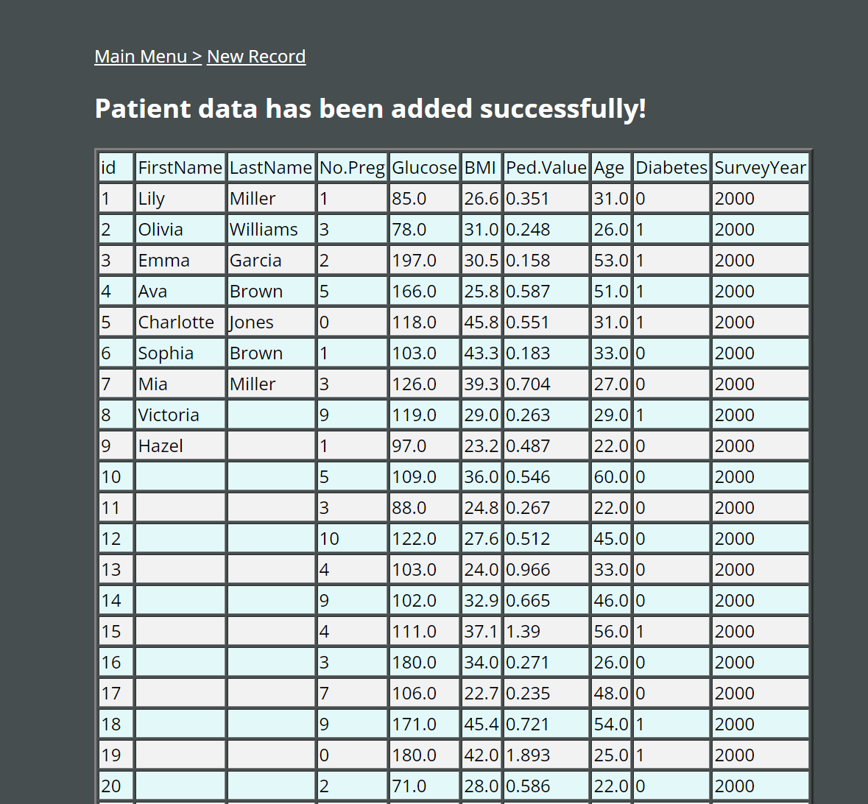
Experiments and Methods(Input)

Slide 7
Experiments and Methods
Analysis
Summary statistics: mean, standard deviation, median, minimum, maximum, number of observations.
Model: logistic regression.
Predictors: 0-5 predictors, as determined by user
Outputs:
Risk to develop diabetes
Individual values used for prediction
Sample year range
Model information: number of observations, AIC, etc
Parameter estimates, 95% confidence interval, p value, z value
Odds ratio, 95% confidence interval
Plot: Histogram, ROC curve with AUC value.

Slide 8
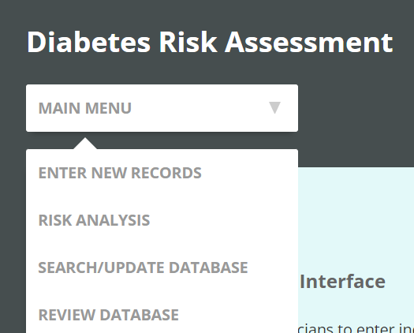
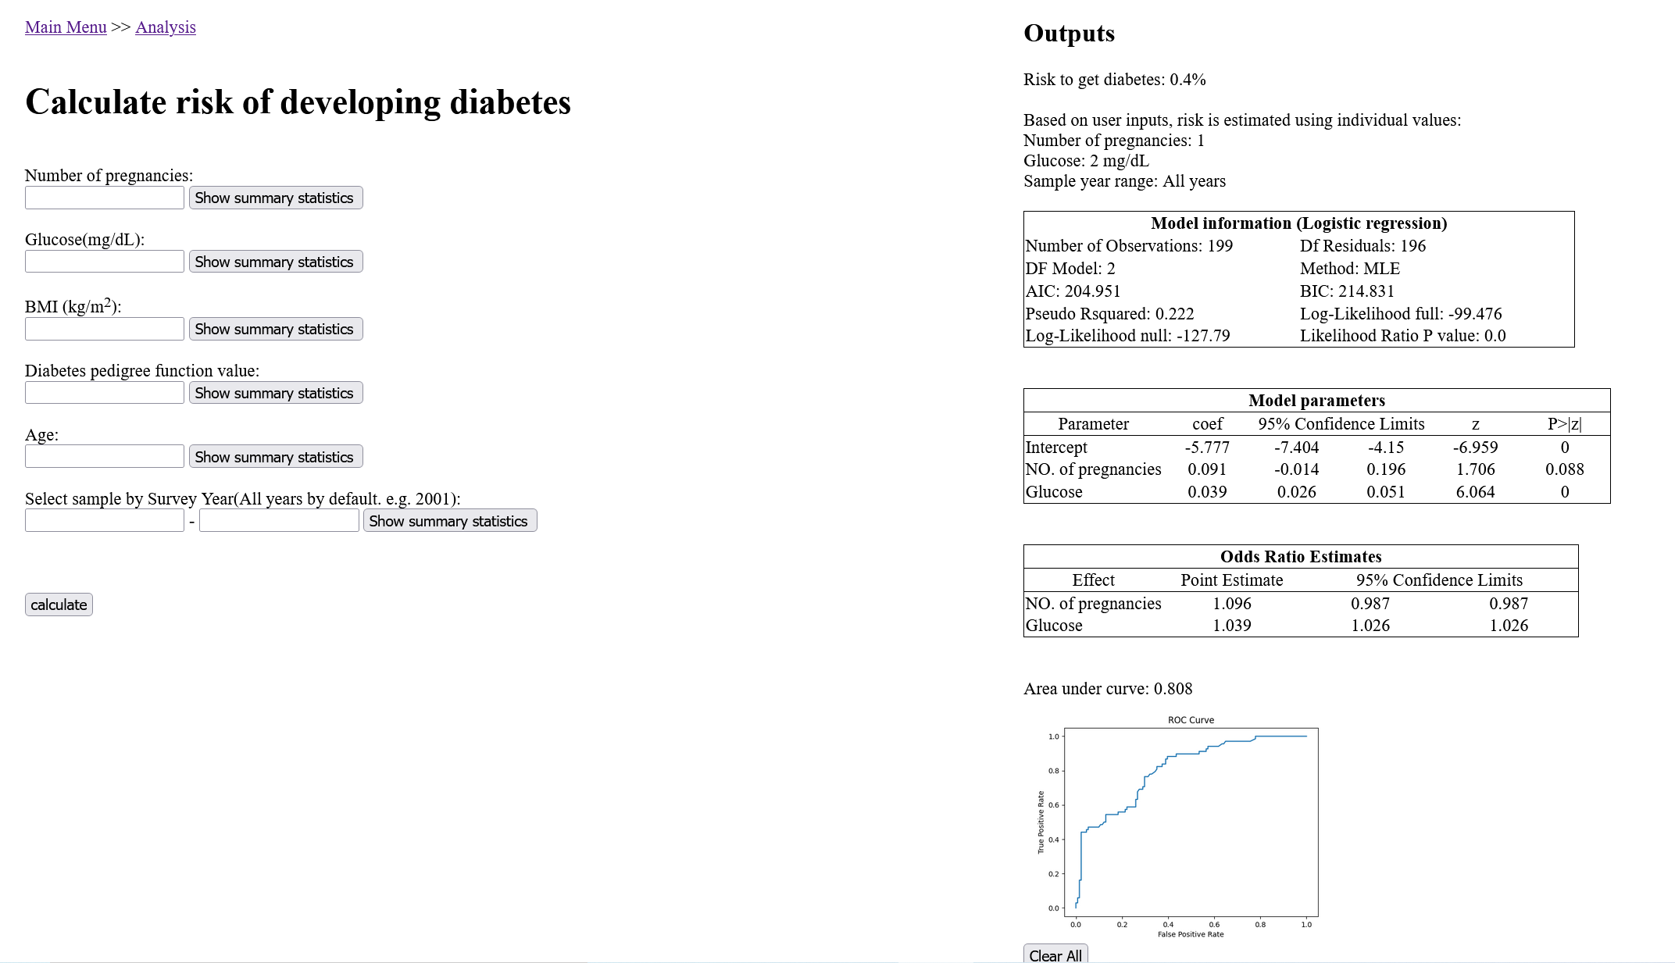
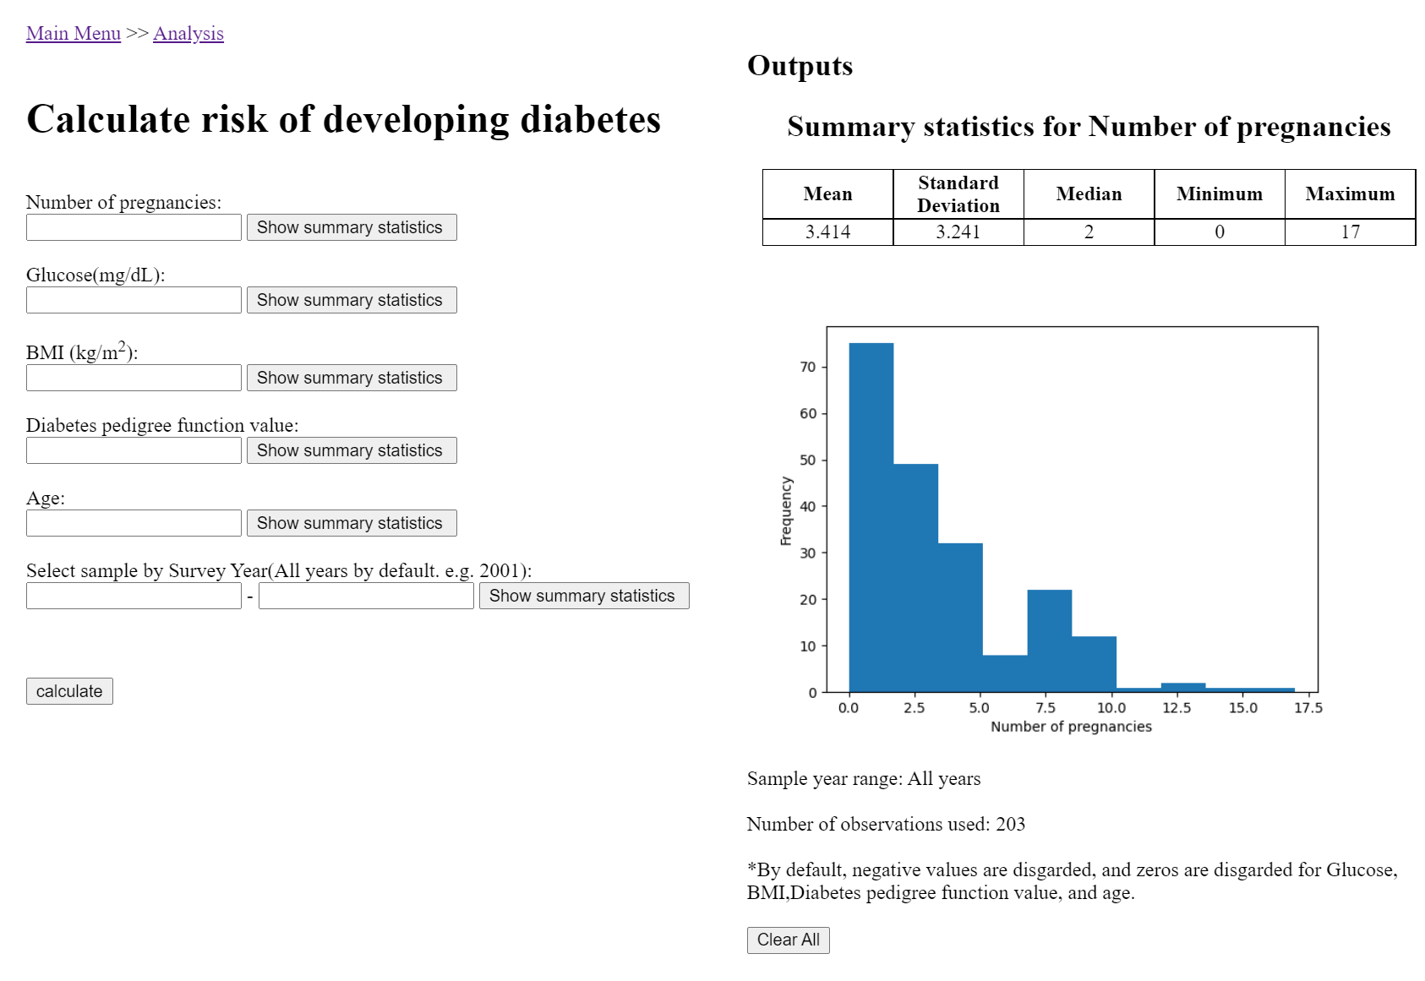
Experiments and Methods(Analysis)

Slide 9
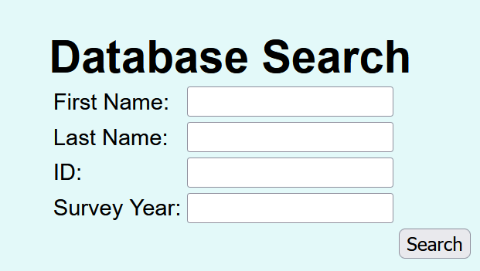
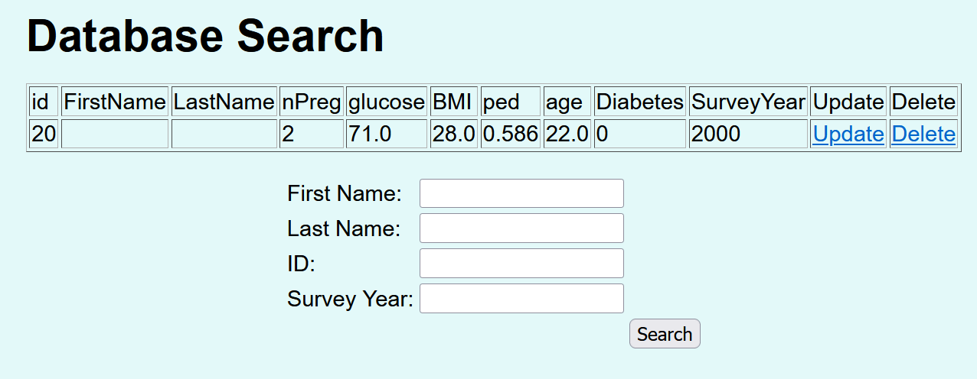
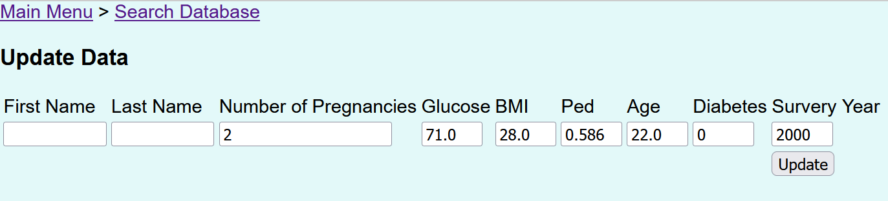
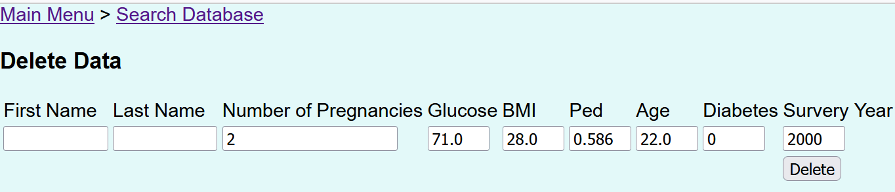
Experiments and Methods(Maintenance)

Slide 10
Experiments and Methods
Software
apache, php, python,html
Python Modules: sys os sqlite3 pandas numpy matplotlib statsmodels(to fit logistic models) sklearn(to make ROC curve) statistics

Slide 11
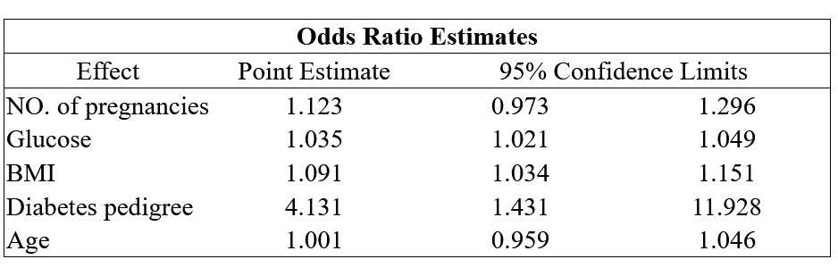
Results
Demonstrate application
Main findings from model (e.g. 5 predictors):

Slide 12
Discussion
Significance : More pregnancies, higher glucose level, higher BMI and higher diabetes pedigree function value, consistent with CDC reports.
Limitations:
Unable to view summary statistics for each specific model predictors.
Database is housed in local computers instead of a server.
Searching the database is not fully dynamic.
Future extension of application :
Add functions to view summary statistics for each specific model predictors.
Add more predictors in model and more features for dataset
Implement a login in system for Physicians for added security.

Slide 13
References
[1] “Gestational Diabetes and Health Behaviors Among Women: National Health and Nutrition Examination Survey, 2007–2014” https://www.cdc.gov/pcd/issues/2018/18_0094.htm
[2] CDC: https://www.cdc.gov/diabetes/basics/risk-factors.html
[3] Associations between Variables Regarding Diabetes for Pima Indian Women https://rpubs.com/ikodesh/53189

