Slide 1
New England Really Attractive?
APRIL MCBROOM, ISAAC MOISE, NICHOLAS CICCIO

Slide 2
Client-Side Module Development
How can we make New England New and Attractive?
How can we make the website more user-friendly and interactive?
What’s New(Table of Contents)
Eastern and Pacific Clock
Educational Quiz
Ticket Ordering

Slide 3

Home Page:
Eastern and Pacific Clock
Our Answer is to be more engaging to users across the United States.
Traveling can be complicated. We designed a solution to make traveling more conventional.
Those looking to travel from the pacific area we’ll be able to identify time differences.

Slide 4
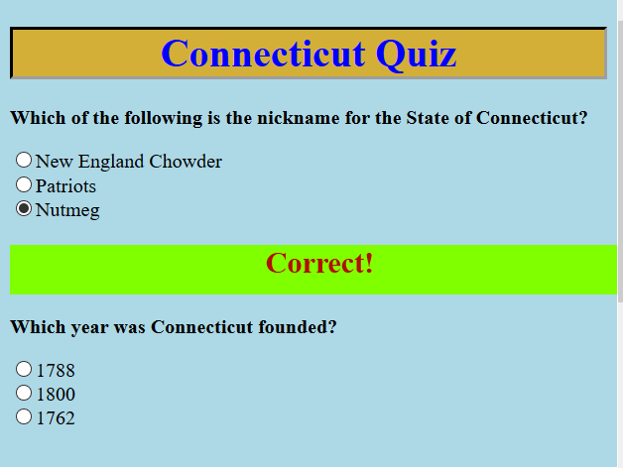
Educational Quizzes
We’ve implemented several quizzes associated with each state.
These quizzes are designed to be fun and engaging to our audience, as well as pointing out different facts across the states.
The user using the submit button opens a new proceeding window.
Each quiz is highlighted in order to show difference between correct and incorrect selections.

Slide 5
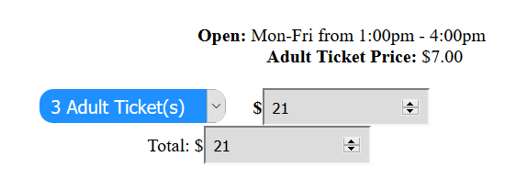
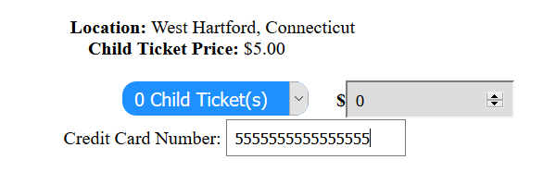
Historical Page
The Idea of Historical History in New England.
An experience for the whole family.
Benefit of New England’s Rich and Thriving History.

Slide 6
Contact Page
We’ve implemented a subscription text-box in order to process information from user.
This allows updates for the client to view our on-going digital subscription.

Slide 7
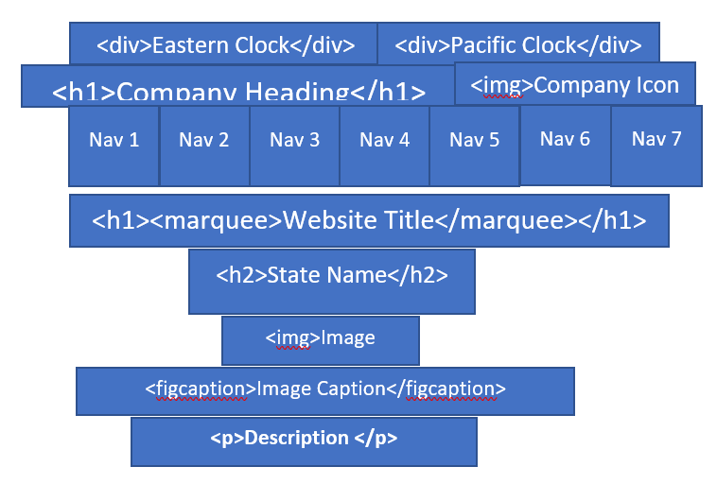
Diagram

Slide 8
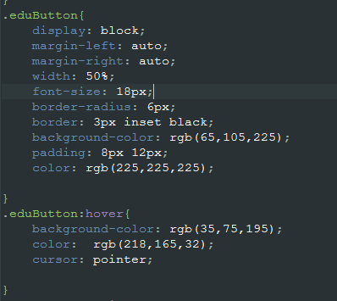
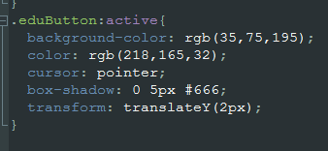
CSS Education

Slide 9
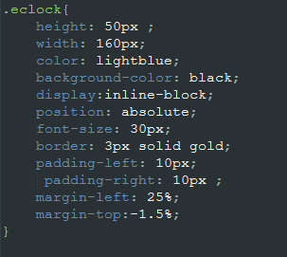
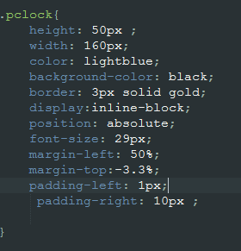
CSS Clocks

